Slide 1

SPANISH LALIGA 2018/2019
GONZALO JARABA – DANIEL RAPOSO
IST-Database and Data Mining – INSA Lyon
NOVEMBER 7, 2023

Slide 2
1. DOMAIN AND ER DIAGRAM (I)
Spanish main soccer league: LaLiga 2018/19
Domain Knowledge
Data availability
Personal interest
Entities definition
Team: team_name, city, stadium, foundation year, president
Match: match_id, date, place, winnerHF, winnerFT
Player: player_name, birthyear, nationality, position, number
Goal: goal_id, minute, penalty?, own_goal?
Card: card_id, type, minute

Slide 3
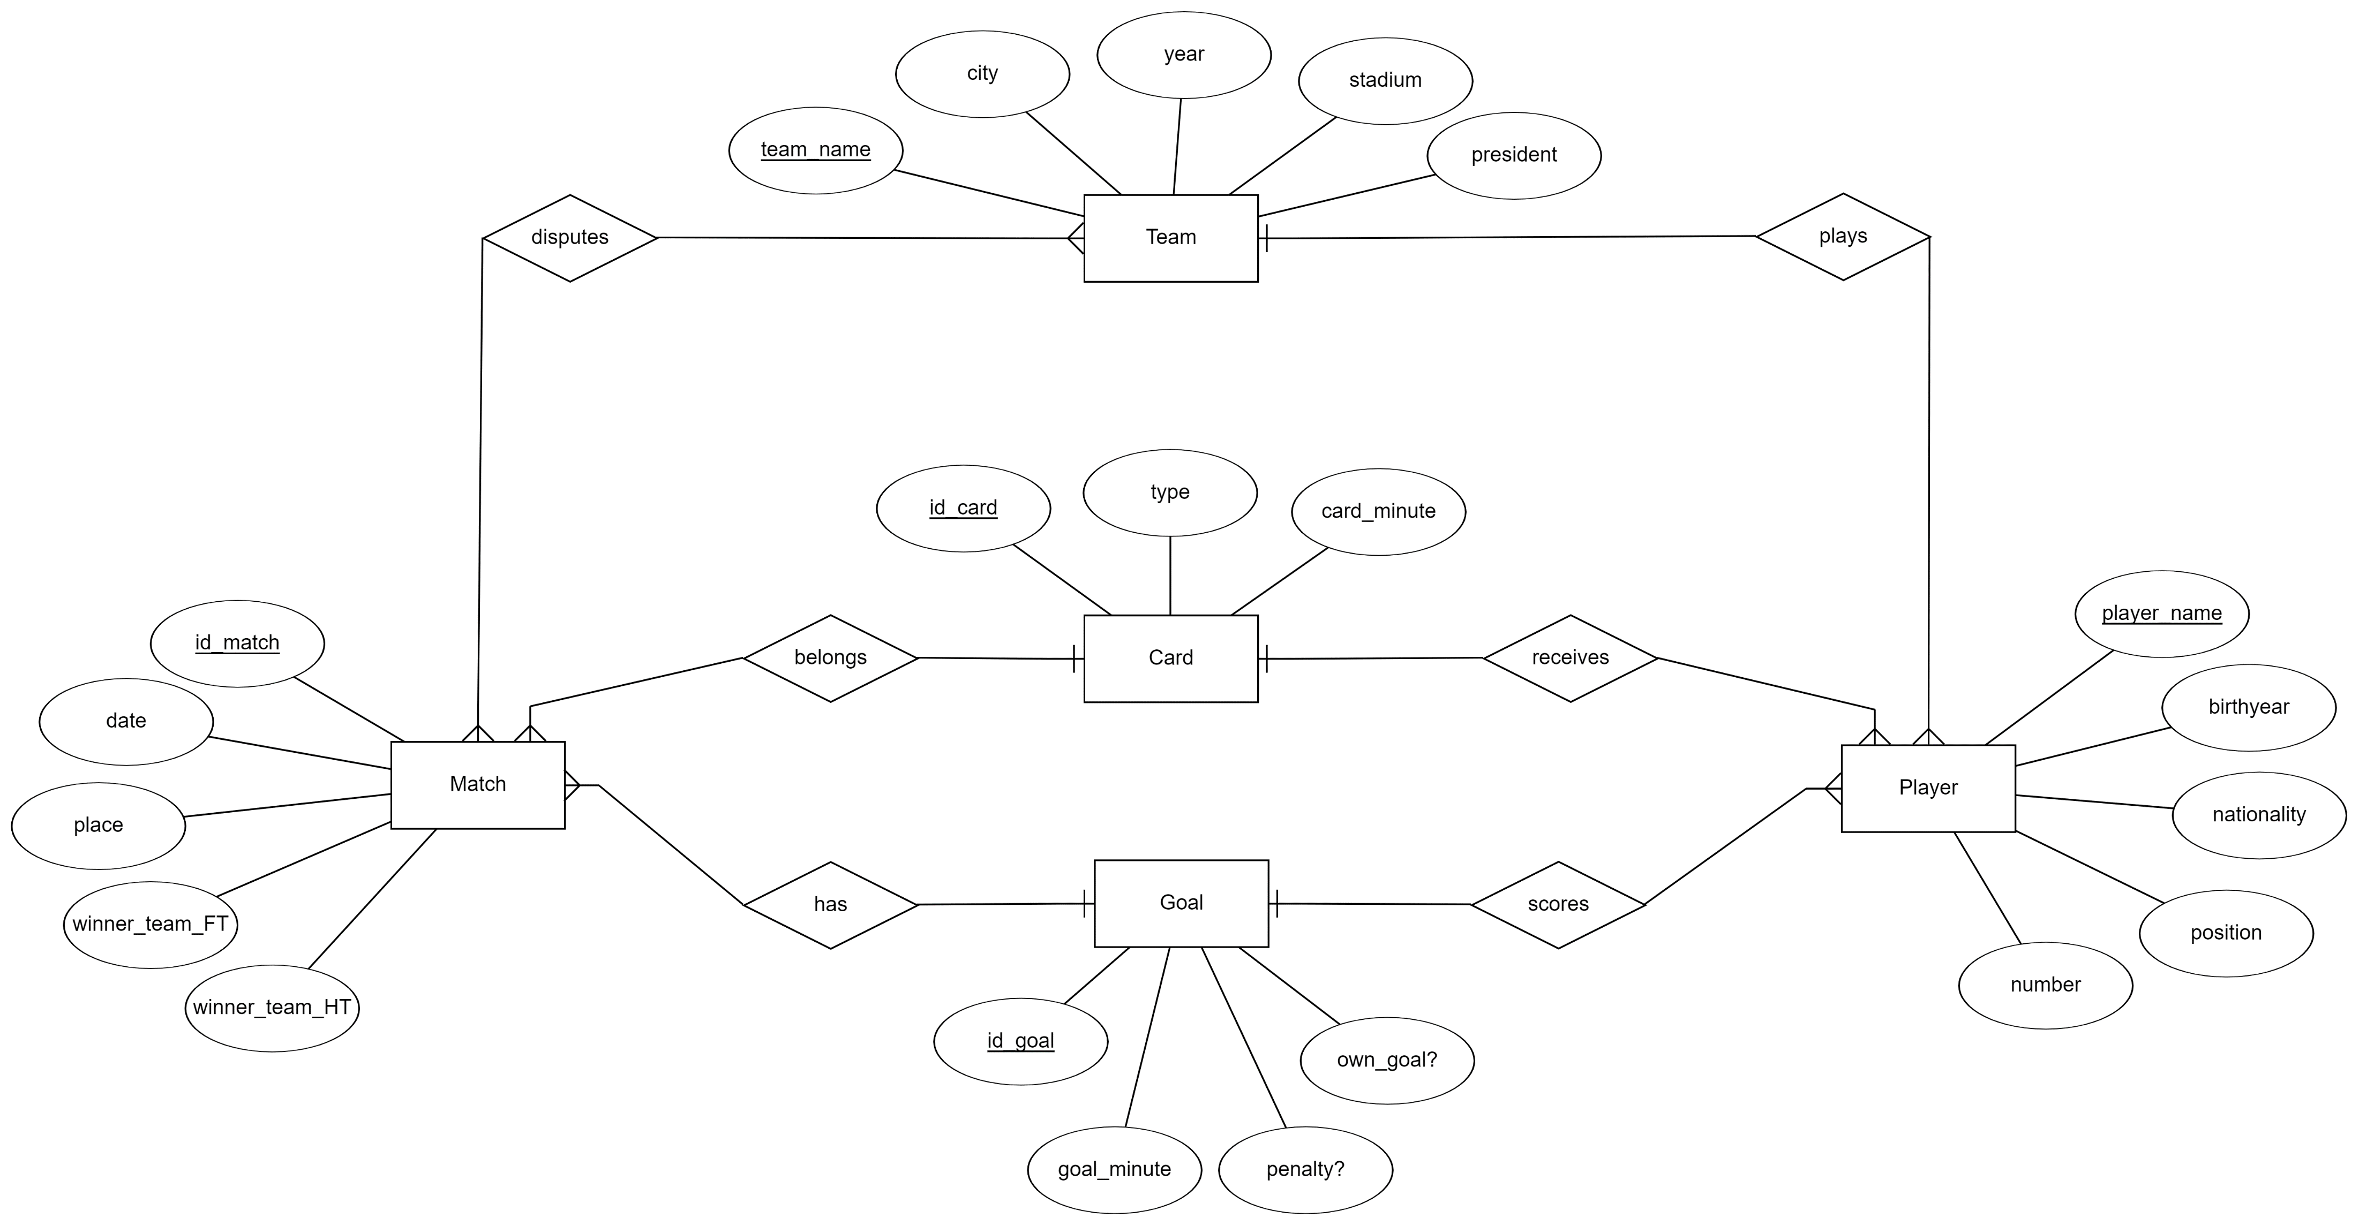
1. DOMAIN AND ER DIAGRAM (II)

Slide 4
2. DATA EXTRACTION AND PREPROCESSING (I)
Matches and players
Found existing public CSV, formatted and doubled checked veracity
Added nationality and birthyear with OpenAI tool
Teams:
Due to its few entries (20), manually generated
Goals:
Very heavy table (~1000 entries) -> Manually generation not convenient
Python script to automatically extract data from Google
Cards:
Same issue as goals (>2000 entries)
Python script to partially automatize extraction of data

Slide 5
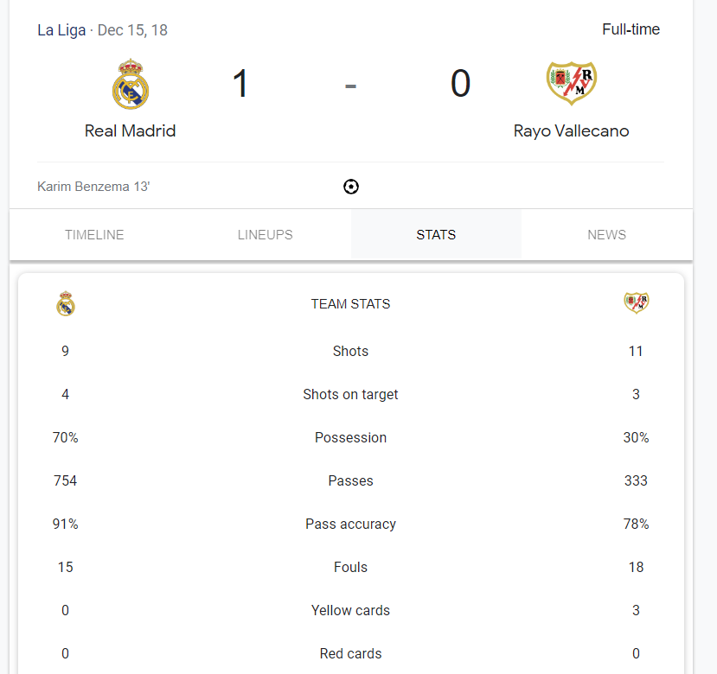
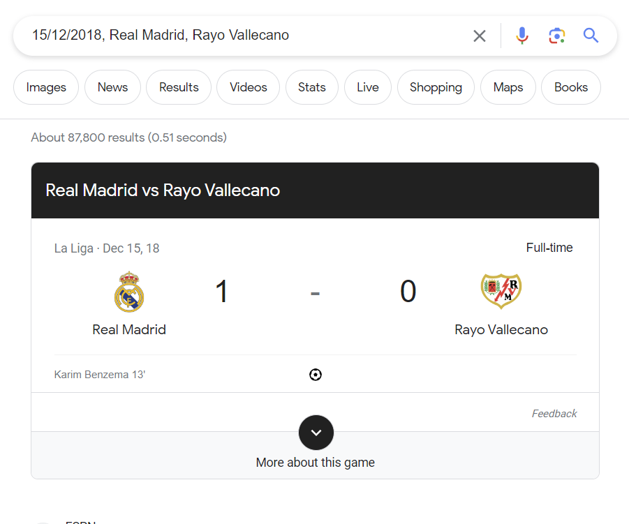
2. DATA EXTRACTION AND PREPROCESSING (II)

Slide 6
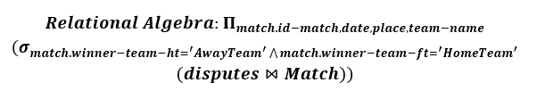
3. SQL AND RA EXAMPLE
We have answered some questions like: in which matches did the home team start losing but ended up winning?
SELECT match.id_match,date,place,ARRAY_AGG(team_name) AS homeTeam_VS_awayTeam FROM match
INNER JOIN disputes ON match.id_match = disputes.id_match
WHERE match.winner_team_ht = 'AwayTeam' AND match.winner_team_ft = 'HomeTeam'
GROUP BY match.id_match
ORDER BY match.date ASC

Slide 7
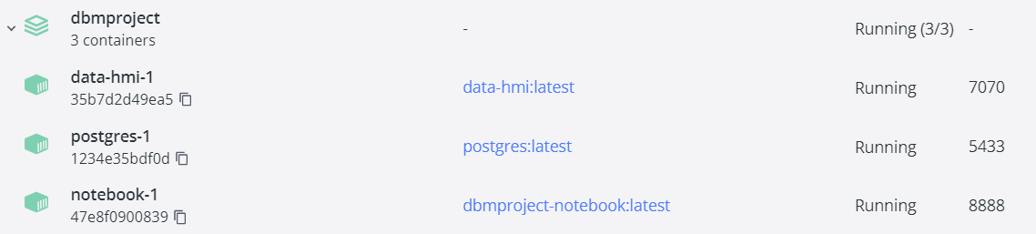
4. FULL STACK IMPLEMENTATION
Docker container with three images
Postgres DBMS: with mounted volume for data persistence
Jupyter Notebook (only for DB definition)
NodeJS front-end & back-end service: running and with an exposed port for external interaction

Slide 8

DEMO TIME !

