Slide 1

SPANISH LALIGA 2018/2019
IST-Database and Data Mining 2 – INSA Lyon
DECEMBER 11, 2023

Slide 2
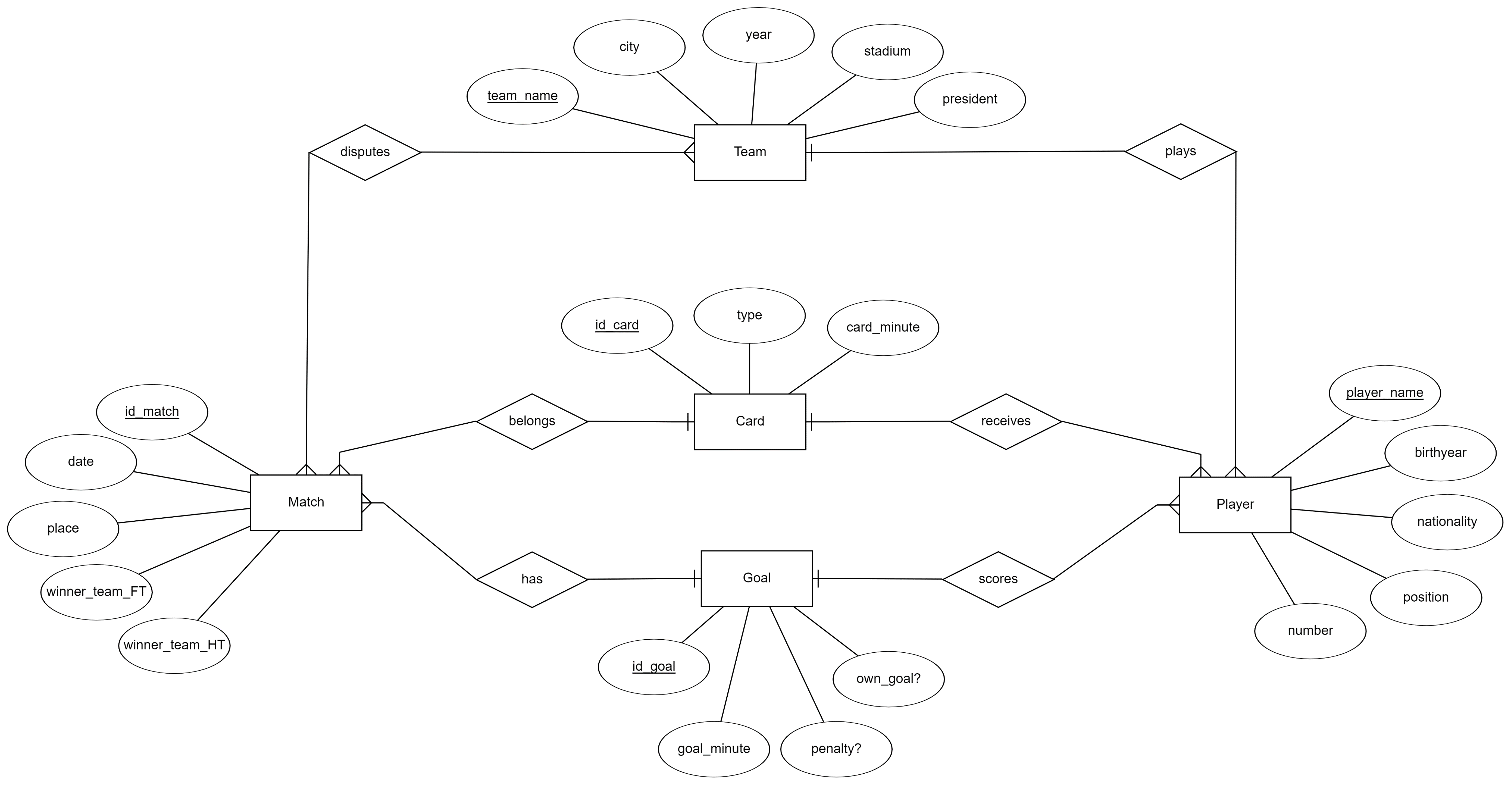
0. RECALING DATA USED

Slide 3
1. TASKS DONE
Predicting result of matches
CLASSIFICATION
Soccer players as defensive or defensive
FREQUENT PATTERN MINING
Patterns with statistical info of players
CLUSTERING
50 top player’s statistics

Slide 4
2. CLASSIFICATION (I)
2.1. Prediction of Full Time Result of matches
We have used the following data for this task:
MATCH
HomeTeam | AwayTeam | Betting odds and indicators
The process to accomplish the classification has been:
Build a Decision Tree model
Weakest Link Pruning
Random Forest with different depths and amount of trees

Slide 5
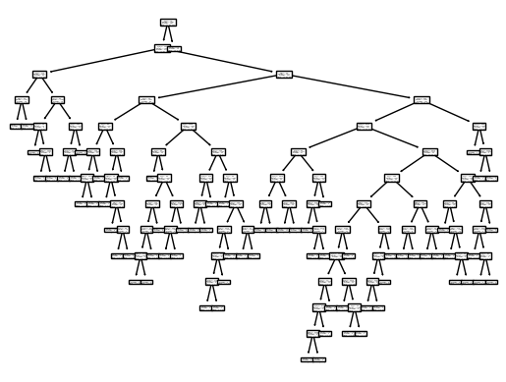
2. CLASSIFICATION (II)
To build the model we have a 25-75 training-test set ratio, and without shuffle. This is to determine if it would be possible to predict the 75% of LaLiga matches with only the first 25% of the season.
Criterion | Accuracy
Entropy | 0.43
Gini | 0.49
Log Loss | 0.41

Slide 6
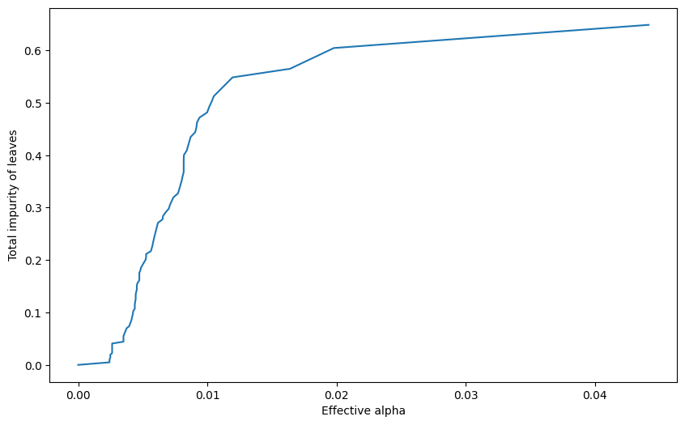
2. CLASSIFICATION (III)
We can see that for our model we have a Decision Tree with a depth of 12 levels. This can lead to leafs with impurities that produce error in the classification task. Let’s use a post pruning technique named “Weakest Link Pruning” to avoid this!

Slide 7
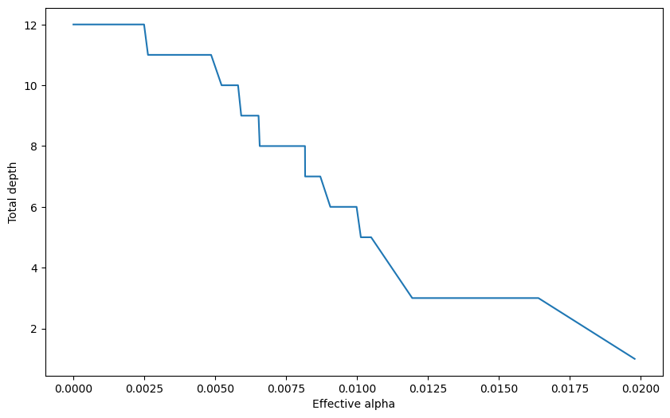
2. CLASSIFICATION (IV)
The effective alpha of this method has a direct relation to the depth of the Decision Tree.
To see the improvement, we will choose a maximum depth of 4.

Slide 8
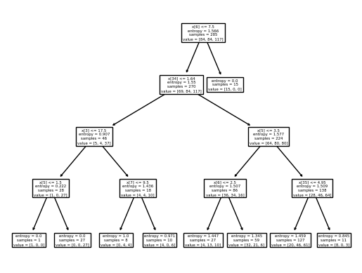
2. CLASSIFICATION (V)
We have some improvement in the accuracy of our model. Let’s not forget that this task is a very complex one, since predicting matches holds a lot of variables!
Criterion | Accuracy
Entropy | 0.50
Gini | 0.44
Log Loss | 0.50

Slide 9
2. CLASSIFICATION (VI)
We tried Random Forest, since is known for having good results for most cases and it combines multiple Decision Trees to reach a single result.
Criterion | Number of trees | Max. Depth | Accuracy
RANDOM FOREST 1
Entropy | 100 | 12 | 0.52
Gini | 100 | 12 | 0.50
Log Loss | 100 | 12 | 0.49
RANDOM FOREST 2
Entropy | 500 | 12 | 0.47
Gini | 500 | 12 | 0.49
Log Loss | 500 | 12 | 0.52
RANDOM FOREST 3
Entropy | 1000 | 3 | 0.54
Gini | 1000 | 3 | 0.54
Log Loss | 1000 | 3 | 0.55

Slide 10
2. CLASSIFICATION (VII)
2.2. Classification of the players as OFFENSIVE or DEFENSIVE
Data used for the task:
PLAYER
Nationality | Position | Number | Cards Received | Goals Scored
The process to accomplish the classification has been:
Use only forwards and defenders (offensive and defensive)
Outlier detection (z-score for numerical and manually for nominal)
Building a Decision Tree model
Using model to classify midfielders

Slide 11
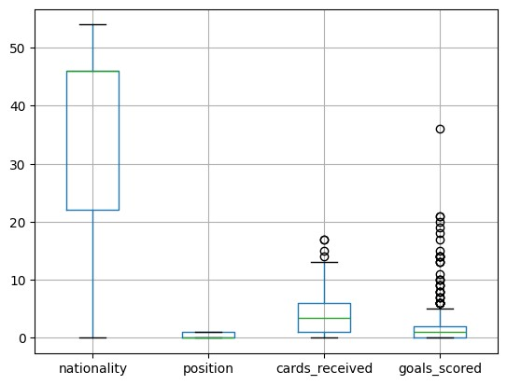
2. CLASSIFICATION (VIII)
2.2. Classification of the players as OFFENSIVE or DEFENSIVE
Criterion | Accuracy
Entropy | 0.812
Gini | 0.816
Log Loss | 0.82

Slide 12
3. FREQUENT PATTERN MINING
Data used for the task:
Gamesplayed avg | Goalscored bin | Goalwhilepitch avg | Interceptions avg | Recoveries avg | Clearances avg | Offsides bin | Foulssuffered avg | Foulcommitted avg
Penaltieswon bin | Penaltiesgiven bin | Handballs bin | Shots avg | Assists bin | Corners bin | Duels avg | Offensive bin | Defensive bin
Interesting results:
support | itemset
0.536804 | (recoveriesavg, deffensivebin)
0.443447 | (gamesplayedavg, goalswhilepitchavg)
0.420108 | (assistsbin, recoveriesavg)
0.377020 | (interceptionsavg, recoveriesavg)

Slide 13
4. CLUSTERING (I)
We have used the following data for this task:
PLAYER
Goals Scored | Assists | Dribbling per game | Key Pass per game | Shots per game
The process to accomplish this clustering has been:
Visualization of the data
K-means Clustering
Elbow Method
K=2
K=4

Slide 14
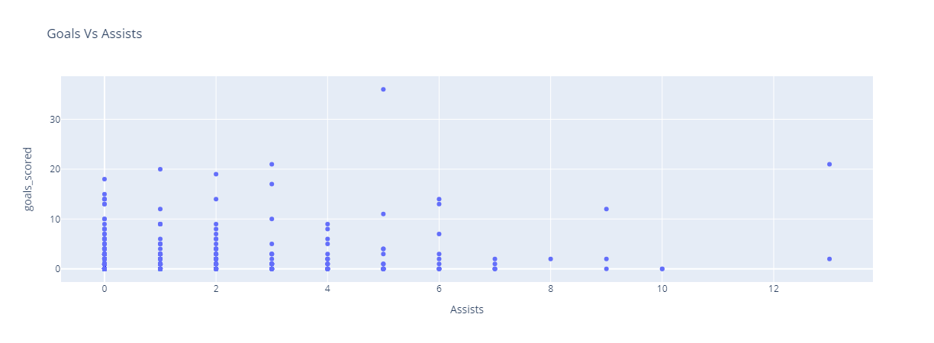
4. CLUSTERING (II)
First, we will see how the data is distributed across all players, comparing Goals vs Assists:

Slide 15
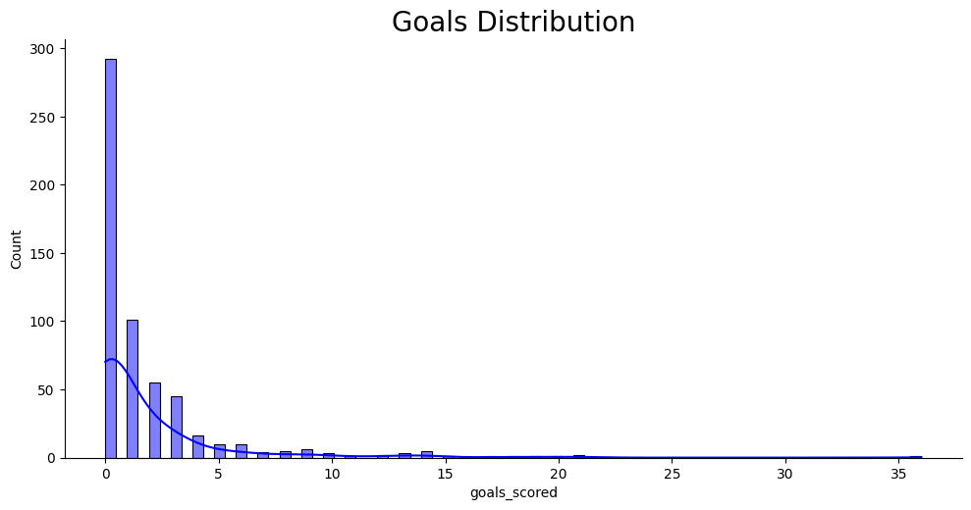
4. CLUSTERING (III)

Slide 16
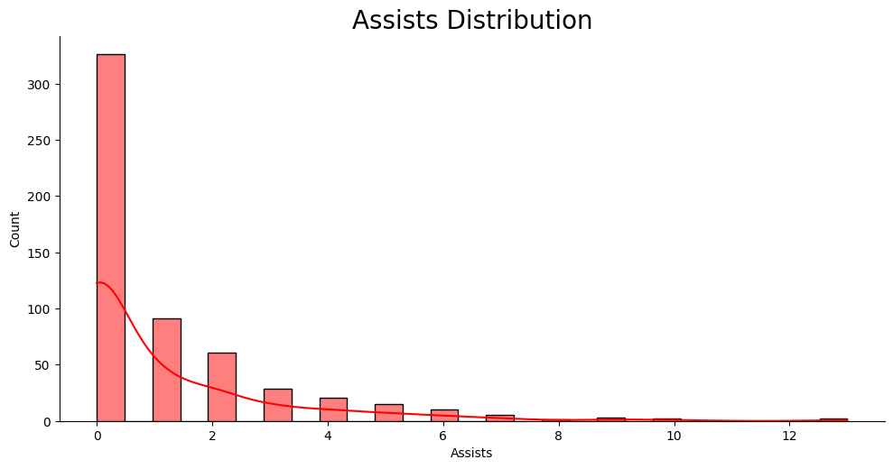
4. CLUSTERING (IV)

Slide 17
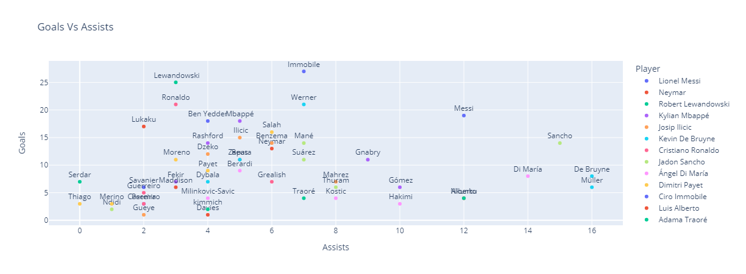
4. CLUSTERING (V)
It is a better approach to the clustering task using only the top 50 players across all leagues to have a much more interesting result and substance to the data.

Slide 18
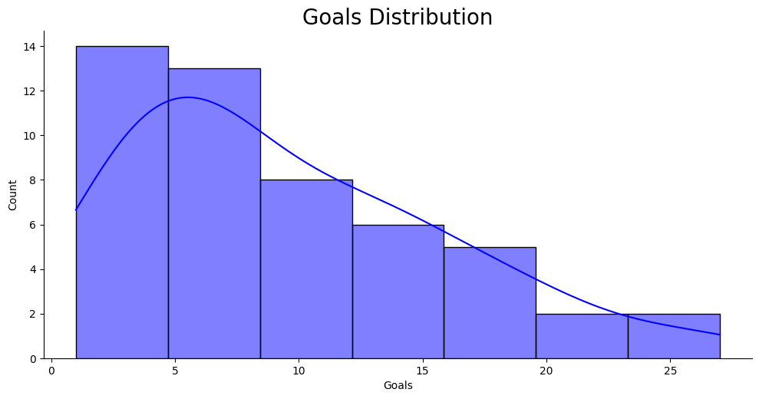
4. CLUSTERING (VI)

Slide 19
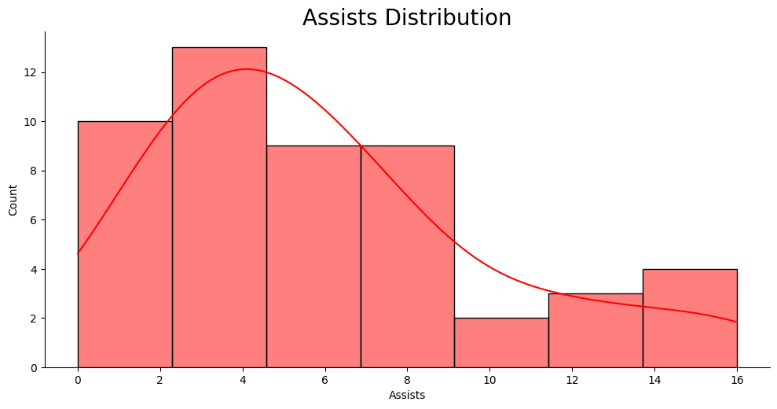
4. CLUSTERING (VII)

Slide 20
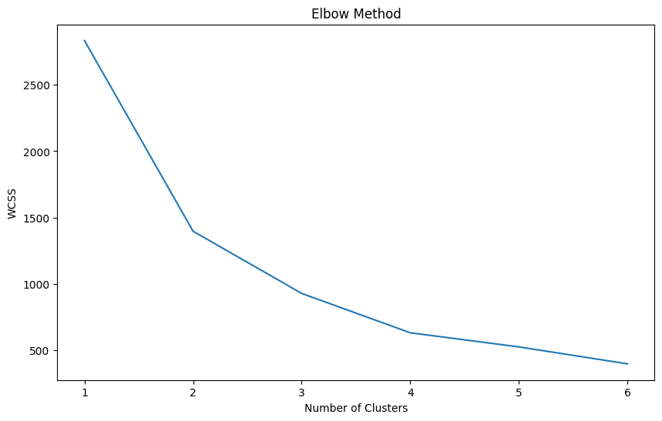
4. CLUSTERING (VIII)
To obtain the number of clusters needed we use the Elbow Method and Within-Cluster Sum of Squares (WCSS):

Slide 21
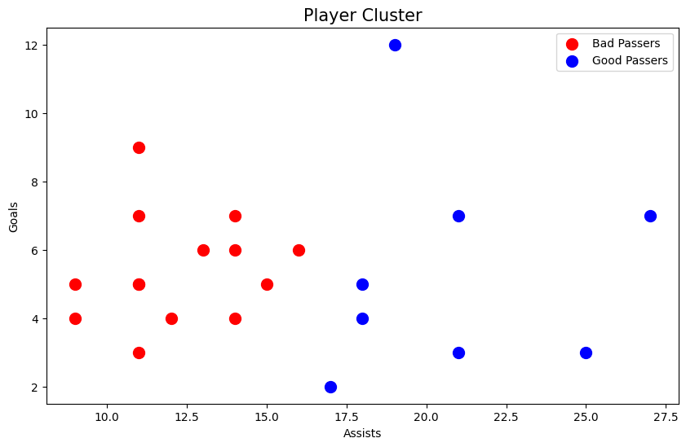
4. CLUSTERING (IX)

Slide 22
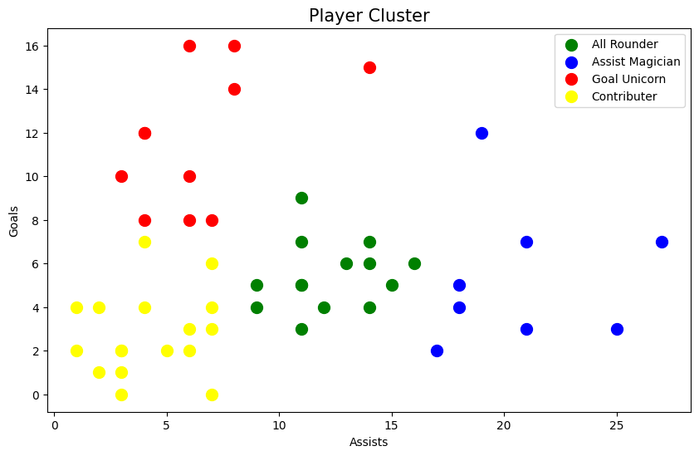
4. CLUSTERING (X)

Slide 23
THANK YOU!

