Slide 1
Attack
combo
swap
Attack 1
5\5
Attack 2
15\15
Item
Attack 3
0\5
Attack 4
1\1
Run

Slide 2
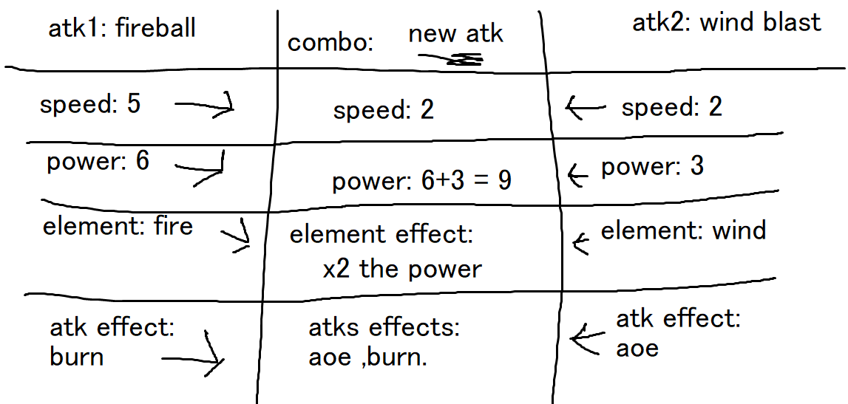
Attack
combo
swap
Item
Run

Slide 3
6\6 teammates
Team hp
You can correct yourself if you picked the wrong character
Attack
combo
swap
Item
Run

Slide 4
all
Consume
Wepons
List of items by categories
Attack
combo
swap
Item
Run

Slide 5
Attack
combo
swap
If succeeded just run
If not -> fail
Item
Run

Slide 6
EYAL\Front\05_13
Title
Changes I made
Git
Front – UI
Backend
Backend functions
DB
Json\Mysql\NoSQL

Slide 7
Monster (3) (fire and stone)
Def (80) -> normal def,
Special defense (strong against fire) (80+40)
Attack state -> per element
Special attack dmg -> every 3-4 turn it will create a combination.
HP -> depends on monster type and levels
Speed
Player
Two attack
Same states as the monster

Slide 8
Questions:
How do we upload games to steam?

