Slide 1
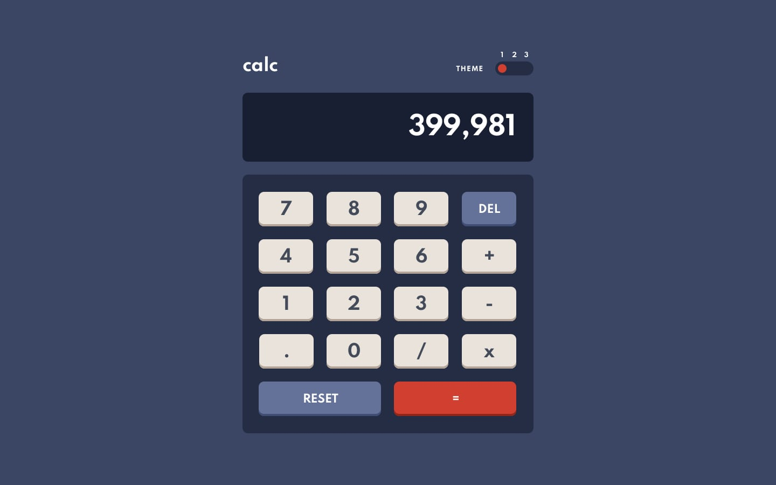
<main>
<div>
<div>
<section.calc-header>
<section. result>
<section.calc-pad>
*grid container
<button#del>
<button#plus>
<button#minus>
<button#minus>

Slide 2
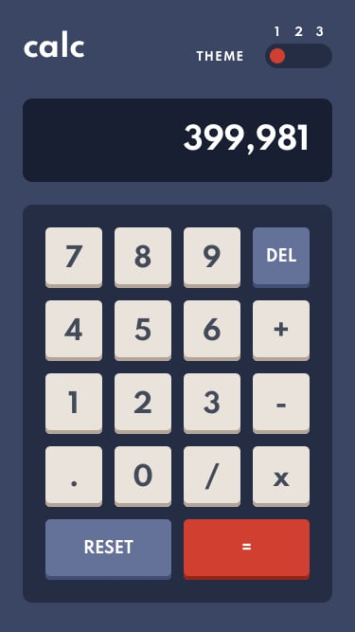
From Desktop – Mobile:
Reduce width of sections
buttons become squares

