Slide 1
CONTEXTUAL MEMORY ARCHITECTURE
OPEN SOURCE · v0.5 · ALPHA
Contextual Memory
Architecture (CMA)
A memory layer your agent carries with it.
github.com/danny-watkins/contextual-memory-architecture
DANNY WATKINS · 2026

Slide 2
01 · THESIS
02 / 17
The closed loop.
Three sentences. The entire thesis.
→
Memory becomes context.
→
Context shapes action.
→
Action becomes memory.
// the loop CMA implements
CONTEXTUAL MEMORY ARCHITECTURE · v0.5
DANNY WATKINS

Slide 3
02 · THE PROBLEM
03 / 17
Stateless agents don't compound.
Every session starts cold. Experience never transfers.
01
02
Forget prior decisions
Re-learn project context
Every session re-litigates the same architectural choices.
Conventions, constraints, and quirks rediscovered on every task.
03
04
Repeat the same mistakes
Lose relational context
Postmortems exist but never surface when the same failure recurs.
RAG retrieves chunks, not the decisions linked to the project.
CONTEXTUAL MEMORY ARCHITECTURE · v0.5
DANNY WATKINS

Slide 4
03 · THE GAP
04 / 17
RAG is not memory.
The most useful context is structurally nearest, not semantically nearest.
STANDARD RAG RETRIEVES
AGENT MEMORY NEEDS
—
the nearest vector chunk
→
decisions linked to projects
—
by cosine similarity
→
postmortems linked to failures
—
ignores edges, time, status
→
patterns inferred across tasks
—
indifferent to provenance
→
supersession-aware exclusion
CONTEXTUAL MEMORY ARCHITECTURE · v0.5
DANNY WATKINS

Slide 5
04 · TOPOLOGY
05 / 17
Per-agent. Not one shared brain.
Each agent owns its own vault. Cross-agent retrieval is opt-in, never default.
AGENT A
AGENT B
AGENT C
email-checker
trade-router
doc-summarizer
NETWORK LAYER
opt-in, gated, future direction
// fractal by design — same primitives compose upward. cross-agent edges require explicit policy.
CONTEXTUAL MEMORY ARCHITECTURE · v0.5
DANNY WATKINS

Slide 6
05 · ARCHITECTURE
06 / 17
Three intelligent functions.
Reasoner frames. Retriever recalls. Recorder forms.
01
02
03
REASONER
RETRIEVER
RECORDER
→
→
frames the goal,
decides what context matters
memory → context spec
via hybrid + graph search
experience → structured
durable memory
// memory feeds the next task
CONTEXTUAL MEMORY ARCHITECTURE · v0.5
DANNY WATKINS

Slide 7
06 · SUBSTRATE
07 / 17
The vault is the memory.
Just markdown. Open in Obsidian. Version with git. Grep from the shell.
async-capital-call-processing.md
YAML frontmatter
machine-readable metadata
---
type: decision
title: Async Capital Call Processing
status: accepted
[[Wikilinks]]
confidence: 0.86
graph edges between notes
tags: [capital-calls, performance, backend]
---
# Async Capital Call Processing
We decided to move capital call processing
Filename
into an async queue.
stable record id
Uses [[Queue Retry Pattern]].
CONTEXTUAL MEMORY ARCHITECTURE · v0.5
DANNY WATKINS

Slide 8
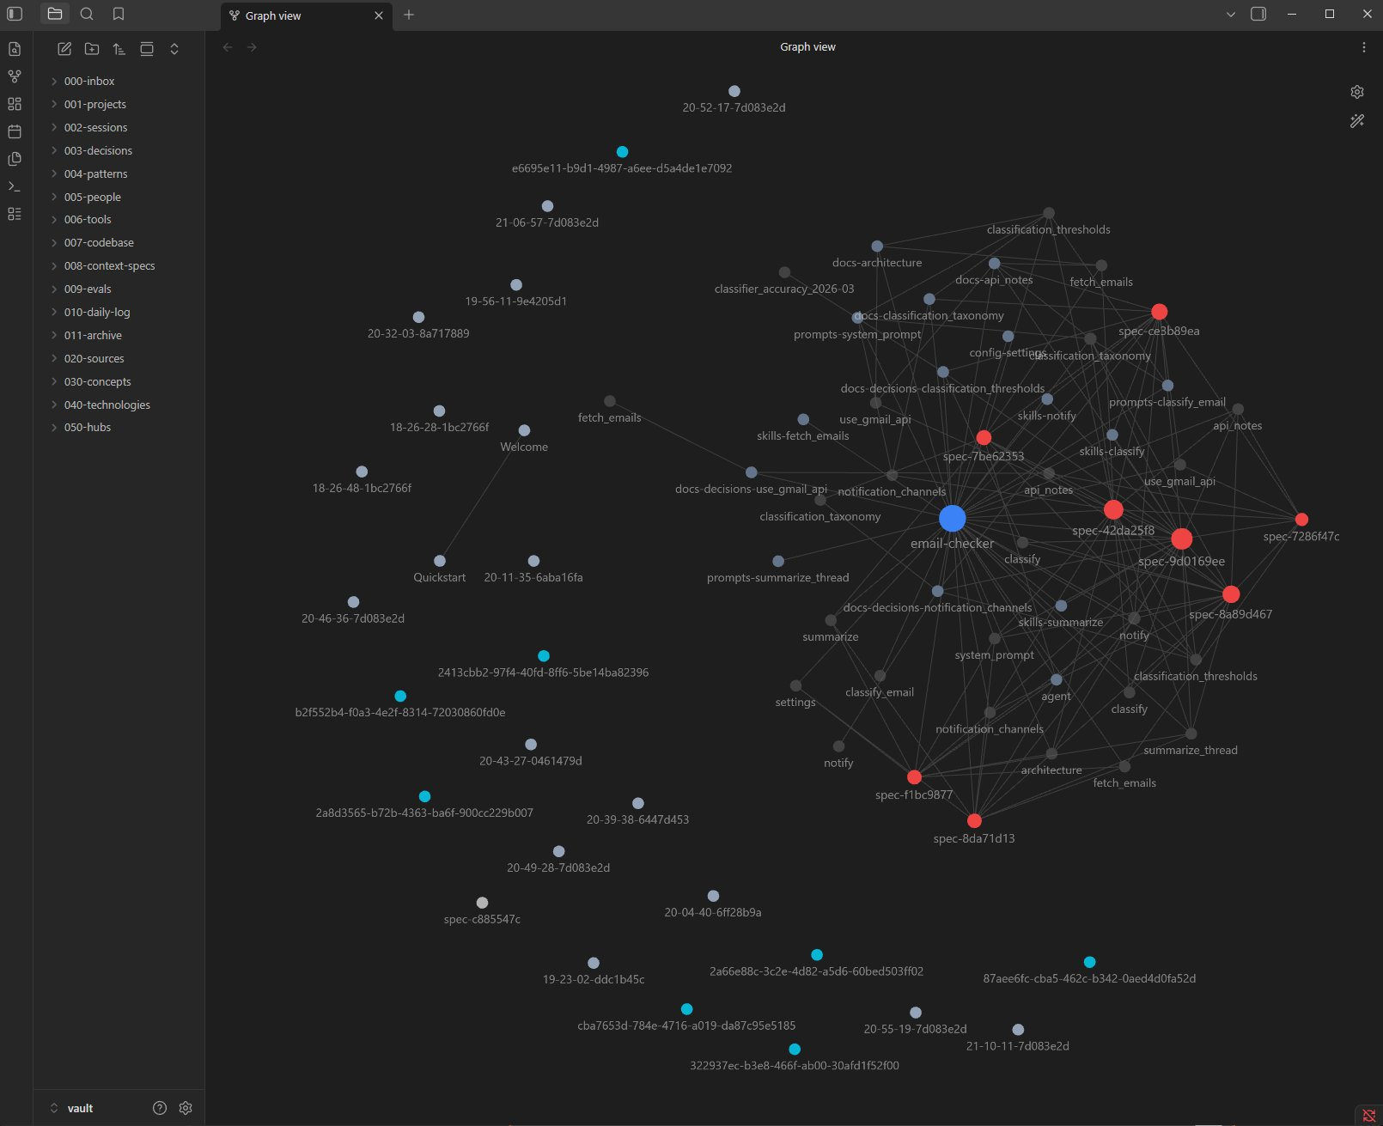
07 · IN PRACTICE
08 / 17
Live from a working vault.
An email-checker agent. Every dot, a memory; every line, a relationship.
Obsidian graph view · email-checker agent · spec → source → backlink
CONTEXTUAL MEMORY ARCHITECTURE · v0.5
DANNY WATKINS

Slide 9
08 · RETRIEVAL
09 / 17
Query to context, in five stages.
Deterministic. Inspectable. Reproducible.
01
Hybrid seed search
BM25L lexical + optional dense embeddings = hybrid score
02
Beam-pruned multi-hop traversal
Expand outward over wikilinks, beam-prune at each depth
03
Final scoring
metadata_boost × depth_decay ^ depth
04
Paragraph-level fragment extract
Score paragraphs against query, dedupe across nodes
05
Context Spec assembly
Structured artifact: fragments + relationship map + provenance
CONTEXTUAL MEMORY ARCHITECTURE · v0.5
DANNY WATKINS

Slide 10
09 · SCORING
10 / 17
Hybrid scoring, depth-decayed.
Lexical and semantic combined, then modulated by metadata and depth.
node_score = α · semantic + (1 − α) · lexical
final_score = node_score · metadata_boost · decay ^ depth
DEFAULTS
METADATA BOOSTS
DEPTH DECAY
multiplicative, clamped at 0
traversal penalty: decay ^ depth
α
0.7
decay
0.80
accepted decision
× 1.10
DEPTH
HOPS
MULTIPLIER
rejected decision
× 0.70
0
direct match
× 1.00
beam_width
5
superseded decision
× 0.50
1
one hop away
× 0.80
max_depth
2
archived (any type)
× 0.80
human_verified
× 1.10
2
two hops away
× 0.64
confidence ≥ 0.85
× 1.08
// farther hops earn inclusion via topology
confidence < 0.30
× 0.90
CONTEXTUAL MEMORY ARCHITECTURE · v0.5
DANNY WATKINS

Slide 11
10 · WRITE POLICY
11 / 17
Confidence-gated memory writes.
Every potential write runs through these gates. The vault only sees what survives.
DECISION FLOW
REFERENCE TABLE
yes
confidence < 0.25 ?
→
SKIP
dropped
STATUS
CONFIDENCE
ACTION
no
yes
accepted
any
WRITE
status = accepted | rejected ?
→
WRITE
→ vault
rejected
any
WRITE
no
yes
proposed
≥ 0.75
WRITE
confidence ≥ 0.75 ?
→
WRITE
→ vault
proposed
0.50 – 0.74
DRAFT
no
yes
proposed
0.25 – 0.49
PROPOSE
confidence ≥ 0.50 ?
→
DRAFT
→ vault (draft)
any
< 0.25
SKIP
no
yes
otherwise
→
PROPOSE
→ proposals/
// without gating, every guess lands in memory. compounding noise degrades reasoning.
CONTEXTUAL MEMORY ARCHITECTURE · v0.5
DANNY WATKINS

Slide 12
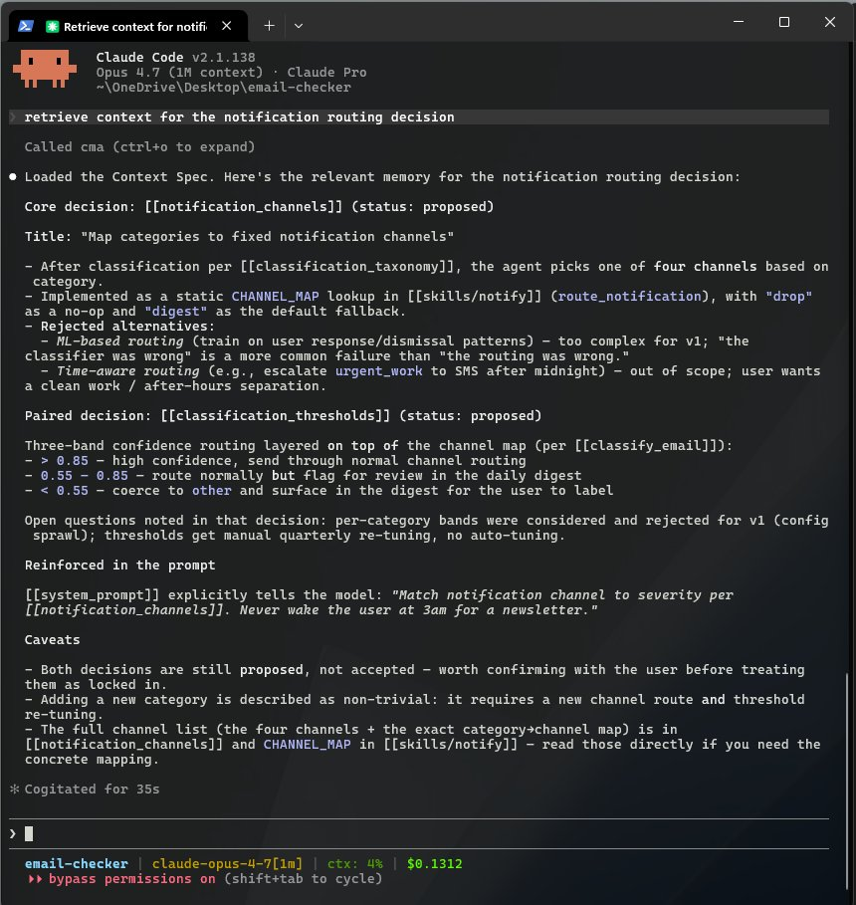
11 · IN PRACTICE
12 / 17
What an agent sees.
A retrieve() call surfaces the relevant decision — linked, contextualized, ready to reason over.
OBSERVATION
Structured retrieval
Claude calls cma, gets a Context Spec — not a chunk dump.
Decisions surface as decisions
[[notification_channels]] arrives with status, rationale, and rejected alternatives.
Caveats included
"Both decisions are still proposed, not accepted" — the agent knows what's tentative.
Self-narrating
What was loaded, why it was relevant, what to read next.
CONTEXTUAL MEMORY ARCHITECTURE · v0.5
DANNY WATKINS

Slide 13
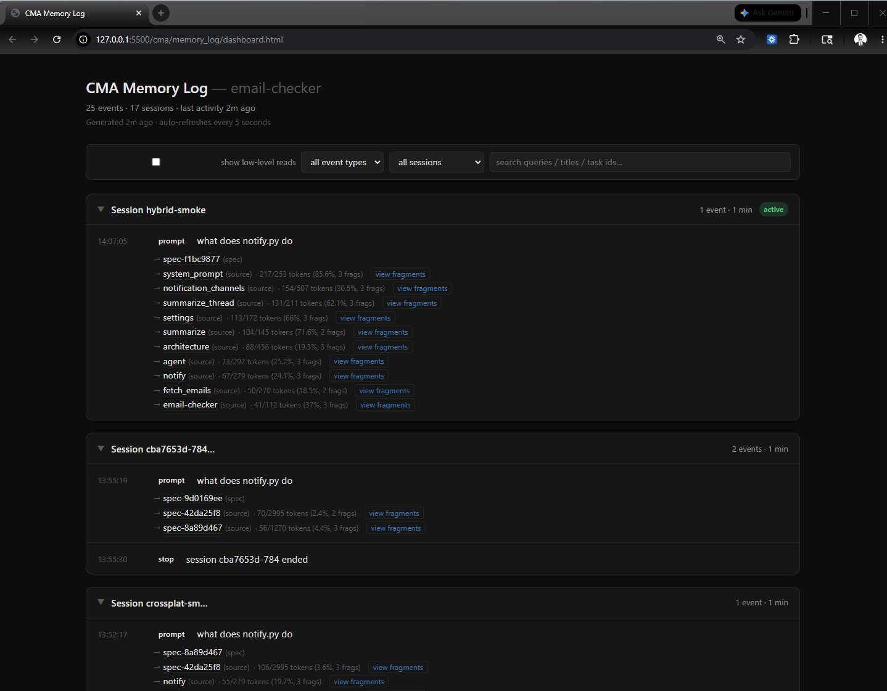
12 · OBSERVABILITY
13 / 17
Memory you can watch.
Every retrieve, search, and write — logged, grouped by session, linked to every artifact.
cma/memory_log/dashboard.html · static, self-refreshing, no server
CONTEXTUAL MEMORY ARCHITECTURE · v0.5
DANNY WATKINS

Slide 14
13 · INTEGRATION
14 / 17
Ten MCP tools. Any agent.
Six graph primitives, four orchestrators. Stdio transport.
GRAPH PRIMITIVES
ORCHESTRATORS
search_notes(query, top_k)
retrieve(query, max_depth, beam_width)
get_note(title)
record_completion(yaml, dry_run)
get_outgoing_links(title)
graph_health()
get_backlinks(title)
reindex()
traverse_graph(start, depth)
search_by_frontmatter(key, value)
// wires into Claude Code via .mcp.json
CONTEXTUAL MEMORY ARCHITECTURE · v0.5
DANNY WATKINS

Slide 15
14 · SCALE
15 / 17
Designed for single-CPU scale.
Footprint and warm-process latency on commodity hardware (MiniLM-L6-v2 384d).
VAULT SIZE
MARKDOWN
EMBEDDINGS
PROCESS RAM
WARM RETRIEVE
SOURCE
1K notes
~4 MB
1.5 MB
~750 MB
~40 ms
measured
10K notes
~37 MB
15 MB
~1.2 GB
~170 ms
measured
100K notes
~370 MB
~150 MB
~2 GB
~1.7 s
projected
1M notes
~3.7 GB
~1.5 GB
~10+ GB
needs ANN
projected
// 1K and 10K rows measured via docs/bench_scaling.py. 100K row extrapolated linearly from the 10K measurement.
// process RAM includes the ~500 MB resident sentence-transformers model. beyond ~100K, swap to FAISS / hnswlib.
// warm retrieve = in-process (MCP server case). shell-invoked cma retrieve pays a ~10-15 s model load per call.
CONTEXTUAL MEMORY ARCHITECTURE · v0.5
DANNY WATKINS

Slide 16
15 · WHY IT MATTERS
16 / 17
Smarter agents, fewer tokens.
Same mechanism does both: cherry-pick fragments, persist what was learned.
→
MEMORY COMPOUNDS
Decisions, patterns, and postmortems from prior sessions surface
automatically on the next relevant task. The agent inherits its own work.
→
CONTEXT IS CHERRY-PICKED
Fragment-level extraction, not whole-document dumping. The Retriever
ranks paragraphs against the query and pulls only what's relevant.
DEMO MEASUREMENT
ARCHITECTURAL BOUND
email-checker · one retrieve · 10 sources
Output size is bounded by configuration
(beam_width, max_depth, max_fragments_per_node),
not by vault size. Cost per query stays flat as
memory grows.
Source bodies (total)
2,697 tokens
Fragments extracted
1,038 tokens
Reduction
61.5 %
// measurement from cma/memory_log/activity.jsonl on the email-checker demo. your mileage will vary with vault and query.
CONTEXTUAL MEMORY ARCHITECTURE · v0.5
DANNY WATKINS

Slide 17
Get started.
Local-first. Open source. Drop-in for any MCP-aware agent.
zsh
$
git clone github.com/danny-watkins/contextual-memory-architecture
$
cd contextual-memory-architecture
$
pip install -e ".[all]"
$
cd /path/to/your-agent-project
$
cma add
# scaffold + ingest + wire MCP
$
claude
# CMA fires on every prompt
→
github.com/danny-watkins/contextual-memory-architecture
Open source · Local-first · Built for Claude Code · Works with any MCP-aware agent

