Slide 1
進度報告
2025/09/29
學生: 戴良育
指導教授: 謝君偉

Slide 2
模型復刻
Spectroformer: Multi-Domain Query Cascaded Transformer Network For Underwater Image Enhancement
MD Raqib Khan1, Priyanka Mishra2, Nancy Mehta3, Shruti S. Phutke4 Santosh Kumar Vipparthi2, Sukumar Nandi5, Subrahmanyam Murala1 1CVPR Lab, School of Computer Science and Statistics, Trinity College Dublin, Ireland 2CVPR Lab, Indian Institute of Technology Ropar, India 3Computer Vision Lab, CAIDAS, IFI, University of Wurzburg, Germany ¨ 4Institute for Integrated and Intelligent Systems, Griffith Univeristy, Australia 5Indian Institute of Technology Guwahati, India khanmd@tcd.ie

Slide 3
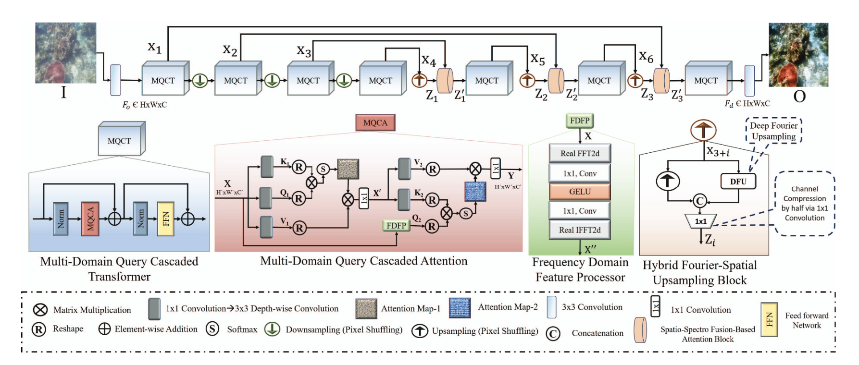
模型架構
main goal is to combine the insights from both frequency and spatial domains for revealing fine details and patterns in the degraded underwater images.

Slide 4
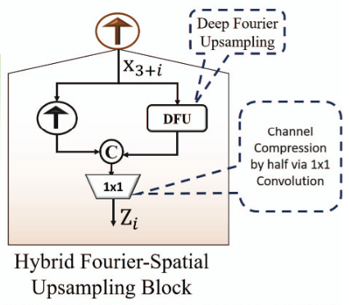
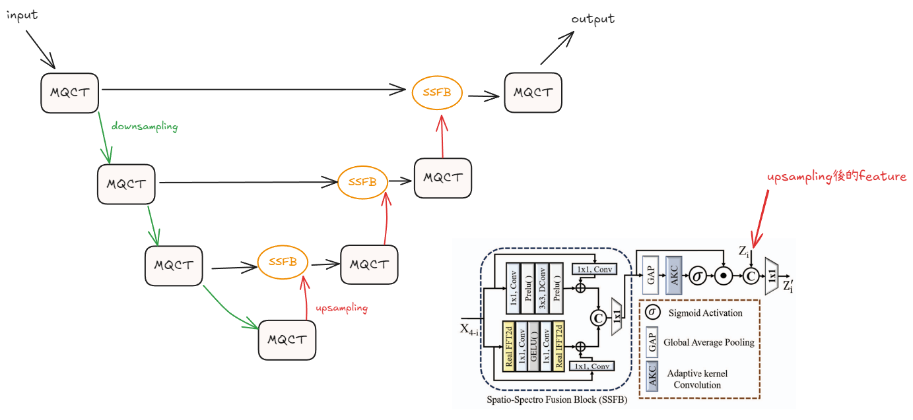

模型架構

Slide 5
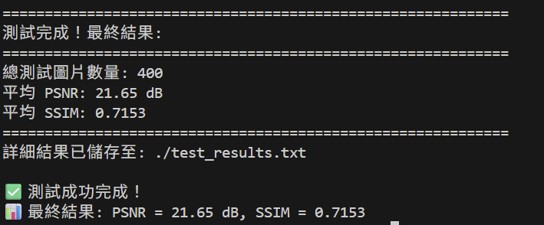
目前進度
Batch size : 4
Epoch : 25
PSNR : 21.65
SSIM : 0.7153

Slide 6
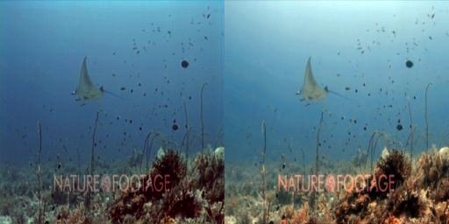
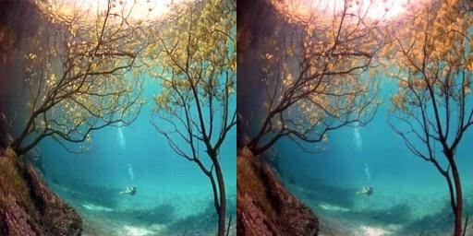
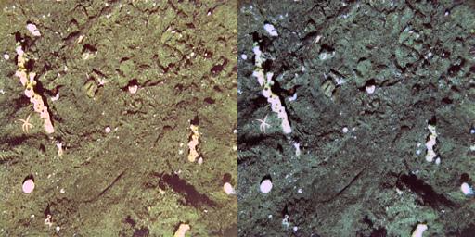
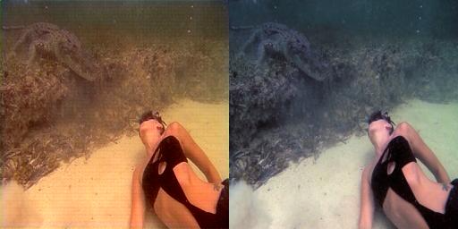
目前進度

Slide 7

目前進度
SSFB通道權重
hybrid Fourier – spatial Upsampling block
MQCA – Frequency

Slide 8
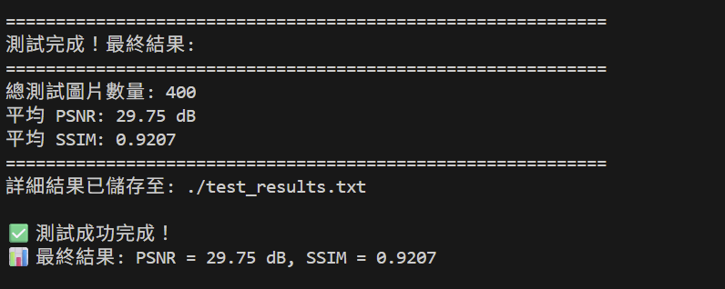
目前進度
Batch size : 4
Epoch : 533
PSNR : 29.75
SSIM : 0.9207

Slide 9
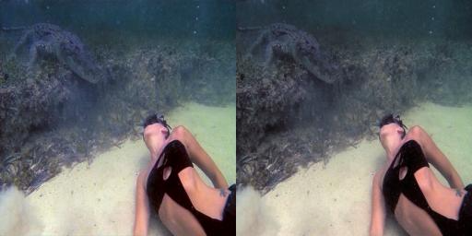
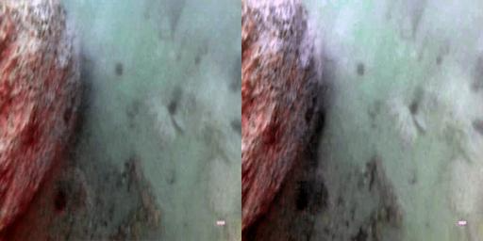
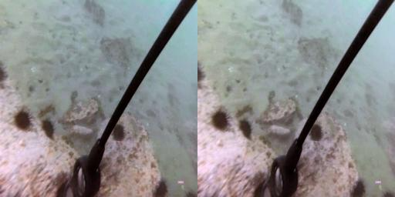
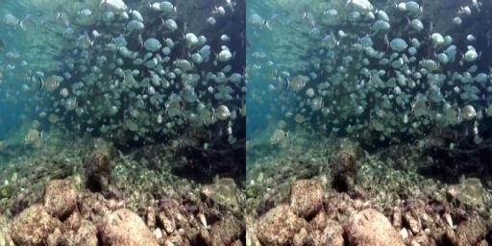
目前進度

