Slide 1
Training Log

Slide 2
WithOut external data
model_lgb = lgb.LGBMRegressor(bagging_fraction=0.77, bagging_freq=4, bagging_seed=9,
early_stopping_rounds=150, feature_fraction=0.8,
feature_fraction_seed=9, learning_rate=0.01, max_bin=550,
metric='mape', min_data_in_leaf=1, min_sum_hessian_in_leaf=5,
n_estimators=30000, num_leaves=350, objective='regression',
verbose=0)
Submit MAPE: 9.754163

Slide 3
With External data (LightGBMV2)
all_data = concat_externaldata(all_data, "./dataset/external_data/ATM資料.csv", 'ATM資料', radius=300.0)
all_data = concat_externaldata(all_data, "./dataset/external_data/大學基本資料.csv", '大學基本資料', radius=3000.0)
all_data = concat_externaldata(all_data, "./dataset/external_data/公車站點資料.csv", '公車站點資料', radius=300.0)
all_data = concat_externaldata(all_data, "./dataset/external_data/火車站點資料.csv", '火車站點資料', radius=3000.0)
all_data = concat_externaldata(all_data, "./dataset/external_data/金融機構基本資料.csv", '金融機構基本資料', radius=1000.0)
all_data = concat_externaldata(all_data, "./dataset/external_data/便利商店.csv", '便利商店', radius=300.0)
all_data = concat_externaldata(all_data, "./dataset/external_data/高中基本資料.csv", '高中基本資料', radius=3000.0)
all_data = concat_externaldata(all_data, "./dataset/external_data/國小基本資料.csv", '國小基本資料', radius=3000.0)
all_data = concat_externaldata(all_data, "./dataset/external_data/國中基本資料.csv", '國中基本資料', radius=3000.0)
all_data = concat_externaldata(all_data, "./dataset/external_data/捷運站點資料.csv", '捷運站點資料', radius=300.0)
all_data = concat_externaldata(all_data, "./dataset/external_data/郵局據點資料.csv", '郵局據點資料', radius=1000.0)
all_data = concat_externaldata(all_data, "./dataset/external_data/腳踏車站點資料.csv", '腳踏車站點資料', radius=300.0)
all_data = concat_externaldata(all_data, "./dataset/external_data/醫療機構基本資料.csv", '醫療機構基本資料', radius=3000.0)
model_lgb = lgb.LGBMRegressor(bagging_fraction=0.84, bagging_freq=4, bagging_seed=9,
early_stopping_rounds=150, feature_fraction=0.8,
feature_fraction_seed=9, learning_rate=0.01, max_bin=300,
metric='mape', min_data_in_leaf=2, min_sum_hessian_in_leaf=2,
n_estimators=30000, num_leaves=375, objective='regression',
reg_alpha=0.03, reg_lambda=0.07, verbose=0)
Rmsle:0.07753321390205888
Mape:0.059529117430796
Test_score:6998.905432795532
Train_score:9700.98898393088
Submit MAPE: 8.492715

Slide 4
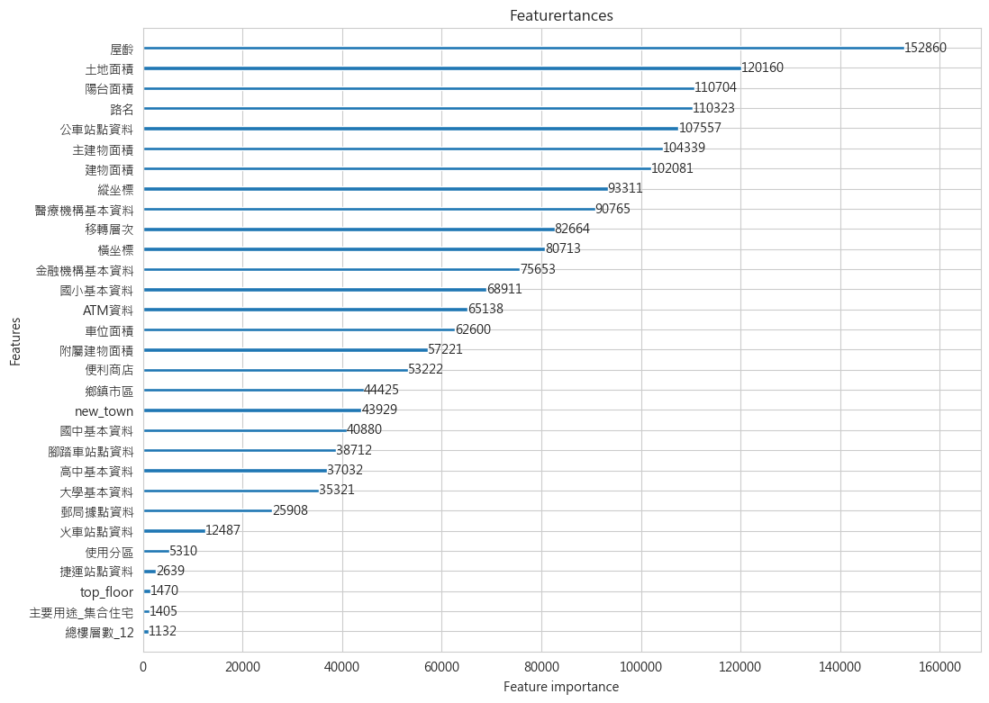

Slide 5
New features --- V2 (LightGBMV3)
"""New feature --- V2"""
### is near the big road
all_data['is_street'] = all_data['路名'].astype(str).str.endswith('街').astype(int)
### how to use '備註'？
### way1: if there are 備註
all_data['備註'] = np.where((all_data['備註'] == 'None'), 1, 0)
all_data = concat_externaldata_concentric(all_data, "./dataset/external_data/ATM資料.csv", 'ATM資料', radius=[100.0, 300.0, 500.0])
all_data = concat_externaldata_concentric(all_data, "./dataset/external_data/大學基本資料.csv", '大學基本資料', radius=[1000.0, 1500.0, 3000.0])
all_data = concat_externaldata_concentric(all_data, "./dataset/external_data/公車站點資料.csv", '公車站點資料', radius=[100.0, 200.0, 300.0])
all_data = concat_externaldata_concentric(all_data, "./dataset/external_data/火車站點資料.csv", '火車站點資料', radius=[500.0, 1000.0, 3000.0])
all_data = concat_externaldata_concentric(all_data, "./dataset/external_data/金融機構基本資料.csv", '金融機構基本資料', radius=[500.0, 750.0, 1000.0])
all_data = concat_externaldata_concentric(all_data, "./dataset/external_data/便利商店.csv", '便利商店', radius=[100.0, 200.0, 300.0])
all_data = concat_externaldata_concentric(all_data, "./dataset/external_data/高中基本資料.csv", '高中基本資料', radius=[1000.0, 1500.0, 3000.0])
all_data = concat_externaldata_concentric(all_data, "./dataset/external_data/國小基本資料.csv", '國小基本資料', radius=[1000.0, 1500.0, 3000.0])
all_data = concat_externaldata_concentric(all_data, "./dataset/external_data/國中基本資料.csv", '國中基本資料', radius=[1000.0, 1500.0, 3000.0])
all_data = concat_externaldata_concentric(all_data, "./dataset/external_data/捷運站點資料.csv", '捷運站點資料', radius=[100.0, 200.0, 300.0])
all_data = concat_externaldata_concentric(all_data, "./dataset/external_data/郵局據點資料.csv", '郵局據點資料', radius=[300.0, 500.0, 1000.0])
all_data = concat_externaldata_concentric(all_data, "./dataset/external_data/腳踏車站點資料.csv", '腳踏車站點資料', radius=[100.0, 200.0, 300.0])
all_data = concat_externaldata_concentric(all_data, "./dataset/external_data/醫療機構基本資料.csv", '醫療機構基本資料', radius=[500.0, 1000.0, 3000.0])
model_lgb = lgb.LGBMRegressor(bagging_fraction=0.72, bagging_freq=4, bagging_seed=9,
early_stopping_rounds=150, feature_fraction=0.7,
feature_fraction_seed=9, learning_rate=0.01, max_bin=425,
metric='mape', min_data_in_leaf=2, min_sum_hessian_in_leaf=10,
n_estimators=30000, num_leaves=350, objective='regression',
reg_lambda=0.15, verbose=0)
Rmsle:0.07711829036019067
Mape:0.05958775907037752
Test_score:7015.90538723497
Train_score:9696.984951687899
Submit MAPE: 8.493608

Slide 6
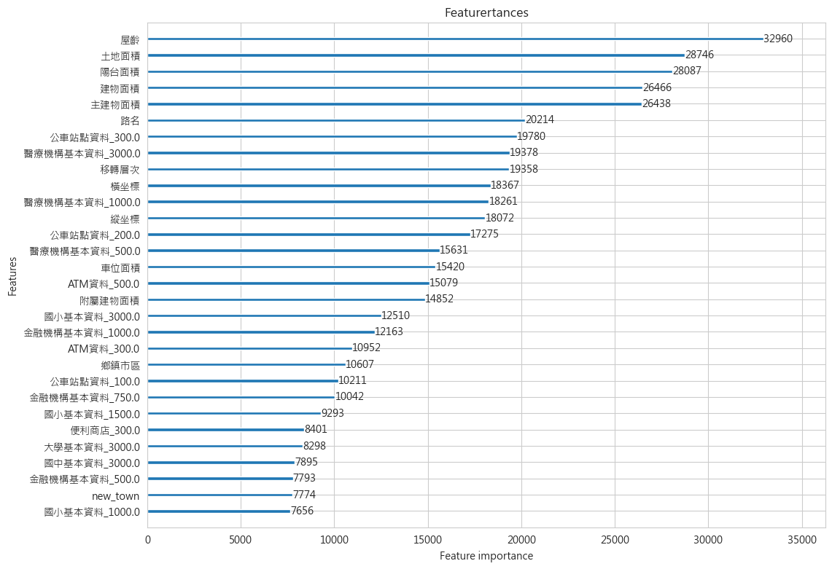

Slide 7
New features --- V2 (LightGBMV3)
"""New feature --- V2"""
### is near the big road
all_data['is_street'] = all_data['路名'].astype(str).str.endswith('街').astype(int)
### how to use '備註'？
### way1: if there are 備註
all_data['備註'] = np.where((all_data['備註'] == 'None'), 1, 0)
all_data = concat_externaldata(all_data, "./dataset/external_data/ATM資料.csv", 'ATM資料', radius=300.0)
all_data = concat_externaldata(all_data, "./dataset/external_data/大學基本資料.csv", '大學基本資料', radius=3000.0)
all_data = concat_externaldata(all_data, "./dataset/external_data/公車站點資料.csv", '公車站點資料', radius=300.0)
all_data = concat_externaldata(all_data, "./dataset/external_data/火車站點資料.csv", '火車站點資料', radius=3000.0)
all_data = concat_externaldata(all_data, "./dataset/external_data/金融機構基本資料.csv", '金融機構基本資料', radius=1000.0)
all_data = concat_externaldata(all_data, "./dataset/external_data/便利商店.csv", '便利商店', radius=300.0)
all_data = concat_externaldata(all_data, "./dataset/external_data/高中基本資料.csv", '高中基本資料', radius=3000.0)
all_data = concat_externaldata(all_data, "./dataset/external_data/國小基本資料.csv", '國小基本資料', radius=3000.0)
all_data = concat_externaldata(all_data, "./dataset/external_data/國中基本資料.csv", '國中基本資料', radius=3000.0)
all_data = concat_externaldata(all_data, "./dataset/external_data/捷運站點資料.csv", '捷運站點資料', radius=300.0)
all_data = concat_externaldata(all_data, "./dataset/external_data/郵局據點資料.csv", '郵局據點資料', radius=1000.0)
all_data = concat_externaldata(all_data, "./dataset/external_data/腳踏車站點資料.csv", '腳踏車站點資料', radius=300.0)
all_data = concat_externaldata(all_data, "./dataset/external_data/醫療機構基本資料.csv", '醫療機構基本資料', radius=3000.0)
model_lgb = lgb.LGBMRegressor(bagging_fraction=0.77, bagging_freq=12, bagging_seed=9,
early_stopping_rounds=150, feature_fraction=0.8,
feature_fraction_seed=9, learning_rate=0.01, max_bin=600,
metric='mape', min_data_in_leaf=2, min_sum_hessian_in_leaf=8,
n_estimators=30000, num_leaves=375, objective='regression',
reg_alpha=0.05, reg_lambda=0.15, verbose=0)
Rmsle:0.0773925750633253
Mape:0.05942822225978149
Test_score:6888.9055713821035
Train_score:9684.984843628807
Submit MAPE: -

Slide 8
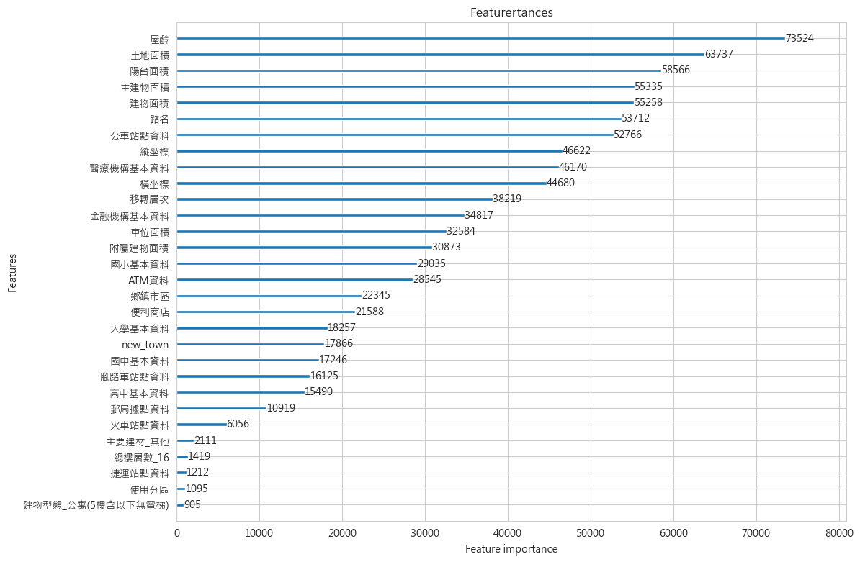

Slide 9
With External data (Light drop data) (LightGBMV4)
all_data = concat_externaldata(all_data, "./dataset/external_data/ATM資料.csv", 'ATM資料', radius=300.0)
all_data = concat_externaldata(all_data, "./dataset/external_data/大學基本資料.csv", '大學基本資料', radius=3000.0)
all_data = concat_externaldata(all_data, "./dataset/external_data/公車站點資料.csv", '公車站點資料', radius=300.0)
all_data = concat_externaldata(all_data, "./dataset/external_data/火車站點資料.csv", '火車站點資料', radius=3000.0)
all_data = concat_externaldata(all_data, "./dataset/external_data/金融機構基本資料.csv", '金融機構基本資料', radius=1000.0)
all_data = concat_externaldata(all_data, "./dataset/external_data/便利商店.csv", '便利商店', radius=300.0)
all_data = concat_externaldata(all_data, "./dataset/external_data/高中基本資料.csv", '高中基本資料', radius=3000.0)
all_data = concat_externaldata(all_data, "./dataset/external_data/國小基本資料.csv", '國小基本資料', radius=3000.0)
all_data = concat_externaldata(all_data, "./dataset/external_data/國中基本資料.csv", '國中基本資料', radius=3000.0)
all_data = concat_externaldata(all_data, "./dataset/external_data/捷運站點資料.csv", '捷運站點資料', radius=300.0)
all_data = concat_externaldata(all_data, "./dataset/external_data/郵局據點資料.csv", '郵局據點資料', radius=1000.0)
all_data = concat_externaldata(all_data, "./dataset/external_data/腳踏車站點資料.csv", '腳踏車站點資料', radius=300.0)
all_data = concat_externaldata(all_data, "./dataset/external_data/醫療機構基本資料.csv", '醫療機構基本資料', radius=3000.0)
train = train.drop(train[(train['土地面積']>10)].index)
train = train.drop(train[(train['移轉層次']>=35)].index)
train = train.drop(train[(train['建物面積']>=8)].index)
train = train.drop(train[(train['車位面積']>=7)].index)
train = train.drop(train[(train['主建物面積']>= 7)].index)
train = train.drop(train[(train['陽台面積']>= 7)].index)
train = train.drop(train[(train['附屬建物面積']>= 10)].index)
model_lgb = lgb.LGBMRegressor(bagging_fraction=0.86, bagging_freq=4, bagging_seed=9,
early_stopping_rounds=150, feature_fraction=0.55,
feature_fraction_seed=9, learning_rate=0.01, max_bin=300,
metric='mape', min_data_in_leaf=2, min_sum_hessian_in_leaf=7,
n_estimators=30000, num_leaves=300, objective='regression',
verbose=0)
Rmsle:0.0670310538320515
Mape:0.05188054421013167
Test_score:6872.917980180031
Train_score:9677.980092166219
Submit MAPE: 8.374716

Slide 10
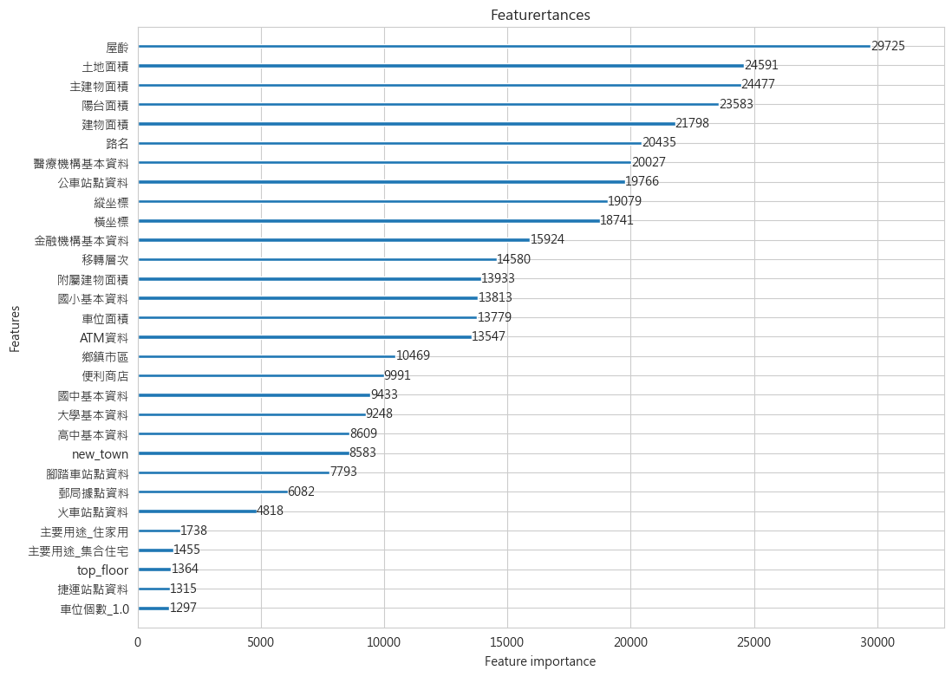

Slide 11
With External data + new features (LightGBMV23)
all_data = concat_externaldata(all_data, "./dataset/external_data/ATM資料.csv", 'ATM資料', radius=300.0)
all_data = concat_externaldata(all_data, "./dataset/external_data/大學基本資料.csv", '大學基本資料', radius=3000.0)
all_data = concat_externaldata(all_data, "./dataset/external_data/公車站點資料.csv", '公車站點資料', radius=300.0)
all_data = concat_externaldata(all_data, "./dataset/external_data/火車站點資料.csv", '火車站點資料', radius=3000.0)
all_data = concat_externaldata(all_data, "./dataset/external_data/金融機構基本資料.csv", '金融機構基本資料', radius=1000.0)
all_data = concat_externaldata(all_data, "./dataset/external_data/便利商店.csv", '便利商店', radius=300.0)
all_data = concat_externaldata(all_data, "./dataset/external_data/高中基本資料.csv", '高中基本資料', radius=3000.0)
all_data = concat_externaldata(all_data, "./dataset/external_data/國小基本資料.csv", '國小基本資料', radius=3000.0)
all_data = concat_externaldata(all_data, "./dataset/external_data/國中基本資料.csv", '國中基本資料', radius=3000.0)
all_data = concat_externaldata(all_data, "./dataset/external_data/捷運站點資料.csv", '捷運站點資料', radius=300.0)
all_data = concat_externaldata(all_data, "./dataset/external_data/郵局據點資料.csv", '郵局據點資料', radius=1000.0)
all_data = concat_externaldata(all_data, "./dataset/external_data/腳踏車站點資料.csv", '腳踏車站點資料', radius=300.0)
all_data = concat_externaldata(all_data, "./dataset/external_data/醫療機構基本資料.csv", '醫療機構基本資料', radius=3000.0)
"""New feature"""
### is_Top_floor
all_data['top_floor'] = np.where((all_data['總樓層數'] == all_data['移轉層次']), 1, 0)
### new_town = city + town
all_data['new_town'] = all_data['縣市'].apply(str) + '_' + all_data['鄉鎮市區'].apply(str)
### is_2_floor
all_data['is_2_floor'] = np.where(all_data['移轉層次'] == 2, 1, 0)
### is_4_floor
all_data['is_4_floor'] = np.where(all_data['移轉層次'] == 4, 1, 0)
### is_13_floor
all_data['is_13_floor'] = np.where(all_data['移轉層次'] == 13, 1, 0)
### old_house (age >= 20)
all_data['old_house'] = np.where(all_data['屋齡'] >= 20, 1, 0)
### high_floor
all_data['percentage_floor'] = all_data['移轉層次'] / all_data['總樓層數']
all_data['percentage_floor'] = np.where(all_data['percentage_floor'] >= 2/3, 'high', np.where(all_data['percentage_floor'] >= 1/3, 'median', 'low'))
all_data.loc[(all_data['建物型態'] == '公寓(5樓含以下無電梯)') | (all_data['建物型態'] == '透天厝'), 'percentage_floor'] = 'None'
model_lgb = lgb.LGBMRegressor(bagging_fraction=0.78, bagging_freq=10, bagging_seed=9,
early_stopping_rounds=150, feature_fraction=0.65,
feature_fraction_seed=9, learning_rate=0.01, max_bin=600,
metric='mape', min_data_in_leaf=0, min_sum_hessian_in_leaf=1,
n_estimators=30000, num_leaves=425, objective='regression',
reg_alpha=0.001, verbose=0)
Rmsle:0.077391721409536
Mape:0.059545744276229336
Test_score:7007.905429871101
Train_score:9700.990405579138
Submit MAPE: 8.352278

Slide 12
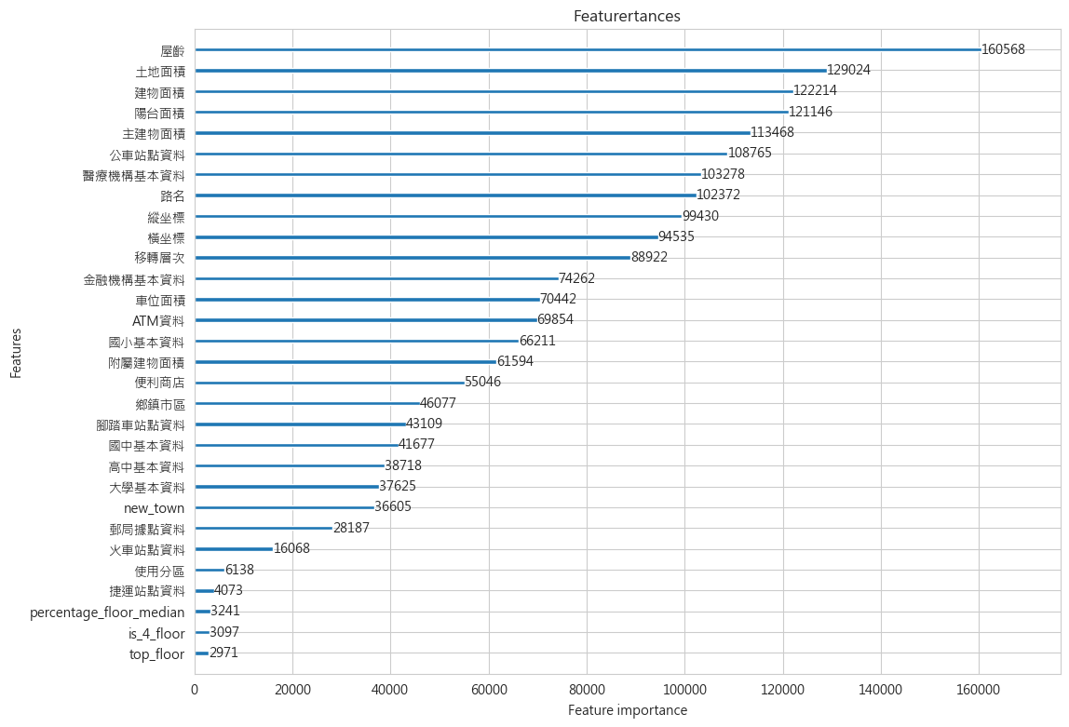

Slide 13
With External data + new features (LightGBMV24)
"""New feature"""
### is_Top_floor
all_data['top_floor'] = np.where((all_data['總樓層數'] == all_data['移轉層次']), 'YES', 'NO')
### new_town = city + town
all_data['new_town'] = all_data['縣市'].apply(str) + '_' + all_data['鄉鎮市區'].apply(str)
### is_2_floor
all_data['is_2_floor'] = np.where(all_data['移轉層次'] == 2, 'YES', 'NO')
all_data.loc[(all_data['建物型態'] == '透天厝'), 'is_2_floor'] = 'None'
### is_4_floor
all_data['is_4_floor'] = np.where(all_data['移轉層次'] == 4, 'YES', 'NO')
all_data.loc[(all_data['建物型態'] == '透天厝'), 'is_4_floor'] = 'None'
### is_6_floor
all_data['is_6_floor'] = np.where(all_data['移轉層次'] == 6, 'YES', 'NO')
### is_8_floor
all_data['is_8_floor'] = np.where(all_data['移轉層次'] == 8, 'YES', 'NO')
### is_13_floor
all_data['is_13_floor'] = np.where(all_data['移轉層次'] == 13, 'YES', 'NO')
### new_house (age < 5)
### medieval_house (5 <= age <= 20)
### old_house (age > 20)
all_data['house_age'] = np.where(all_data['屋齡'] < 5, 'new_house', np.where(all_data['屋齡'] > 20, 'old_house', 'medieval_house'))
### high_floor
all_data['percentage_floor'] = all_data['移轉層次'] / all_data['總樓層數']
all_data['percentage_floor'] = np.where(all_data['percentage_floor'] >= 2/3, 'high', np.where(all_data['percentage_floor'] >= 1/3, 'median', 'low'))
all_data.loc[(all_data['建物型態'] == '公寓(5樓含以下無電梯)') | (all_data['建物型態'] == '透天厝'), 'percentage_floor'] = 'None'
### is_city: 住商工 None(Yes), 農 其他(NO)
all_data['is_city'] = np.where((all_data['使用分區'] == '農') | (all_data['使用分區'] == '其他'), 'YES', 'NO')
all_data = concat_externaldata(all_data, "./dataset/external_data/ATM資料.csv", 'ATM資料', radius=300.0)
all_data = concat_externaldata(all_data, "./dataset/external_data/大學基本資料.csv", '大學基本資料', radius=3000.0)
all_data = concat_externaldata(all_data, "./dataset/external_data/公車站點資料.csv", '公車站點資料', radius=300.0)
all_data = concat_externaldata(all_data, "./dataset/external_data/火車站點資料.csv", '火車站點資料', radius=3000.0)
all_data = concat_externaldata(all_data, "./dataset/external_data/金融機構基本資料.csv", '金融機構基本資料', radius=1000.0)
all_data = concat_externaldata(all_data, "./dataset/external_data/便利商店.csv", '便利商店', radius=300.0)
all_data = concat_externaldata(all_data, "./dataset/external_data/高中基本資料.csv", '高中基本資料', radius=3000.0)
all_data = concat_externaldata(all_data, "./dataset/external_data/國小基本資料.csv", '國小基本資料', radius=3000.0)
all_data = concat_externaldata(all_data, "./dataset/external_data/國中基本資料.csv", '國中基本資料', radius=3000.0)
all_data = concat_externaldata(all_data, "./dataset/external_data/捷運站點資料.csv", '捷運站點資料', radius=300.0)
all_data = concat_externaldata(all_data, "./dataset/external_data/郵局據點資料.csv", '郵局據點資料', radius=1000.0)
all_data = concat_externaldata(all_data, "./dataset/external_data/腳踏車站點資料.csv", '腳踏車站點資料', radius=300.0)
all_data = concat_externaldata(all_data, "./dataset/external_data/醫療機構基本資料.csv", '醫療機構基本資料', radius=3000.0)
model_lgb = lgb.LGBMRegressor(bagging_fraction=0.78, bagging_freq=10, bagging_seed=9,
early_stopping_rounds=150, feature_fraction=0.65,
feature_fraction_seed=9, learning_rate=0.01, max_bin=600,
metric='mape', min_data_in_leaf=0, min_sum_hessian_in_leaf=1,
n_estimators=30000, num_leaves=425, objective='regression',
reg_alpha=0.001, verbose=0)
Rmsle:0.077391721409536
Mape:0.05942403724743006
Test_score:7007.905429871101
Train_score:9700.990405579138
Submit MAPE: 8.369518

Slide 15
With External data + new features (LightGBMV231)
"""New feature"""
### is_Top_floor
all_data['top_floor'] = np.where((all_data['總樓層數'] == all_data['移轉層次']), 1, 0)
### new_town = city + town
all_data['new_town'] = all_data['縣市'].apply(str) + '_' + all_data['鄉鎮市區'].apply(str)
### is_2_floor
all_data['is_2_floor'] = np.where(all_data['移轉層次'] == 2, 1, 0)
### is_4_floor
all_data['is_4_floor'] = np.where(all_data['移轉層次'] == 4, 1, 0)
### is_13_floor
all_data['is_13_floor'] = np.where(all_data['移轉層次'] == 13, 1, 0)
### old_house (age >= 20)
all_data['old_house'] = np.where(all_data['屋齡'] >= 20, 1, 0)
### high_floor
all_data['percentage_floor'] = all_data['移轉層次'] / all_data['總樓層數']
all_data['percentage_floor'] = np.where(all_data['percentage_floor'] >= 2/3, 'high', np.where(all_data['percentage_floor'] >= 1/3, 'median', 'low'))
all_data.loc[(all_data['建物型態'] == '公寓(5樓含以下無電梯)') | (all_data['建物型態'] == '透天厝'), 'percentage_floor'] = 'None'
all_data = concat_externaldata(all_data, "./dataset/external_data/ATM資料.csv", 'ATM資料', radius=300.0)
all_data = concat_externaldata(all_data, "./dataset/external_data/大學基本資料.csv", '大學基本資料', radius=3000.0)
all_data = concat_externaldata(all_data, "./dataset/external_data/公車站點資料.csv", '公車站點資料', radius=300.0)
all_data = concat_externaldata(all_data, "./dataset/external_data/火車站點資料.csv", '火車站點資料', radius=3000.0)
all_data = concat_externaldata(all_data, "./dataset/external_data/金融機構基本資料.csv", '金融機構基本資料', radius=1000.0)
all_data = concat_externaldata(all_data, "./dataset/external_data/便利商店.csv", '便利商店', radius=300.0)
all_data = concat_externaldata(all_data, "./dataset/external_data/高中基本資料.csv", '高中基本資料', radius=3000.0)
all_data = concat_externaldata(all_data, "./dataset/external_data/國小基本資料.csv", '國小基本資料', radius=3000.0)
all_data = concat_externaldata(all_data, "./dataset/external_data/國中基本資料.csv", '國中基本資料', radius=3000.0)
all_data = concat_externaldata(all_data, "./dataset/external_data/捷運站點資料.csv", '捷運站點資料', radius=300.0)
all_data = concat_externaldata(all_data, "./dataset/external_data/郵局據點資料.csv", '郵局據點資料', radius=1000.0)
all_data = concat_externaldata(all_data, "./dataset/external_data/腳踏車站點資料.csv", '腳踏車站點資料', radius=300.0)
all_data = concat_externaldata(all_data, "./dataset/external_data/醫療機構基本資料.csv", '醫療機構基本資料', radius=3000.0, mining_name='hospital')
model_lgb = lgb.LGBMRegressor(bagging_fraction=0.72, bagging_freq=4, bagging_seed=9,
early_stopping_rounds=150, feature_fraction=0.7,
feature_fraction_seed=9, learning_rate=0.01, max_bin=500,
metric='mape', min_data_in_leaf=3, min_sum_hessian_in_leaf=1,
n_estimators=30000, num_leaves=350, objective='regression',
reg_alpha=0.03, reg_lambda=0.15, verbose=0)
Rmsle:0.07734740075384453
Mape:0.05918457527806669
Test_score:7032.9059997991135Train_score:9703.988323130272
Submit MAPE: 8.312276

Slide 16
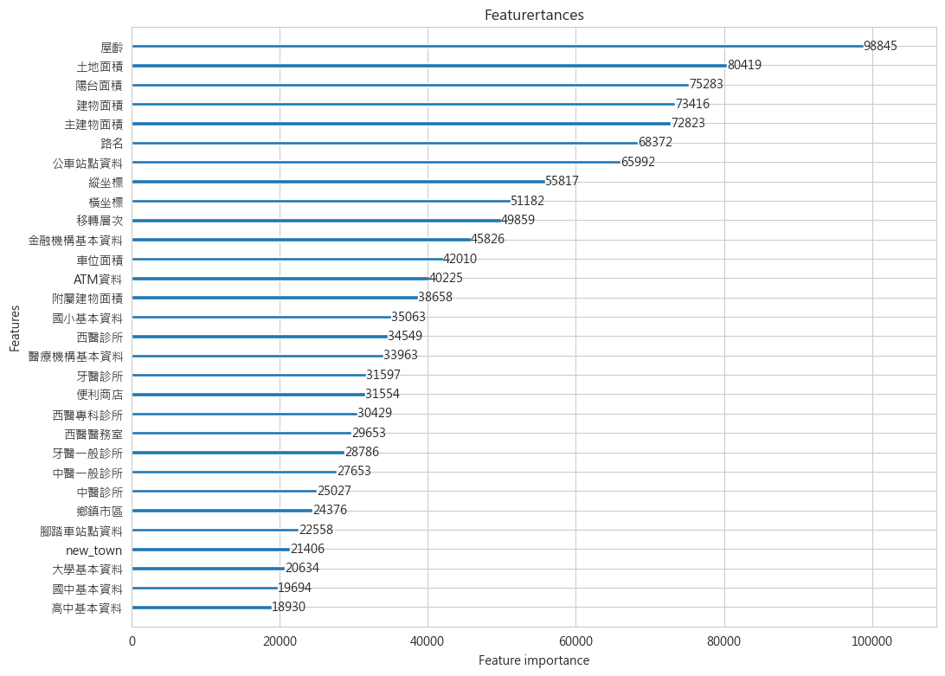

Slide 17
Stacking model sample

Slide 18
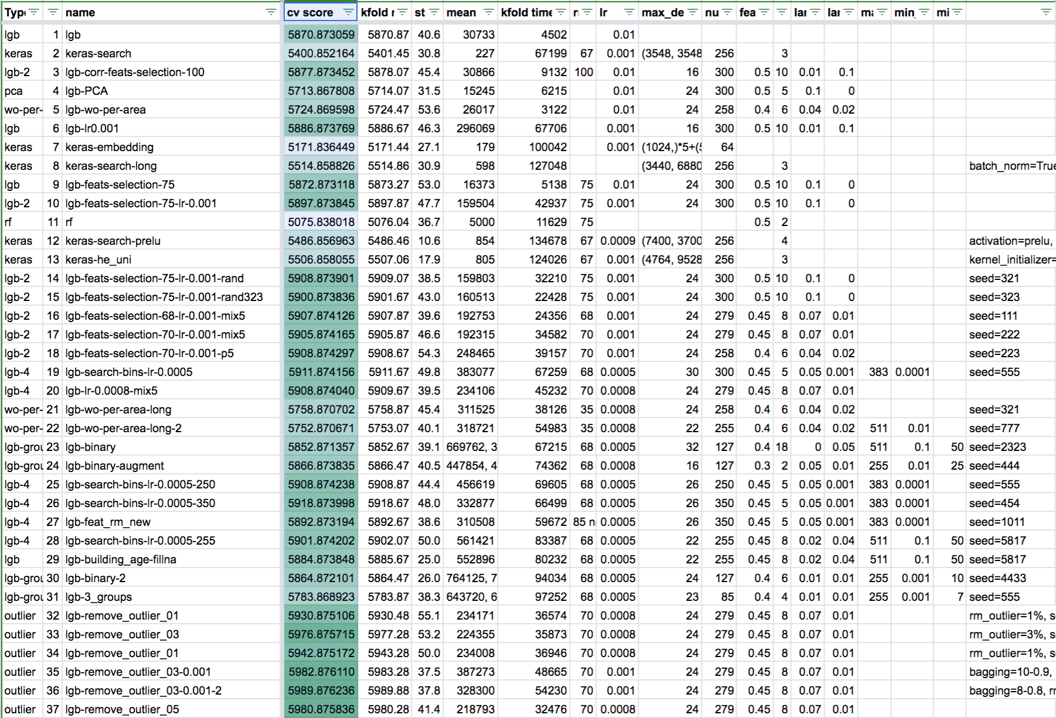

Slide 19
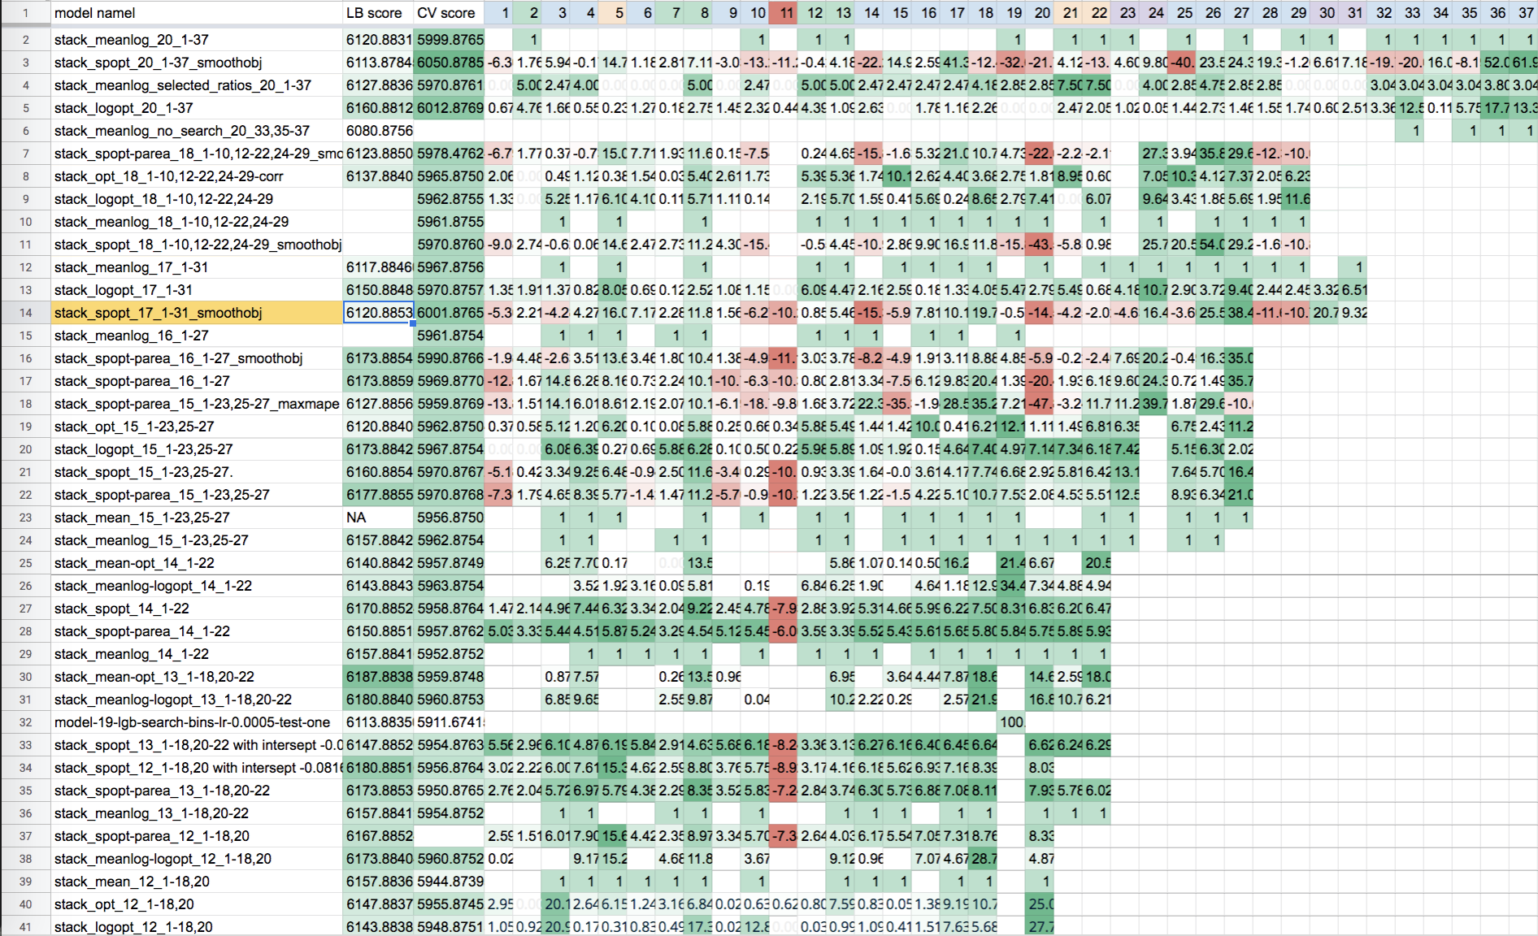

Slide 20
Model

Slide 21
Top1 result :
val : -0.9187111836415967
bagging_fraction 0.74
bagging_freq 12
feature_fraction 0.5
max_bin 500
max_depth -1
min_data_in_leaf 0
min_sum_hessian_in_leaf 2
num_leaves 300
reg_alpha 0.0
reg_lambda 0.03
Top2 result :
val : -0.9185934328077671
bagging_fraction 0.84
bagging_freq 12
feature_fraction 0.5
max_bin 300
max_depth -1
min_data_in_leaf 3
min_sum_hessian_in_leaf 7
num_leaves 300
reg_alpha 0.0
reg_lambda 0.03
Top3 result :
val : -0.9185934328077671
bagging_fraction 0.84
bagging_freq 12
feature_fraction 0.5
max_bin 300
max_depth -1
min_data_in_leaf 3
min_sum_hessian_in_leaf 7
num_leaves 300
reg_alpha 0.0
reg_lambda 0.03
Top4 result :
val : -0.9185934328077671
bagging_fraction 0.84
bagging_freq 12
feature_fraction 0.5
max_bin 300
max_depth -1
min_data_in_leaf 3
min_sum_hessian_in_leaf 7
num_leaves 300
reg_alpha 0.0
reg_lambda 0.03

