Slide 1

ARXIV: 2601.16175
Learning to Discover at Test Time
Yuksekgonul, Koceja, Li, Bianchi, McCaleb, Wang, Kautz, Choi, Zou, Guestrin, Sun
NVIDIA
Stanford
AI2
UW

Slide 2

“What if LLMs could improve themselves on each new problem — discovering solutions no human has found?”
Frozen LLMs are limited by their training data. Repeated sampling generates many candidates but doesn’t learn. TTT-Discover applies reinforcement learning at test time — the model adapts its weights per-problem to find exceptional solutions.

Slide 3

TTT-Discover Pipeline
1
Sample
Generate candidate solutions from current model
2
Evaluate
Score via entropic discovery objective
3
Update
RL fine-tune model weights on this problem
4
Iterate
Repeat with PUCT tree reuse across rounds
Key insight: Model weights are updated per problem — unlike best-of-N which uses a frozen model

Slide 4

Two Key Innovations
Entropic Discovery Objective
Rewards novel solutions with low likelihood under current model
Prevents collapse to familiar patterns
Maximizes information gain through entropy-based scoring
Explores solution space instead of exploiting known answers
PUCT Tree Reuse
Maintains search tree statistics across RL iterations
Value estimates guide future exploration
Avoids recomputing the entire search space
Planning Upper Confidence bounds applied to Trees

Slide 5

II
Experimental Results
Mathematics, GPU Engineering, Algorithms, Biology

Slide 6
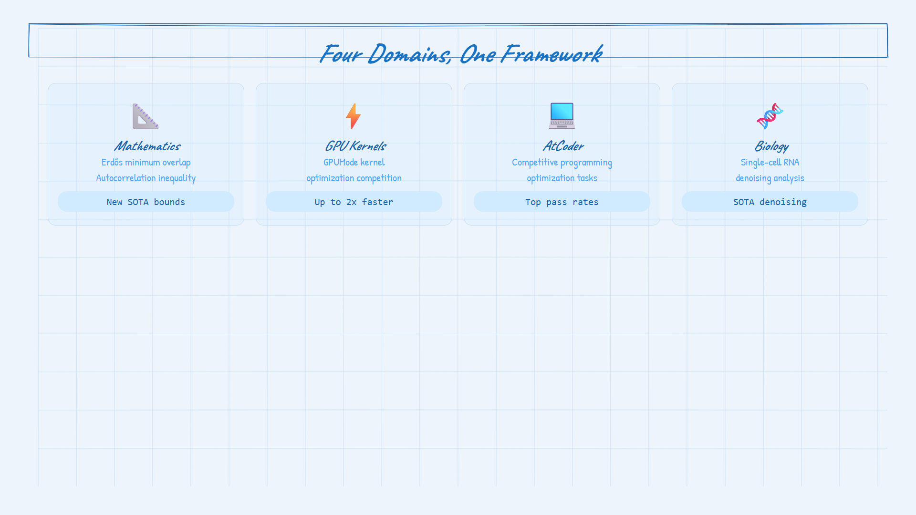

Slide 7

GPU KERNEL OPTIMIZATION
2x
faster than previous best methods
GPUMode competition: TTT-Discover generated GPU kernels that outperformed hand-optimized and LLM-generated baselines by up to 2x

Slide 8

Detailed Results by Domain
Mathematics
Erdős minimum overlap: improved known bounds
Autocorrelation inequality: new solutions discovered
Outperforms repeated sampling by large margin
AtCoder
Competitive programming optimization
Higher pass rates than best-of-N
Model learns from failed attempts
Biology
Single-cell RNA denoising
SOTA on specialized benchmarks
Beats traditional & learning baselines
Model: gpt-o3s-120b (open-source) · Platform: Tinker API (Thinking Machines) · Cost: ~$100s per problem

Slide 9

The best solution to a hard problem is found not by sampling more — but by learning to search better

Slide 10

Thank You
Questions & Discussion
Paper: arxiv.org/abs/2601.16175
Code: github.com/mert-yuksekgonul/ttt-discover

