Slide 1

Learning to (TTT-)Discover at Test Time
Yuksekgonul, Koceja, Li, Bianchi, McCaleb, Wang, Kautz, Choi, Zou, Guestrin, Sun
NVIDIA · Stanford · AI2 · UW
arXiv: 2601.16175

Slide 2
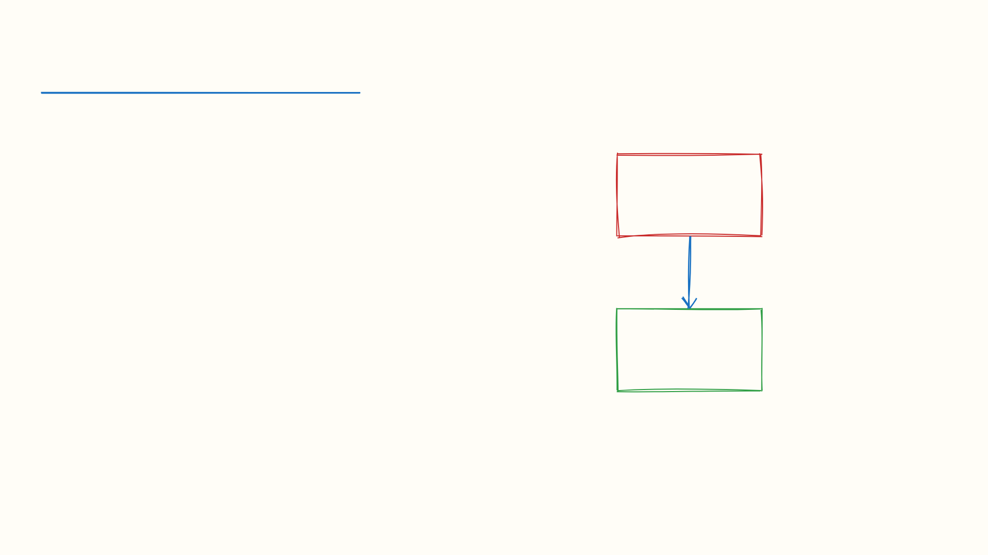
The Problem
🧠
[Insert: Frozen vs Adaptive model diagram]
Frozen LLMs are limited by training data
Repeated sampling generates candidates but doesn't learn
TTT-Discover: RL at test time — model adapts weights per-problem

Slide 3
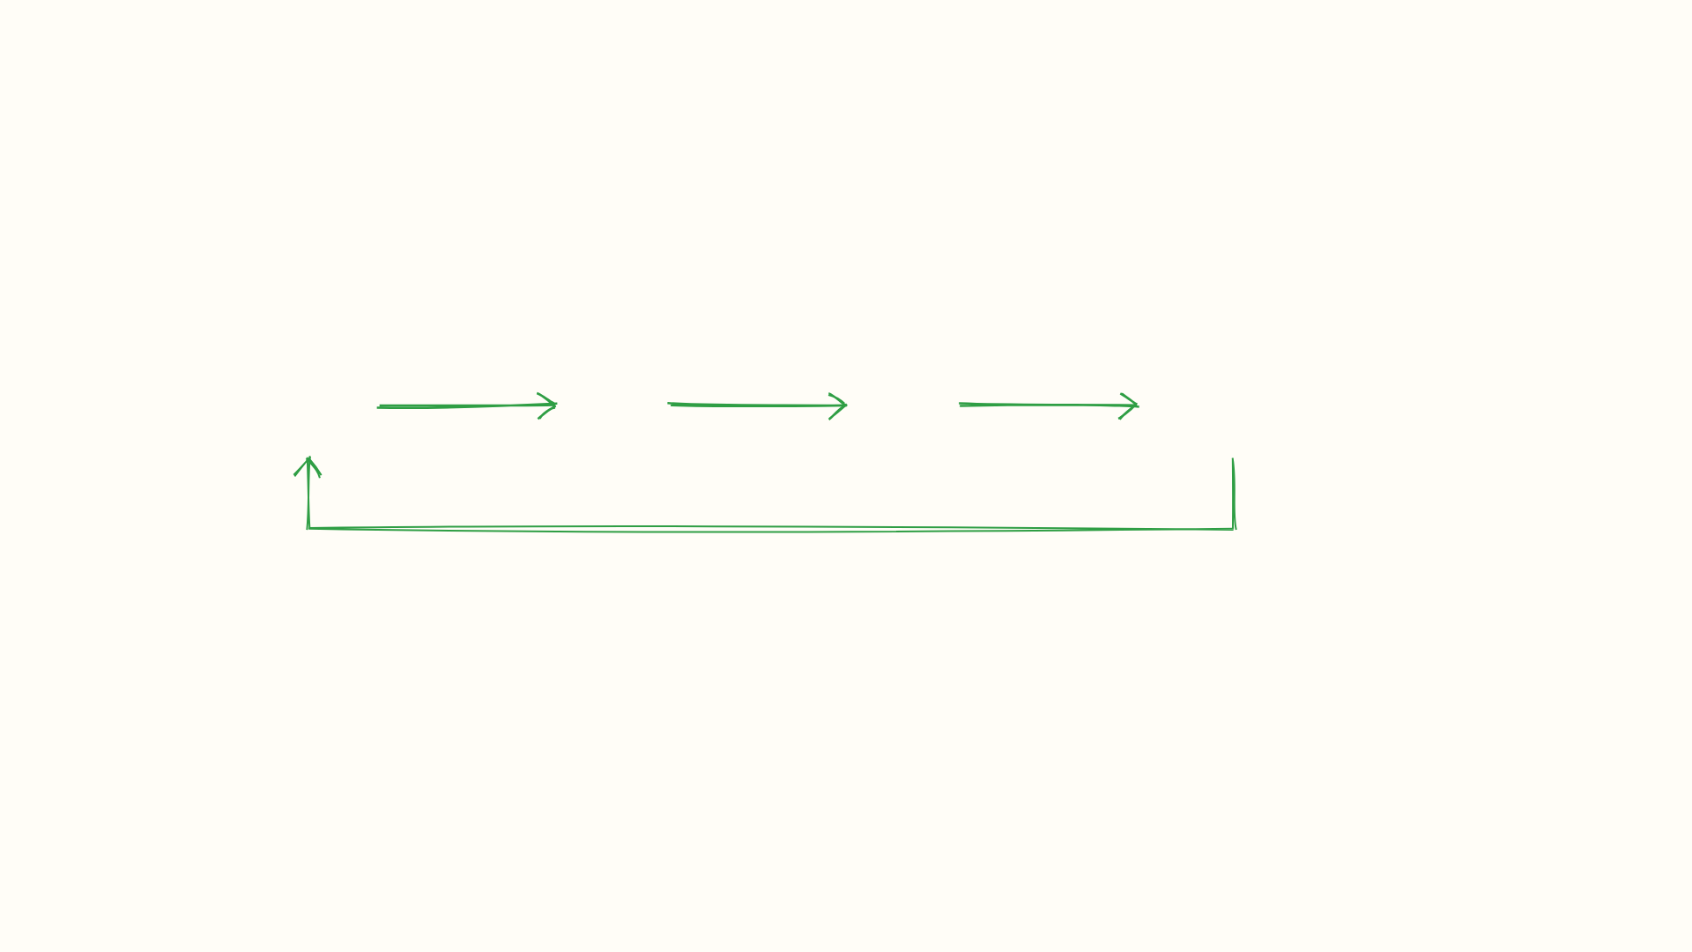
TTT-Discover Pipeline
1. Sample
Generate candidates from current model
2. Evaluate
Score via entropic discovery objective
3. Update
RL fine-tune model weights
4. Iterate
Repeat with PUCT tree reuse
Key: Model weights updated per problem — unlike best-of-N (frozen model)

Slide 4

Two Key Innovations
Entropic Discovery Objective
PUCT Tree Reuse
Rewards novel solutions with low likelihood
Prevents collapse to familiar patterns
Maximizes information gain
Maintains search tree across RL iterations
Value estimates guide future exploration
Avoids recomputing entire search space
vs

Slide 5
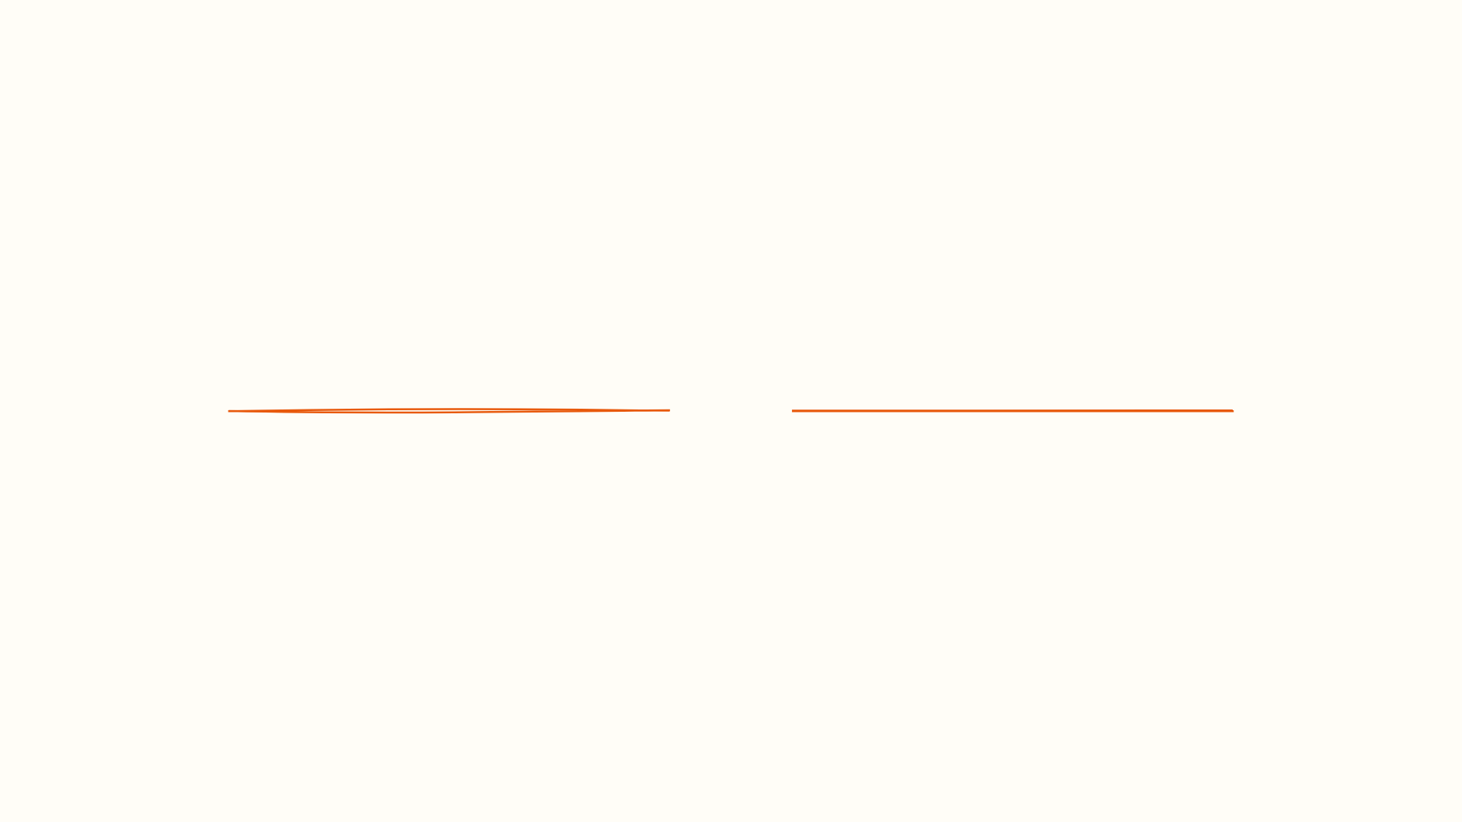
II
Experimental Results
Mathematics, GPU Engineering, Algorithms, Biology

Slide 6

2×
faster than previous best methods
GPU Kernel Optimization
GPUMode competition: outperformed hand-optimized and LLM-generated baselines

Slide 7

Results by Domain
📐 Mathematics
Improved known bounds on Erdős minimum overlap
New autocorrelation solutions discovered
💻 AtCoder
Higher pass rates than best-of-N
Model learns from failed attempts
🧬 Biology
Single-cell RNA denoising
SOTA on specialized benchmarks
Model: gpt-o3s-120b · Platform: Tinker API · Cost: ~$100s per problem

Slide 8
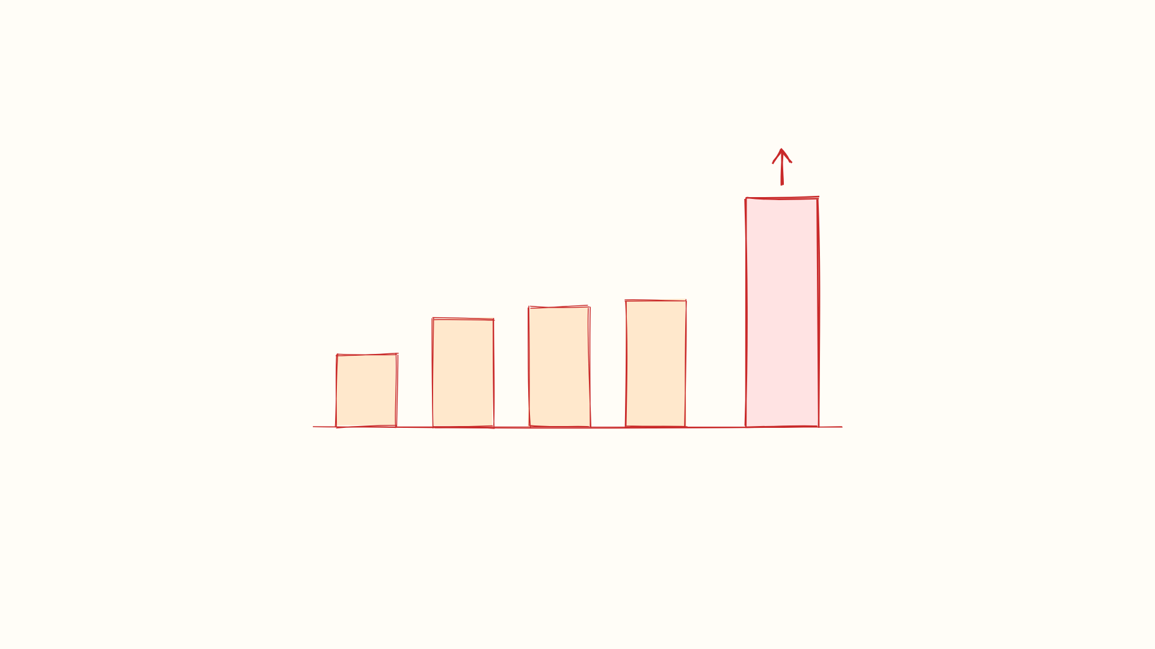
Key Insight
📈
[Rough.js concept: sampling plateau vs TTT-Discover growth]
The best solution is found not by sampling more — but by learning to search better

Slide 9

Thank You!
Questions & Discussion
Paper: arxiv.org/abs/2601.16175
Code: github.com/mert-yuksekgonul/ttt-discover

