Slide 1

AT Attendance Tracker
Education in niger
Group IT-01

Slide 2
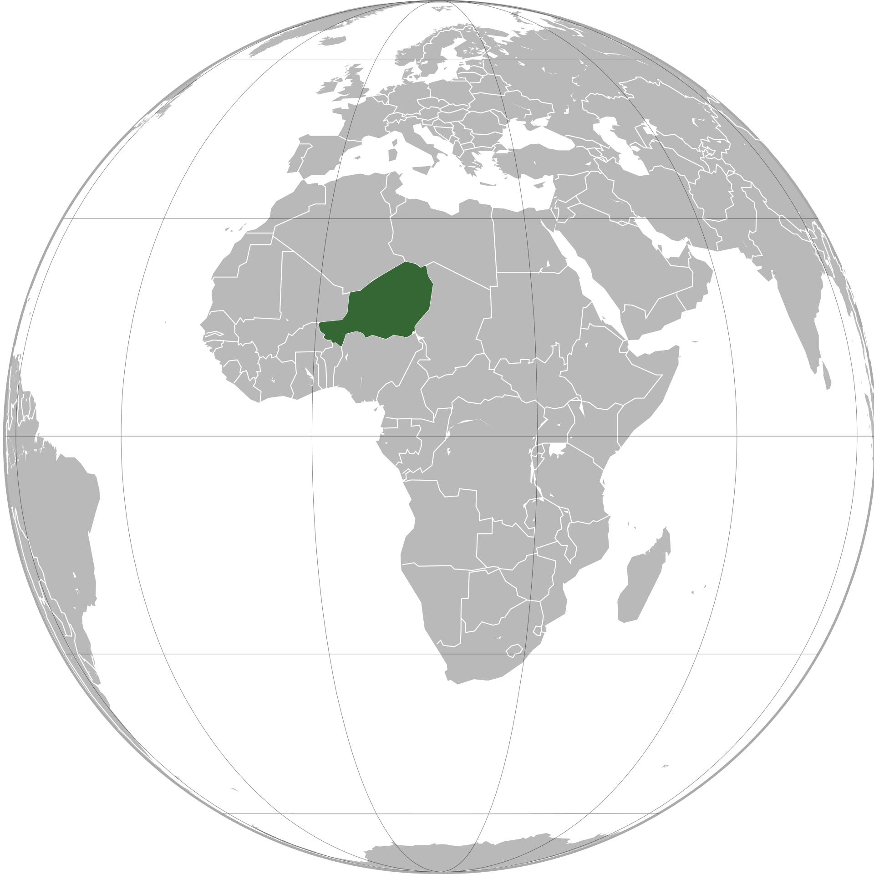
Niger
Population: 24 206 644 (FN, 2020)
Human development index: 186/186
20 % have power
Few areas with access to internet

Slide 3

Education
Illiteracy: 69% (FN 2019)
5 years education average
One of two goes to elementary school
One of tenth goes to middle school
One of fifty goes to high school (borg enproject.org)
Covid – 19 further led to 3.6 million people lose their education (Unicef)

Slide 4
AT – Attendance Tracker
No electricity
No permanent internet connectivity
Solves lack of data tracking
User friendly
Self-sufficient
Enviromental friendly

Slide 5
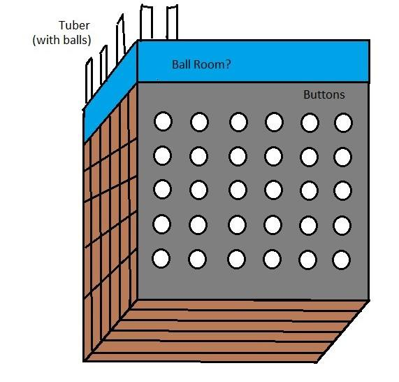
One button per student
Press when entering the class
Ball drops and attendance is registered
Spaces where the balls fall down after the student has pressed their button that day

Slide 6
The Growth of educational infrastructure
International Tracking
National Attendance tracking – optical machine reader
AT machine in class

Slide 7
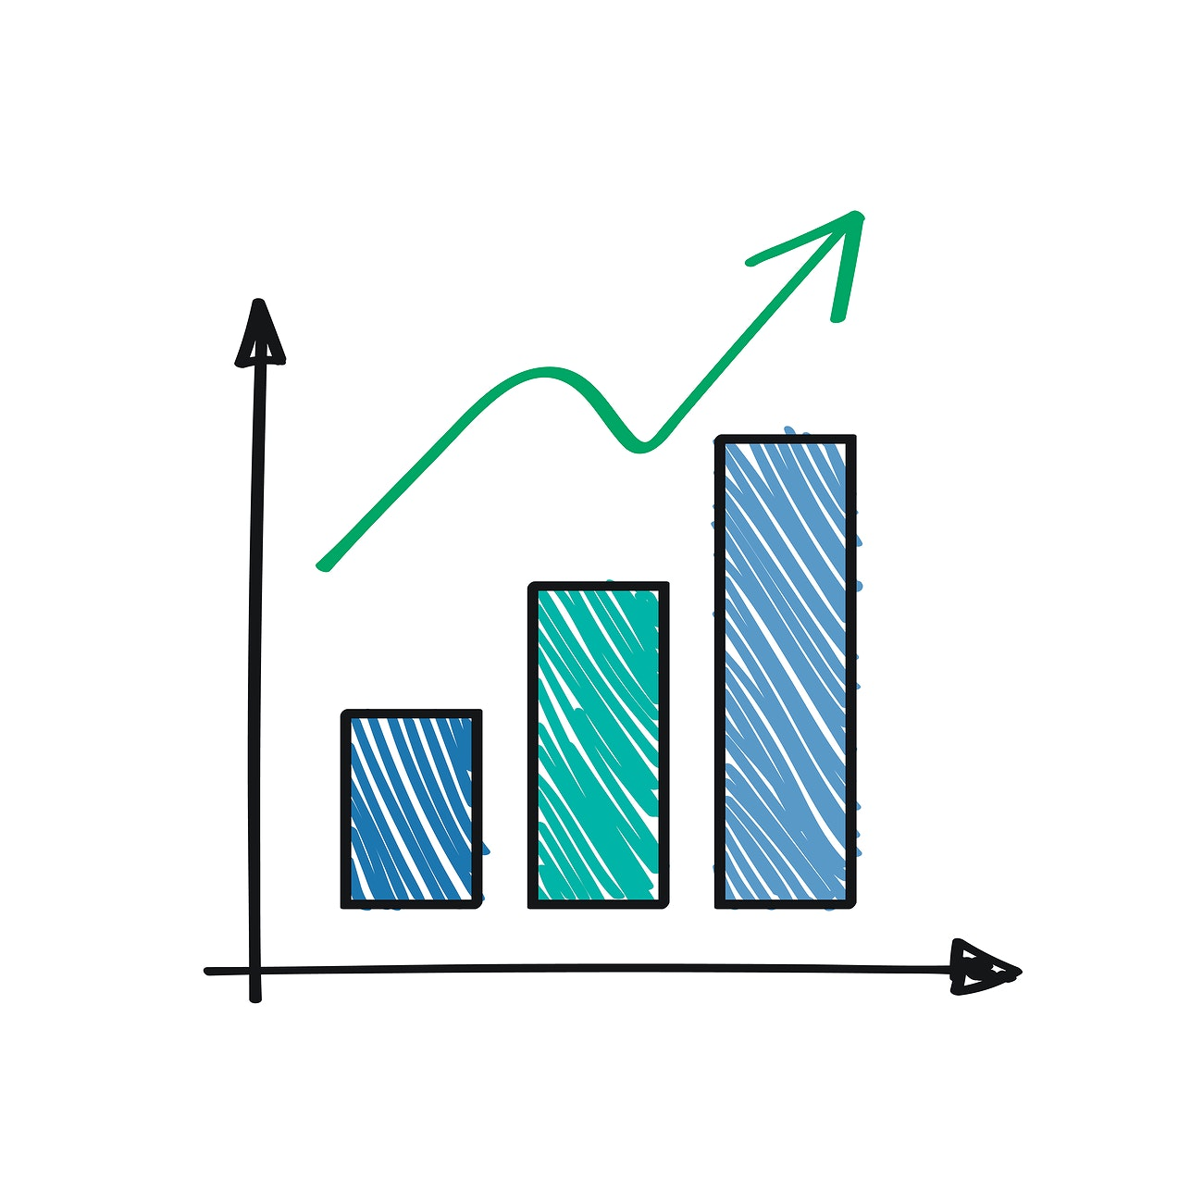
Analysis and Prevention
Pre-register for information
Gender
Age
Socio-economic status
Physical distance
Early marrige
When data is analysed, the causes will be known, and specific action could be taken

Slide 8
Cost – benefit analysis
Scaleable project
Effecient analysis
International engagement and funding (EU, Redd Barna)
Post --> Network
Data collection once per week
Environmentally friendly, Bioplast 45$/0.5kg
Klikk for å legge til tekst

Slide 9
Sources
https://en.wikipedia.org/wiki/Niger#/media/File:Niger_(orthographic_projection).svg
https://www.fn.no/Land/niger
https://www.unicef.org/niger/stories/mitigating-impacts-covid-19-childrens-education
https://borgenproject.org/girls-education-in-niger-requires-serious-improvement/
https://www.graphicmaps.com/niger/languages
https://ppiaf.org/documents/3153/download
https://www.fn.no/Land/niger

