Slide 1


Auto chess gaming using EC
7109064087 王弈壬 Daniel Wang
2021/01/06

Slide 2
Outline
Research motivation
What is auto chess?
How does auto chess GA works?
Experiment : 3 ranks and 9 types of chesses
Experiment : 4 ranks and 12 types of chesses

Slide 3


Research motivation
After spending a lot of time to play
Auto chess……
= what a player do
Choose
chess
= what my project do
Decide the
formation
AI
Sale redundant
chess
Choose equipment
I want to get to the
highest rank:
Queen
Get a Bishop and start to
Conceive the decision making AI

Slide 4








What is auto chess?
The money you have
Every chess has its own profession and race
Find a set of same profession or race chesses
will enhance your chess strength
Collect three identical chesses to make it
“level up”
Chesses on the table that you can buy
Your level
Your chess set
=
+
+

Slide 5
What is auto chess?
The points to win auto chess:
Choose chesses that have same race or profession
Sell the chesses that you don‘t want in your chess set to get money, and invest on the better chess
Make your chess level up by collecting three identical chesses
Every round you will get a new chess table, you can spend two dollars to refresh chess table
Make your strategy flexible when the chesses on the table doesn‘t meet your expectation, in order to survive to the late game when you are unlucky.

Slide 6
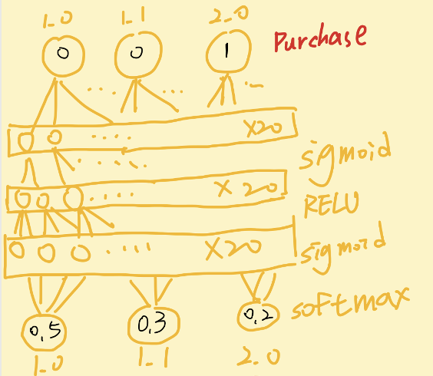
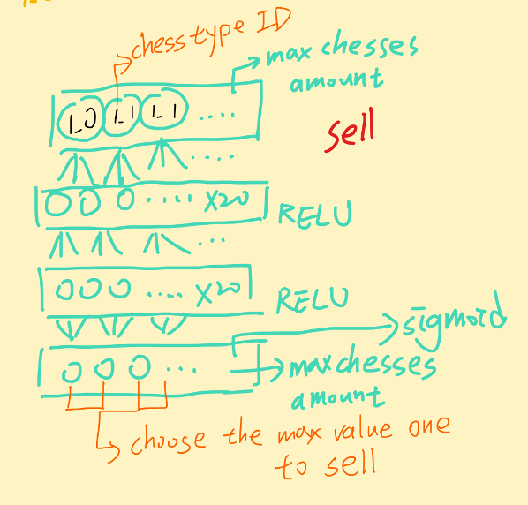
How does auto chess GA works?
Neural networks based GA:
Every individual has two neural networks to represent its gene:

Slide 7
How does auto chess GA works?
The process of GA:
the offspring get conduct Tournament
Crossover and mutation
Offspring play the game for 50 rounds, and calculate the chess set they pick in this game
Population play the game as well
Compare with the original population with the chess set strength
Get the member of next generation

Slide 8
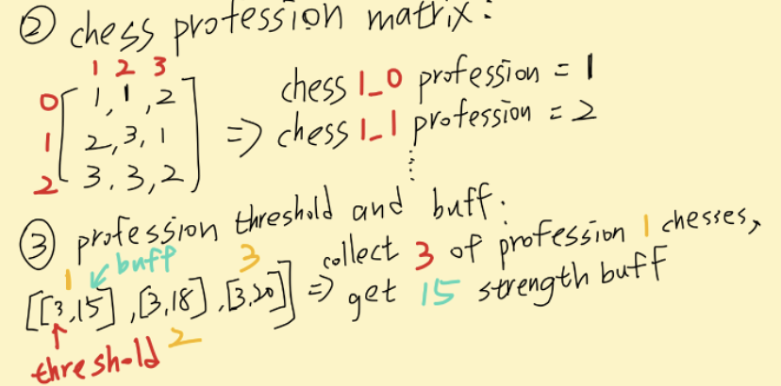
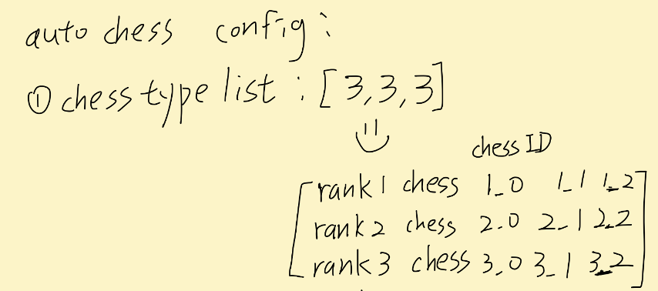

How does auto chess GA works?
Because the individual cannot always be the best, so the ideal individual should have a policy(flexible strategy) which makes it survived to the next generation
The setting of auto chess game:

Slide 9
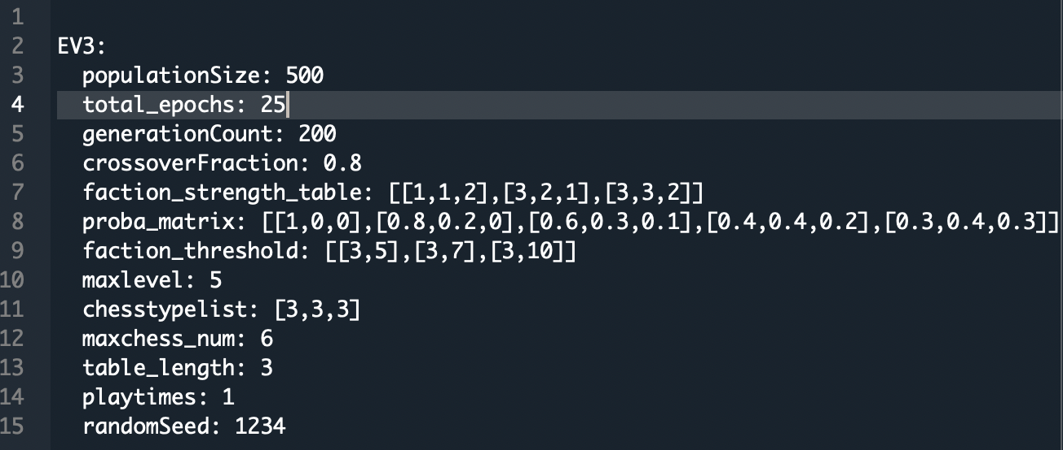
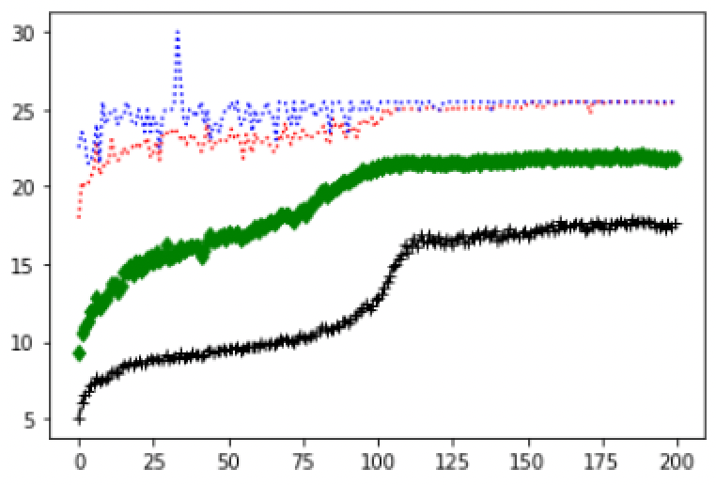
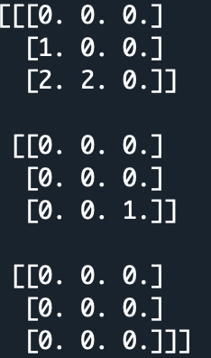
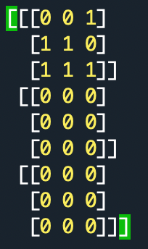
Experiment : 3 ranks and 9 types of chesses
Chess strength
Rank 1 LV1 chess = 1 point
Rank 2 LV1 chess = 1.5
Rank 3 LV1 chess = 2
LV2 = 3* LV1 strength
LV3 = 5* LV1
generations
Set Strength 25.5 = 1.5*1 + 2*4 + 2*3*1 + 10
Blue points = the best strength of all individuals
Red points = the average of top ten strengths of all individuals
Best set = 27
= 1 + 1.5*2 + 2*3 +10+7
Green diamonds = the average of first 25% strengths of all individuals
Black + = the average strength of all individuals

Slide 10
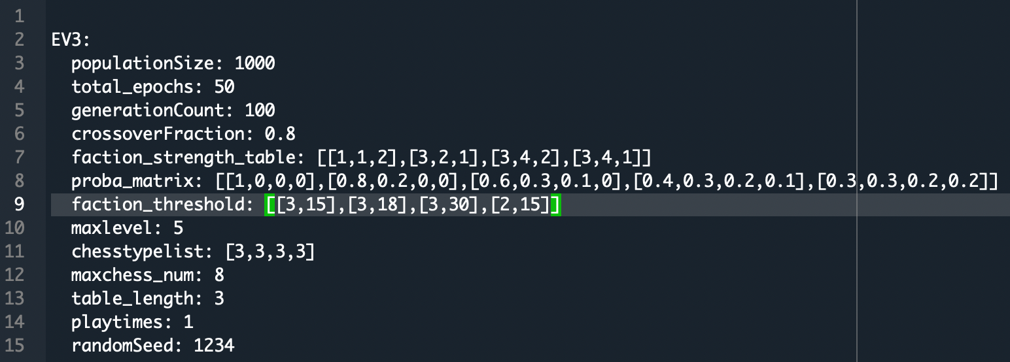
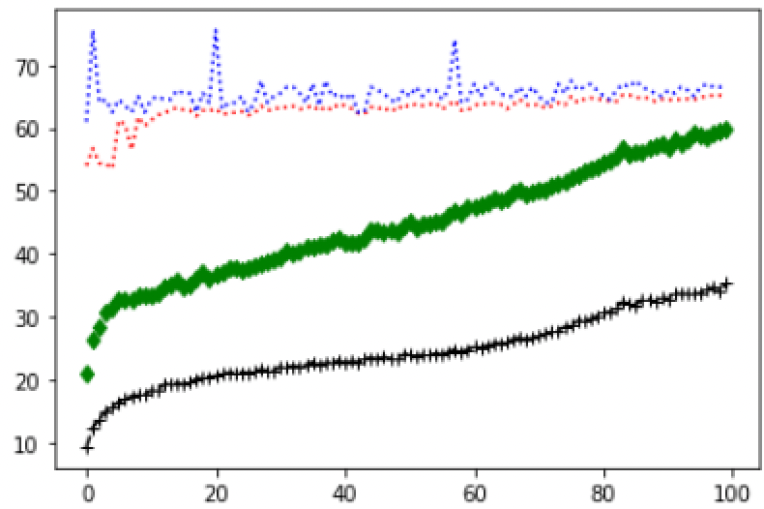
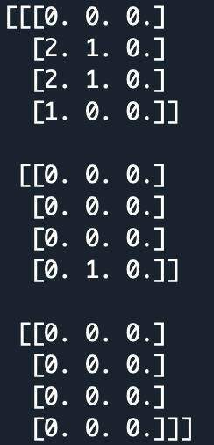
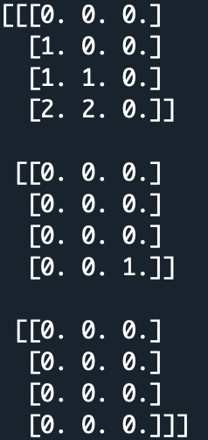
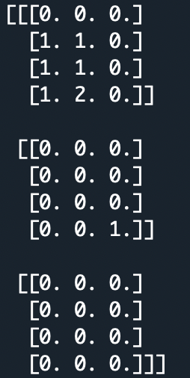
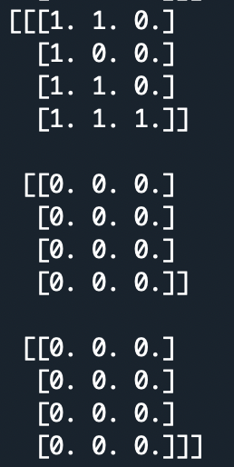
Experiment : 4 ranks and 12 types of chesses
Chess strength
Generations
Strength = 65.5
Strength = 68
Strength = 67
Strength = 75.5
Get profession bonus:
3,4
Get profession bonus:
3,4
Get profession bonus:
3,4
Get profession bonus:
1,3,4

