Slide 1
CSE7301 - INTERNSHIP Review-4 Presentation Design and Management Intern
Student Details
Name | K Md Hizqueel Danish
Roll No | 20211CCS0076
Section | 8-CCS-03
Batch No.
Under the Supervision of,
Dr. Sharmasth Vali Y
Associate Professor, School of Computer Science and Engineering
Presidency University
Name of the Program: Review 4
Name of the HoD: Dr. Anand Raj S P
Name of the Program Project Coordinator: Dr. Sharmasth Vali Y
Name of the School Internship/Project Coordinators: Mr. Md Ziaur Rahman /
Dr. Sampath A K / Dr. Abdul Khadar A

Slide 2
Content
About Company or Organization
Working domain or the technology
About your team and reporting Manager
Challenges Faced in Internship
Objectives of the work
Internship Roadmap
Github Link

Slide 3
About Tecograph Global Pvt Ltd
Tecograph Global Pvt Ltd is a design and development company specializing in UI/UX, branding, and digital solutions. The company not only provides design services but also develops custom applications tailored to client needs.
Industry Presence: Tecograph serves a diverse range of industries, including cosmetics, fashion, and Ayurveda, helping brands enhance their digital presence.
Clients: The company works with multiple brands, offering solutions that range from branding and marketing materials to interactive applications that improve user engagement.
Products & Services: They develop custom applications and design solutions that align with modern UI/UX principles, ensuring a seamless and engaging user experience

Slide 4
Working domain or the technology
Domain: UI/UX Design/ Graphic designing/ Project Management
Tools Using: Adobe Creative Suite, Sketch, Figma, Canva, Illustrator
Key Responsibilities:
Creating design prototypes (UI/UX interfaces, wireframes)
Collaborating with senior designers & developers
Branding & marketing materials (social media, presentations)
Participating in brainstorming and design reviews
Ensuring design consistency across all platforms
Managing Team, deadlines, directly handling clients and their queries
and updating them about the work.

Slide 5
About your team and reporting Manager
Team Size: 5 members
Your Reporting Manager: Naveen Babu
Position: Graphic Design, UI/UX & Project Management
Role: Supervises the design process, provides feedback,
and ensures design consistency. Managing Team and Clients.

Slide 6
Challenges Faced in Internship
While securing the internship was smooth due to a referral, there were still challenges in adapting to the work environment:
Balancing work & academics: Managing internship tasks while keeping up with college studies required effective time management.
Remote work adjustment: Since the internship is Hybrid, ensuring clear communication with the team and staying aligned with expectations took some effort.
Learning professional workflows: Understanding real-world design standards, collaboration processes, and feedback loops was a learning curve.
Ensuring design consistency: Making sure all deliverables matched the company’s branding and design guidelines was crucial.

Slide 7
Faced a little issue in Managing Clients at first. Then picked it up easily.
Managing deadlines.
Ensuring the Team members are doing the work and maintaining consistency
was challenging.

Slide 8
Objectives of the work
Goal: Improve the company’s digital and print branding through UI/UX and
graphic design
How it contributes:
Enhances user experience for digital products
Strengthens brand identity through marketing materials
Helps maintain design consistency across media

Slide 9
Internship Road Map
Note: Write in the below table what u will be achieving in each review
Review 0
Began assisting in basic tasks. Got familiar with design tools. Understood company workflow.
Review 1
Collaborated with the team on branding and marketing materials.
Review 2
Worked on real client projects, improving and creating branding. Applied feedback to refine designs.
Review 3/4
Started Managing Clients and Teams. Shifting towards Project Management(PM). Currently Handling 2 Clients.

Slide 10
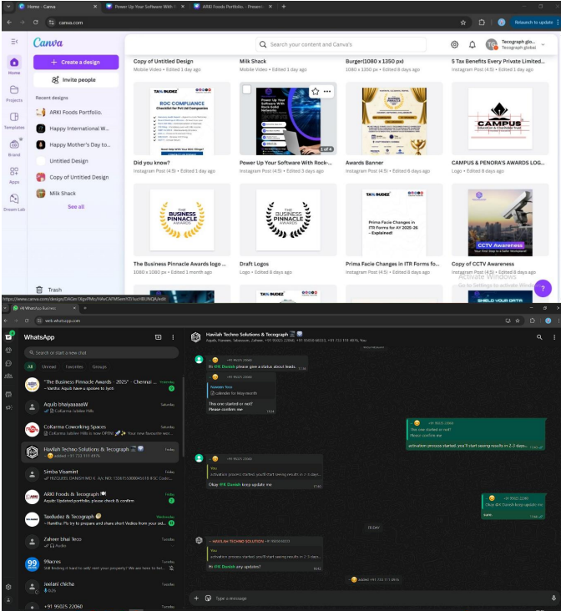
Screenshots

Slide 11
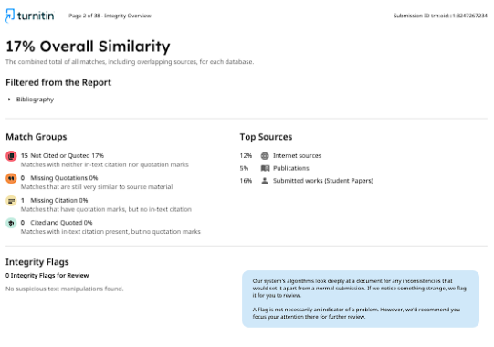
Plagiarism Report:

Slide 12
Github Link
https://github.com/danny3311/PIP4004---INTERNSHIP

Slide 13
Q&A

Slide 14
Thank you !!

