Slide 1




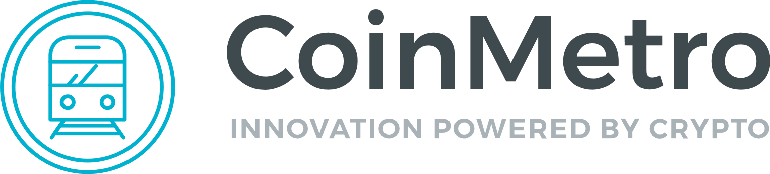


One-stop platform
For the digital asset ecosystem

Slide 2


Existing platforms are failing to meet the needs of users.
Difficult to use, not accessible to the mainstream.
Poor customer service.
Limited support for fiat/crypto.
Lack of investment tools.
Long wait times, high fees, unstable uptime.
Lack of liquidity for growing number of ERC-20 tokens.
Failure to adapt to regulatory changes.

Slide 3




What the news is saying:
The most popular online exchange for trading digital currencies is generating a surge in customer complaints this year even as investors are lured by a dramatic rise in prices.
- Bloomberg, April 30, 2017
Users of the digital exchanges saw slowed performance on the websites, and, in some cases, couldn't log into their accounts.
- Business Insider, Nov. 29 2017
Digital currency exchange operators Coinbase and Bitfinex reported problems with service through their websites on Tuesday, frustrating traders seeking to cash in on the latest surge in the value of bitcoin and other cryptocurrencies.
- Reuters, Dec. 12, 2017

Slide 4


What users are saying:
Missing Deposits (self.bitfinex)
Submitted 13 minutes ago by Jeff254
comment share save hide report crosspost
Neo withdrawal issue > 12 days(self.bitfinex)
Submitted 17 minutes ago by x_Skyline3_x
comment share save hide report crosspost
Almost a month my two BTC Deposit still showing 1/3 Confirmed [No Action Taket Yet] (self.bitfinex)
Submitted 10 hours ago by FunkyBerry
comment share save hide report crosspost
To „approve” button of a withdraw is unclickable for me (self.bitfinex)
Submitted 11 hours ago by manish_bist03
comment share save hide report crosspost
Bitfinex support? (self.bitfinex)
Submitted 1 day ago by BobbyG
comment share save hide report crosspost
I still haven’t received money to withdrew to my bank account (self.CoinBase)
Submitted 3 days ago by BaronVonHumungus
comment share save hide report crosspost
70 DAYS I’M WAITING FOR MY COINS. (self.bitfinex)
Submitted 5 days ago by EricQuartz
comment share save hide report crosspost
[Warning] Fake bitfinex official accounts (self.bitfinex)
Submitted 9 days ago by EmilieStone
comment share save hide report crosspost
You make millions daily and can’t SUPPORT your users… (self.bitfinex)
Submitted 12 days ago by JazzySylvia
comment share save hide report crosspost
Class Action Lawsuit on Coinbase (self.CoinBase)
Submitted 19 days ago by Steve009
comment share save hide report crosspost
How long does it take for Binance SUPPORT to answer the ticket?! (self.bitfinex)
Submitted 20 days ago by George981B
comment share save hide report crosspost
Missing wire deposit (self.CoinBase)
Submitted 21 days ago by N3odoc
comment share save hide report crosspost
Identification Verification Issues (self.CoinBase)
Submitted 23 days ago by web_elf
comment share save hide report crosspost
Verifying withdrawal uk bank account with coinbase (self.CoinBase)
Submitted 25 days ago by jamesddolls
comment share save hide report crosspost
ID verification takes ages (self.CoinBase)
Submitted 27 days ago by Guilh3m
comment share save hide report crosspost
Binance SUPPORT didn’t fix my account (self.CoinBase)
Submitted 27 days ago by Guilh3m
comment share save hide report crosspost

Slide 5

CoinMetro Ecosystem Solution:
One easy-to-use platform that does everything, designed for mainstream adoption.
Exchange
Trading
Investment Platform
ICO Express Framework
Fast, easy, and secure way to buy, sell, and trade crypto.
User-focused trading environment designed to meet the needs of beginners and pro traders.
Innovative investment models. Diversification options with ETCF’s.
Managed accounts with TAM.
Deploy smart contracts and launch custom tokens with a few clicks.

Slide 6

Exchange Platform
Easy, accessible services that users actually want. Real customer support.
Proactive approach to regulations.
Fast & Scalable
Secure
Low transaction fees and profit sharing to makers.
Off-chain transactions and Atomic SWAP like options
Emphasis on regulatory compliance
Fast & Scalable
Secure
Low transaction fees and profit sharing to makers.
Off-chain transactions and Atomic SWAP like options
*Collaboration with FXPIG enables our Token Buyback program, designed to support long term value of COIN and maintain stability on the exchange.

Slide 7
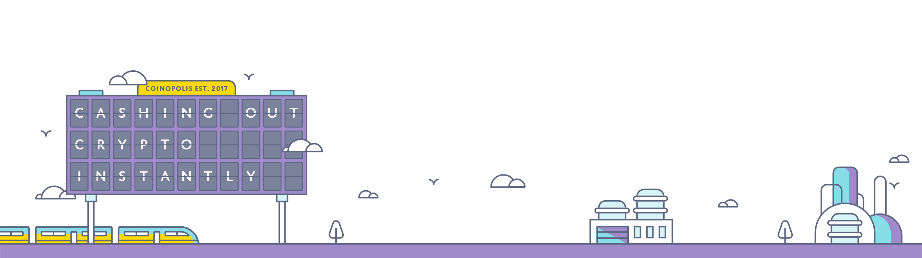
Trading Platform
User-friendly interface; accessible to beginners
Advanced tool set designed for professional traders
Customizable charting & analytics
Up to 1:50 leverage on non-deliverable OTC digital assets
Matching engine supports standard and non-standard order types.
Easy lending options.

Slide 8


Investment Platform
Taking proven trading models from traditional finance and adapting them to the digital asset economy.

Slide 9

TAM - Tokenized Asset Management
Based on a successful managed account model we created at FXPIG, TAM is designed to let anyone partner with a pro trader to grow their portfolio.
Professional asset managers get a unique personal token.
Investors buy these tokens backed by a manager’s trading performance
Managers earn a percentage of their overall gains based on the high-watermark principle, similar to a commission; investors benefit based on the growth of their investment.

Slide 10

ECTFs : Electronically Traded Crypto Funds
Like ETFs, but for crypto.
Diversify into baskets of digital assets curated by our team.
Easily invest in multiple tokens with one click.
Enter into markets like healthcare, IoT, or fintech.
Invest in funds based on risk profile, or factors like social media influencer scores of tokens grouped inside the fund.
ECTF’s bring liquidity to ERC20 tokens.
CoinMetro is partnering with a leading ICO rating site that will provide ratings, like the “big three” do for mutual funds, so that investors
will have an idea of the risk ratings of each product.

Slide 11

ICO Express Framework
A complete turnkey solution for ICO’s
Vetted ICO’s can issue smart contracts & tokens with a few clicks.
Tokens are immediately liquid and tradable on the exchange after a successful ICO.
Possible inclusion in our ETCF Board for added liquidity.
White labelling opportunities for enterprise clients.
Integration with NEM, ETH, and NEO blockchains.
Larger Token Sale Investors get first access to new tokens minted inside the platform.

Slide 12

Platform Comparison Chart
CoinMetro offers many services within one platform.
 | Fiat and Crypto Exchange | Complete Investment Platform | Turnkey ICO Services | Off Chain or `Atomic SWAPs` | ERC20 Liquidity Solutions | Multi-CCY Margin Lending | Tokenized Asset Options
CoinMetro | Yes | Yes | Yes | Yes | Yes | Yes | Yes
Binance | No | No | No | No | No | Limited | No
Bitfinex | Yes | No | No | No | No | Limited | No
Crypto20 | No | Limited | No | No | No | No | Yes
Trade.io | Yes | No | No | No | No | No | No

Slide 13
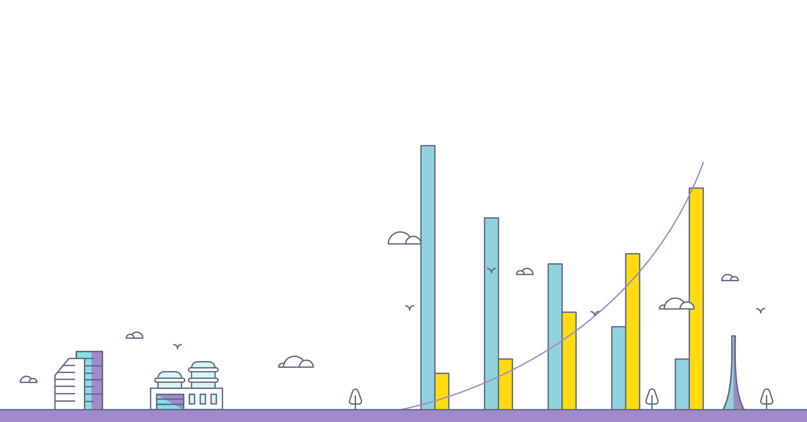
Revenue model
All platform fees are charged in the base currency of the underlying operation but converted, on our exchange, and paid to us in our COIN (XCM) token, thus increasing demand for the token as platform usage accelerates:
Default per operation revenue of 0.1%.This is on all exchange operations, all TAM token purchases or sale, on all ETCF purchases or sales, on all ICO Express token purchases, etc.

Slide 14

Milestones
CoinMetro Roadmap
Feb 2018
Token Sale starts
April 2018
Expanded licensing & COIN tradable on CoinMetro Exchange
July 2018
CM debit card launch & Full PSP services
October 2018
ETCF launch
Jan Feb Mar Apr May Jun Jul Aug Sep Oct Nov Dec
March 2018
Exchange Launch (beta)
July 2018
ICO Express launch
October 2018
TAM Platform launch

Slide 15



CoinMetro
Binance
In-house token (XCM) for discounted fees and other services
Token Buyback Program
Burns percentage of tokens
Supports crypto & fiat deposits/withdrawals
Supports wide variety of standard and non-standard order types
Lending options
Offers leverage
Diversification options with ETCF’s (like ETF’s for crypto)
Managed accounts with TAM
Highly customizable charting tools with drag-and-drop functionality and robust analytics
Complete Turnkey ICO Express framework
In-house token (BNB) for discounted fees over 4 year period
Token Buyback Program
Burns percentage of tokens
Only supports crypto deposits/withdrawals
Supports some standard order types
No Lending options
No leverage
No ETF-like options
No managed accounts
Offers some analytic charting tools, not easily customizable
Lab offering some pre-ICO tools
Launchpad offering some ICO tools

Slide 16


Our stance is that regulation is not only inevitable it is welcomed and needed for the industry to achieve mass adoption.
CoinMetro will be progressive when it comes to regulation. Looking to acquire Crypto specific licenses and licenses where we feel regulators will package crypto in the near future, speculating that the same thing that happened in the FX markets in the early 2000's will happen in the Crypto Space.
Hong Kong
The base of our token sale and future Asia hub for the CoinMetro Group of Companies.
Georgia - Tbilisi
Awaiting approval of an eMoney registration with the National Bank of Georgia. No tax in GE on reinvested profits.
Estonia - Tallinn
The EU arm and base for the exchange. Currently awaiting approval on an Alternative Payment License as well as a Fiat to Crypto Exchange license. Our gateway to EU bank relationships.

Slide 17

Why now?
Interest in crypto is at an all time high.
Current exchange platforms lack support for a growing user base.
CoinMetro is the way forward.

