Slide 1

Operating Systems (INFR10079) 2023/2024 Semester 2
Virtual Memory
(Replacement Algorithms and More)
abarbala@inf.ed.ac.uk
Chapter 10

Slide 2
Page Replacement Algorithm
What page to evict?
Reduce page-fault rate by selecting best victim page
Reduce page-fault overhead
Best victim page is the one that will never be touched again
Not needed in the near future
Belady’s Theorem
Evicting the page that won’t be used for the longest period of time minimizes page fault rate
Evict unmodified pages first
No need to write them back to disk
Examine page replacement algorithms
Assume that a process pages against itself
Using a fixed number of page frames
Notes:
Do from here!

Slide 3
String of Memory References
Ordered list of pages the program will reference
Example 1, 2, 3, 4, 1, 2, 5, …
MOV R0, 0x0123
MOV R1, 0x1234
MOV R2, 0x2345
MOV R3, 0x3456
MOV 0x0100, R0
MOV 0x1200, R1
MOV R4, 0x4567
0x0000
1
0x1000
2
0x2000
3
0x3000
4
0x4000
5
0x5000
Notes:
How a problem of page replacement is posed?

Slide 4
First-In-First-Out (FIFO) Algorithm
Replace page that has been inserted first and is still in
3 physical page frames, 5 virtual pages
Reference string: 0, 1, 2, 3, 0, 1, 4, 0, 1, 2, 3, 4
Easy to implement
Maintain a linked list of all pages in the order they come into memory
Tail of list
0 | 1 | 2 | 3 | 0 | 1 | 4 | 0 | 1 | 2 | 3 | 4
0
1
0
2
1
0
3
2
1
0
3
2
1
0
3
4
1
0
4
1
0
4
1
0
2
4
1
3
2
4
3
2
4
3 frames
P | P | P | P | P | P | P |  |  | P | P
Beginning
of list
9 page faults!

Slide 5
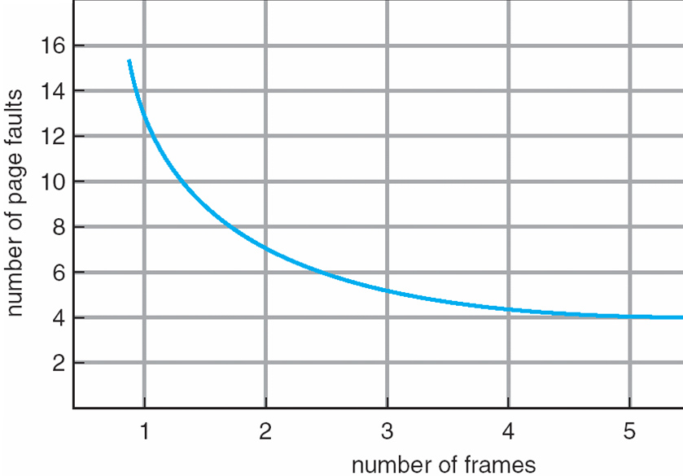
Belady’s Anomaly
Expected Behavior
(more page frames less page faults)
FIFO Behavior
(more page frames do not
guarantee less page faults)
Notes:
In general more frames less page faults, left graph, but in the reality for certain algorithms that is not true, see right of the slides ….

Slide 6
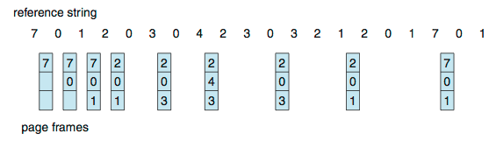
Optimal Algorithm
Replace page that will not be used for longest period
Lowest page-fault rate
Never suffer from Belady’s anomaly
3 physical page frames, 8 virtual pages
Reference string: 7,0,1,2,0,3,0,4,2,3,0,3,0,3,2,1,2,0,1,7,0,1
How do you know what page will not be used?
Can’t read the future
Used for measuring how well your algorithm performs
9 page faults
Notes:
the algorithm that has the lowest page-fault rate of all algorithms and will never suffer from Belady’s anomaly.

Slide 7
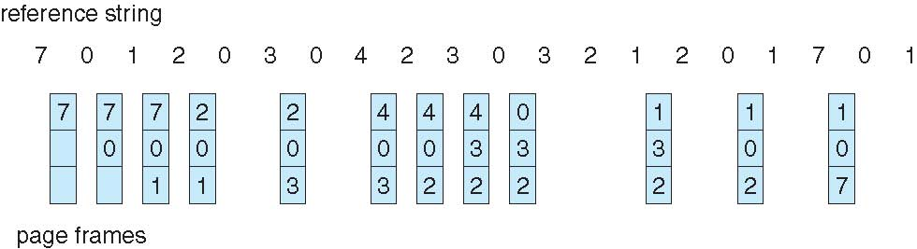
Least Recently Used (LRU) Algorithm
Replace page that has not been used in the most amount of time
Use past knowledge rather than future
Never suffer from Belady’s anomaly (stack algorithm)
3 physical page frames, 8 virtual pages
Reference string: 7,0,1,2,0,3,0,4,2,3,0,3,0,3,2,1,2,0,1,7,0,1
Generally good algorithm and frequently used
How to implement?
Associate time of last use with each page
Requires substantial hardware assistance
12 page faults
Notes:
• Counters. In the simplest case, we associate with each page-table entry a
time-of-use field and add to the CPU a logical clock or counter. The clock is
incremented for every memory reference.Whenever a reference to a page
is made, the contents of the clock register are copied to the time-of-use
field in the page-table entry for that page. In this way, we always have
the “time” of the last reference to each page. We replace the page with the
smallest time value. This scheme requires a search of the page table to find
the LRU page and a write to memory (to the time-of-use field in the page
table) for each memory access. The times must also be maintained when
page tables are changed (due to CPU scheduling). Overflow of the clock
must be considered.
• Stack. Another approach to implementing LRU replacement is to keep a
stack of page numbers.Whenever a page is referenced, it is removed from
the stack and put on the top. In this way, the most recently used page is
always at the top of the stack, and the least recently used page is always
at the bottom (Figure 10.16). Because entries must be removed from the
middle of the stack, it is best to implement this approach by using a doubly
linked list with a head pointer and a tail pointer. Removing a page and
putting it on the top of the stack then requires changing six pointers at
worst. Each update is a little more expensive, but there is no search for
a replacement; the tail pointer points to the bottom of the stack, which is
the LRU page. This approach is particularly appropriate for software or
microcode implementations of LRU replacement.
Note that neither implementation of LRU would be conceivable without
hardware assistance beyond the standard TLB registers. The updating of the
clock fields or stack must be done for every memory reference. If we were
to use an interrupt for every reference to allow software to update such data
structures, it would slow every memory reference by a factor of at least ten,
hence slowing every process by a factor of ten. Few systems could tolerate that
level of overhead for memory management.

Slide 8
Approximating LRU
Use page table entry bits, maintained by hardware
Page referenced (if accessed or not)
Page modified (if access was in write)
Keep a history/counter for each page, in software
History-based page replacement algorithms
Recording the reference bits at regular intervals
keep history bits in a table in memory
Aging
Second-chance (clock)
Enhanced second-chance
Counting-based page replacement algorithms
Keep a counter of the number of references that have been made
Least frequently used (LFU)
the page with the smallest count be replaced
Most frequently used (MFU)
the page with the highest count be replaced

Slide 9
Second Chance
FIFO variant
Adds the concept of usage (references)
Examine pages in FIFO order starting from beginning of list
Consider “reference bit”, R=0 has not been referenced
IF R=0, remove page, go to c)
IF R=1, set R=0 and place it at the end of FIFO list (hence, the second chance), go to a)
Add new page at the end of FIFO (with R=1)
If not enough replaces, revert to pure FIFO on second pass

Slide 10
Second Chance: Example
We would like to insert I
R=1
R=0
…
R=0
…
R=0
I
R=0

Slide 11
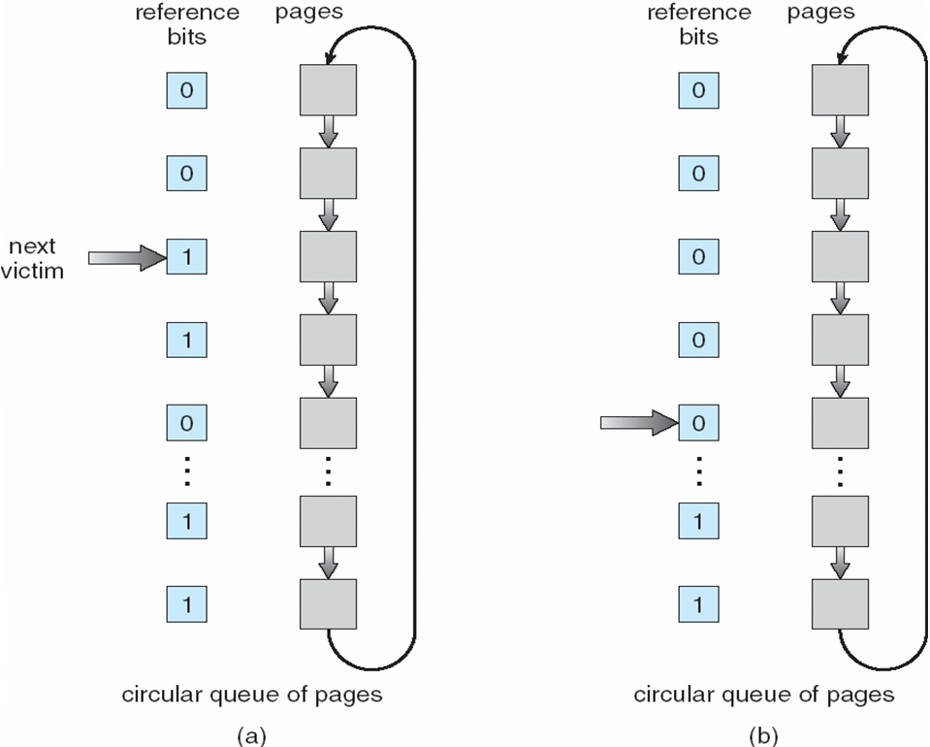
Second Chance Clock

Slide 12
Second Chance Clock: Example
“Use” = “Reference”

