Slide 1
Parking Lots Real-time Information
R05942103 王以彥
R05942080 鄭理文

Slide 2
Outline
Final project proposal
System architecture
Mongo-spark connector
Demo

Slide 3
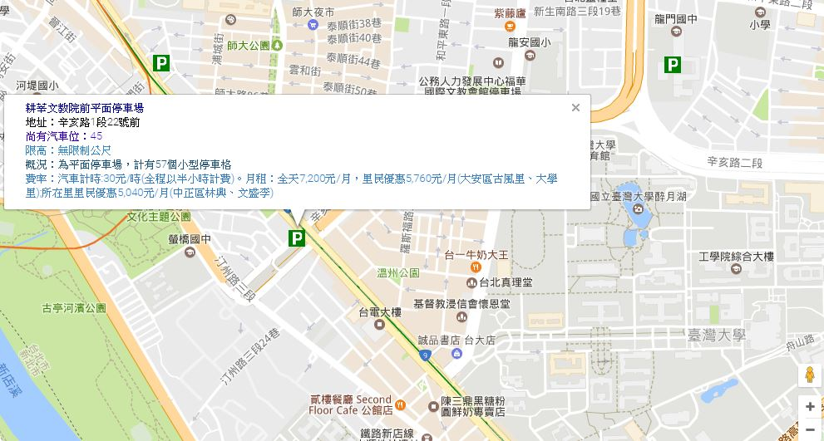
Proposal
Using real-time parking lots information and combine with google map

Slide 4




System Architecture
Open
Data
web application
and mobile app

Slide 5
Open Data Resource
Real-time information : http://data.gov.tw/node/26701
Parking lots location information : http://data.gov.tw/node/26653
Using python requests to get information
Using linux crontab to update information every 3~5 minutes

Slide 6
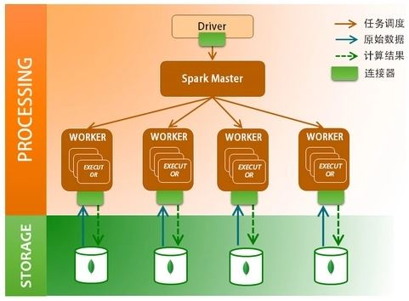
Mongo-Spark Connector

Slide 7
Mongo-Spark Connector
Official mongo-spark connector :
https://docs.mongodb.com/spark-connector/master/
Stratio spark-mongo connector :
https://github.com/Stratio/Spark-MongoDB
Support for Scala、Java、R、Python
Provides integration between MongoDB and Apache Spark
In this project, we use python version

Slide 8
Mongo-Spark Connector
What can Mongo-Spark connector do
Support both read and write between from Spark to MongoDB
Support condition push
search condition in Spark will be pushed to MongoDB, and execute in MongoDB server
Support building Spark and MongoDB on each worker node

Slide 9
MongoDB server address
spark.mongodb.input.uri : MongoDB server address to read data
--conf "spark.mongodb.input.uri=mongodb://127.0.0.1/test.myCollection?readPreference=primaryPreferred“
spark.mongodb.output.uri : MongoDB server address to write data
--conf "spark.mongodb.output.uri=mongodb://127.0.0.1/test.myCollection"

Slide 10
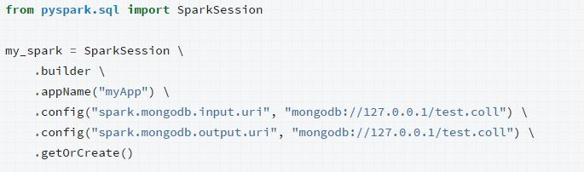
PySpark SparkSession
Can also set configuration options in pyspark SparkSession
Use SparkSession object to write/read data to MongoDB, create DataFrames, and perform SQL operations

Slide 11
Write/Read Data to MongoDB
Write
people.write.format("com.mongodb.spark.sql.DefaultSource").mode("append"). save()
Mode : append 、 overwrite
Read
df = spark.read.format("com.mongodb.spark.sql.DefaultSource").load()

Slide 12

Aggregation Pipeline
Apply filtering rules and perform aggregation operations when reading data from MongoDB into Spark
pipeline = "{'$match': {'type': 'apple'}}"
df=spark.read.format("com.mongodb.spark.sql.DefaultSource").option("pipeline", pipeline).load()
df.show()

Slide 13
Filtering
Filtering with python dataframe function
df = spark.read.format("com.mongodb.spark.sql.DefaultSource").load()
df.filter(df['qty'] >= 10).show()
When using filters with DataFrames, the underlying Mongo Connector code constructs an aggregation pipeline to filter the data in MongoDB before sending it to Spark.

Slide 14
SQL
Using SQL command to filter data
df.createOrReplaceTempView("temp")
some_fruit = spark.sql("SELECT type, qty FROM temp WHERE type LIKE '%e%'")
some_fruit.show()

Slide 15
DEMO

