Slide 1
Emission of CO2 in Rwanda

Slide 2
Introduction
Climate change is a global crisis, and accurate carbon emissions monitoring is essential for effective mitigation strategies. While many regions have sophisticated monitoring systems, Africa often lacks such infrastructure. This notebook aims to address this gap by performing deep data analysis on carbon emissions using satellite data.

Slide 3
Objective
The goal of this notebook is to clean and analyse the dataset to find deep and unusual patterns in the dataset.
The ability to accurately monitor carbon emissions is a critical step in the fight against climate change. Precise carbon readings allow researchers and governments to understand the sources and patterns of carbon mass output. While Europe and North America have extensive systems in place to monitor carbon emissions on the ground, there are few available in Africa.

Slide 4
Data description
Each data point, in the dataset is characterized by four location-based indices (latitude, longitude, year, and week number), 70 descriptive features, and a target variable representing emissions.
Feature Groups
The 70 features are organized into eight distinct groups, each with a varying number of elements.
Sulfur Dioxide
Carbon Monoxide
Nitrogen Dioxide
Formaldehyde
UV Aerosol Index
Ozone
Cloud
UvAerosolLayerHeight

Slide 5
Data preprocessing
Data dropping:
The UvAerosolLayerHeigh features contains so many missing values, usually over 90%, so they were dropped off.
Feature engineering:
Three features were derived from the combination of the original dataset.

Slide 6
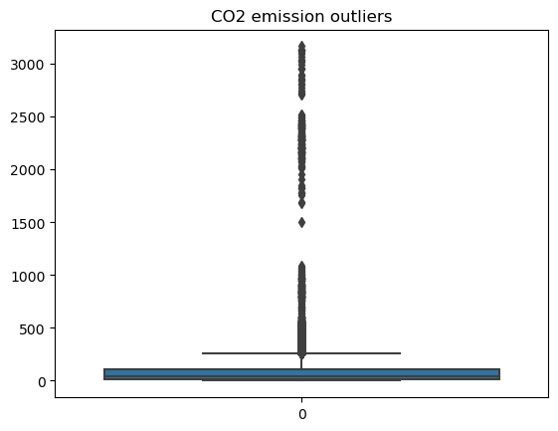
Emission
Sudden spikes in emissions data could be due to unusual events, which cause a lot of outliers in the emission data.

Slide 7
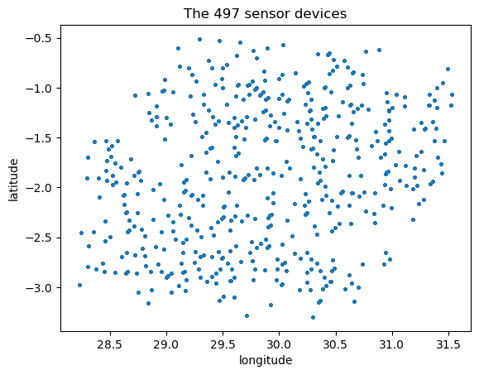
There are 497 locations in the dataset.

Slide 8
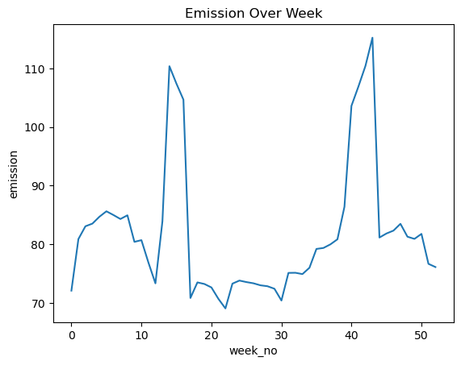
Emission over the 52 weeks.

Slide 9
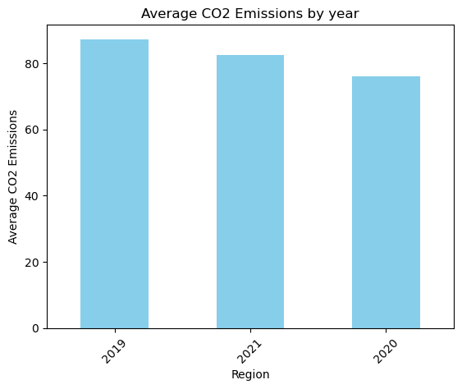
Average CO2 emission by year

Slide 10
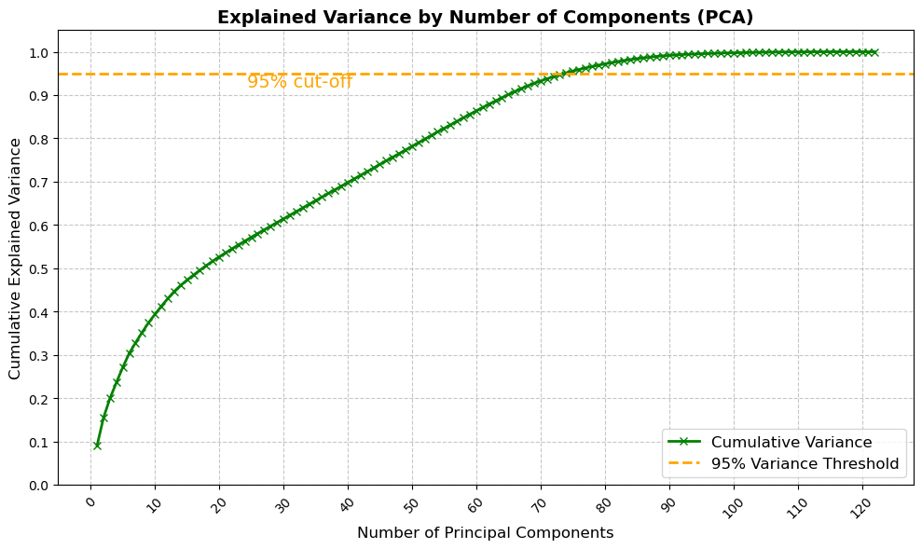
PCA
The curve shows that the first few principal components capture a significant amount of the variance in the dataset. For example, the first 40–50 components account for roughly 70-80% of the variance. This indicates that most of the important patterns and variability in the data are captured by these early components.

