Slide 1


UNIT B · COURSE SETUP
Build your
creative-coding
environment
+
Your first 45 minutes: install, connect, compile, run.
BlueJ 6.0.0 · Processing 4.5.6
Validated 25 August 2026
Notes:
TIME: 00:00–00:01
SAY
• Welcome. Today we are turning this computer into the creative-coding studio we will use throughout Unit B.
• No prior BlueJ or Processing experience is expected. Follow one screen at a time and stop whenever your screen differs from mine.
DO
• Ask students to place their laptop on charge and close unrelated applications.
[Sources]
- https://bluej.org/
- https://processing.org/download/
[/Sources]

Slide 2
UNIT B · COURSE SETUP
START
Today ends with a working sketch
By the end of class, you will…
1
Install
FINISH LINE
BlueJ and Processing open correctly.
edit → compile → run → observe
2
Connect
If an installation is blocked, raise your hand immediately. Waiting silently costs the class time.
BlueJ reports the Processing library as Loaded.
3
Prove it
An orange circle follows your mouse—and becomes larger when you edit one number.
2
Notes:
TIME: 00:01–00:02
SAY
• The finish line is not ‘the software installed.’ The finish line is a visible program that you successfully change.
• We will use three class checkpoints: BlueJ opens, the library says Loaded, and the sketch runs.
DO
• Tell students how to signal for help in your room.

Slide 3
UNIT B · COURSE SETUP
CHECK
First, identify your computer
Windows
macOS
Press Windows + I
Open System → About
Find System type
Expected: 64-bit operating system
Open the Apple menu
Choose About This Mac
Find Chip or Processor
Record: Apple silicon or Intel
Windows 11 is already 64-bit.
Chip = Apple silicon · Processor = Intel
CHECKPOINT
Tell your teacher your OS and processor type.
3
Notes:
TIME: 00:02–00:05
SAY
• We check the machine first because the wrong installer may refuse to open or run poorly.
• Windows students need the 64-bit installer. Mac students must distinguish Apple silicon from Intel.
DO
• Pause until every student can name their route. Pair students by operating system for peer support.
CHECK
• Windows: look for ‘64-bit operating system’ and usually ‘x64-based processor.’
• Mac: ‘Chip’ means Apple silicon; ‘Processor’ means Intel.
[Sources]
- https://support.microsoft.com/en-US/Windows/Experience/Compatibility/32-bit-and-64-bit-windows-frequently-asked-questions
- https://support.apple.com/en-us/116943
[/Sources]

Slide 4
UNIT B · COURSE SETUP
INSTALL
Download the BlueJ installer that matches
01
Open
Windows
macOS
bluej.org
Choose Windows
64-bit installer
Choose Apple silicon
or Intel
Download target
BlueJ 6.0.0
The installer already includes the JDK.
Do not install a separate Java package.
4
Notes:
TIME: 00:05–00:07
SAY
• Use the official BlueJ site. BlueJ 6.0.0 includes the Java Development Kit, so a separate Java download is unnecessary.
• Mac students: the architecture choice must match the result from the previous slide.
DO
• Circulate and check the file name/architecture before students run the installer.
[Sources]
- https://bluej.org/
- https://bluej.org/versions.html
[/Sources]

Slide 5
UNIT B · COURSE SETUP
INSTALL
Install BlueJ, then open it
Windows
macOS
1
Open Downloads
1
Open the download
Double-click the BlueJ MSI installer.
Unzip the BlueJ application.
2
Accept the defaults
2
Move to Applications
Keep the suggested installation location.
Drag BlueJ into Applications, then open it.
3
Launch BlueJ
3
If macOS blocks it
Use Start and search for BlueJ.
Use System Settings → Privacy & Security → Open Anyway, only for the official download.
5
Notes:
TIME: 00:07–00:13
SAY
• Install now. Keep this slide visible while students work.
DO
• Use the time to identify machines without administrator permission; move those students to the school-approved recovery route.
IF STUDENTS ARE STUCK
• Windows SmartScreen: confirm the file came from bluej.org before proceeding.
• macOS warning: do not disable Gatekeeper globally. Use Open Anyway only for the verified official download.
[Sources]
- https://bluej.org/
- https://support.apple.com/en-ie/102445
[/Sources]

Slide 6
UNIT B · COURSE SETUP
CHECK
Checkpoint 1: BlueJ opens
BlueJ
EXPECTED
Version 6.0.0
Help → About BlueJ
When you see the version, leave BlueJ open and show a thumbs-up.
On macOS: BlueJ → About BlueJ
6
Notes:
TIME: 00:13–00:15
SAY
• This is our first class checkpoint. We do not continue until BlueJ opens for everyone or a student has an assigned recovery plan.
CHECK
• Target version: 6.0.0.
• A different newer version is not automatically wrong, but the screenshots and paths in this deck were validated with 6.0.0.
[Sources]
- https://bluej.org/
[/Sources]
VALIDATION
• Windows walkthrough confirmed BlueJ 6.0.0 with bundled Java 21.0.6.

Slide 7
UNIT B · COURSE SETUP
INSTALL
Download Processing, our drawing toolkit
02
Open
processing.org/download
Download target
Processing 4.5.6
Windows: MSI installer
macOS: matching DMG
Download from the official page only.
7
Notes:
TIME: 00:15–00:17
SAY
• Processing provides the drawing and animation tools our Java programs will use.
• We are installing Processing 4.5.6, the version validated for this course setup.
[Sources]
- https://processing.org/download/
[/Sources]

Slide 8
UNIT B · COURSE SETUP
INSTALL
Install it, open it once, then close it
Windows
macOS
Double-click the Processing MSI
Accept the suggested location
Open Processing from Start
Open the Processing DMG
Drag Processing to Applications
Open Processing from Applications
CHECKPOINT
Processing opens correctly
After the window appears, close Processing. BlueJ will be our coding workspace.
8
Notes:
TIME: 00:17–00:23
SAY
• Opening Processing once verifies that the installation itself is healthy. We then close it because students will write, compile, and launch from BlueJ.
DO
• Wait for a visible Processing window on every machine before asking students to close it.
IF STUDENTS ARE STUCK
• Windows: search Start for Processing.
• macOS: confirm Processing was dragged to Applications rather than launched repeatedly from the disk image.
[Sources]
- https://processing.org/tutorials/gettingstarted/
[/Sources]

Slide 9
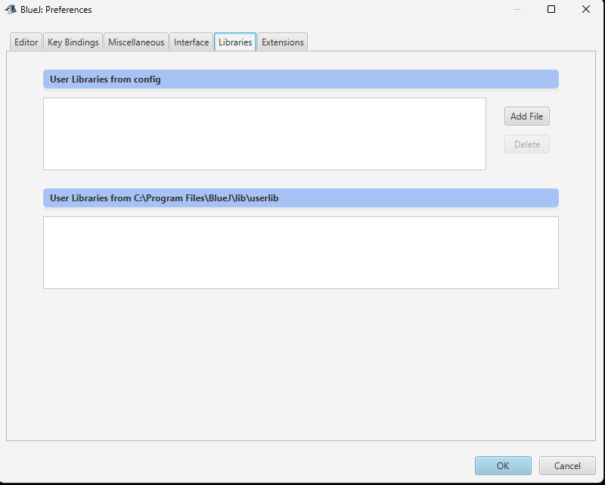
UNIT B · COURSE SETUP
CONNECT
Open BlueJ’s Libraries settings
Windows
Tools → Preferences → Libraries
macOS
BlueJ → Preferences → Libraries
The upper list may be empty. That is normal.
BlueJ 6.0.0 · Libraries tab before setup
9
Notes:
TIME: 00:23–00:25
SAY
• We are about to tell BlueJ where Processing’s drawing commands live.
DO
• Model the Windows menu first, then state the macOS menu difference without changing the core action.
VALIDATION
• Screenshot captured during the successful Windows 11 walkthrough.

Slide 10
UNIT B · COURSE SETUP
CONNECT
Add only the Processing core JAR
03
Click Add File
Then locate this folder:
Windows
macOS
C:\Program Files\Processing\
app\resources\core\library
Processing.app → Show Package Contents
Contents/app/resources/core/library
Select: core-4.5.6.jar
10
Notes:
TIME: 00:25–00:28
SAY
• Select only core-4.5.6.jar for this course setup. Do not select every JAR in the folder.
• On macOS, Control-click Processing in Applications and choose Show Package Contents. If the bundle is hidden in the file chooser, use Command–Shift–G and paste the folder path.
CHECK
• The selected file name begins ‘core-’ and ends ‘.jar’.
IF STUDENTS ARE STUCK
• If the folder layout differs, open Appendix slide 22 and search inside Processing.app for core-4.5.6.jar.
[Sources]
- https://processing.org/environment/
[/Sources]
VALIDATION
• Windows path and file were verified directly with Processing 4.5.6.

Slide 11
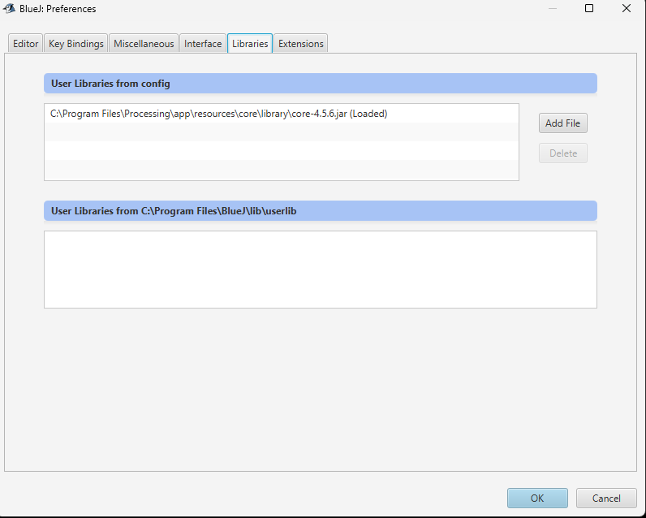
UNIT B · COURSE SETUP
CHECK
Restart BlueJ and look for “Loaded”
1
Click OK
2
Close BlueJ completely
3
Reopen BlueJ and return to Libraries
EXPECTED
core-4.5.6.jar (Loaded)
The word Loaded is the checkpoint.
11
Notes:
TIME: 00:28–00:30
SAY
• The library is not active until BlueJ restarts. The exact success word is Loaded.
CHECK
• Ask students to leave this screen open and point to ‘Loaded’ for a quick visual sweep.
IF STUDENTS ARE STUCK
• If the entry says ‘Not loaded,’ use Appendix slide 21.
VALIDATION
• Screenshot captured after the successful BlueJ restart on Windows 11.

Slide 12
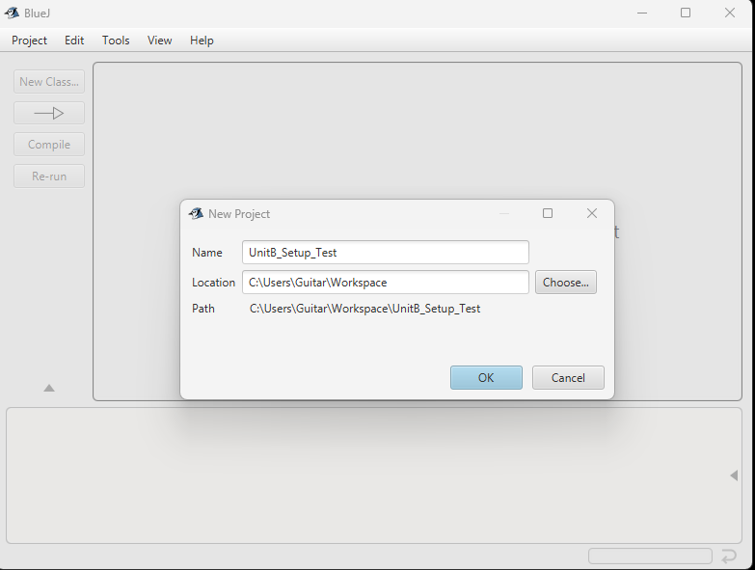
UNIT B · COURSE SETUP
BUILD
Create the setup-test project
Project → New Project
1
Name
UnitB_Setup_Test
2
Location
C:\Users\Student\Workspace
...\Workspace\UnitB_Setup_Test
Use your normal course workspace or Documents folder.
3
Create
BlueJ 6.0.0 uses the OK button.
Your path may differ; the project name must match.
12
Notes:
TIME: 00:30–00:32
SAY
• The project name is exact. Your folder location may differ from the screenshot.
DO
• Emphasise that BlueJ 6.0.0 labels the confirmation button OK, not Create.
VALIDATION
• The OK-button wording was corrected during the live walkthrough.

Slide 13
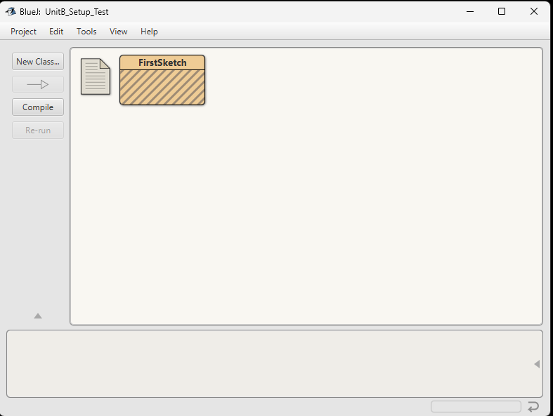
UNIT B · COURSE SETUP
BUILD
Create one Java class
Click New Class…
Class name
FirstSketch
Leave Class selected
Leave Java selected
Click OK
Striped means: created, not compiled yet.
13
Notes:
TIME: 00:32–00:34
SAY
• Capital F and capital S matter. Java class names are case-sensitive.
• The stripes are normal; they mean the source exists but no compiled class exists yet.
CHECK
• Every student should have one striped FirstSketch class box.
VALIDATION
• Screenshot captured from the successful setup-test project.

Slide 14
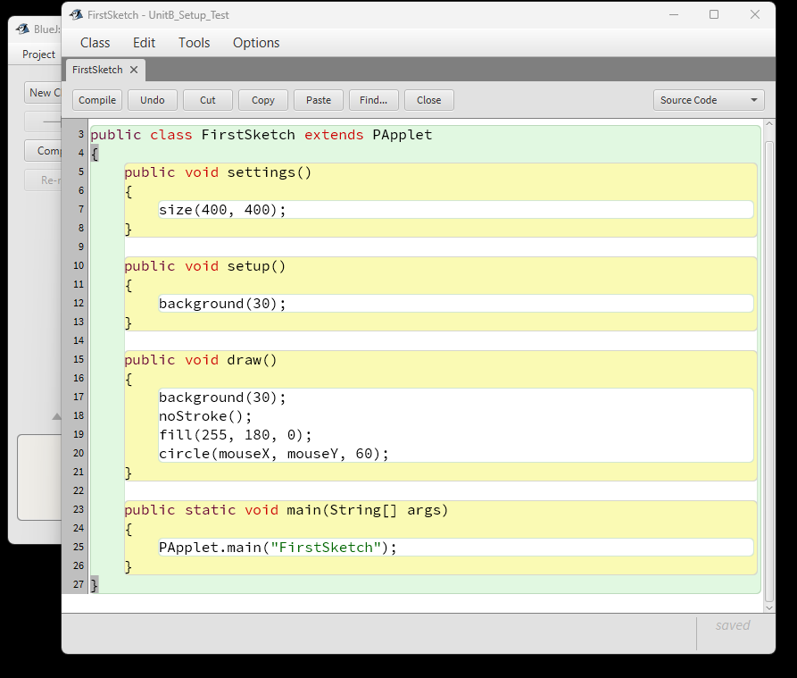
UNIT B · COURSE SETUP
BUILD
Open the editor and replace the template
1
Open
Double-click FirstSketch.
2
Select all
Click in the editor, then press Ctrl+A (Windows) or Command+A (macOS).
3
Replace
Delete the template and paste the complete code from the next slide.
BlueJ highlights each method as a code block.
14
Notes:
TIME: 00:34–00:35
SAY
• Students are replacing the entire generated template, not adding code beneath it.
DO
• Provide the starter code as selectable text through the course distribution channel. Keep the next slide visible while students paste.
IF STUDENTS ARE STUCK
• If a student sees two class declarations, they did not replace the template. Use Select All again.
VALIDATION
• Screenshot captured from the verified FirstSketch editor.

Slide 15
UNIT B · COURSE SETUP
BUILD
Paste the complete working program
import processing.core.PApplet;
public class FirstSketch extends PApplet
{
public void settings()
{
size(400, 400);
}
public void setup() { background(30); }
public void draw()
{
background(30);
noStroke();
fill(255, 180, 0);
circle(mouseX, mouseY, 60);
}
public static void main(String[] args)
{
PApplet.main("FirstSketch");
}
}
Do not change yet
Use 60
You do not need to understand class, extends, or main today. They are fixed launcher code that we will reuse.
Important: size() belongs in settings().
15
Notes:
TIME: 00:35–00:39
SAY
• Paste the whole program exactly. Today, the outer class and main method are fixed launcher code to recognise, not object-oriented programming to learn.
• The window size is inside settings(). That placement is required when Processing runs through BlueJ.
• The draw method repeatedly clears the window and draws an orange circle at the mouse position.
DO
• Pause until all students have pasted. Ask them to locate the number 60 without changing it.
CHECK
• The class name and the string inside PApplet.main must both read FirstSketch.
[Sources]
- https://processing.org/environment/
[/Sources]
VALIDATION
• This exact wrapper compiled and ran with BlueJ 6.0.0 and Processing 4.5.6 on Windows 11.

Slide 16
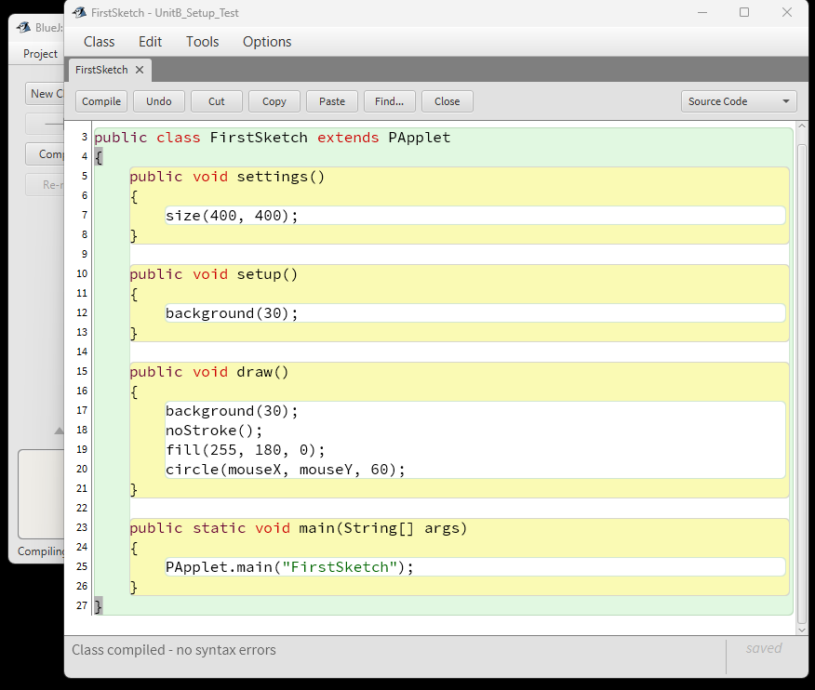
UNIT B · COURSE SETUP
PROVE
Compile before you run
Click Compile
Compiling translates your source code and checks its syntax.
EXPECTED MESSAGE
Class compiled – no syntax errors
Read the message at the bottom of the editor.
16
Notes:
TIME: 00:39–00:41
SAY
• Compile is a separate step in BlueJ. Read the bottom message; do not assume success because nothing dramatic happened.
CHECK
• Success message: Class compiled – no syntax errors.
IF STUDENTS ARE STUCK
• If an error appears, compare the first error line, the class name, and the import before inspecting the rest.
VALIDATION
• Screenshot captured from the verified compile.

Slide 17
UNIT B · COURSE SETUP
PROVE
Run main, then move the mouse
1
Close the editor
Return to the project window.
400 × 400
2
Right-click FirstSketch
An orange circle
follows your mouse
Choose void main(String[] args).
3
Accept the argument
Leave { } unchanged and click OK.
CHECKPOINT
The sketch window opens and responds
17
Notes:
TIME: 00:41–00:43
SAY
• Right-click the class itself, not the empty project background. The main method launches the Processing sketch.
DO
• Ask students to move the mouse across the sketch window and hold it where you can see the circle.
IF STUDENTS ARE STUCK
• The sketch may open behind BlueJ. Use Alt+Tab on Windows or Command+Tab on macOS.
• If the main option is missing, compile again and confirm the class contains public static void main.
VALIDATION
• The method-call dialog and empty String array were confirmed in the live BlueJ walkthrough.

Slide 18
UNIT B · COURSE SETUP
PROVE
Prove that you control the program
Find this line
Compile again
circle(mouseX, mouseY, 60);
Run main again
Change only one number
The circle should be twice as wide.
circle(mouseX, mouseY, 120);
18
Notes:
TIME: 00:43–00:44
SAY
• A working environment is useful only if the edit–compile–run cycle works. Change 60 to 120, compile again, and rerun main.
CHECK
• The new circle diameter is twice the original diameter.
IF STUDENTS ARE STUCK
• If the old size remains, the student probably reran without compiling the edited source.
VALIDATION
• The 60-to-120 modification produced the expected larger circle in the live walkthrough.

Slide 19
UNIT B · COURSE SETUP
PROVE
You completed the real programming cycle
EDIT
COMPILE
RUN
OBSERVE
Change a value
Check the code
Launch main
See the effect
This loop is how we will learn throughout Unit B.
19
Notes:
TIME: 00:44–00:45
SAY
• Name the cycle aloud together: edit, compile, run, observe.
• This is the habit students will repeat in every Unit B lesson.
CHECK
• Ask the class: ‘Which step did we forget if the program still shows the old circle?’ Expected: compile.

Slide 20
UNIT B · COURSE SETUP
START
Setup complete
Show your teacher
Exit question
A moving orange circle
The line ending in 120
No compile errors
What is one thing you are curious to create with code?
Keep UnitB_Setup_Test. It is your installation-check project.
20
Notes:
TIME: Dismissal / final check
SAY
• Students keep this project. If anything breaks later, it is the fastest known-good test.
DO
• Collect the exit response verbally, on paper, or through the class platform.
CHECK
• Do not mark setup complete for a student who has only installed the applications; the runnable modified sketch is the acceptance test.

Slide 21
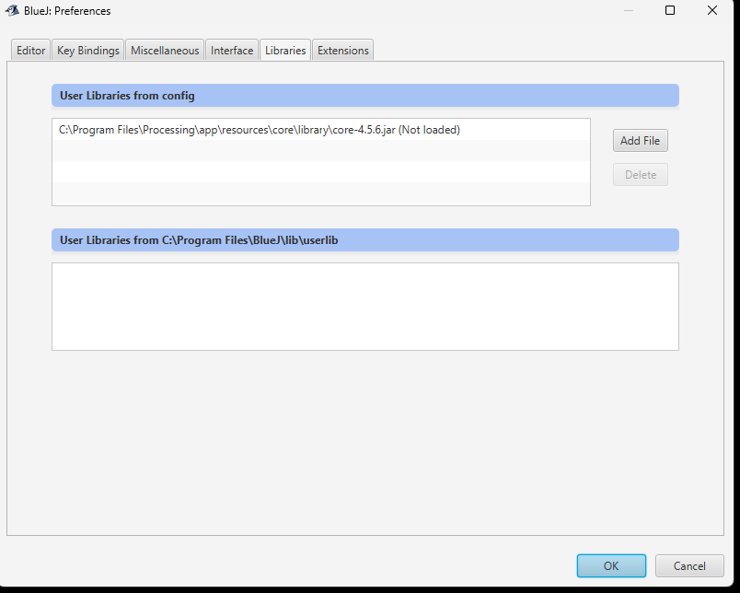
UNIT B · COURSE SETUP
HELP
If the library says “Not loaded”
This is usually a pending restart—not a failed installation.
1
Click OK
Save the Preferences change.
2
Quit BlueJ
Close every BlueJ window.
3
Reopen and check
The label should change to Loaded.
Expected before the required restart.
A1
Notes:
TIME: Use only when needed
SAY
• Not loaded immediately after adding the file is expected. The configuration activates after a complete restart.
IF STUDENTS ARE STUCK
• If it still says Not loaded after a true restart, remove the entry, add the exact core JAR again, click OK, and restart once more.
VALIDATION
• This exact state occurred during the live walkthrough and resolved after clicking OK and restarting BlueJ.

Slide 22
UNIT B · COURSE SETUP
HELP
Find the Processing core JAR
Windows
macOS
Paste this path into the file chooser:
Open Applications in Finder
Control-click Processing
Choose Show Package Contents
Search the package for core-4.5.6.jar
C:\Program Files\Processing\
app\resources\core\library
Choose the file named core-4.5.6.jar—not a native or OpenGL JAR.
A2
Notes:
TIME: Use only when needed
SAY
• The version number is part of the current file name. In a later validated Processing release, the number may change.
IF STUDENTS ARE STUCK
• On macOS, Command–Shift–G opens Go to Folder in many file choosers. Try /Applications/Processing.app/Contents/app/resources/core/library.
[Sources]
- https://processing.org/environment/
[/Sources]
VALIDATION
• The Windows path was verified with the installed Processing 4.5.6 distribution. The macOS package route must be preflighted on a Mac before classroom delivery.

Slide 23
UNIT B · COURSE SETUP
HELP
If processing.core cannot be found
Symptom
error: package processing.core does not exist
Check in this order
The first line is: import processing.core.PApplet;
Preferences → Libraries shows core-4.5.6.jar (Loaded)
BlueJ was completely restarted after adding the JAR
The file selected was core-4.5.6.jar—not the library folder
A3
Notes:
TIME: Use only when needed
SAY
• This compiler error means BlueJ cannot see the Processing class library. It is not caused by the drawing commands later in the file.
IF STUDENTS ARE STUCK
• Fix the library configuration before editing unrelated lines of student code.
[Sources]
- https://processing.org/environment/
[/Sources]

Slide 24
UNIT B · COURSE SETUP
HELP
If the sketch does not open
1
Run the correct method
Right-click FirstSketch → void main(String[] args).
Still stuck?
Close the sketch and BlueJ
Reopen BlueJ
Compile once more
Run main again
2
Accept { }
Leave the String array unchanged and click OK.
3
Look behind BlueJ
Use Alt+Tab or Command+Tab to find the sketch window.
Do not add P2D or P3D to the setup test. The default renderer keeps this first program simple.
A4
Notes:
TIME: Use only when needed
SAY
• Separate compile success from launch success. If compilation succeeded, preserve that evidence and check the launch path first.
IF STUDENTS ARE STUCK
• Read BlueJ’s terminal/error window only after checking the main-method selection and hidden-window possibility.

Slide 25
UNIT B · COURSE SETUP
TEACHER
Teacher pre-flight: run this before every new class
VERSIONS
Confirm BlueJ 6.0.0 and Processing 4.5.6—or revalidate the deck against newer releases.
DOWNLOADS
Open both official download pages and confirm school filtering does not block them.
PERMISSIONS
Know which students can install software and the school-approved fallback for managed devices.
STARTER
Make the FirstSketch code available as selectable text before class begins.
WINDOWS
Run the full install → Loaded → compile → run → edit acceptance test on a clean Windows account.
macOS
Run the same acceptance test on both available Mac architectures; confirm the current core-JAR package path.
A5
Notes:
TIME: Teacher preparation
SAY
• This appendix slide is the release gate for using the deck with a new cohort.
DO
• Record the tested date and versions in the course repository. Update file names, paths, screenshots, and notes together when versions change.
[Sources]
- https://bluej.org/
- https://processing.org/download/
[/Sources]
VALIDATION
• Windows 11 x64 route passed on 25 August 2026. macOS final sign-off remains required before the first Mac-inclusive delivery.

