Slide 1


CSCI 7000-006 AI-driven Leadership
Danny Dig
University of Colorado

Slide 2
Semester recap: What this seminar was really about
A quick refresher
STARTING POINT
OUR ARC THIS SEMESTER
Why now?
1
Understand AI
prompting, communication, leadership context
• AI moved from tool to collaborator • Communicating with AI became a leadership skill • Organizations began redesigning work around AI, not just adding a tool
2
Reality check
industry adoption, agents, executive trends
3
Human impact
Gen Z, workload, fatigue, jobs, trust
4
Managerial response
onboarding agents, building capability
Big idea
The course was about learning to think, lead, and decide in an AI-augmented world.
Notes:
[Sources] Course topics provided by the user in the prompt for class sequence. How executives are thinking about AI heading into 2026: https://hbr.org/2026/01/hb-how-executives-are-thinking-about-ai-heading-into-2026 Create an Onboarding Plan for AI Agents: https://hbr.org/2026/03/create-an-onboarding-plan-for-ai-agents

Slide 3
What we learned about the market
AI adoption is accelerating — but implementation is still messy
INDUSTRY SIGNALS
From tools to agents
From summit discussions and executive surveys:
Next
2023–24
2025–26
Manage humans + agents together
• Agentic AI moved to center stage
• Leaders stayed bullish despite slow ROI
• The biggest barriers were capability, workflow redesign, and governance
Ask AI for answers
Design AI-enabled workflows
Leadership implication
Competitive advantage comes from experimentation, role clarity, and responsible oversight — not just buying a model.
Bottom line:
The challenge is less “Can AI do it?” and more “Can organizations manage it well?”
Notes:
At industry events (e.g., NY AI Summit):
Massive focus on Agentic AI
Shift from copilots → autonomous workflows
From executive surveys:
High investment, but unclear ROI in many orgs
Biggest gaps:
Talent capability
Integration into workflows
Trust & governance
Key tension we discussed:
Leaders are excited about AI
But organizations are not yet structurally ready
Takeaway:
The bottleneck is no longer the technology—it’s people, processes, and leadership clarity

Slide 4
What we learned about people and work
AI changes effort, identity, expectations, and attention
Gen Z paradox
Work intensification
Brain fry
Your generation uses AI fluently, but also worries about originality, skill loss, fairness, and what counts as “real” learning or work.
AI often speeds up tasks — then raises expectations. Faster output can become more tasks, more review, and more pressure.
Not all AI use feels the same. Passive overreliance can create cognitive fatigue; intentional use can reduce friction without replacing thinking.
Class insight
Class insight
Class insight
Using AI well is also an ethical and developmental question.
Productivity gains do not automatically mean less work.
The goal is augmentation, not mental outsourcing.
Notes:
Slide 3 — Human Impact: How AI Is Changing Work (and You)
Core idea: AI doesn’t just help work—it reshapes how we think and feel about work.
From Gen Z + HBR discussions:
Heavy users of AI—but:
Concerned about over-reliance
Worried about losing originality and skills
From “AI intensifies work”:
AI → faster output → higher expectations
Work becomes:
More cognitively demanding
More always-on
From “brain fry”:
Cognitive overload from constant AI interaction
Reduced deep thinking if used passively
Class insight:
AI creates a paradox:
More productivity
But also more pressure and mental strain
Takeaway:
Using AI well requires intentional thinking, not passive delegation

Slide 5
What strong AI leadership looks like
The course ended with capability-building, not hype
BEST USERS
BEST ORGANIZATIONS
What top AI users did differently
Give agents a role, boundaries, and handoffs
• They treated AI as a reasoning partner
• They gave clear goals, context, and constraints
• They iterated instead of expecting one-shot perfection
• They used AI to widen ambition, not only save time
Train employees, not just deploy software
Redesign workflows around human + AI collaboration
Keep governance, accountability, and judgment visible
Meaning for students
Final takeaway
The most valuable habit is learning when to trust AI, challenge it, and build on it.
AI advantage comes from better judgment, better systems, and better leadership.
Notes:
Slide 4 — What Great AI Users & Organizations Do Differently
Core idea: The difference is not access—it’s behavior and design.
From onboarding agents & top AI users:
Best users:
Iterate with AI (not one-shot prompts)
Treat AI as a thinking partner
Break problems into structured steps
Organizations succeeding with AI:
Treat agents like employees (onboarding, roles, feedback loops)
Redesign workflows—not just add AI on top
Invest in training, not just tools
From fireside chat on jobs:
Jobs are not disappearing—they’re evolving
Value shifts toward:
Judgment
Creativity
Coordination with AI systems
Final takeaway:
The real skill you’ve been building is:
How to lead, think, and create in an AI-augmented world

Slide 6
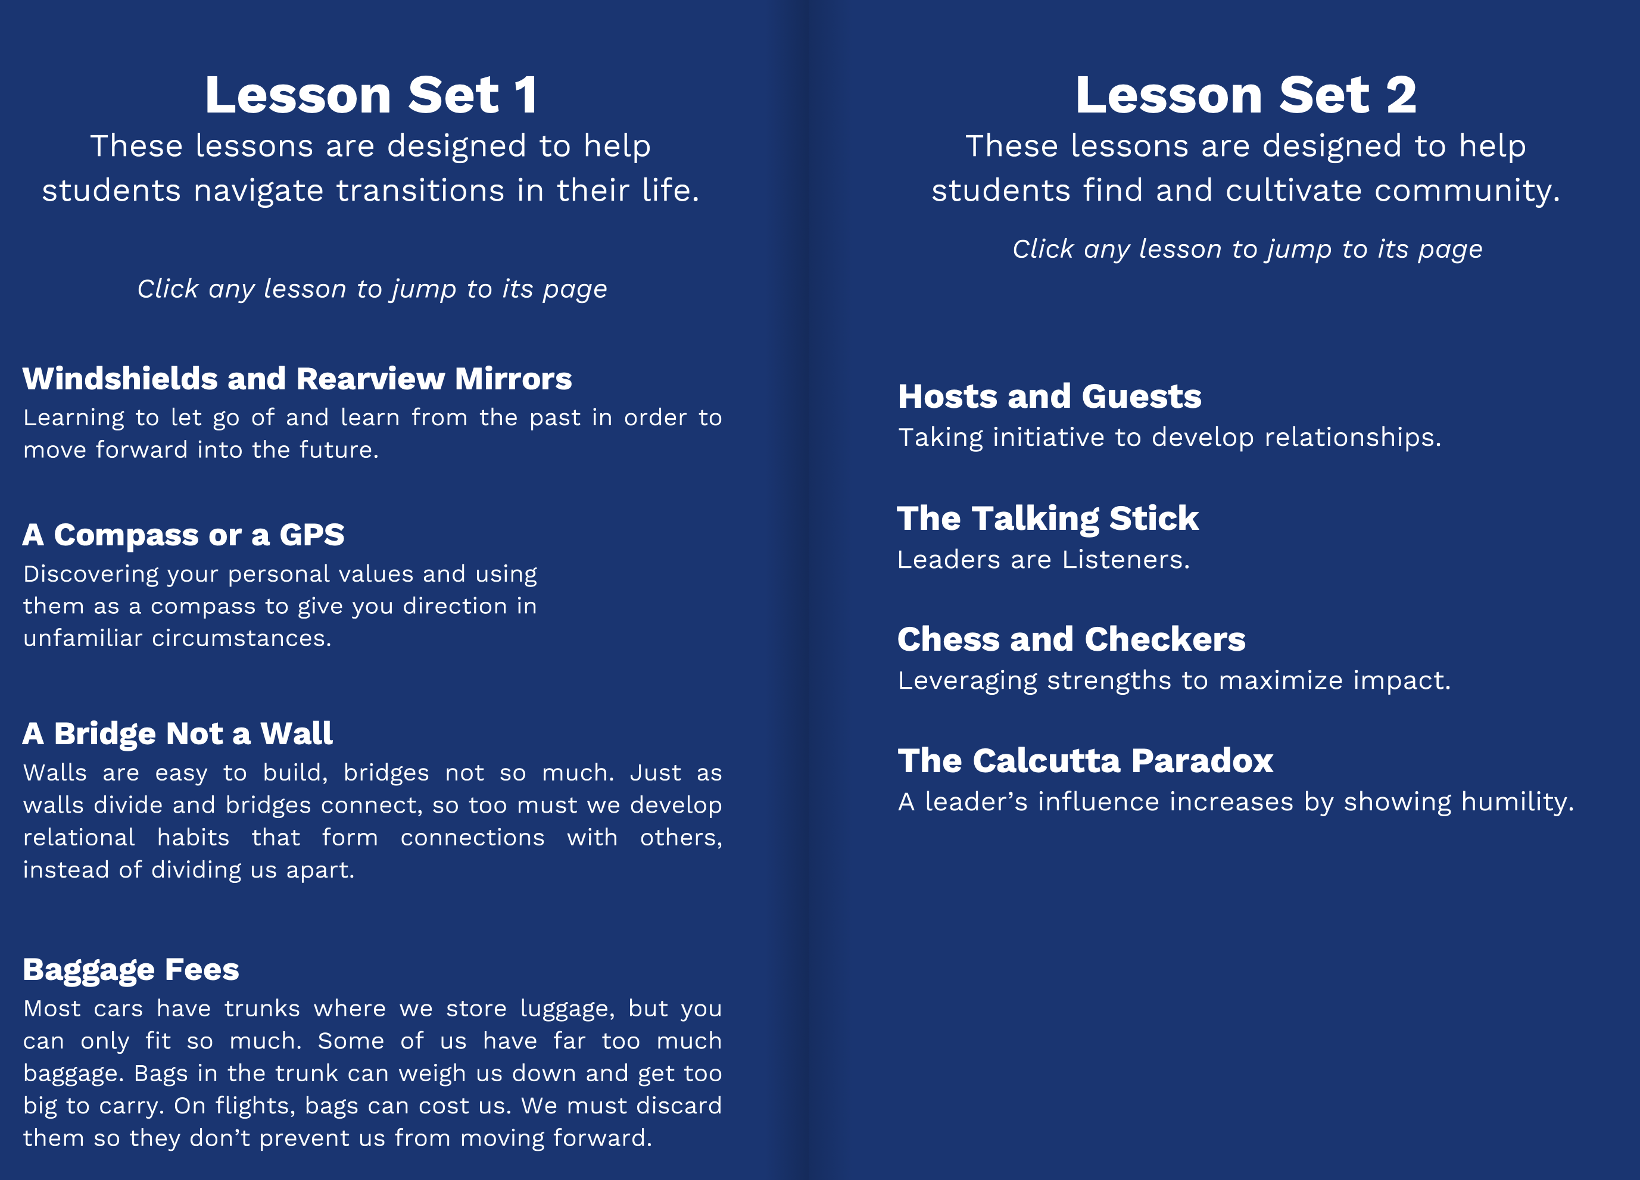
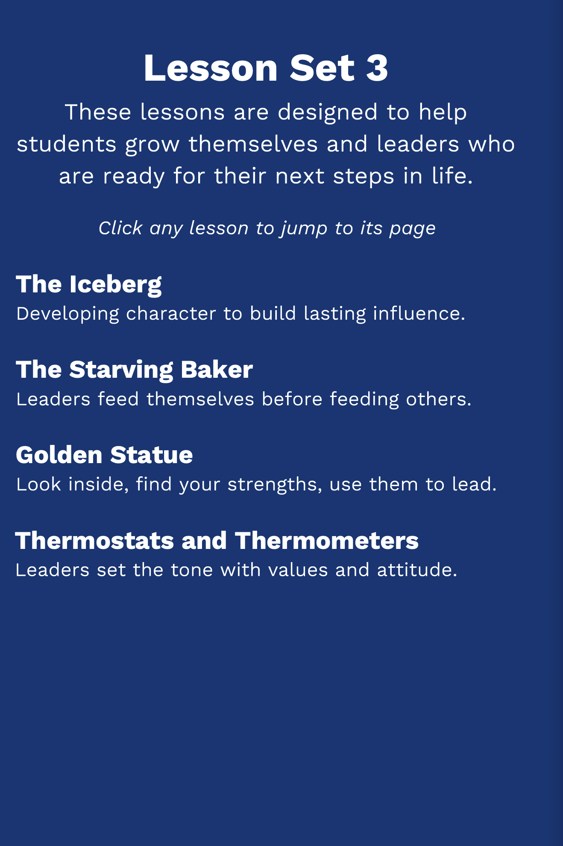
Roundtable Leadership Development
Notes:
“As you fill out your evaluations, think about this:
What changed in how you approach problems, think, or work with AI compared to the beginning of the semester? That shift is the real outcome of this class.”

