Slide 1
Intro to F# With a Twist of Xamarin
@dannydwarren
dannydwarren@gmail.com

Slide 2
About Danny & InterKnowlogy
InterKnowlogy (www.interknowlogy.com)
15 year old services firm – Custom Application Development
Focused on building NUI solutions
Universal Windows Platform (Desktop, Tablet, Phone), Xamarin, WPF, Kinect, Azure
Touch, Gestures (Touchless), & Mouse and Keyboard
Formal R&D program: RECESS
Self guided learning/My time to prepare this presentation
Danny Warren, Sr. Software Engineer
Graduate Neumont University 2009, B.S. C.S.
Alumnus Microsoft MVP in Windows Platform Development
Oct 2013 – Oct 2015
Former Nokia Champion
Avid Mt. Biker and aspiring Rock Climber

Slide 3
Agenda
What is F#
Nature of C# vs F#
What do you mean: “Classes of Bugs Don’t Exist”
Language and Tooling Intro
F# in Mobile (Using Xamarin)
I can’t use F#, but how will it make me a better developer?

Slide 4
What is F#
F# is the 3rd major .NET Language
Thanks CLI (Common Language Interface)
Functional First, but is Multi-paradigm
Can also do OO
NOT An Academic Language!
Mature, but still FUN!

Slide 5
Nature vs Nurture
C#
F#
OO
Mutable
Rigid Type System
Insignificant Whitespace
Explicit Blocks of Code
NULL is Significant
Functions not First Class
Can use Delegate
Functional
Immutable
Flexible Type System (Major Benefit)
Significant Whitespace
Implicit Blocks of Code
NULL is Avoided, but still exists
Function is First Class
Can be treated as an object

Slide 6
That Bug CAN’T Exist Here!
Immutability by default
Forces us away from stateful bugs
In order to make something mutable you must be explicit
So in theory the developer thought this through… Yeah right! ;-)
Online Sample: http://fsharpforfunandprofit.com/posts/correctness-immutability/
Flexible Type System
Can force compile time validation.
Online Sample: http://fsharpforfunandprofit.com/posts/designing-for-correctness/
Example in Demo Code
NULL avoided
Forces developers to think through all code paths
Avoids many unnecessary NullReferenceExceptions!
Online Sample: http://fsharpforfunandprofit.com/posts/the-option-type/#option-is-not-null

Slide 7
Hai! I’m F#! And dis mai friend REPL…
Language Intro:
Start Here: http://fsharp.org/about/learning.html
Syntax Guide: http://dungpa.github.io/fsharp-cheatsheet/
Why? Here’s Why!: http://fsharpforfunandprofit.com/why-use-fsharp/
My personal favorite intro session: https://skillsmatter.com/skillscasts/4971-domain-driven-design-with-scott-wlaschin
FSharpForFunAndProfit: http://fsharpforfunandprofit.com/site-contents/
More Why!: http://fsharpforfunandprofit.com/series/why-use-fsharp.html
Tooling Intro:
F# Interactive (REPL)
VS Debugging works just like it does in C#

Slide 8
How to Get it Installed?
Can Develop using VS2015 Community Edition or higher
Must install F# 3.1.2 standalone package
http://www.microsoft.com/en-us/download/details.aspx?id=44011
VS2015 Now Fully supports F# PCL Creatation
F# 4.0 Is NOW Supported by Xamarin
C# UI Projects do NOT yet support F# 4.0 (ONLY F# 3.0 & 3.1)
The Catch!
IF you want to create C# Android or iOS Xamarin Project and use an F# Library
THEN you must install VS2013 Community Edition or higher
This installs F# 3.1 for you. Just apply the F# update ready to go when after installing.
The F# Library must be created using the Visual F# Portable Library (Legacy) template in VS2013
Copy this library to any solution and you’re good to go! You can use VS2015 or VS2013 to edit the library after it has been created.

Slide 9
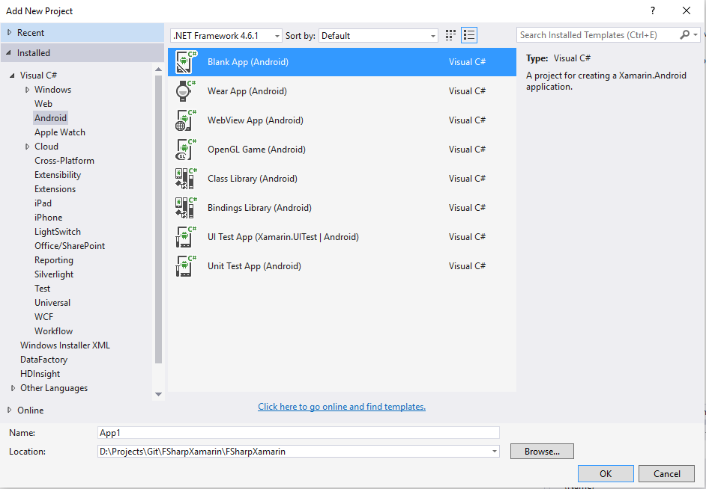
Create Android App with C# UI

Slide 10
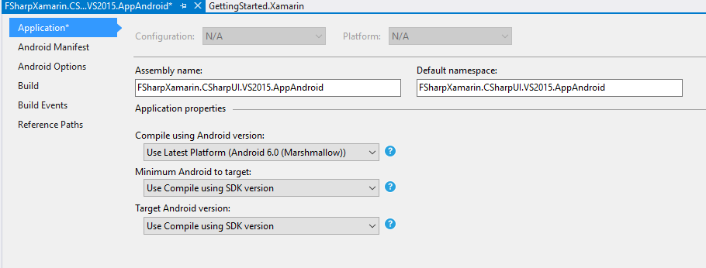
Change Minimum Android to target: Use Compile using SDK version

Slide 11
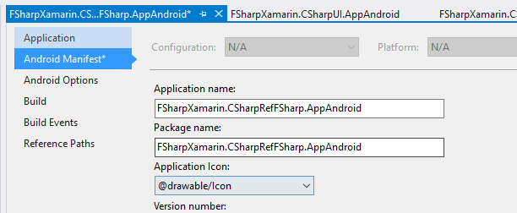
Change Package name & Application Icon

Slide 12
Create F# PCL to be used in C# or F# Projects

Slide 13
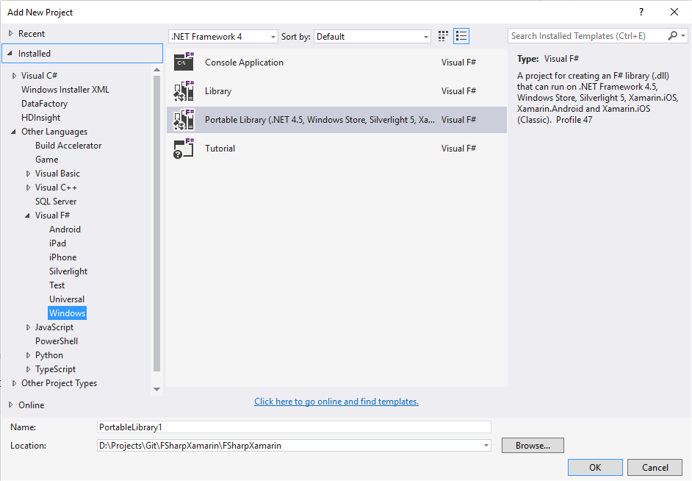
Select .NET Framework 4
Visual F#
/Windows
Select Portable Library
With Profile 47

Slide 14
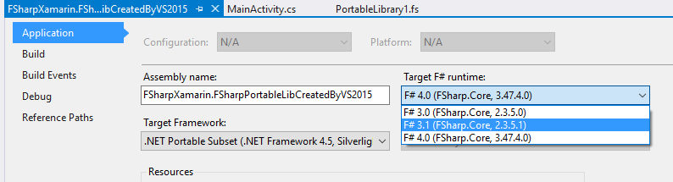
Change Target Version of F#

Slide 15
CODE! CODE! CODE!
Solution
F# Android
F# iOS
C# Android
C# Windows 8.1 Universal (UAP)
Windows + Phone
C# Windows UWP (Win10)
Not Really Supported… ☹
F# Library
ALL Apps use this library!
F# Tutorial Project (Template Provided With VS)

Slide 16
Platform Limitations
.NET Native for UWP does not Support F#... Yet…
https://wpdev.uservoice.com/forums/110705-universal-windows-platform/suggestions/9110134-f-support-in-net-native-for-uwp
However as of April 22 work is IN PROGRESS!!!

Slide 17
open FSharpMakesYouABetterDev
F# thinks in mathematical terms
Understanding how to “think” is probably the BEST benefit F# provides a developer IMHO!
Example:
Monoid: http://fsharpforfunandprofit.com/posts/monoids-without-tears/
F#’s Nature forces you to question everything you know about and do in C#!
Don’t be a C# militant, do your research! Open your mind!
Functional Thinking and Immutability
These 2 concepts alone have helped me immensely in C#!
Amazing Community
We are all who we are in large part because of who we know.
The F# community is full of some of the most talented and amazing developers.
ALL of them want to help you!

Slide 18
OK, I’m Convinced! Sign Me Up!
Trial by Fire
Learn by doing: https://github.com/jorgef/fsharpworkshop
Practice, Practice, Practice:
https://projecteuler.net/
http://exercism.io/languages/fsharp

Slide 19
Materials
Xamarin Support Overview
http://developer.xamarin.com/guides/cross-platform/fsharp/fsharp_support_overview/
F# Async is a bit different than C# Async
http://stackoverflow.com/questions/13063792/windows-store-apps-and-f
http://stackoverflow.com/questions/6811072/referencing-asynchronous-f-datatype-from-c-sharp
Always 5 Equation
http://www.pedagonet.com/maths/always.htm
The Book of F#, By Dave Fancher (https://twitter.com/davefancher)
Gist about Discriminated Union
https://gist.github.com/dannydwarren/cefb9d33a67b689bddf8
Pipe |> vs Function Composition >>
http://fsharpforfunandprofit.com/posts/function-composition/
Visual Studio Emulator for Android
https://blogs.msdn.microsoft.com/visualstudioalm/2014/11/12/introducing-visual-studios-emulator-for-android/

Slide 20
Download Materials
Blog: http://bit.ly/dannydwarren
GitHub Repo (Materials): http://bit.ly/fsharpxamarin
Interested in talking more?
Reach Out!
dannydwarren@gmail.com
Mention: Nerds Like You Meetup
LinkedIn: dannydwarren Twitter: dannydwarren

