Slide 1
Azure Mobile Apps APIs in the Cloud for you Mobile Needs
@dannydwarren
dannydwarren@gmail.com

Slide 2
About Danny & InterKnowlogy
InterKnowlogy (www.interknowlogy.com)
15 year old services firm – Custom Application Development
Focused on building NUI solutions
Universal Windows Platform (Desktop, Tablet, Phone), Xamarin, WPF, Kinect, Azure
Touch, Gestures (Touchless), & Mouse and Keyboard
Formal R&D program: RECESS
Self guided learning/My time to prepare this presentation
Danny Warren, Sr. Software Engineer
Graduate Neumont University 2009, B.S. C.S.
Microsoft MVP in Windows Platform Development
Oct 2013 – Oct 2015
Former Nokia Champion
Avid Mt. Biker and aspiring Rock Climber

Slide 3
Agenda
What is Azure Mobile App
Define API
Which mobile platforms are supported?
How do I set it up?

Slide 4
Azure Mobile App
Suite of Related Azure Services
Web App (API)
Application Insights (analytics/metrics)
Extensible Grouping (via Resource Group)
Add services like
SQL DB
Document DB
Azure Storage (Tables, Queues, Blobs, etc.)
A ton of other awesome Azure services!

Slide 5
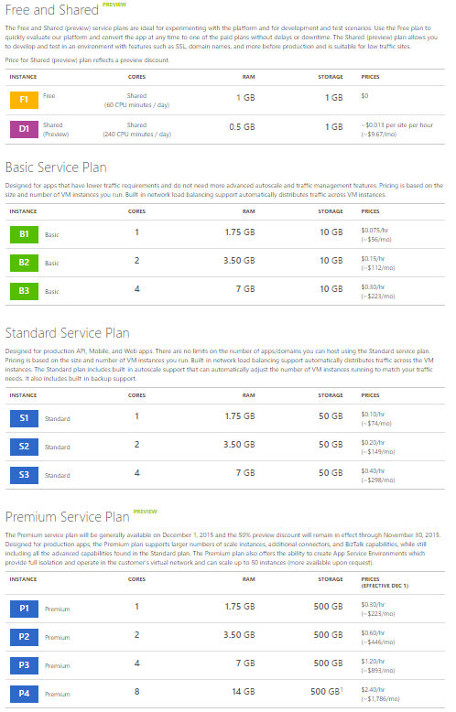
Cost?
As of 11/12/2015 @ 7:30pm Pacific Time
Don’t trust me! Go to: https://azure.microsoft.com/en-us/pricing/details/app-service/

Slide 6
Define API
ASP.NET Web API
ASP.NET MVC
Other IIS Hosted Web Site
“A hosted site that provides endpoints which provide data, process data, and store data on a mobile app’s behalf [in the cloud]!”

Slide 7
Can I use [x], [y], and [z] mobile platforms?
Windows 8.1 Universal Apps (UAP for Win8.1+)
Universal Windows Apps (UWP for Win10+)
iOS (Swift or Objective-C)
Xamarin (C# or F#)
iOS
Android
Cordova
Phone Gap
WPF (Wait that’s not Mobile!)
Windows Forms (Also, not Mobile…)
Etc…

Slide 8
Demo Time!

Slide 9
Image Walkthrough
In case the internet refuses us access. ☺

Slide 10
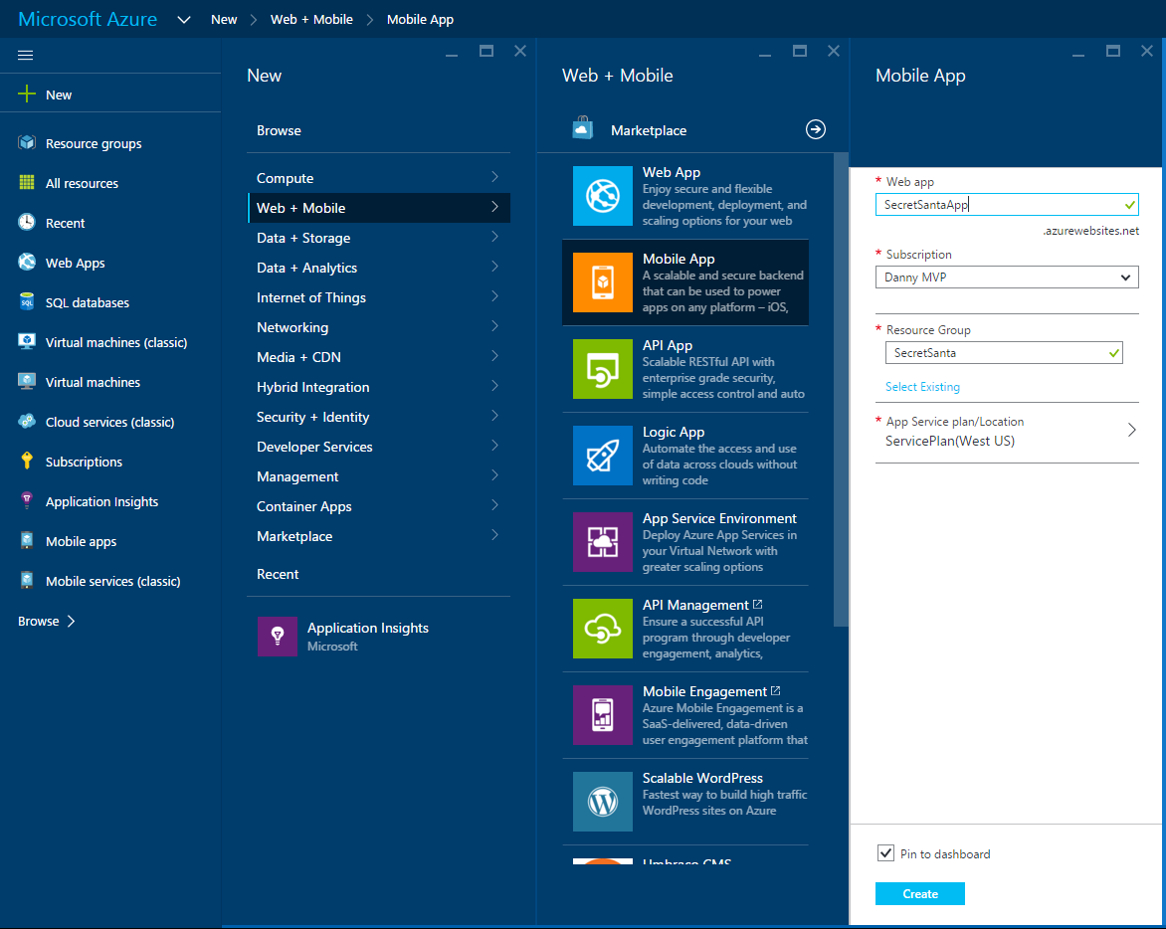

Slide 11
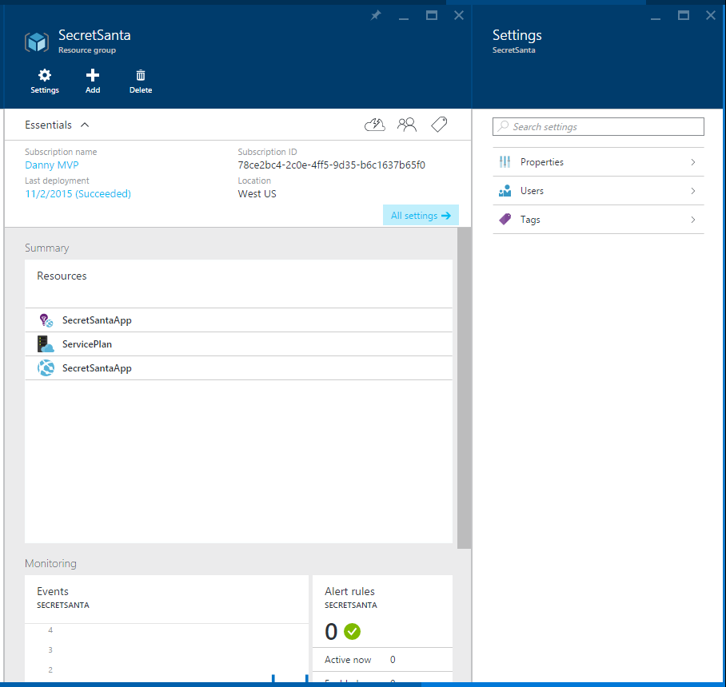

Slide 12
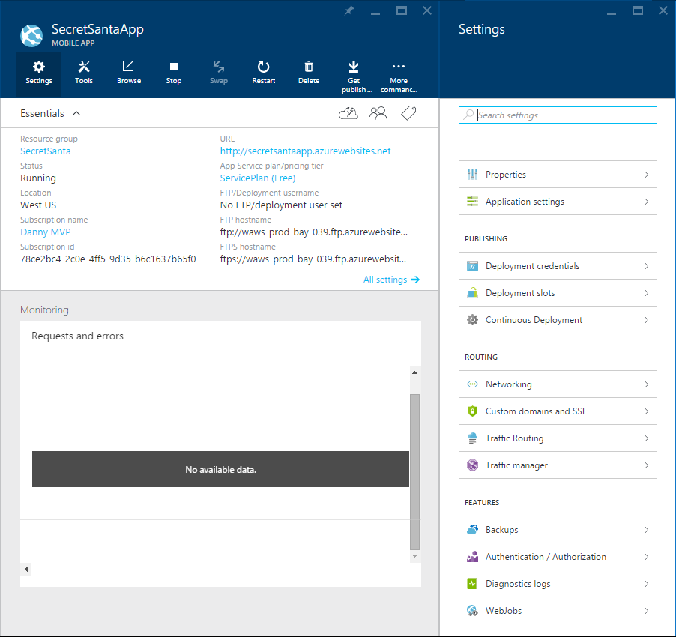

Slide 13
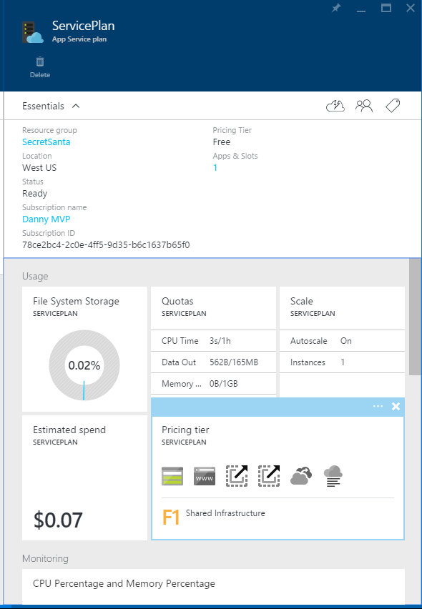

Slide 14
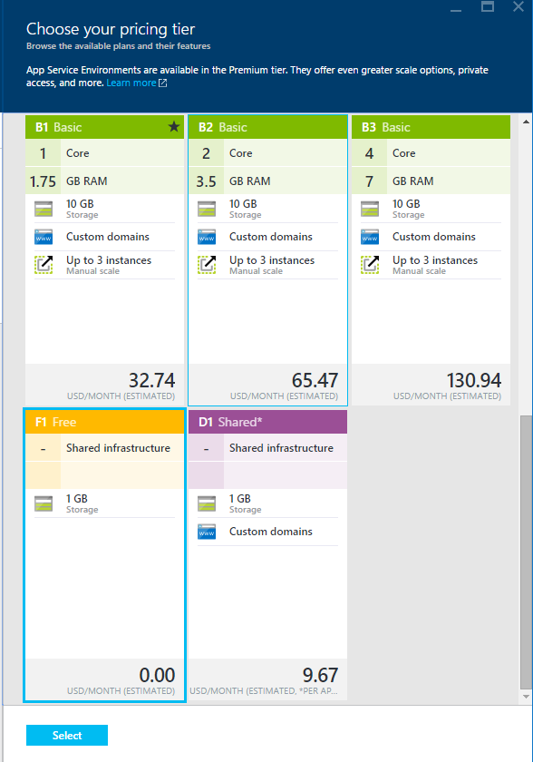

Slide 15
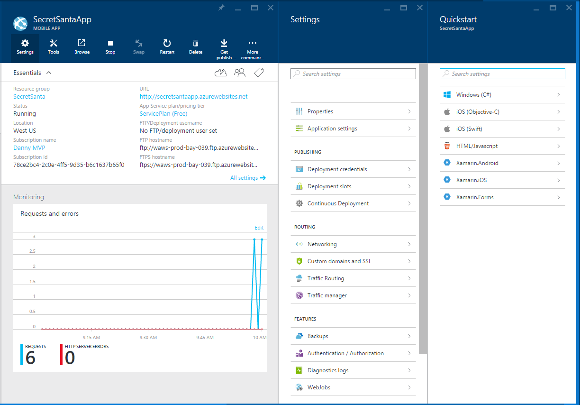

Slide 16
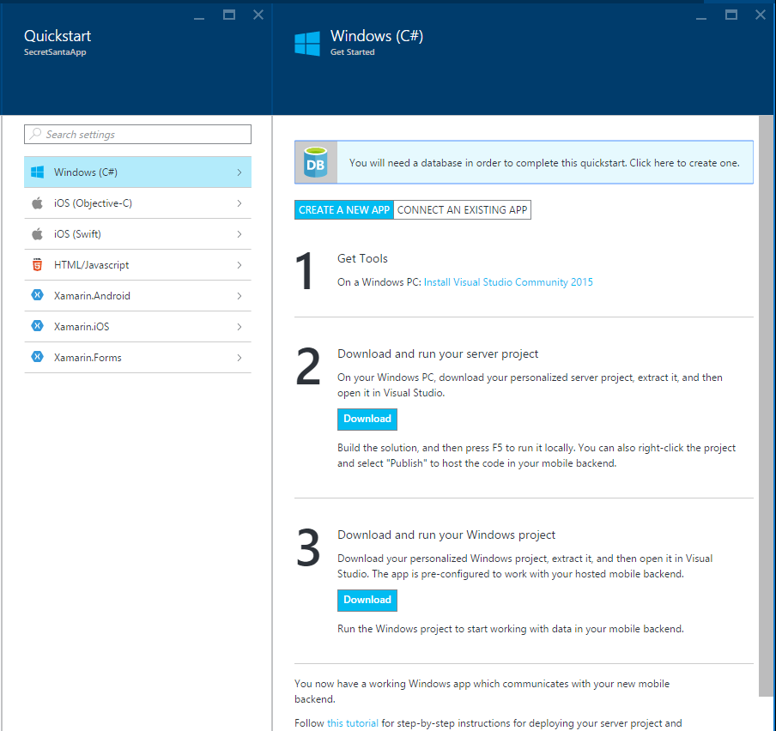

Slide 17
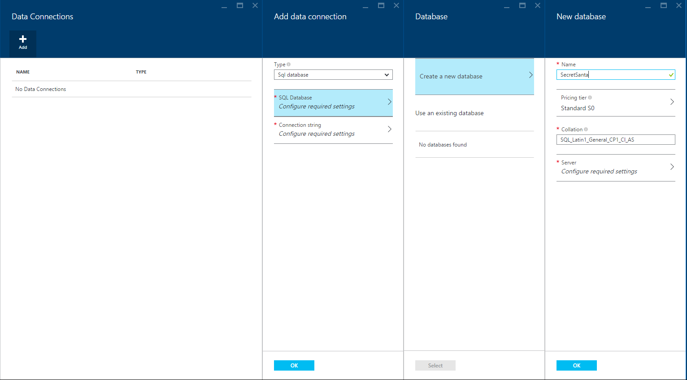

Slide 18
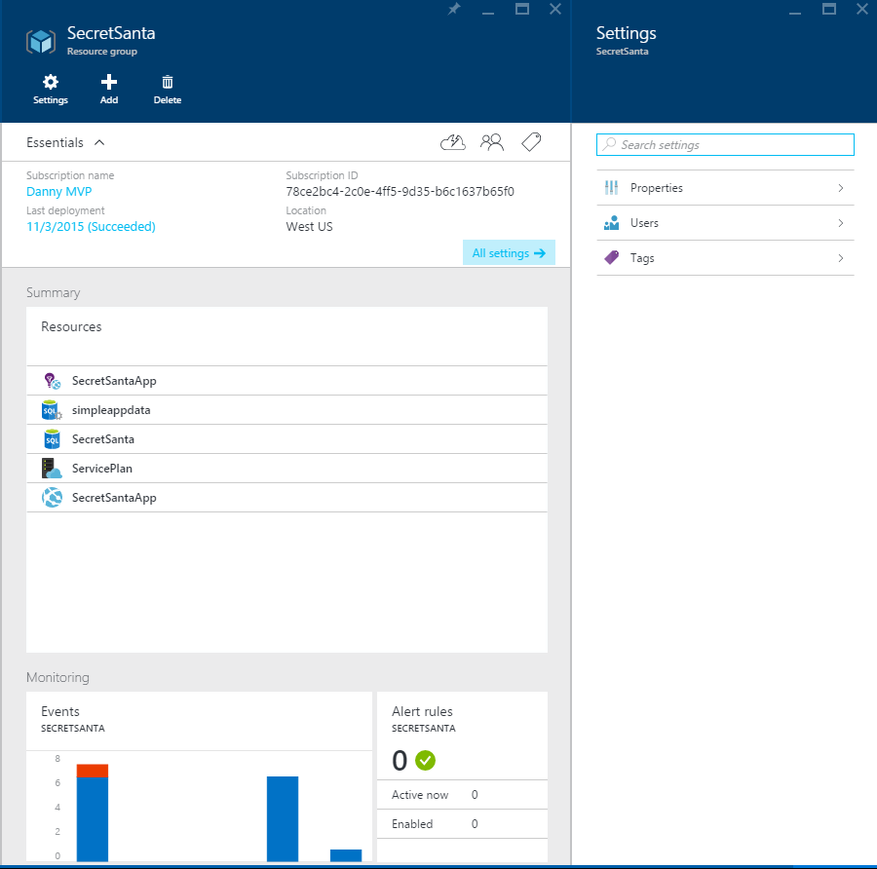

Slide 19
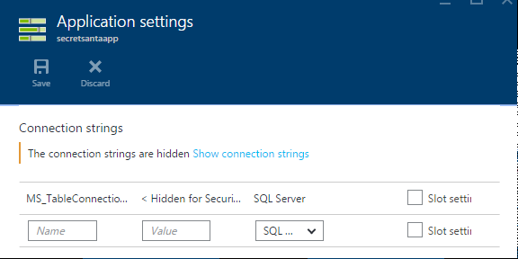
Limitation Notice

Slide 20
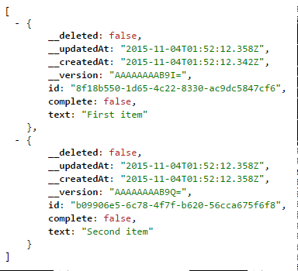
Try out your API
http://secretsantaapp.azurewebsites.net/tables/todoitem

Slide 21
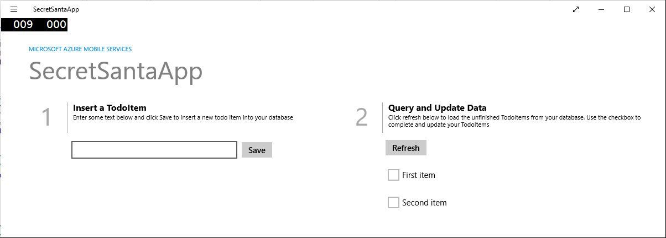
App in Motion

Slide 22
Materials
Azure: http://portal.azure.com/
Visual Studio: https://www.visualstudio.com/en-us/visual-studio-homepage-vs.aspx
Azure Mobile App Documentation: https://azure.microsoft.com/en-us/services/app-service/mobile/
Azure Mobile App Tutorial: https://azure.microsoft.com/en-us/documentation/articles/app-service-mobile-windows-store-dotnet-get-started/
My Blog Post/Tutorial: http://blogs.interknowlogy.com/2015/11/04/getting-started-with-azure-mobile-apps/

Slide 23
Download Materials
Blog: http://bit.ly/dannydwarren
GitHub Repo (Materials): http://bit.ly/introazuremobileapps
Interested in talking more?
Reach Out!
dannydwarren@gmail.com
Mention: SoCal Code Camp
LinkedIn: dannydwarren Twitter: dannydwarren

