Slide 1
Developing for Windows 8/WinRT Session 1 - Introduction
Kevin Stumpf
Danny Warren

Slide 2
Meet Your Instructors
Kevin Stumpf
Danny Warren
B.Sc. Business Informatics from Germany
Former WPF Instructor
message@stumpf-kevin.com
http://blogs.interknowlogy.com/author/kevinstumpf/
B.S. Computer Science from Neumont University
http://neumont.edu/
Certified .NET 4 Developer (MCPD)
@dannydwarren
dannydwarren@gmail.com
http://blogs.interknowlogy.com/author/dannywarren/

Slide 3
Meet Your Peers
Where are you coming from?
What experience do you have in software? (XAML/C#?)
Have you installed Windows 8 yet?

Slide 4
Meet Your Sponsors
InterKnowlogy
vNext
Nokia

Slide 5
Mission of this Course
Gain a broad understanding of Windows 8 development platform
Learn how to use the most important Windows 8 features and WinRT APIs

Slide 6
Course Overview
Introduction (TODAY)
Introduction to XAML and WinRT’s powerful Control Framework (4 Dec 2012)
Page-Navigation Model and Application Lifecycle (8 Jan 2012?)
Fundamentals (Async/Await, WinRT API, Security) (17 Jan 2012?)
Settings and Search Contract
Share Contract
Live Tiles and Device Orientation Handling
Background Tasks and Proximity using Near Field Communication (NFC)
Introduction to ModelViewViewModel (MVVM)
InterKnowlogy’s WinRT MVVM Framework Session Part I/II
InterKnowlogy’s WinRT MVVM Framework Session Part II/II
Presentation of Hackathon Entries+ Certificate/Prize Giveaway

Slide 7
Session Format
During Session
Post Session
Homework Review
Theory
Practical Implementation
Homework Assignment
Q&A
Ask Questions on the Windows 8 Forums and email us a link to your question.
http://social.msdn.microsoft.com/Forums/en-US/category/windowsapps
Do your homework!
Mom will be proud.
Materials will be available online within 24hrs after each session.
http://blogs.interknowlogy.com/

Slide 8
Hackathon
Create your own Windows Store App
Individually or in Teams
Judging by Peers and Instructors
Prizes

Slide 9
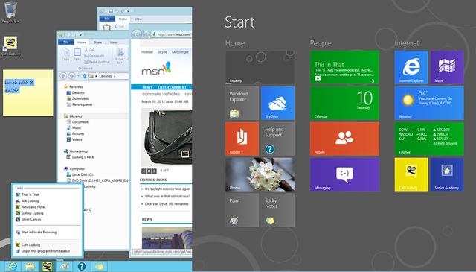
Introducing Windows 8
Two Faces

Slide 10
Key Features (Demos)
Live Tiles
Search
Share
Settings

Slide 11
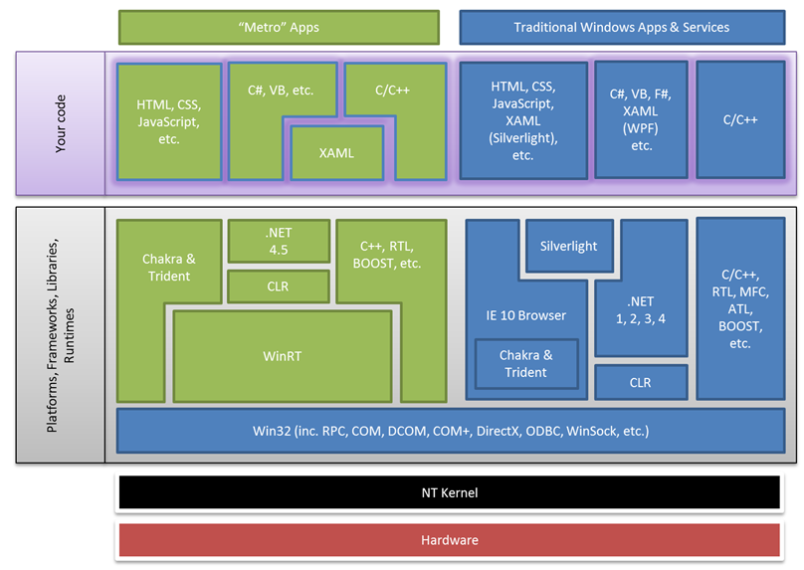

Slide 12
Development Environment Tips
OS and Tools Installation Instructions
http://blogs.interknowlogy.com/2012/11/21/development-environment-for-windows-8/
DPI Change
Task Bar
Icon Arrangement

Slide 13
Q&A
WHAT! Is your favorite color?
Blue…NO Yellooooow….
Anything else?
Need help with Windows 8 and development tools installations?

Slide 14
The End
We’re here to help!
So ask questions. ☺

