Slide 1

Automated Functional Testing Using Cucumber and Wiremock
BLUE HARVEST
Daniel Flores, 2018

Slide 2
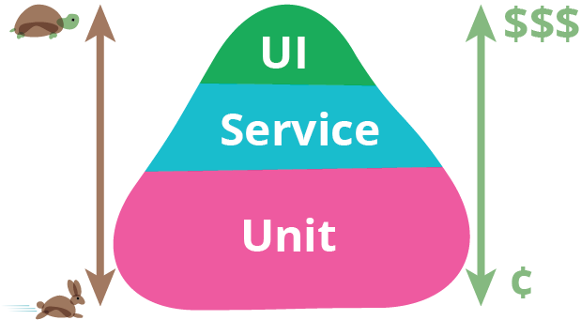
(Automated) Test Pyramid
Brittle even for small changes
Time consuming to re-record
Slow to run
Test through the API
Check functionality
Essential for DevOps
Write as many as possible
Both FE and BE
Check coverage
https://martinfowler.com/bliki/TestPyramid.html
Notes:
UI
Unit
Service

Slide 3


Typical Web Application Landscape
Your Application
Other System
Other System
Notes:
Assuming all HTTP(S) connections
In the BE you might prefer a queue or bus for decoupling and asynchronous communication

Slide 4
How To Test “Through The API”?
Your Application
Cucumber
Wiremock

Slide 5

Cucumber
A tool for BDD
Merges specification and test documentation
Facilitates TDD
Supports different languages and frameworks
Tests are written in Gherkin language (plain-text English)
Each non-blank line starts with a keyword, followed by arbitrary text
https://cucumber.io/
Notes:
Behaviour-Driven Development (Explore a problem domain → create examples to describe behaviour)
Test-Driven Development

Slide 6
Wiremock
HTTP(S) mock server → like Mockito in unit tests
Supports stubbing, verification and stateful behaviour
Can speed up integration with incomplete APIs
Good for edge cases and fault scenarios
Can be used as a library (JVM) or fat jar
Runs on Jetty
Configurable via REST (JSON) interface or Java API
Easy JUnit 4 integration with Rule
http://wiremock.org
Notes:
Stubbing: serve canned responses to particular requests
Verification: incoming requests can be checked later
Stateful: same request triggers a different response based on previous interactions
Can forward some requests to real services and stub others
Rules are no longer supported in JUnit 5!

Slide 7

Let’s See Some Code!

Slide 8
BLUE HARVEST
DON’T THINK IN BLACK & WHITE

