Slide 1

Automated Functional Testing Using Cucumber and Wiremock
BLUE HARVEST
Daniel Flores, 2018

Slide 2
Why Automation?
Manual Testing of all work flows, all fields, all negative scenarios is time consuming and costly
Automation does not require human intervention
Automation increases speed of test execution
Automation helps increase test coverage
Manual Testing can become boring and hence error prone
Resources for regression tests are reduced
Automated tools available
Notes:
Optional slide for clients who need convincing

Slide 3
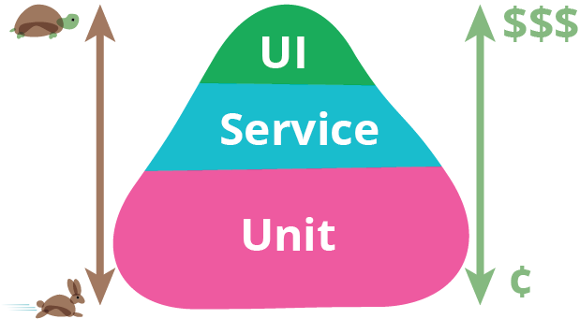
(Automated) Test Pyramid
Brittle even for small changes
Time consuming to re-record
Slow to run
Test through the API
Check functionality
Essential for DevOps
Write as many as possible
Both FE and BE
Check coverage
https://martinfowler.com/bliki/TestPyramid.html
Notes:
UI
Unit
Service

Slide 4


Typical Web Application Landscape
Your Application
Other System
Other System
Notes:
Assuming all HTTP(S) connections
In the BE you might prefer a queue or bus for decoupling and asynchronous communication

Slide 5
How To Test “Through The API”?
Your Application
Cucumber
Wiremock

Slide 6

Cucumber
A tool for BDD
Merges specification and test documentation
Facilitates TDD
Supports different languages and frameworks
Tests are written in Gherkin language (plain-text English)
Each non-blank line starts with a keyword, followed by arbitrary text
https://cucumber.io/
Notes:
Behaviour-Driven Development (Explore a problem domain → create examples to describe behaviour)
Test-Driven Development

Slide 7
Cucumber Workflow
Describe behaviour
Run and fail
Run and pass
Write step definition code
Write business logic
Notes:
Feautre file (a feature of your app) → scenarios of a feature to describe the behavour → steps of a scenario (given, when, then)
Code that is executed for each step
No business code yet
Actual code being tested
If all goes well

Slide 8
Wiremock
HTTP(S) mock server → like Mockito in unit tests
Supports stubbing, verification and stateful behaviour
Can speed up integration with incomplete APIs
Good for edge cases and fault scenarios
Can be used as a library (JVM) or fat jar
Runs on Jetty
Configurable via REST (JSON) interface or Java API
Easy JUnit 4 integration with Rule
http://wiremock.org
Notes:
Stubbing: serve canned responses to particular requests
Verification: incoming requests can be checked later
Stateful: same request triggers a different response based on previous interactions
Can forward some requests to real services and stub others
Rules are no longer supported in JUnit 5!

Slide 9

This is not what you’ve promised!

Slide 10
User Story
As a client, I want to see both my debit and my credit cards listed on one screen

Slide 11
BLUE HARVEST
DON’T THINK IN BLACK & WHITE

