Slide 1



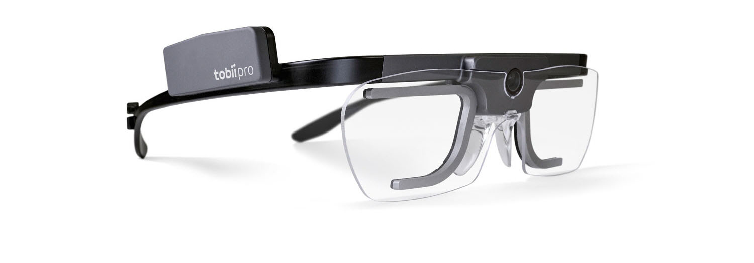

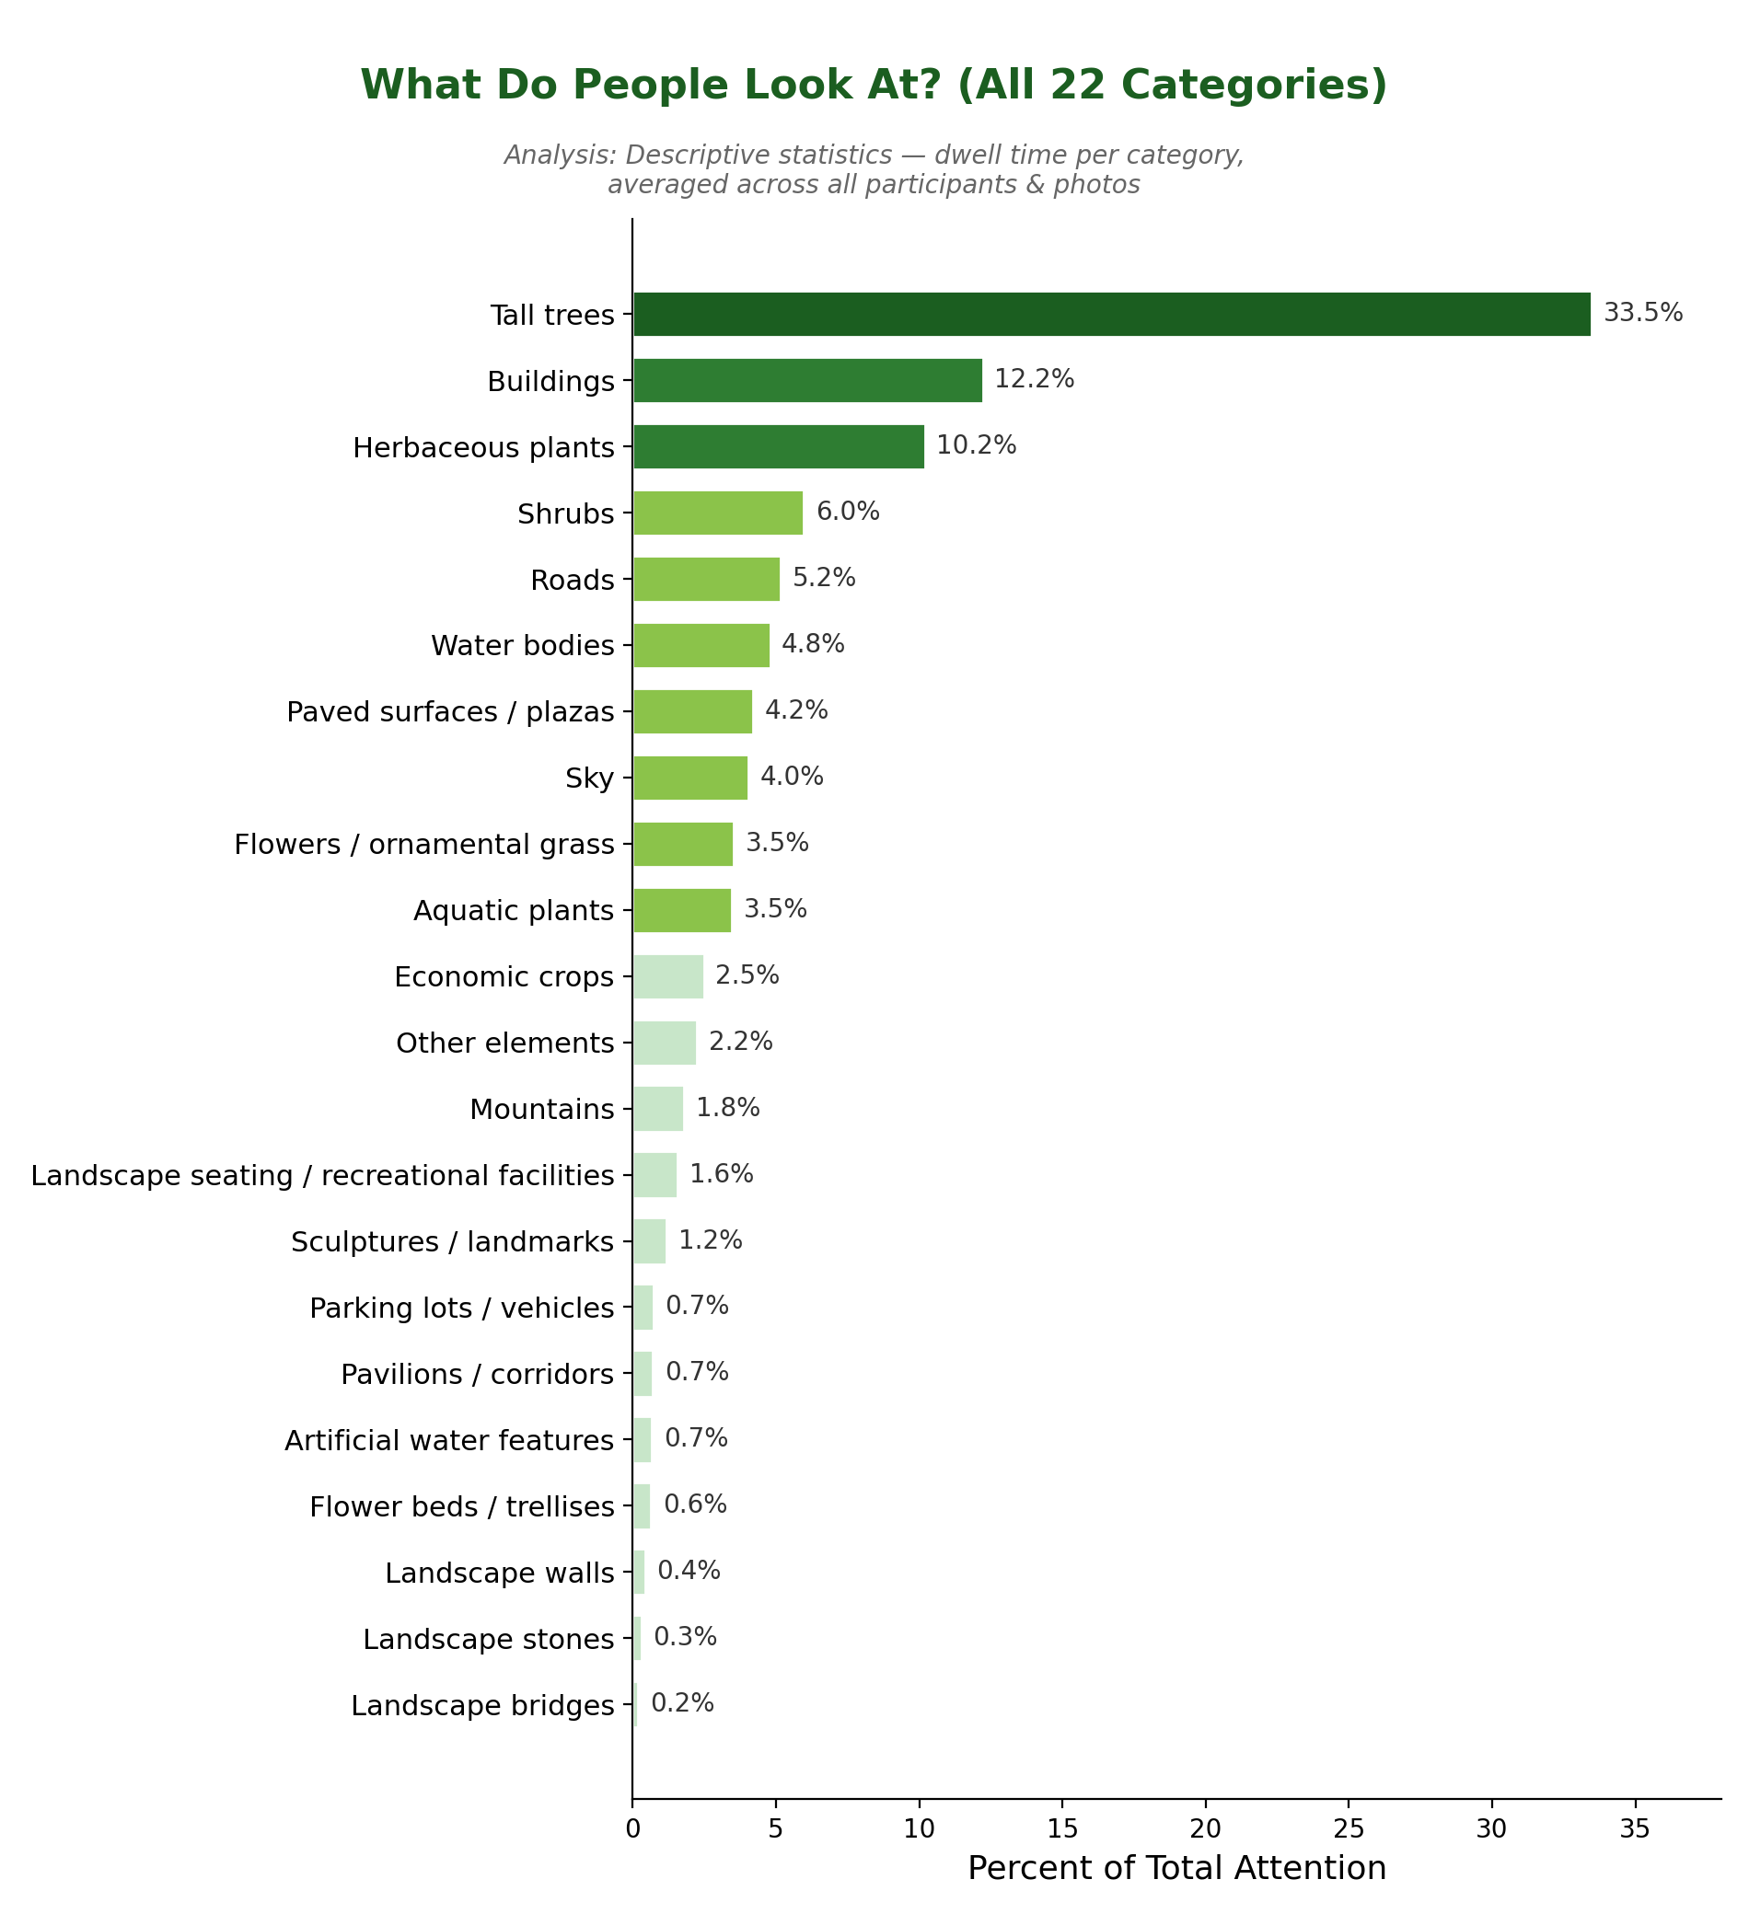
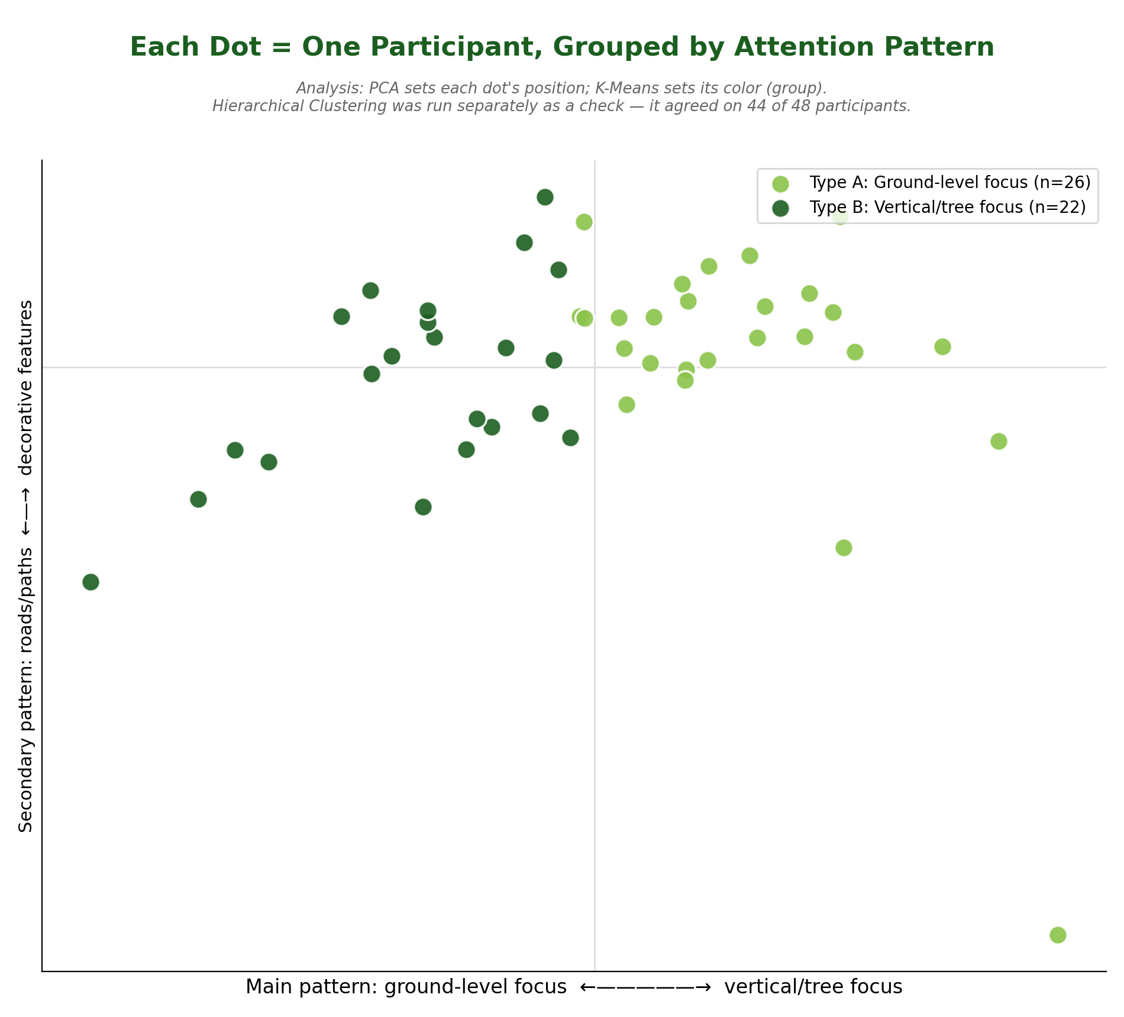
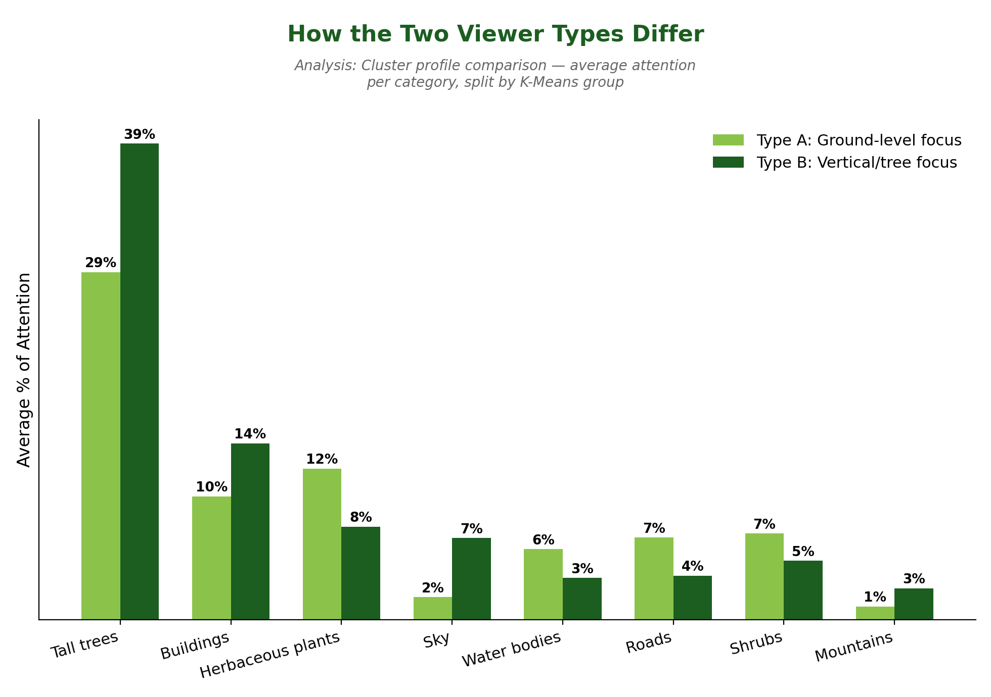
Where Do People Look? Eye-Tracking Analysis of Visual Attention in Landscape Photography
A statistical and machine learning analysis of visual attention allocation in landscape perception
Danny Galvis
Faculty Mentor: Dr. Feng Qi​
INTRODUCTION
DATA COLLECTION
METHODS
Landscape architects and urban designers often have to guess what will catch someone's eye in an outdoor space. This study replaces that guesswork with direct measurement: eye-tracking equipment recorded exactly where 48 people looked while viewing a shared set of landscape photos. The goal was to answer two questions:
Does visual attention depend more on the scene being viewed or on the individual person looking at it?
Are there measurably different types of viewers?
Data was collected using a Tobii eye tracker, which records where a person's gaze lands in real time. Tobii's software presented the landscape photos and logged gaze coordinates throughout each session, storing them across binary, XML, and SQLite project files.
48 valid participants viewed a shared set of landscape photos while their gaze was tracked
Each photo had 22 pre-labeled Areas of Interest (AOIs) (e.g., Tall Trees, Sky, Buildings), later grouped into 6 broader categories
Gaze points were matched against these AOI regions to determine what was being looked at and for how long
This produced roughly 2,300 attention records across all participants and photos
Parsing: Python scripts extracted raw gaze coordinates and AOI polygon data from Tobii's binary/XML/SQLite project files.
Aggregation: Dwell time, gaze counts, and attention percentages computed per participant, per photo, and per AOI category.
Statistics: One-way ANOVA per AOI category, comparing variance explained by Site vs. by Participant.
Machine Learning: Each participant reduced to a 47-feature behavioral profile (mean + consistency of attention to each category, plus dwell time, AOI breadth, and attention entropy), then analyzed with PCA (dimensionality reduction), K-Means, and Hierarchical Clustering (unsupervised grouping).
RESULTS
CONCLUSION
For each landscape feature, a statistical test (ANOVA) measured whether attention was explained more by which photo was shown or by who was viewing it. A higher F-value means that factor had a bigger effect. For 21 of 22 features, the photo had the bigger effect. Sky was the exception, where the person had the bigger effect.
Landscape Feature | Effect of the Person (F-value) | Effect of the Photo (F-value) | Bigger Effect
Farmland / crops | 0.17 not significant | 346.9 p < .001 | The Photo
Aquatic plants | 0.63 not significant | 139.2 p < .001 | The Photo
Buildings | 1.69 p < .01 | 120.7 p < .001 | The Photo
Sky (the exception) | 22.2 p < .001 | 7.4 p < .001 | The Person
The landscape, not the person, drives visual attention — the specific photo explained far more variation than who was viewing it.
Tall trees are the single strongest visual anchor, capturing about a third of all attention.
Two loose viewer styles exist (ground-focused vs. tree-focused), but most people fall in between.
Sky is the one exception — how much someone looks up is personal habit, not scene-driven.
Overall, attention was overwhelmingly nature-oriented (~60% vegetation vs. ~23% built).
Takeaway: Designers should prioritize tall trees and vertical greenery — it reliably captures attention across nearly any visitor.
Table 1. F-value = a measure of how strongly that factor affected attention; higher means a bigger effect. p-value = how confident we can be the effect is real (smaller = more confident; "not significant" means the effect could be due to chance).
Highlighted cell in each row shows which factor — the photo or the person — had the bigger, more reliable effect.
ACKNOWLEDGMENTS
Term | Meaning
PCA | Machine learning method that simplifies many measurements per person into just a couple of overall scores, so people can be plotted and compared
K-Means Clustering | Machine learning method that automatically groups people by similar behavior, without being told what the groups should look like
ANOVA | A test for whether a factor (photo vs. person) had a real effect
Hierarchical Clustering | A second, independent clustering method used to double-check the K-Means groups
The work reported in this poster was supported by the Kean University Scholars Academy, funded by NSF Award #2247157 Improving Undergraduate STEM Education at Hispanic-Serving Institutions (IUSE HSI)-- Institutional Transformation Project: Fostering Communities of Practice through Research and Peer Mentoring.

