Slide 1
Exploring Trending Youtube Videos
Categories Deserving Marketing Attention
By: Daniel Garcia
8/8/2020

Slide 2
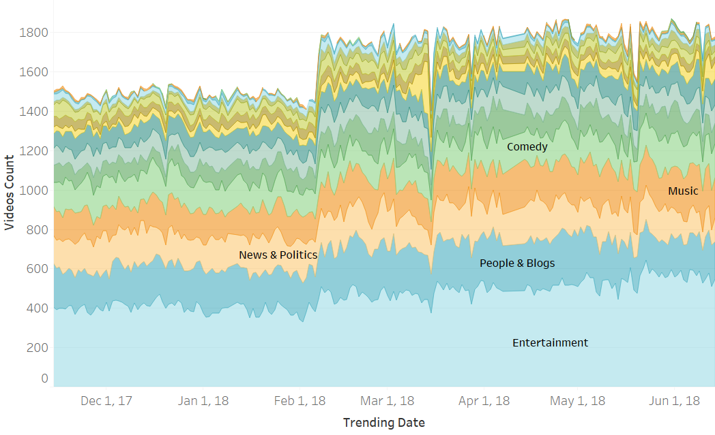
Which Video Categories Trended Most Often?
Trending Videos By Category (Nov. 2017 – Jun. 2018)
Most Popular Trending Video Categories
Entertainment
News & Politics
People & Blogs
Music
Comedy
Categories are sorted in ascending order by aggregate median of video counts.

Slide 3
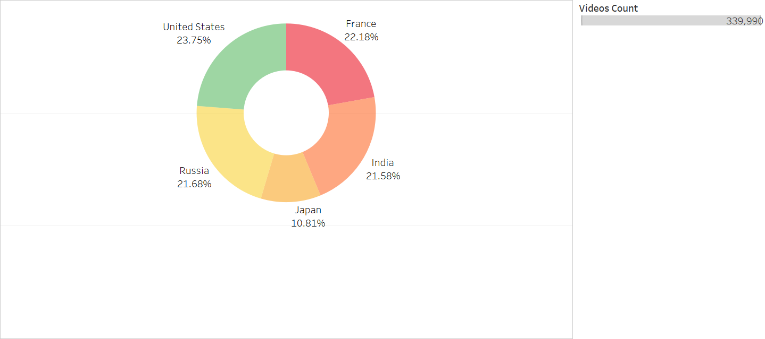
Relative Distribution of Video Counts By Country
How Were Trending Videos Distributed Among Regions?
With the exception of Japan, share of trending videos are roughly equal amongst the countries
In terms of eye views, more efforts should be given to regions with > 20% share of trending videos
Size shows total sum of videos count (from Nov.14, 2017 to June 14,2018).

Slide 4
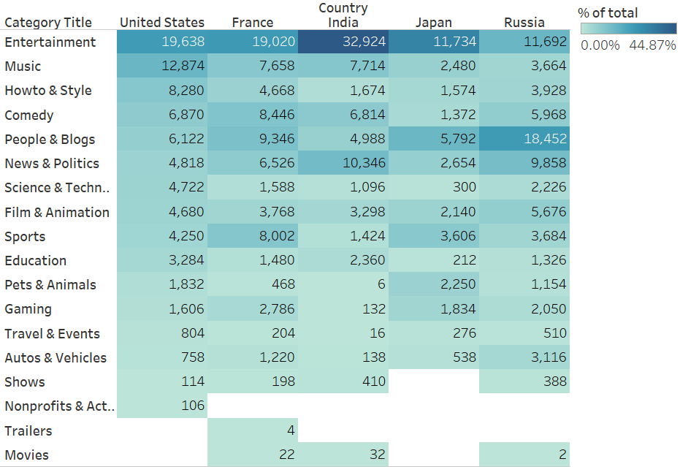
What categories were especially popular in the United States?
Most Popular Trending Video Categories in the United States
Trending Videos By Country and Category
Entertainment
Music
How to & Style
Comedy
People & Blogs
Music and How to & Style categories are more popular in the U.S. relative to the other countries
Sorted in descending order by United States’ trending video count (from Nov.14, 2017 to June 14,2018). Color shows % of total for country. The marks are labeled by sum of video count.
Notes:
Entertainment, music, how to & style, comedy, and people & blogs

Slide 5
Conclusions and Recommendations
Overall top 5 video categories of interest: (1) entertainment, (2) news & politics, (3) people & blogs, (4) music, and (5) comedy
Regions of special interest for the company to advertise in: U.S, France, Russia, and India
In the United States the following categories (listed in order) deserve marketing attention: (1) entertainment, (2) music, (3) how to & style, (4) comedy, and (5) people & blogs

