Slide 1

Market Research Of Establishments in LA: Restaurants Offer the Best Opportunity to Succeed
6/26/2020
Daniel Garcia Rodriguez

Slide 2

General Conclusions:
Opening a Restaurant in LA will Provide The Best Opportunities to Succeed for the Company Given the Novelty of Service Provided (Robot-Waiters).
Large share of establishments in LA: Restaurants make up roughly 75% of the establishments in LA
Less big Players: Restaurants more likely to be non-chains (68.4%)
Recommendation: Open a small non-chain restaurant with 48 seats– average for a restaurant chain
Aggressively grow thereafter – establish a chain
Source: LA Restaurant Dataset – Provided by Yandex By Practicum
Notes:
The large share of establishments in LA, especially considering their high % of non-chain establishments make it relatively easier to compete and thrive given the service it will provide.
If it decides to pivot into a restaurant establishment then the company should consider starting off as a non-chain with 48 seats and depending on its strategy, establish itself in a street with many restaurants and/or one restaurant

Slide 3
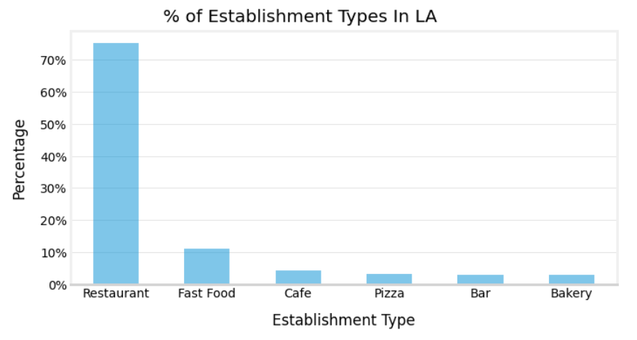
Restaurants Are By Far the Most Common Establishment Type in LA
Roughly 3/4 of establishments in LA are restaurants
On the other hand, Cafes, the company's planned venue, makes up 5% of establishments in LA.
Restaurants seem to have more opportunity to enter
Source: LA Restaurant Dataset – Provided by Yandex By Practicum

Slide 4
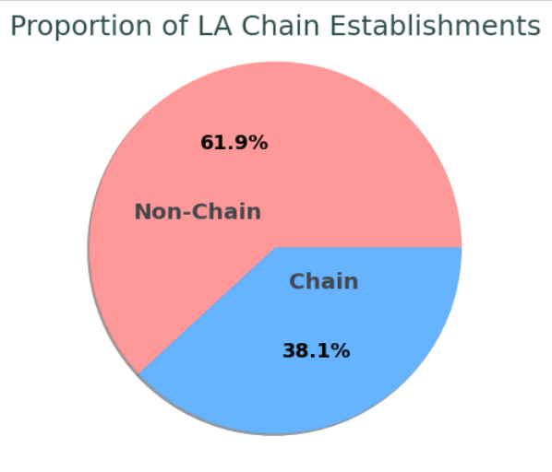
The Majority of Establishments in LA are Not a Chain
Non-chains establishments are 5% points away from representing 2/3 of the LA establishments.
There’s a share of small players in the current LA market.
Source: LA Restaurant Dataset – Provided by Yandex By Practicum

Slide 5
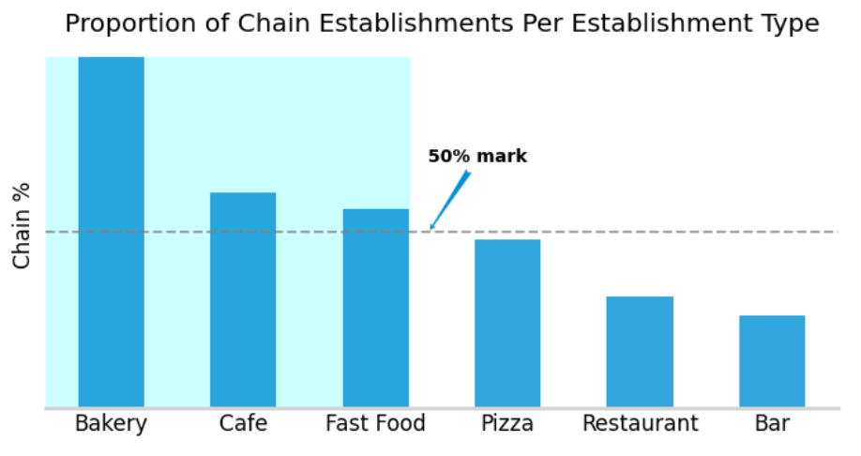
Restaurant Establishments are Less Likely to Be A Chain
Roughly 1/3 (31.6%) of restaurants are a chain. Likely the reason why non-chains were well represented in the pie chart earlier.
Cafes have a higher chance of being a chain establishment. According to market research, 4 out of 5 (78%) coffee shops in the U.S. are chain establishment—figures are growing [1][2].
Restaurants offer the better opportunity for long-term success
Source: LA Restaurant Dataset – Provided by Yandex By Practicum
[1] Allegra World Coffee - Project Café USA 2020 Survey: https://www.worldcoffeeportal.com/Research/LatestReports/Project-Cafe-USA-2020
[2] Daily Coffee News https://dailycoffeenews.com/2019/10/25/nearly-four-of-every-five-us-coffee-shops-are-now-starbucks-dunkin-or-jab-brands/

Slide 6
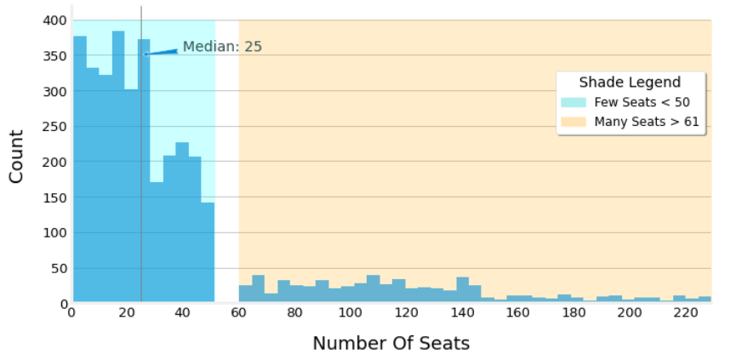
Chain Establishments are Characterized By A Few Establishments With Many Seats
Chain Establishments: Distribution of Seats
At a median of 25 seats, the share of chain establishments given the distribution, leans more towards low number of seats (1-50 seats)--roughly 82% of establishments.
Many seats: right skewed tail and very low share % count.
Considering the proportion and shade for the "many seats" category, indicating that the distribution indicates that
Source: LA Restaurant Dataset – Provided by Yandex By Practicum

Slide 7
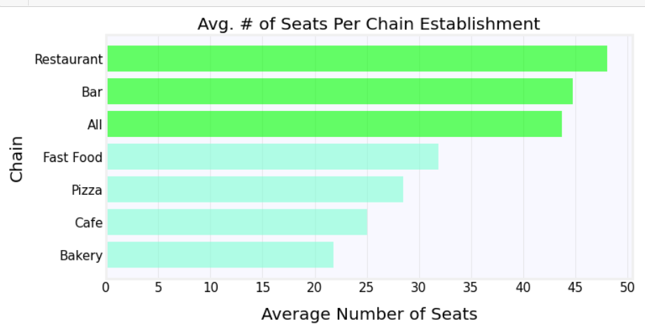
Chain Establishments In LA: Restaurants and Bars Have the Highest
Average Number of Seats
When we consider the aggregate average, notice how the 4 establishment types' average number of seats fall more than 10 seats below it.
On the seat distributions, the majority of the "many seats“ values on the distribution can be attributed to restaurant and bar establishments.
Source: LA Restaurant Dataset – Provided by Yandex By Practicum

Slide 8
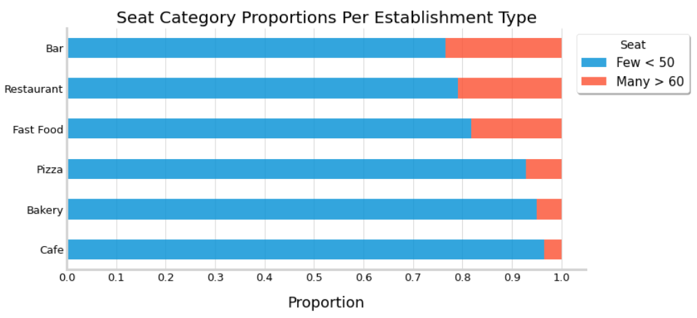
Chain Establishments in LA: Roughly 1/5 of Bar, Restaurant and Fast Food Establishments Have Many Seats
Few Seats %: Indicates that there are many small chain restaurants in LA
Opportunity for company to open while keeping low overhead costs
Company can open with around the average (48) number of seats
Source: LA Restaurant Dataset – Provided by Yandex By Practicum

Slide 9
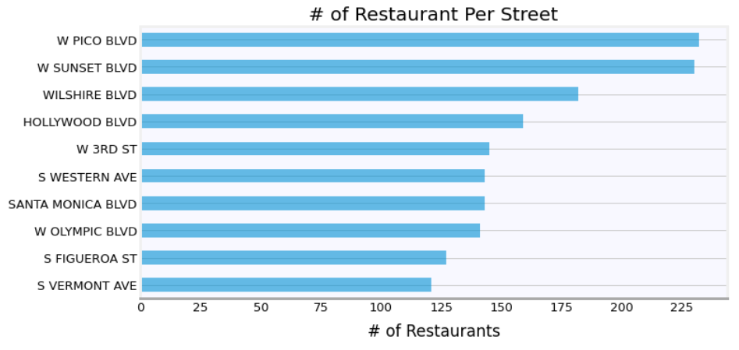
Top 10 Streets With High Restaurant Establishment Concentrations
top 10 streets contain between 110 and 230 restaurants
68% of streets contain 1 restaurant whilst 32% contain more than 1
These streets may be of interest for the company if they want to enter a competitive but thriving market.
Source: LA Restaurant Dataset – Provided by Yandex By Practicum

Slide 10
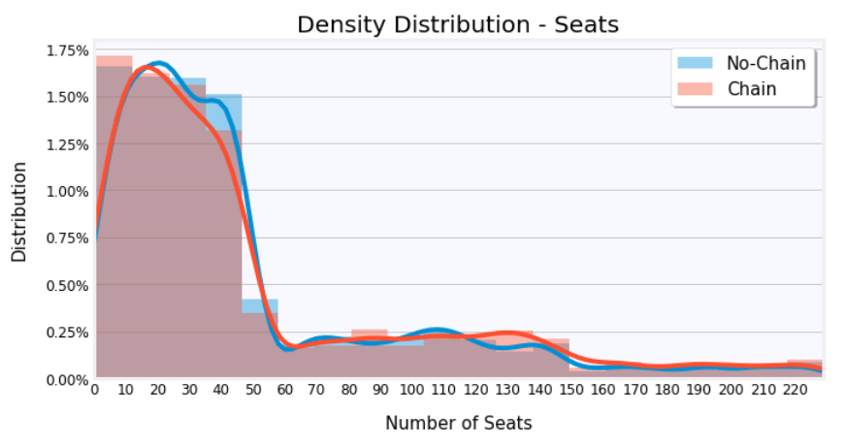
Distribution of Seats
LA Streets With Many Restaurants (>10):
Chain Affiliation Makes No Difference In
Have a median of 32 seats
Distribution of seats can be split into two groups (many and few) and does not differ amongst chains and non-chain restaurant establishments
Source: LA Restaurant Dataset – Provided by Yandex By Practicum

Slide 11
Recommendation
When thinking about establishing in LA, given (1) chosen establishment (small Cafe), (2) the novelty of the service provided (robot waiters), (3) the current market conditions, (4) cost of the project, and (5) long-term goal to maintain a successful establishment, the following recommendation is given:
The company should pivot towards establishing a restaurant as there is less big players (chains) in that market relative to Cafes; small cafes are being outcompeted by Cafe chains.
Large share of establishments in LA, especially considering their high % of non-chain establishments make it relatively easier to compete and thrive given the service it will provide.
Should consider starting off as a non-chain with 48 seats and depending on its strategy, establish itself in a street with many restaurants and/or one restaurant.
It can then aggressively grow and establish a chain thereafter given the novelty of service provided.

