Slide 1

Everything Plus's U.K. Customer Profiles Using RFM Analysis
By: Daniel Garcia
Date Completed: 10/2/2020
Online Retail II Dataset* from UCI Machine Learning Repository
* Data provided by Practicum by Yandex. Some values may differ from the dataset from UCI repository.

Slide 2
OVERVIEW
The Setting (general overview of process)
The Analysis (insights from EDA)
The Segments (RFM Segments and analysis)
Conclusion and Recommendations
Notes:
Pain points, Lillian

Slide 3

1. The Setting
Notes:
Brittney

Slide 4

Problem: Form segments of customers based on similar purchasing characteristics.
Notes:
Problem - Lillian

Slide 5
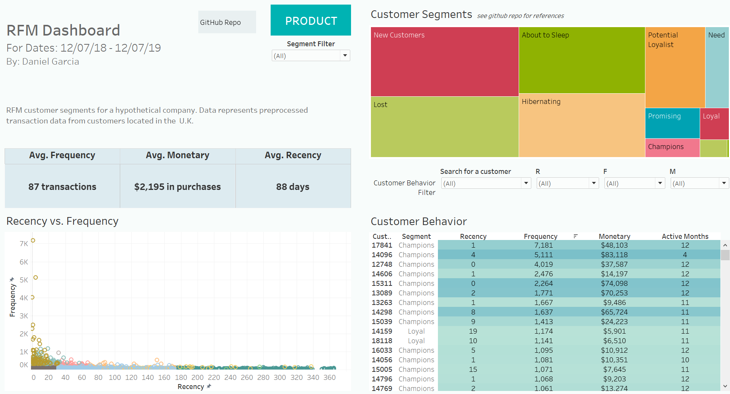
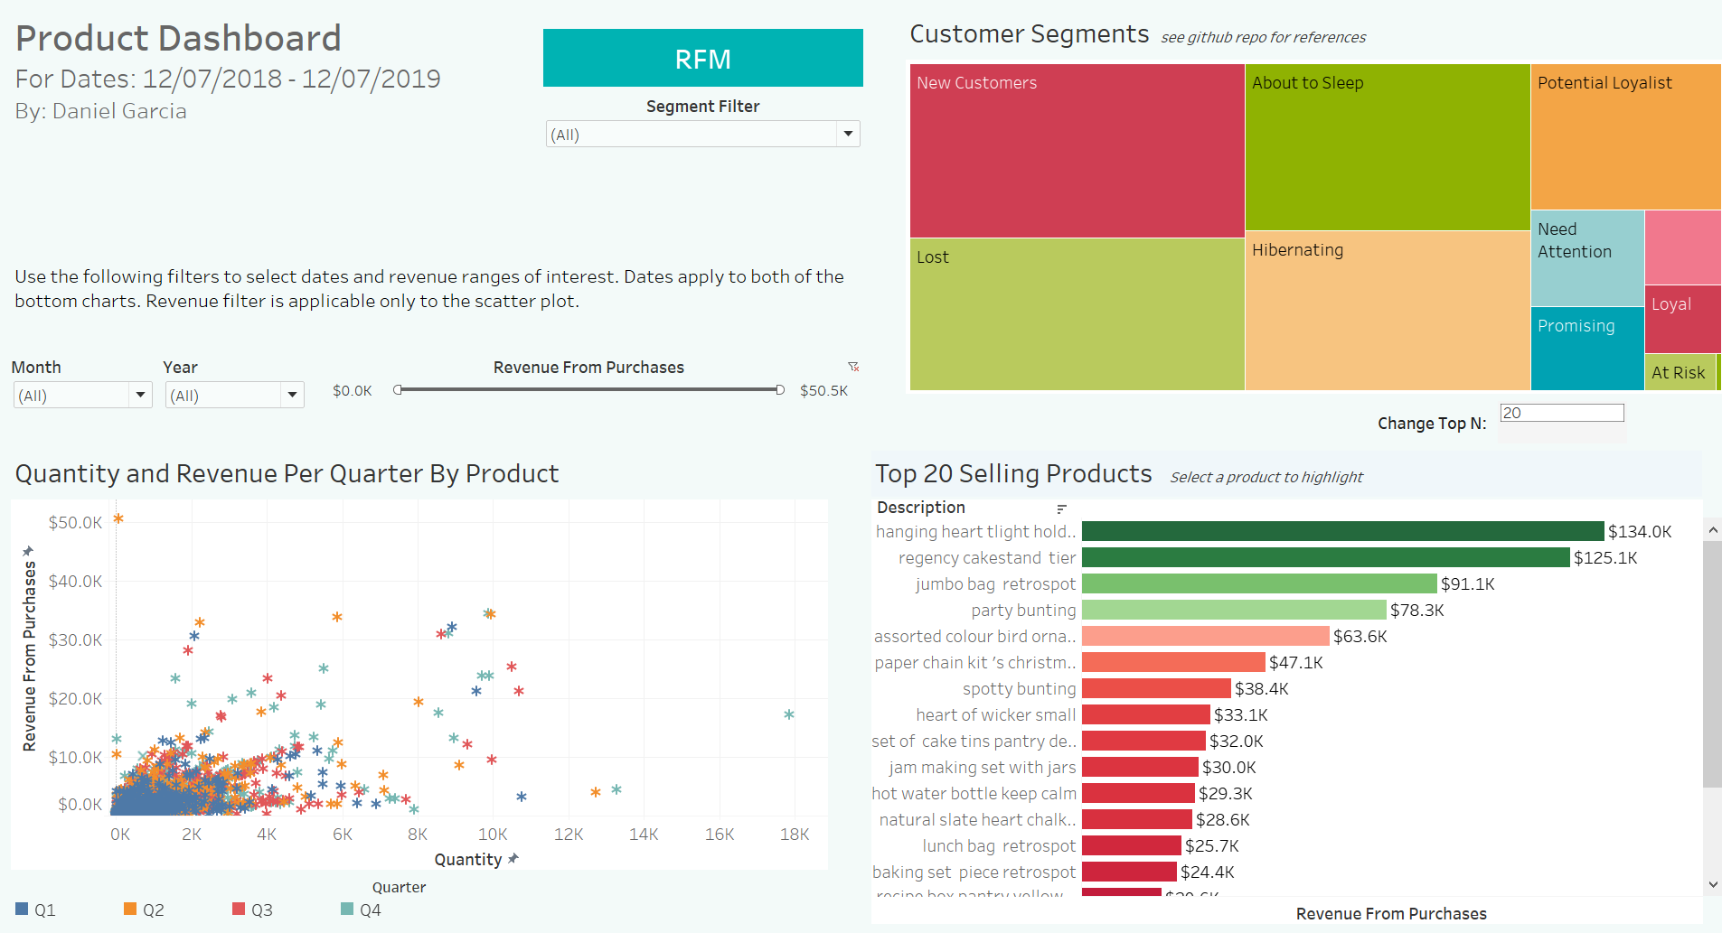
Solution: RFM Segments
Interactive Dashboard
See:https://public.tableau.com/views/graduationProject/RFMDashboard?:language=en&:embed_code_version=3&:loadOrderID=17&:display_count=y&publish=yes&:origin=viz_share_link
Notes:
kristyn

Slide 6
Data Context
Customers:
Must be located in the U.K.
Currency must be in US Dollars rather than the pound sterling,
Time span: One year
Threshold set at one year from the day of last recorded transaction in the dataset.

Slide 7
Methods Overview
Data Understanding
Data Preprocessing
Exploratory Data Analysis
RFM Segmentation
Tableau Dashboard
Got a general idea of the underlying data through basic exploration steps
Dealt with missing values, erroneous or faulty data (ie. negative values), dropped duplicates, and changed data types when needed.
Explored the distribution of variables (ie. quantity) over time (date, month) and per unique customer.
Feature creation
Clustering analysis of the products
Used RFM analysis to segment customers
Exported relevant data from analysis and created a Tableau dashboard as a deliverable for hypothetical stakeholder.

Slide 8




2. The Analysis
Notes:
Brittney

Slide 9
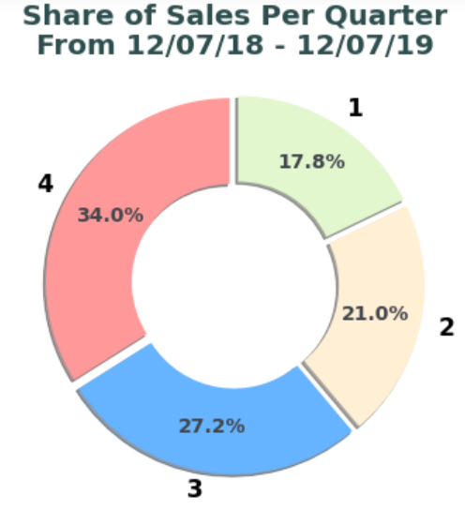
Sales Increase Over Each Quarter
More than 1/3 of revenue is earned during months in the 4th quarter with the first quarter brining in the least
Seasonality seems to come into play; 4th quarter should get the most attention.
Notes:
lMore than 1/3 of revenue is earned during months in the 4th quarter with the first quarter bringing in the least.

Slide 10
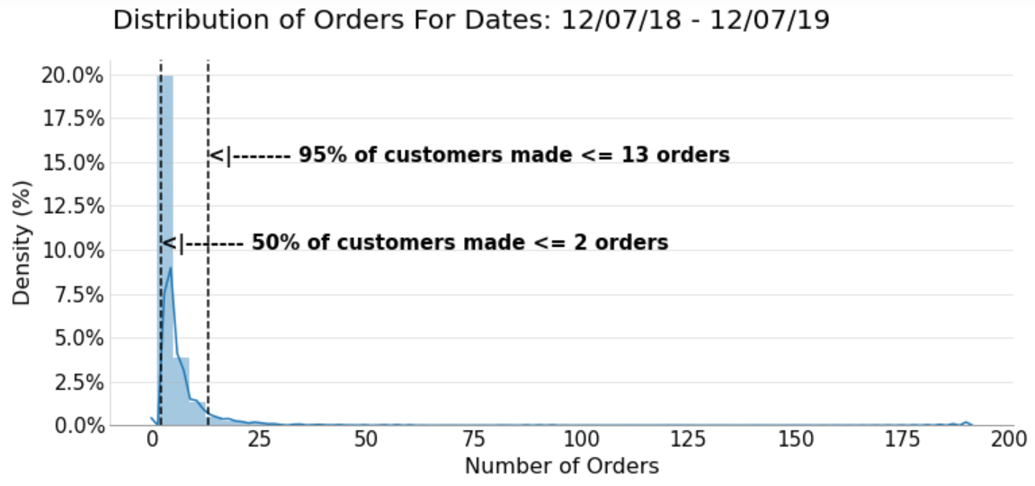
Most Customers Are One Time Purchasers
Only 5% of customer made more than 13 orders over the year
When accounting for revenue, most customers seem to be wholesalers

Slide 11
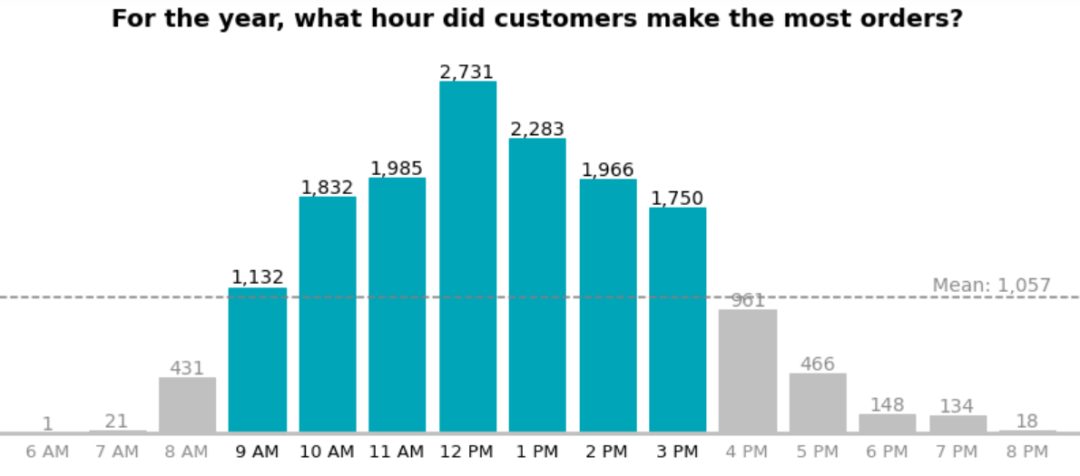
Noon: The Most Important Hour
In terms of purchases, 12 to 2 pm are the online store's peak hours
The company can expect most revenue to have been made during 10 am to 4 pm.
*Note*: may differ given timezone differences; shows distribution based on time log of software
Notes:
daniel

Slide 12
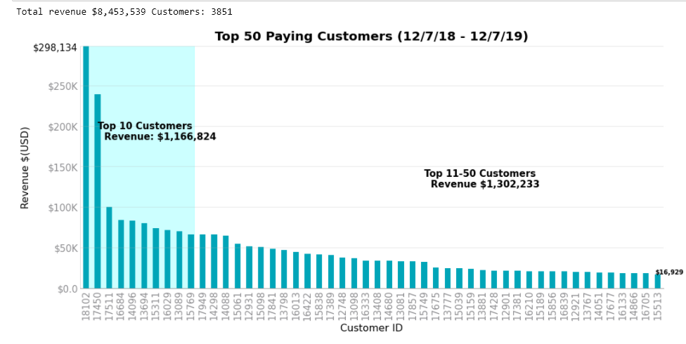
The General market
Top 50 customers made up almost 30% (~$2.5 mil) of total revenue (~$8.45 mil)..
Top 10 customers brought ~$1.15 mil whilst the others top 40 brought in ~$1.30 mil.

Slide 13




3. The Segments
Notes:
Brittney

Slide 14
RFM Metrics:
RFM Definitions Used
e.g. time since last activity
RECENCY
The freshness of customer activity.
FREQUENCY
The frequency of customer transactions.
MONETARY
The willingness to spend.
Used last day of purchased since max date (1207/2019)
Used number of product transactions made (not orders).
Used total purchase amount

Slide 15
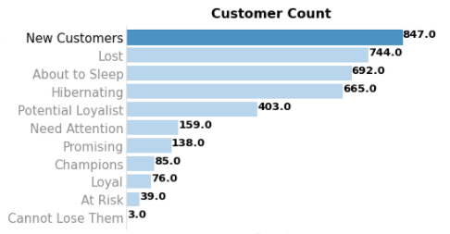
Share of Segments: Most Are Lost or New Customers
Most of the company's customers are either new, lost, about to sleep or hibernating customers. Need improvements.
Champions, loyal , at risk and 'cannot lose them' customers represent the least of the total customers.

Slide 16
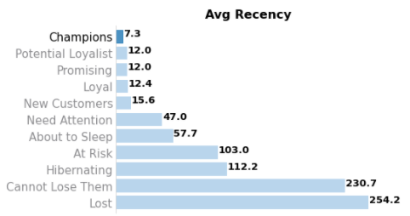
The Top 4 Recency Customers Segments: Consistency Is Key
Lost and ‘Cannot Lose Them’ Customers Haven’t Made a Purchase For Over 8 Months
Recency in purchase is a key feature of the top segments. (w/ exception of ne customers).
Notes:
daniel

Slide 17
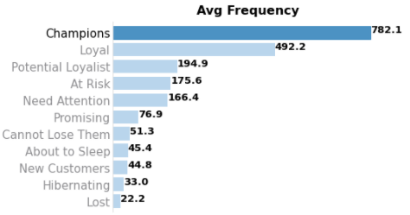
Champions and Loyal Customers, the Kings of Transaction Frequencies
Champions and loyal customers product transaction count for the year, trump the others. Two segments deserve loyalty/rewards program
Given count seen earlier, most customers don’t make as much purchases, hence the low average transaction frequencies.
Notes:
daniel

Slide 18
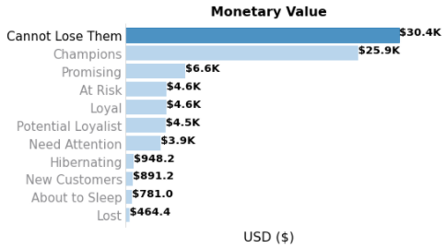
Monetary Value For Top Two Segments: Promotional Offer(s) Needed
Top 2 customer segments brought in ~$26k to $30k over the year.
Lost customer segment on average spends $464 over the year.
Notes:
daniel

Slide 19
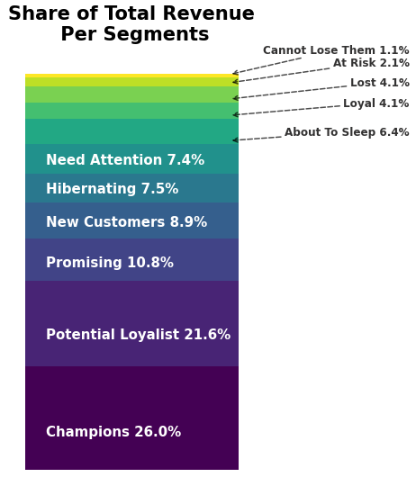
~16% of customers make up ~58% of the total revenue
Top 3 segments, in terms of revenue share should be of interest to the marketing team given their large revenue contribution relative to the other segments.
'Lost' segment (low R,F, and M scores): despite representing ~19% of total customers, their share of contribution to total revenue is a low 4%. Lost segment => Low Priority
Notes:
op 3 segments aforementioned segments should be of interest to the marketing team given their large revenue contribution relative to the other segments.

Slide 20



4. Conclusion and Recommendations
Notes:
Brittney

Slide 21

Relevant Points
Store’s champions (n= 85) : loyal customers who make large number of transactions with high monetary spenditure over the year.
Loyal customers (n=76) have the highest potential of becoming store’s champions given their high avg. RFM values relative to their size.
Promising customers (n =138): relatively new customers given that on average, their last purchase was made 12 days from the max date.
Lost customers (n=744) can be considered lost as they haven't made an order for over 8 months and have on average made a low amount of transactions (22) and total money spenditure for the year.

Slide 22
Suggestions
For champions, loyal: They should be treated with extra care by offering rewards, discounts, bundle offerings (given large order size).
For 'Cannot lose', at risk, and needs attention segment: The company should attempt to reach out to them to win them over as loyal customers through engagement.
For potential loyalist, new customers and promising: Create relationships with them and an offer personalized discounts.
For hibernating and about to sleep segments: Launch campaigns or create a win-back strategy to 'reawaken' them.
For lost segment: Should have the lowest, if any, marketing and sales attention. They do not bring as much value to the company
Notes:
Pain points, Lillian

Slide 23
Questions?

