Slide 1
RBC Next Great Innovator Hackathon
RBC Serve
September 25, 2016
Created By:
Bainian Liu
Danny Gosain
Sadruddin Hashmani
Sanhar Balachandran

Slide 2
Table of Contents
Background on Situation
Solution
Demo
Q&A / For More Information

Slide 3
Background on
Situation

Slide 4
2016 RBC NGI Challenge – Small Business
Small businesses are a core engine for growth for Canada, representing 30% of Canada’s GDP.
Many small businesses are being started by newcomers and younger entrepreneurs, and digital capabilities and flexibility are now very important for small business customers.
Banks are innovating more than ever before and finding ways to win in the attractive Small Business market.

Slide 5
Solution

Slide 6
Product
“An innovative prototype of a web app that RBC could offer to help business owners acquire customers, build relationships and grow their small businesses.”

Slide 7
Demo

Slide 8
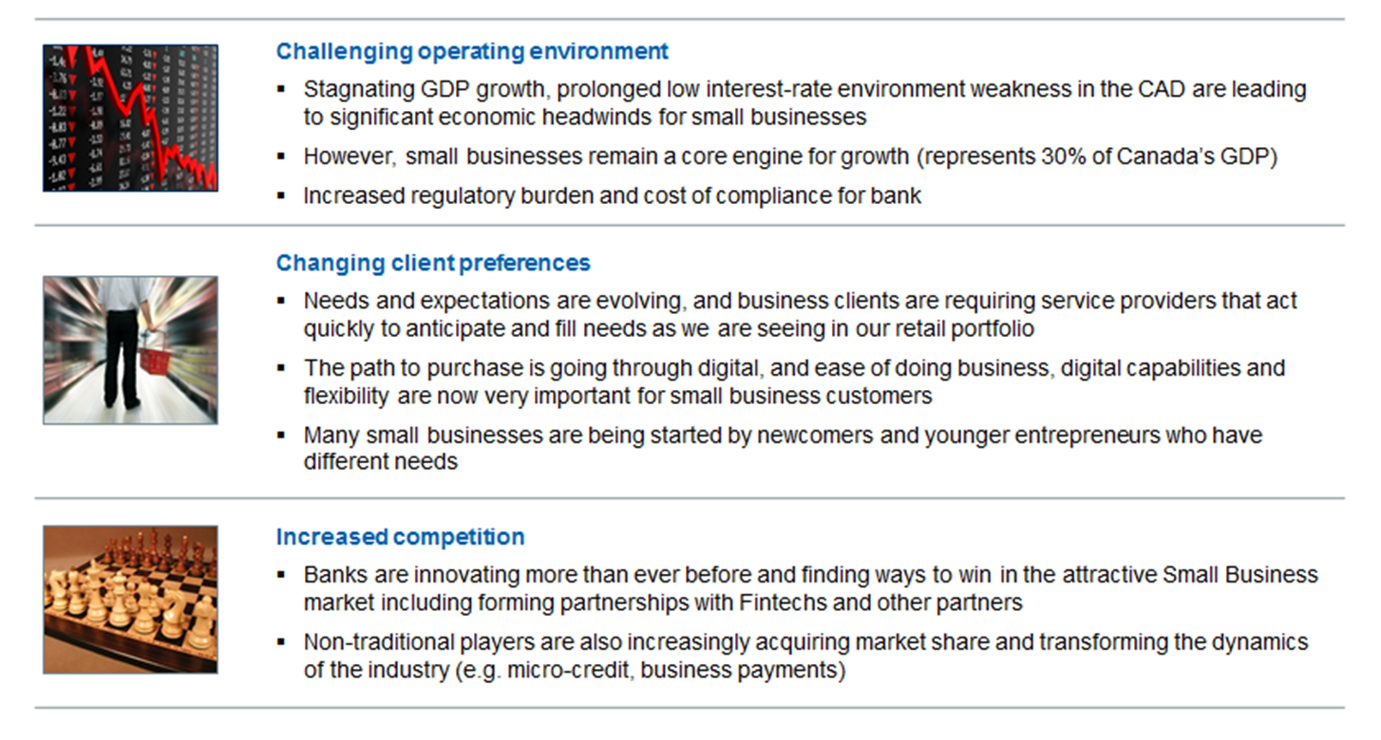
Small Business – Strong Forces of Change

Slide 9
Core Beliefs for Small Business Clients
Acquisition of new business will continue to be critical to our ongoing success
Speed and simplicity are key attributes Small Business Clients are expecting in how we serve them
Our superior multi-channel distribution network can be a stronger competitive advantage, allowing us to serve more clients more often
Easy access to credit is often a lead into new relationships and is a key moment of truth in existing relationships
Small Business clients are increasingly expecting a digital experience for their business that is being shaped by their personal experiences
Given limited time and resources, clients value partners who are able to help them run and grow their business effectively

Slide 10
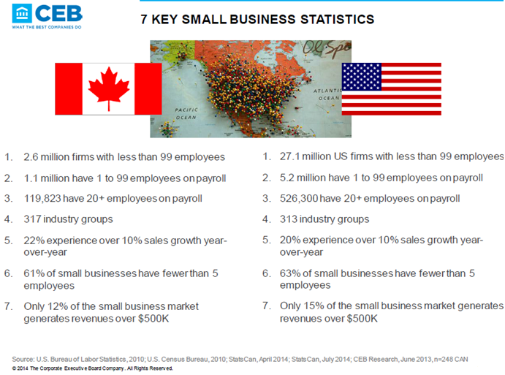
Key Small Business Statistics

Slide 11
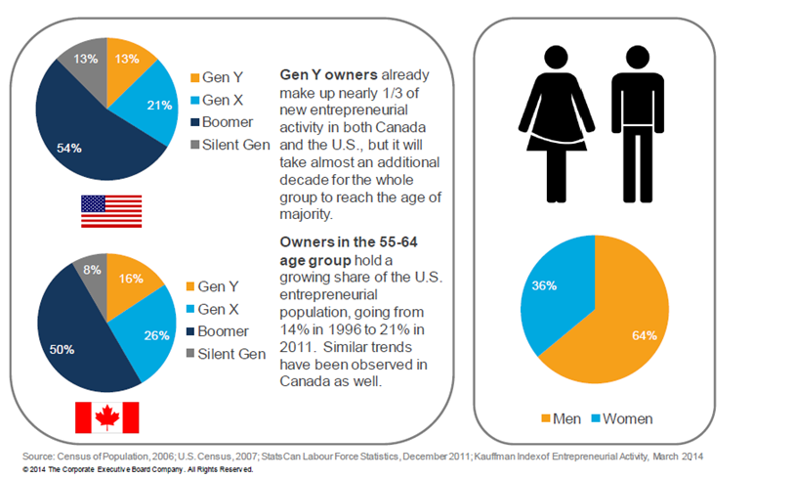
Small Business Owner Profile

Slide 12
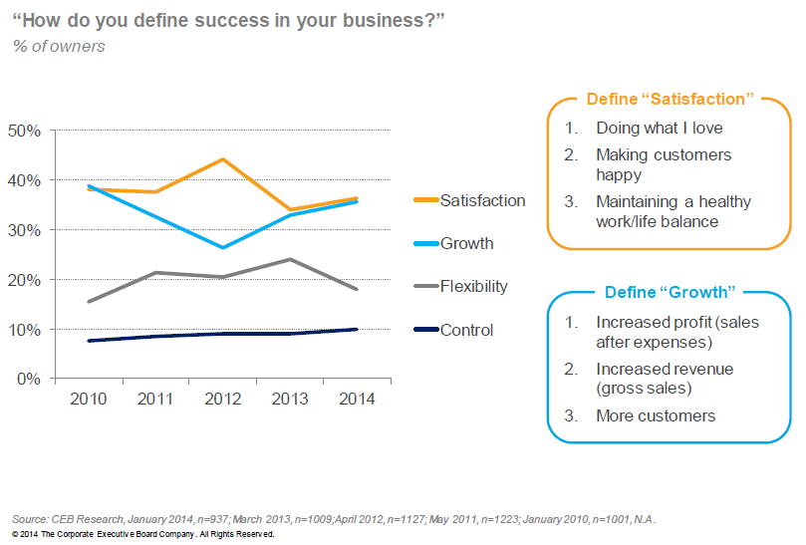
Owners: Motivated by Growth & Satisfaction

Slide 13
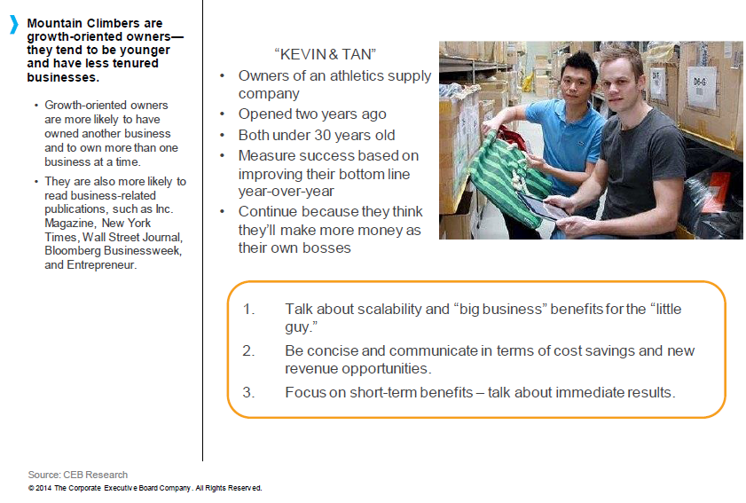
Profile: “Mountain Climber” Business Owner

Slide 14
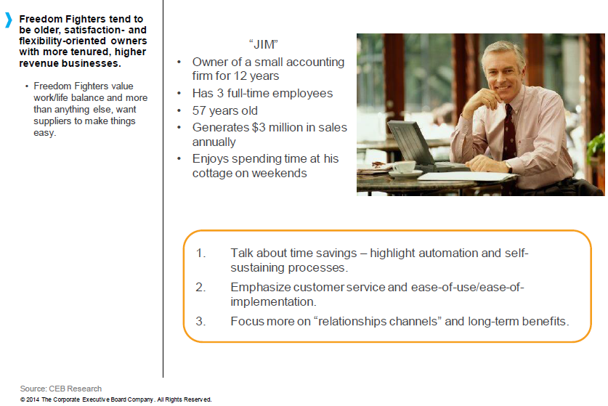
Profile: “Freedom Fighter” Business Owner

Slide 15
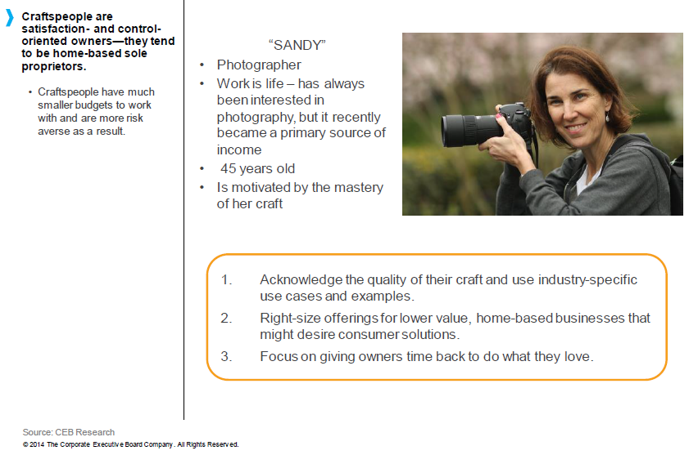
Profile: “Craftsperson” Business Owner

Slide 16




Changing Face/Needs of Small Business Clients
Small business is multi channel in banking, going virtual in business
Business cheques are declining at a rate of 4-5% a year
Busy and time-starved often wearing multiple hats and involved in various levels of decision-making
75%
~58%
of the workforce will be Millennials in less than 15 years
of all small and medium-sized enterprise owners are over 50 years of age
Open to novel / innovative ways of doing business with the goal of “getting things done”
1.6X
Open / familiar / reliant on technology as an enabler for their business
More newcomers start businesses than other Canadians
In search of solutions to grow their business and simplify their operations
SB owners do not solely rely on face-to-face interaction, but are increasingly embracing virtual technologies such as tablet
Flexibility the most important factor in the final decision
Given their busy schedule, seeking to do business on their own terms – time, place and channel of choice

Slide 17
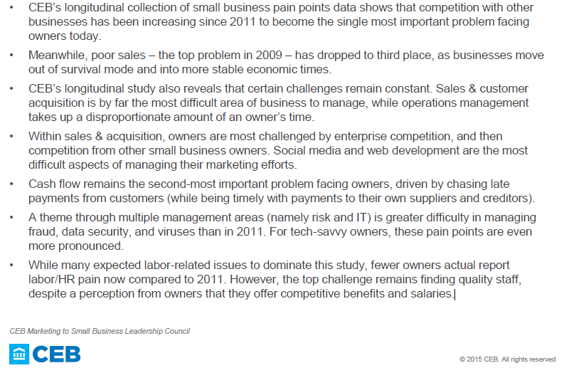
Small Business Pain Points

Slide 18
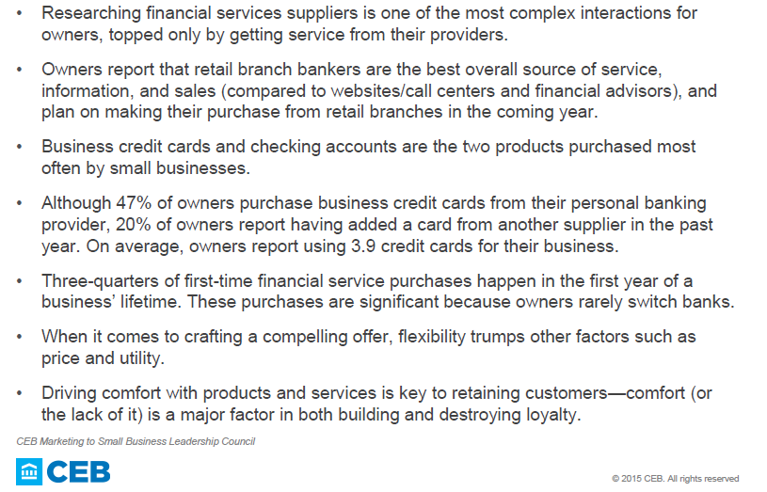
How Owners Buy Financial Services

Slide 19
Judges’ Evaluation Criteria
1st Round (starts @ 11 a.m., Sun.) – 2 min presentation / 2 min Q&A
CLARITY (25%) – Was the concept clearly described?
EXECUTION (30%) – Was a working piece of code demonstrated, questions clearly answered?
VALUE to RBC (30%) – Why should we use your app?
FINAL ROUND (15%) – Will complete working prototype be done by 3 p.m.? Is this a top-5 team?
Final (Top-5) Round (starts @ 2:30 pm, Sun.) – 10 min pres’n, 10 min Q&A
VALUE TO RBC (40%) – Addresses the Challenge question? Trends / change factors addressed? Were RBC needs / opportunities clearly identified? Is the idea feasible, with real potential?
TECHNICAL DEPTH & UI/UX (30%) – Working prototype developed? Makes good use of features of chosen platform? Appealing User Interface (UI) and User Experience (UX)?
ORIGINALITY & CREATIVITY (20%) – Novel approach to serving RBC’s small business clients? Idea thoroughly developed?
PRESENTATION (10%) – Engaging presentation? Clear articulation of idea, including value to RBC and our clients?

Slide 20
Success Tips – Judges are Advocates
Judges privately meet to debate the merits of each team’s submission. Each round, you want at least ONE judge to be “your champion”. So…
Make sure your idea addresses & answers the challenge theme
Ensure that you follow the concept template provided (for submission on Sunday morning)
Be concise in your written submission & spoken presentation
Take advantage of all of the coaching that's offered
Make sure your idea is well supported by research
Use passion to bring your solution to life
BE CLEAR, BE CREDIBLE, BE COMPELLING

Slide 21
First Round Judging
You Provide a Concept Doc
Concept Name
Team Name
History
Idea Description
Value to RBC
Key Issues
Business Pitch
2 minutes
(Elevator Pitch)
Notes:
Concept Documents will be collected at 10am on Sunday November 22nd. Concept documents are a mandatory submission and are required for you to continue in the event. A template for concept document creation will be emailed to you directly. Outlined above are the categories you will find on the concept document.
First round judging will utilize your Concept Document and your 2 minute Pitch to determine the top 5 teams moving onto the Final round.

Slide 22
What is an elevator pitch?
You have only two minutes to say it all, so how do you do it most effectively?
Convince the judges that your idea is best by believing it yourselves
Pick one primary problem and laser-focus on your solution
Don’t waste any time on anything that doesn’t matter – any introductions should be bare minimum (a few seconds at most)
Consider using a very quick real-world story as a way of helping the judges to envision your submission as THE way to solve your stated problem and weave it into your demo
Practice – practice – practice
Use your APP demo to drive the discussion
Notes:
2 minute pitches need to include a showcasing of the prototype being built.

Slide 23
The Pitch: Debunked
So what do you do?
1-Define the problem
Who are you helping?
What is the need?
Demonstrate opportunity!
3-Strengthen the pitch
Be unique
Think sustainability
Talk benefit, not jargon
2-Solve the pain
How are you solving?
What difference are you making?
Are you filling the need?

Slide 24
Pitch Perfect: 3 Cs
The ultimate goal: Maximum Impact
BE CLEAR
BE CREDIBLE
BE COMPELLING
One idea
What’s the point?
Stats/code
No hyperbole
Demo
Show potential
Be personable
Notes:
No hyperbole means “don’t exaggerate”… just substantiate your claims, briefly, with some statistics

Slide 25

Questions
E-mail for questions (*): nextgreatinnovator@rbc.com
james.miller@rbc.com
(*) Only able to answer general questions until the event begins on Sept-24.
Follow Us:
Facebook.com/RBCngi
@rbcinnovator
Nextgreatinnovator.com

