Slide 1
Lung Cancer
Abigail Rhue
Danny Janani

Slide 2
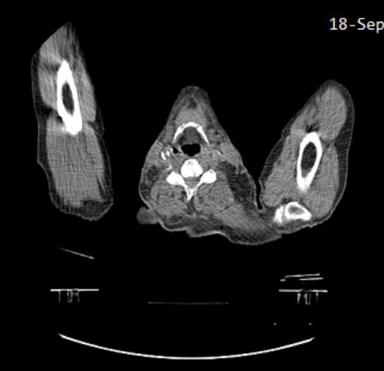
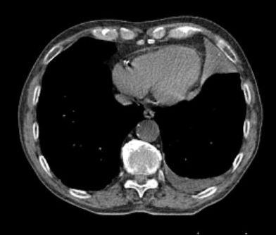
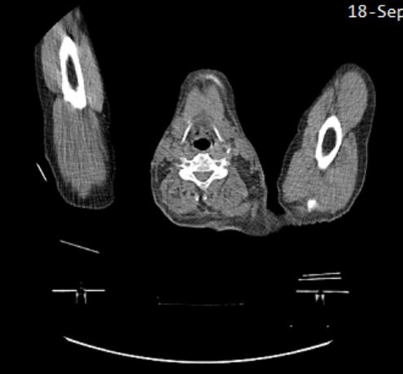
The Problem
Detect type of cancer based on images of cancerous lungs
NSCLC Radiomics Data

Slide 3
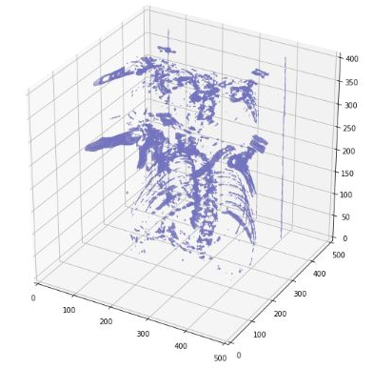
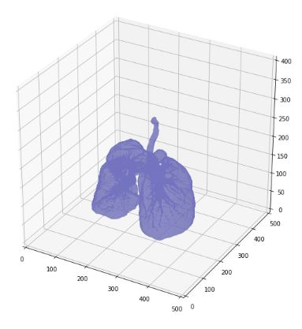
Data Visualization

Slide 4
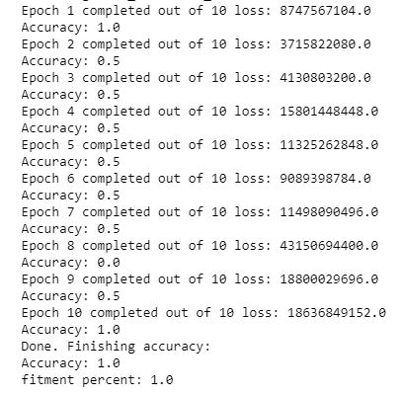
3D Convolution

