Slide 1
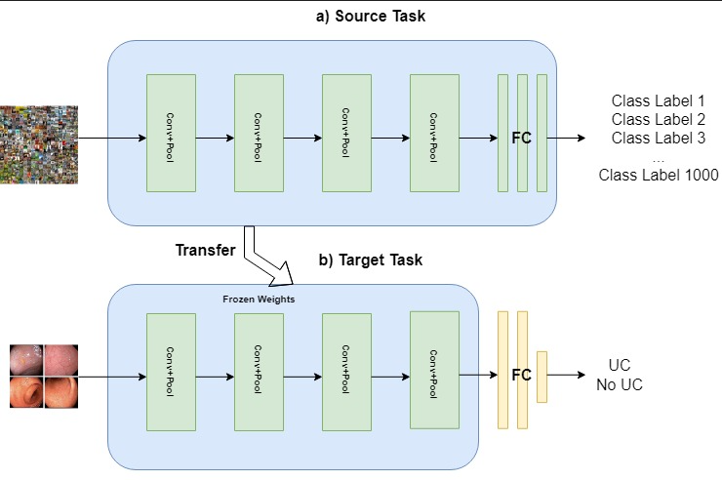
Transfer Learning in the Binary Classification of Ulcerative Colitis.

Slide 2
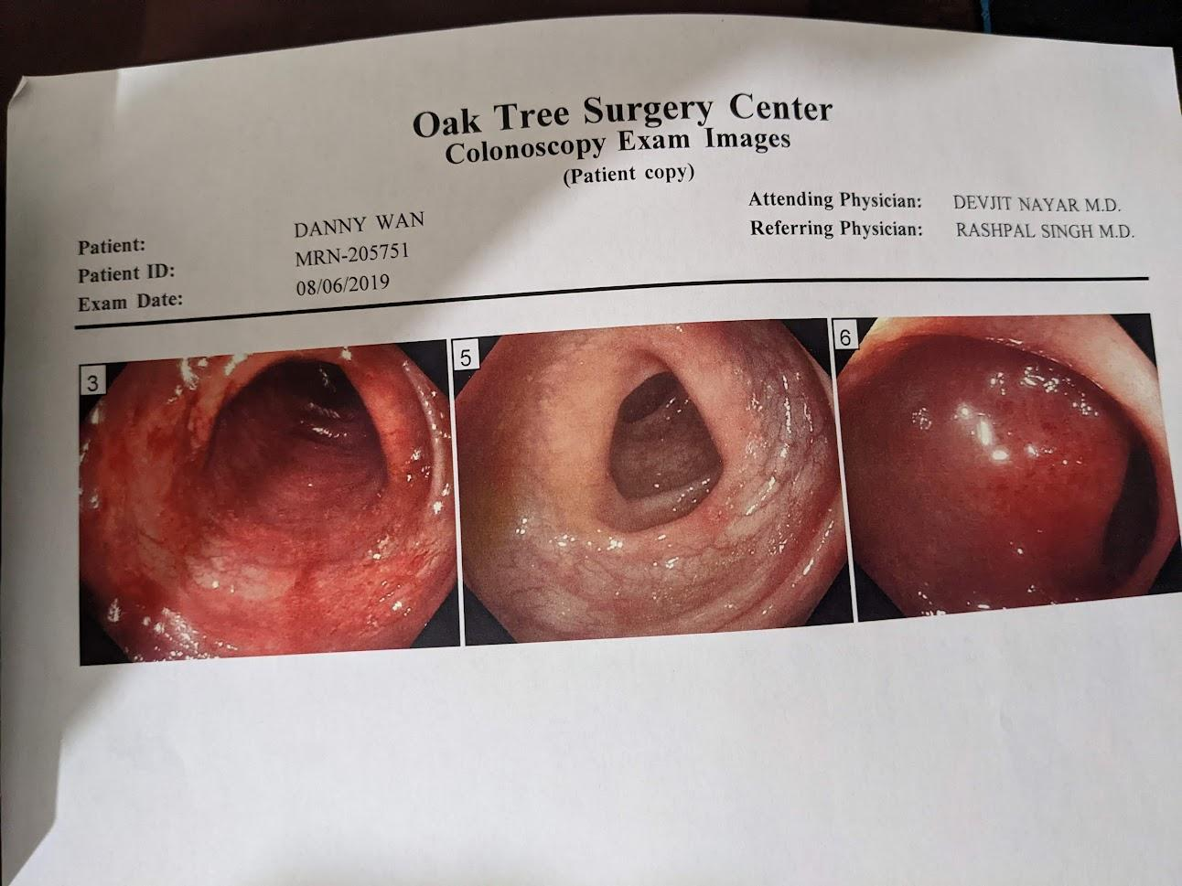


Motivation
UC patient
Misdiagnosed in 2015
Goal of being a physician
Genuine curiosity of AI in medicine

Slide 3
Problem:
Ulcerative Colitis (UC) is a disease that is misdiagnosed in clinical practice due to differences in perception among different gastroenterologist. This often leads to worse clinical outcomes in patients and misuse/waste of healthcare resource.
Solution:
Create an AI solution that will aid gastroenterologist in the diagnosis of UC

Slide 4
Background
Ulcerative Colitis is a rare, autoimmune-related, inflammatory bowel disease (IBD) that affects the lower gastrointestinal tract.
Chronic and Incurable
Prevalence: 3 million Americans are affected by IBD⁽¹⁾
Costly to Patient: Average Annual Cost of $22,987 vs. $6,956 non-IBD⁽²⁾ patients
Costly to Healthcare System: $14.6-31.4 billion USD annually (2014)⁽³⁾

Slide 5
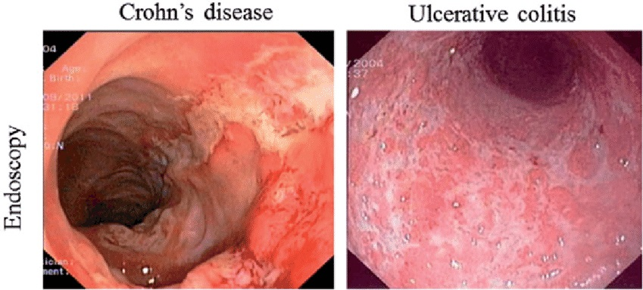
Background (cont.):
Misdiagnosis occurs due to difficulty in classifying UC:
Differential Diagnosis:
IBD mimics
Crohn’s
IBD misdiagnosis rate is as high as 23.5%⁽⁴⁾
Misdiagnosis leads to:
Worse patient outcomes
Increase malpractice cases
Increase cost to healthcare organizations

Slide 6
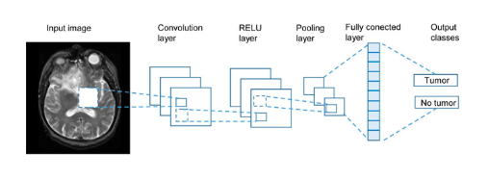
Solution
Utilize pretrained convolutional neural network (CNN) models to create a binary classifier that will aid gastroenterologist in diagnosing UC clinical practice
Example: Tumor Classification using CNN

Slide 7
Data
ERS dataset:
Endoscopy image dataset
113 labels
121,000 labeled/approximately labeled frames
1520 videos from 1135 patients
1.2 million unlabeled frames
Data for Project:
17011 labeled frames from 334 videos
3158 UC-labeled frames from 50 videos

Slide 8
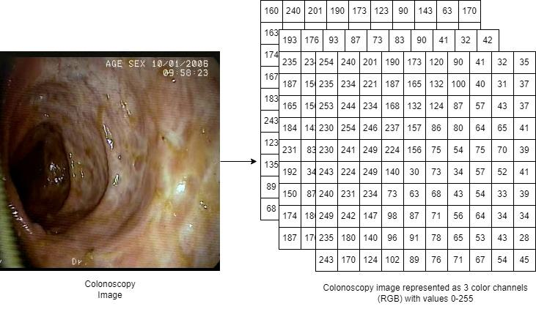
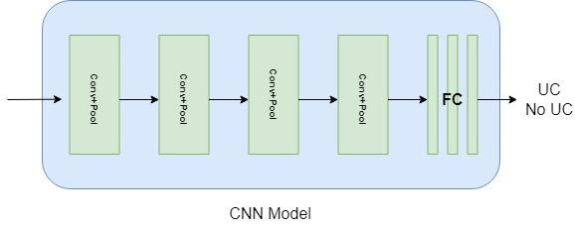
Convolutional Neural Network (CNN)
CNN are a family of deep learning models commonly used in image classification task
Images are read as pixel intensity values and taken as input into the model
Features are automatically learned through convolutional layers
Output from convolutional layers are summarized by pooling layer
Final layer(s) uses features from earlier layers to make a prediction

Slide 9
Why pretrained CNN?
CNN are the best algorithms at classifying images but require a lot of training examples to learn from.
Medical data is sparse:
Privacy
Legality
Transfer Learning:
Transfer of learning from a source task with many training examples to a target task where examples are limited.

Slide 10
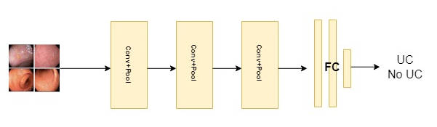
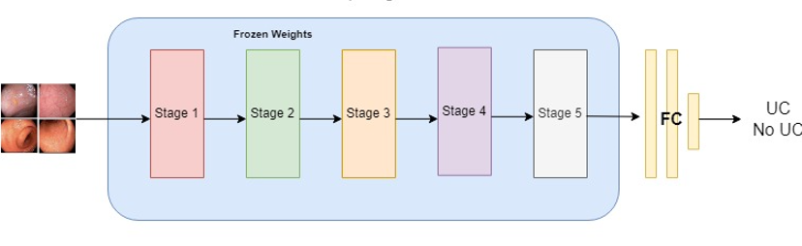
Baseline and Model
Baseline: CNN with 3 convolutional layers + FC
Model: Pretrained ResNet50 + FC
Baseline CNN
ResNet50

Slide 11
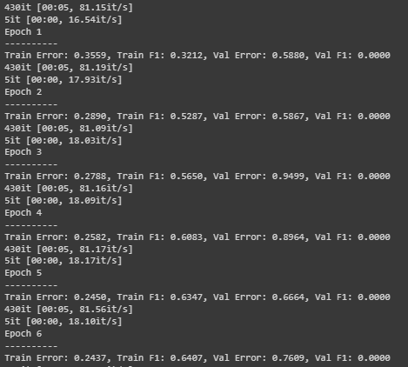
Training, Validation, and Testing
Epoch = 100
Batch Size = 32,256,256
Objective Function: Binary Cross Entropy
Optimization Algorithm: Adam
Model Selection: Validation Error
Test Evaluation Metrics: Accuracy, AUROC, F1, Precision, and Recall

Slide 12
Results
 | Baseline | ResNet50
Accuracy | 0.52 | 0.72
AUROC | 0.63 | 0.93
F1 | 0.27 | 0.62
Precision | 0.29 | 0.98
Recall | 0.25 | 0.45
ResNet Performed Better Than Baseline

Slide 13
Application
Will a gastroenterologist, with the aid of a deep learning model, be able to correctly classify the presence of Ulcerative Colitis in patients, differently on average than a gastroenterologist with no aid?
• Null Hypothesis: DL model + Gastroenterologist Accuracy = Gastroenterologist Accuracy
• Alternative Hypothesis: DL model + Gastroenterologist Accuracy != Gastroenterologist Accuracy
Target population: All licensed gastroenterologist

Slide 14
References
https://www.cdc.gov/ibd/data-and-statistics/prevalence.html CDC IBD Prevalence
https://pubmed.ncbi.nlm.nih.gov/31112238/ The Cost of Inflammatory Bowel Disease: An Initiative From the Crohn's & Colitis Foundation
https://pubmed.ncbi.nlm.nih.gov/27269903/ Report: economic implications of inflammatory bowel disease and its management
https://www.ncbi.nlm.nih.gov/pmc/articles/PMC6518102/ Illuminating an Invisible Epidemic: A Systemic Review of the Clinical and Economic Benefits of Early Diagnosis and Treatment in Inflammatory Disease and Related Syndromes

