Slide 1



AGAS
Automated Gas Alert System
Smart Gas Detection and Automatic Safety Response for Modern Environments

Slide 2


THE PROBLEM
Gas leaks from LPG cylinders can cause fires, explosions, and severe burn injuries.
Many households in Rwanda are adopting LPG cooking but lack advanced gas safety systems.

Slide 3

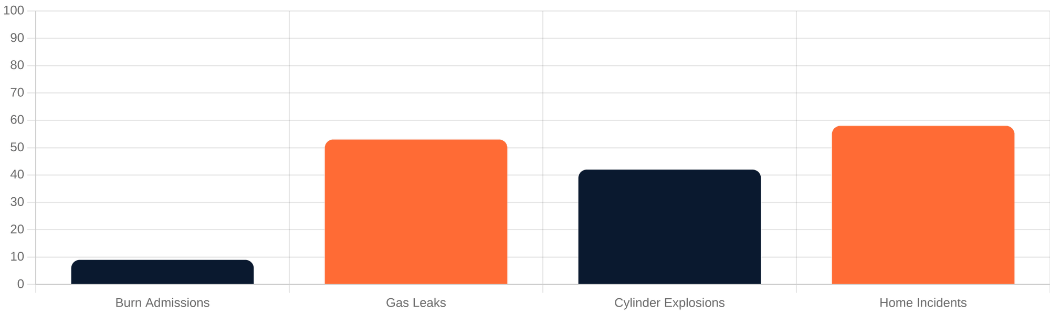
REAL STATISTICS IN RWANDA
Source: CHUK Burn Injury Study (2018) East and Central African Journal of Surgery
9%
53%
42%
58%
Burn Hospital Admissions
Incidents Caused by Leaks
Cylinder Explosions
Accidents Inside Homes

Slide 4



CURRENT LIMITATIONS
PASSIVE DETECTION
Most gas alarms only detect gas and produce sound alerts, which are useless if no one is home.
NO ACTIVE RESPONSE
They do not reduce gas concentration and cannot stop the gas source automatically.

Slide 5






OUR SOLUTION: AGAS
DETECTS GAS LEAKS
ACTIVATES ALARMS
High-precision MQ sensors monitor LPG levels in real-time.
Instant local buzzer and LED alerts when danger is detected.
A smart IoT gas safety system that detects leaks and automatically responds to prevent fire or explosion.
STARTS VENTILATION
WIFI NOTIFICATIONS
Automatic fan activation to reduce gas concentration immediately.
Instant alerts sent to users via the ESP microcontroller.
MECHANICAL GAS SHUTOFF
Uses a high-torque servo motor to physically rotate and close the gas valve, stopping the leak at its source.

Slide 6







HARDWARE COMPONENTS
ESP-F12 MCU
MQ GAS SENSOR
BUZZER & LEDS
The main controller providing processing and WiFi connectivity.
High-sensitivity detection of LPG and flammable gases.
Immediate local audio and visual alert indicators.
LCD DISPLAY
VENTILATION FAN
SERVO MOTOR
Real-time monitoring of gas levels and system status.
Automatic air extraction to mitigate gas concentration.
Mechanical actuator for automatic gas valve shutoff.

Slide 7

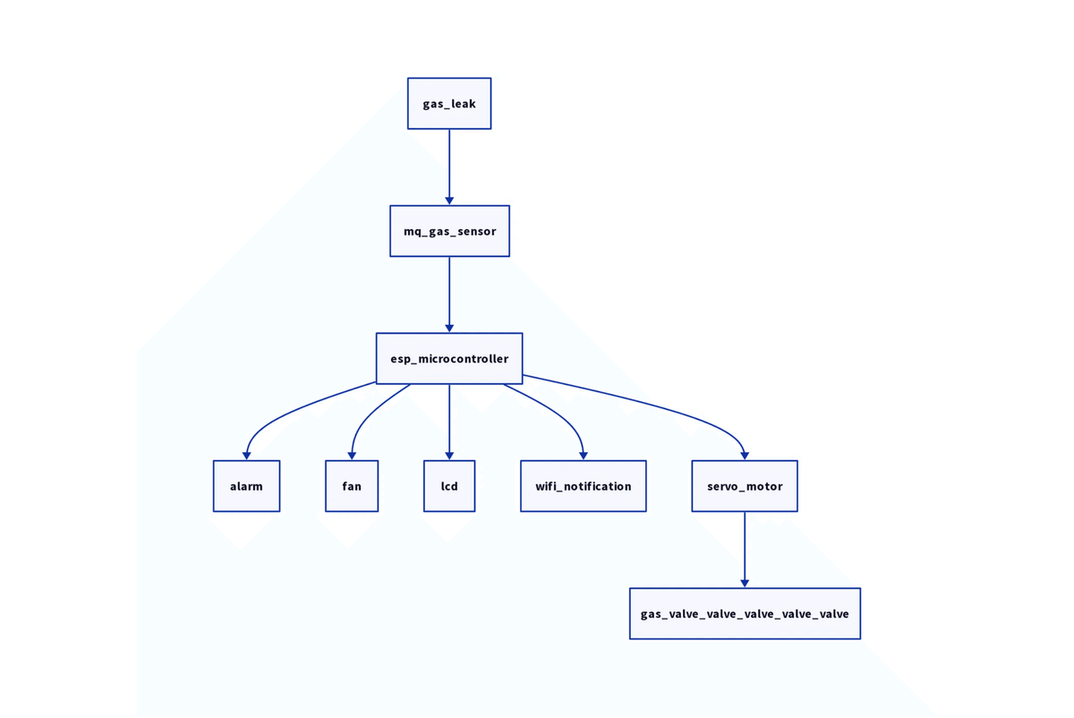




SYSTEM ARCHITECTURE
HARDWARE INTERCONNECTIVITY
Detection: MQ Gas Sensor monitors LPG levels.
Processing: ESP Microcontroller analyzes data.
Response: Activates Alarm, Fan, and LCD.
Connectivity: Sends WiFi alerts to users.
Shutoff: Servo motor closes the gas valve.

Slide 8



IOT CONNECTIVITY
ESP-F12 Integration
The core of our IoT ecosystem, enabling seamless wireless communication between the hardware and the cloud.
Real-time Alerts
Instant push notifications sent directly to smartphones the moment a gas leak is detected.
Remote Monitoring
Users can monitor gas levels and system status from anywhere in the world via a dedicated mobile interface.

Slide 9





SAFETY RESPONSE PROTOCOL
1
2
3
4
ALARM ALERT
VENTILATION
NOTIFICATION
GAS SHUTOFF
Immediate activation of the local buzzer and visual LED indicators.
The fan turns on automatically to extract gas and reduce concentration.
A critical alert is sent to the user's smartphone via WiFi.
The servo motor rotates to mechanically close the gas valve.

Slide 10




IMPACT & VISION
ENHANCED SAFETY
AFFORDABLE TECH
SCALABLE SOLUTION
Significantly reduces the risk of gas-related fires and injuries in Rwandan homes.
Demonstrates how low-cost IoT components can solve critical safety challenges.
A modular design that can be easily integrated into any home or industrial setting.
“SMART TECHNOLOGY CAN TURN EVERYDAY KITCHENS INTO SAFER ENVIRONMENTS.”

