Slide 1
Earthquake Data
Motivation:
Earthquake is a hazard in Southern California and it caused a lot of damages to our infrastructure
Engineers try to predict the earthquake based on its properties
By Danny Mai for DSCI 510 – Fall 2022

Slide 2
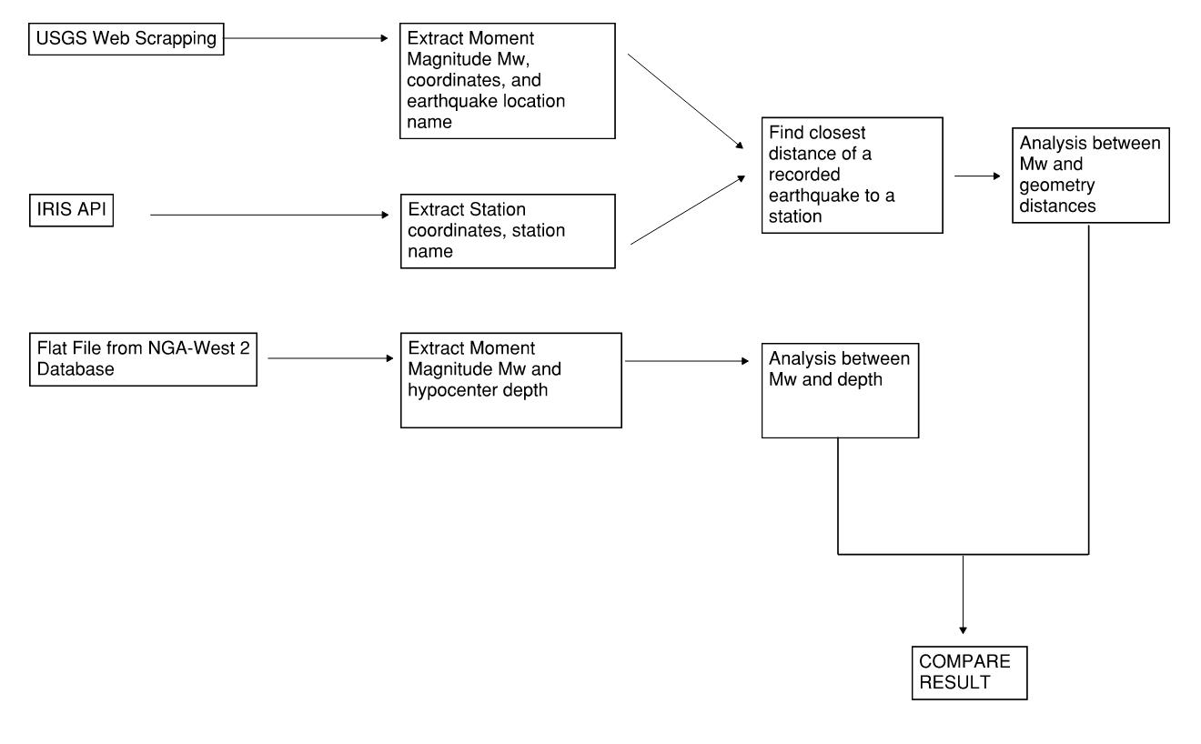
Information Extraction

Slide 3
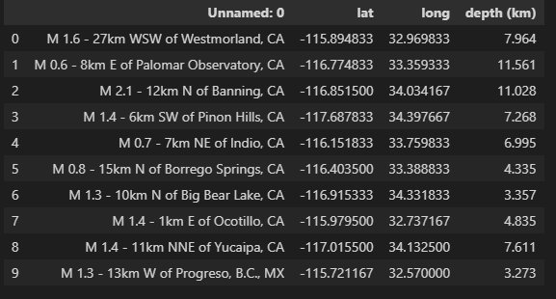
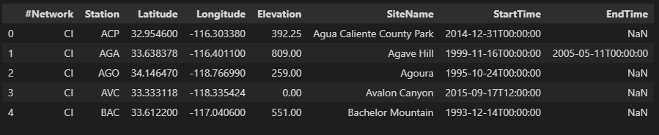
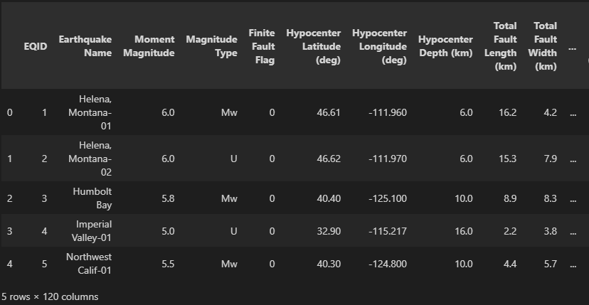
Example of Data

Slide 4
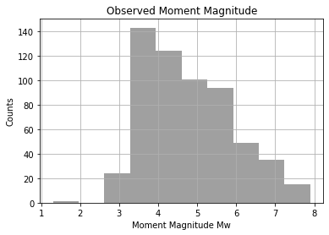
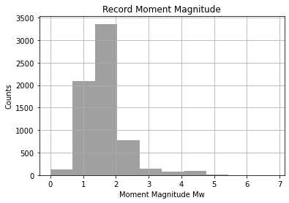
Moment Magnitude

Slide 5
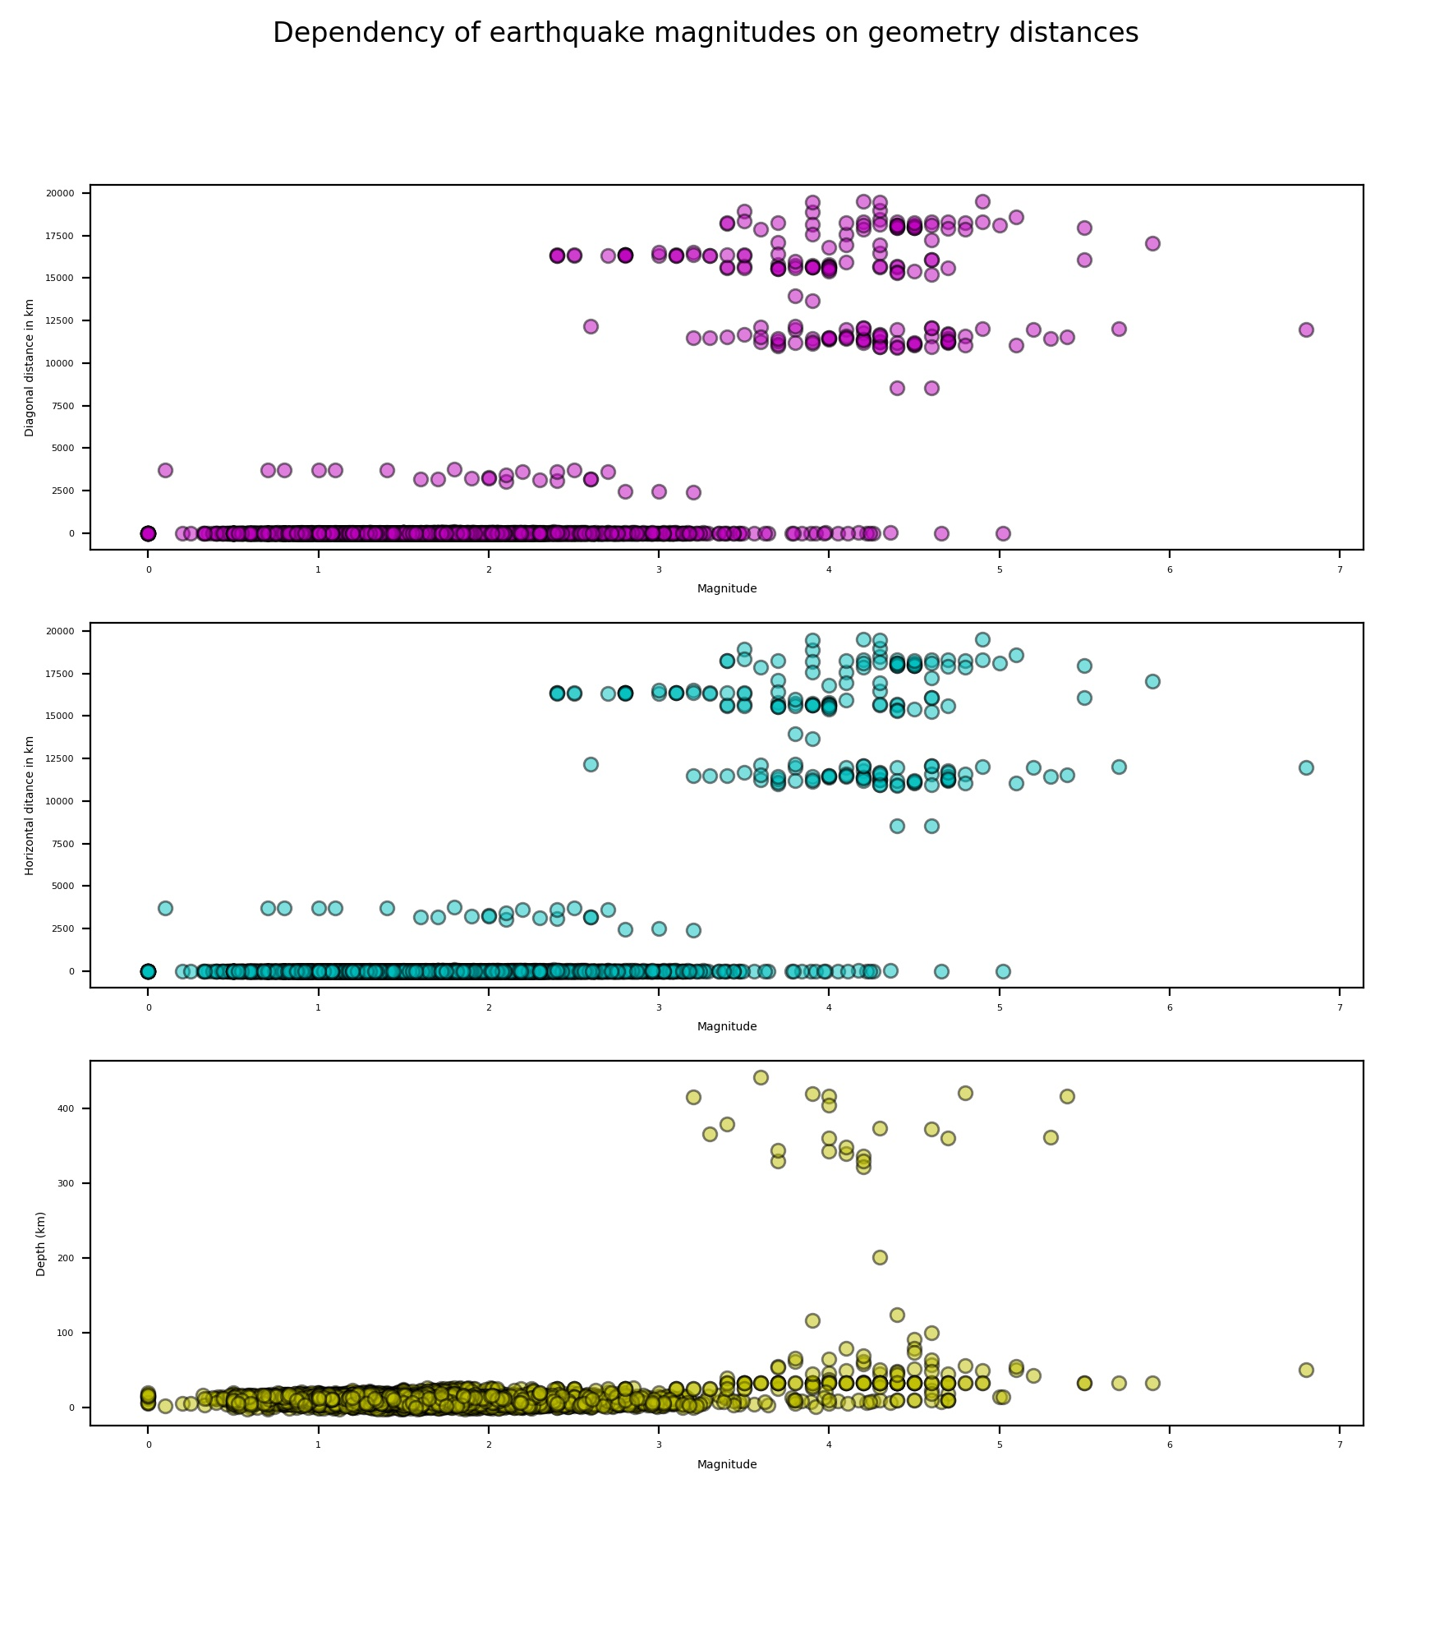
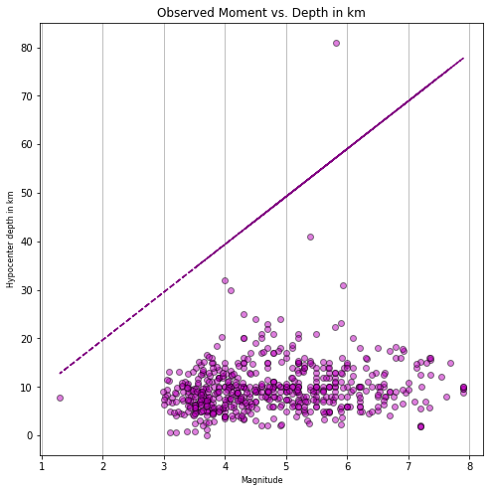
Analysis

Slide 6
Conclusion
There is a correlation between Moment Magnitude Mw and Hypocenter Depth but it is unclear why the data is underfitted
More studies to be done of how Moment Magnitude is calculated

