Slide 1
Peru 5 & 6 DSS, PROMIS Anxiety & Depression
Notes:
What happens wi dss over course of last 6 months during covid in peru
We validated, stable across 6 months even thogh increase reliance (new measure)
More anx symp at time 1 == more dss at time 2?
Higher growth? Change in slopes
More dep symp at time 1 == more dss at time 2?
Higher growth? Change in slopes
Fixed – wave gender age
Random – each individual starting point (intercept)

Slide 2
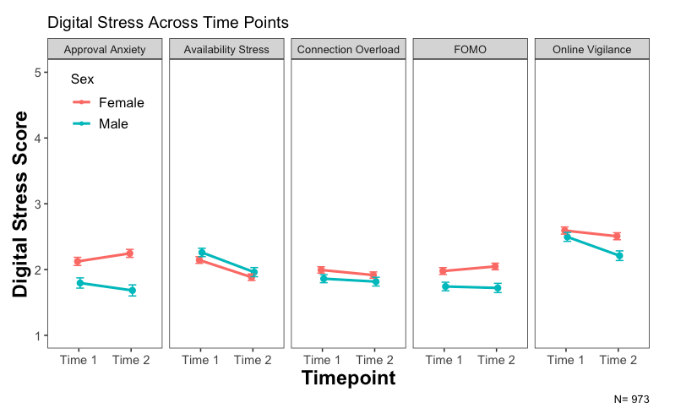
Notes:
For girls - higher approval anxiety, connection overload, FOMO, online vigilance
AS increase across time
FOMO increase across time
OV decrease over time
For boys
Higher availability stress
AS decrease across time
FOMO same across time
OV decrease over time more than girls – why??
Boys and girls start at similar rates of OV, AS at time 1
Big difference at T2 (higher for girls)
AV, similar but higher for boys
AS decrease for both
Age differences?

Slide 3
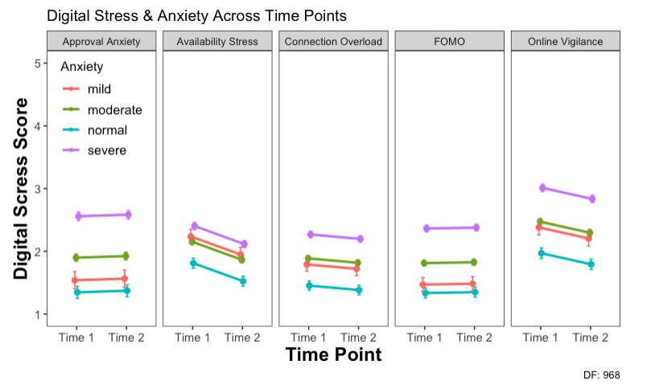
Notes:
Higher rates overall for those with severe anxiety
Mild increased AS – not expected?
Relatively stable across time
AS decrease
OV decrease
AA slight increase
CO slight decrease
FOMO stable – makes sense?
Gender differences?
Age differences?
Run models with interaction

Slide 4
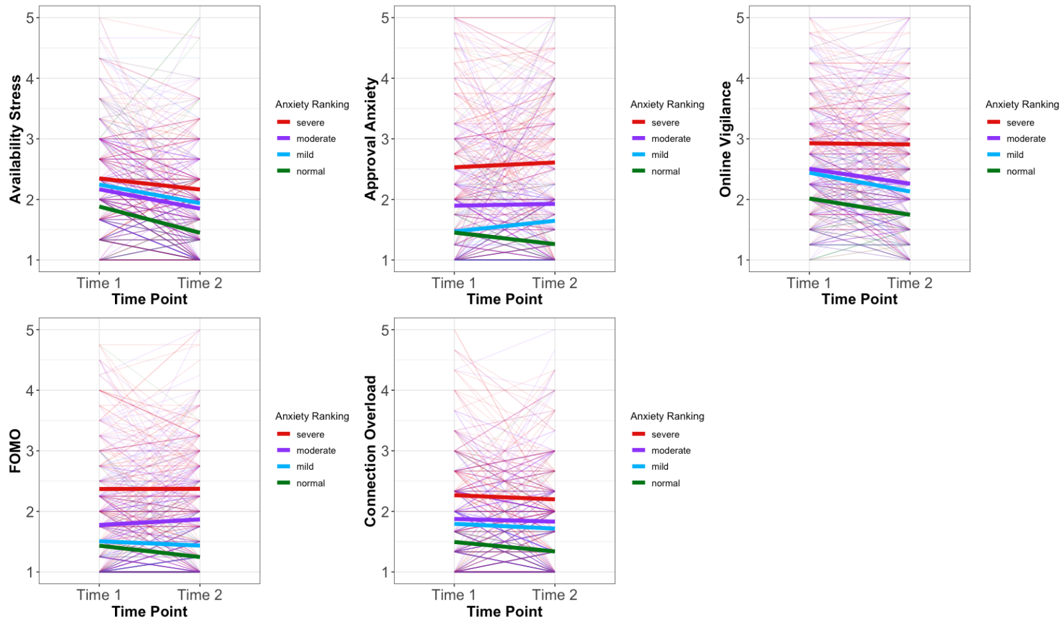
Notes:
NOTE: not looking at interactions between time and anxiety ranking
AS
Significantly lower at time 2
Significant change in those with normal anxiety – makes sense
AA
No significant difference at time 2
Significantly higher for those with severe anxiety – makes sense
FOMO
No significant difference at time 2
Significantly higher for those with moderate and severe
OV
Significantly lower at time 2 – driven by normal drop?
Significantly higher for those with normal – makes sense
Significantly higher for those with severe – makes sense
CO
No significant difference at time 2
Significantly higher for those with normal – makes sense
Significantly higher for those with severe – makes sense
Interaction models
Looking at time 1 severity
Symptoms at time 1 predicting dss at time 2
Mixed effect, not looking at anxiety time 2

Slide 5
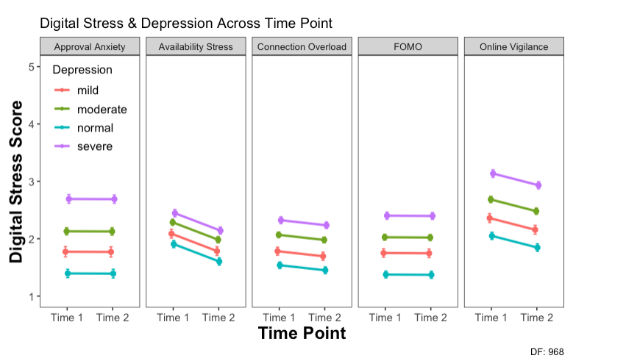
Notes:
Higher rates overall for those with severe depression
AS decrease
OV decrease
AA & FOMO relatively stable
CO slight decrease
Gender differences?
Age differences?

Slide 6
