Slide 1
TAHOE HEALTHCARE SYSTEMS
DSCI6006 – Carles Poles-Mielgo

Slide 2
INTRODUCTION
Tahoe Healthcare Systems operates and owns 14 hospitals.
~18% of the total revenue are insurance reimbursements from Medicare.

Slide 3
CURRENT CHALLENGE
High readmission rate within 30 days.
This fact can be hiding quality problems in hospitals.

Slide 4
CONSEQUENCES
Pay $8,000 penalty per readmitted patient within 30 days.

Slide 5
THE SOLUTION
Roll out a program called CareTracker.
It reduces readmission by 40%.
It costs $1,200 per patient.
CareTracker been tested for AMI condition.

Slide 6
COST COMPARISON
Cost without CareTracker: $7,984,000.
Cost with CareTracker: $10,048,800.
We need to reduce CareTracker costs.

Slide 7
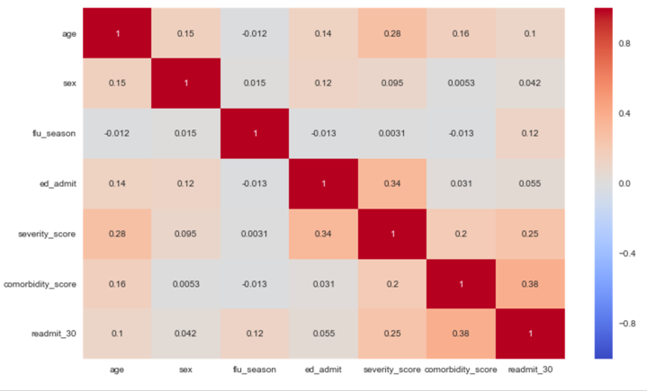
COST COMPARISON
Correlation between readmission and comorbidity and severity scores.

Slide 8
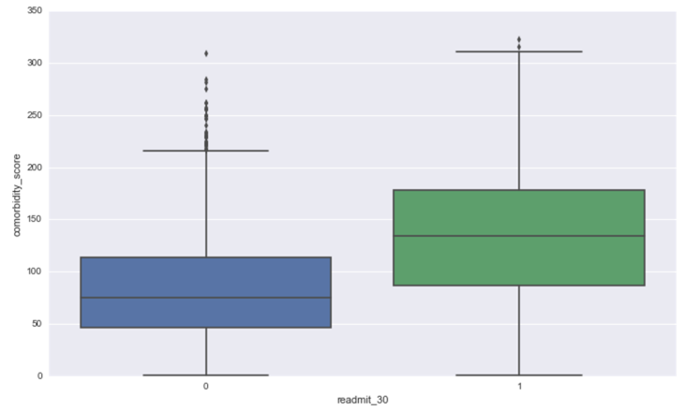
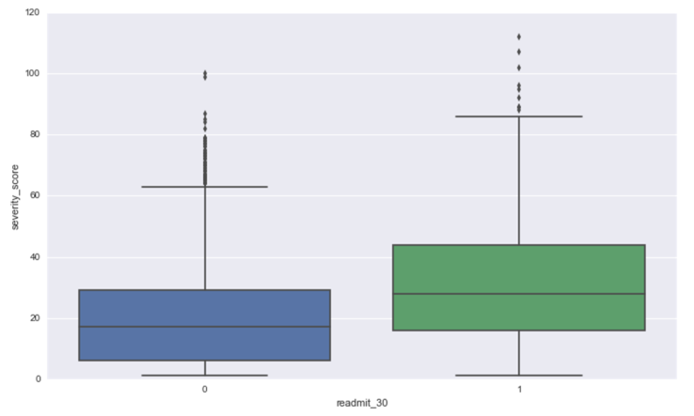
WHAT TO DO

Slide 9
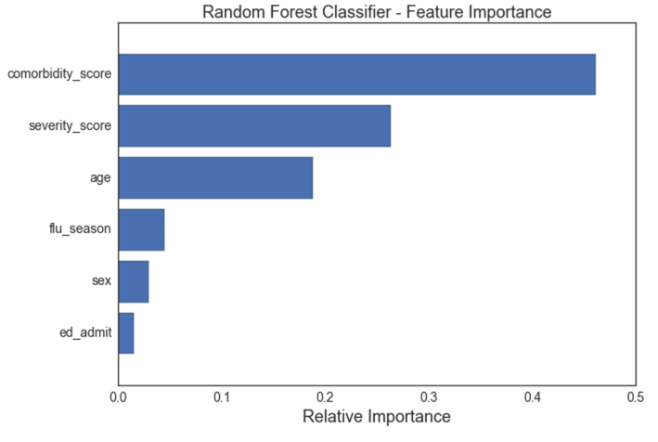
WHERE TO FOCUS

Slide 10
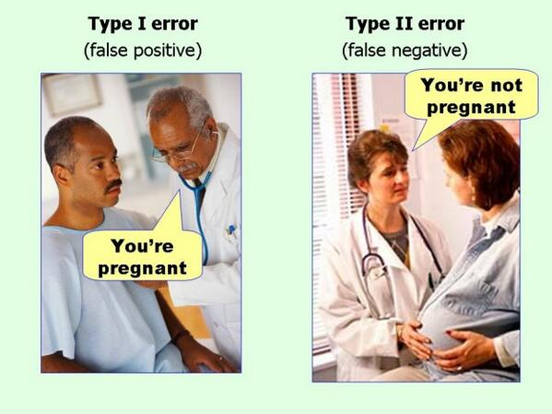
WHERE TO FOCUS
We want to minimize false positives (patients readmitted that shouldn’t).
We don’t care about false negatives (patients not readmitted that should).
https://chemicalstatistician.wordpress.com/2014/05/12/applied-statistics-lesson-of-the-day-type-i-error-false-positive-and-type-2-error-false-negative/comment-page-1/

Slide 11
WHERE TO FOCUS
We care about precision (minimize false positives).
Use a classification algorithm (logistic regression): 65% precision.
CareTracker cost goes down: 0.65 x 1,200 x 4,382 = $3,417,960

Slide 12
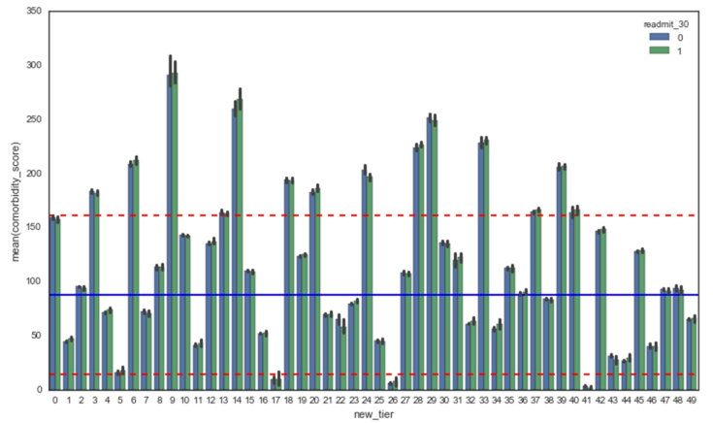
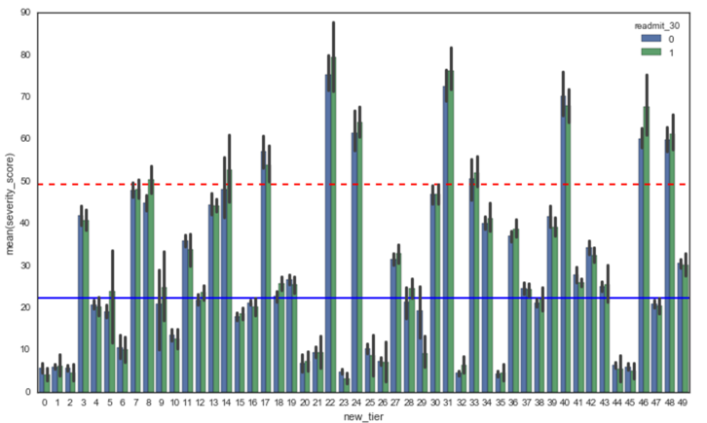
MORE SEGMENTATION (we can do better)

Slide 13
CONCLUSSION
Cost with CareTracker for patients with comorbodity_score > 150 (with penalty fees): $5,695,200.00
Cost with CareTracker for patients with comorbodity_score > 150 and severity_score > 50 (with penalty fees): $6,134,400.00

