Slide 2
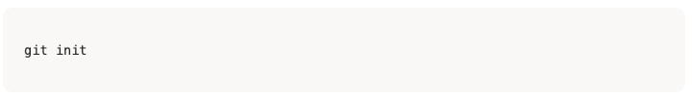
Get Started with Git
: initializes the current directory as an empty Git repository.
: This command is the very first step to start using Git for version control in your project folder.

Slide 3
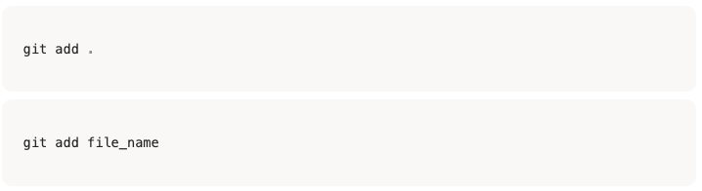
Get Started with Git
This command stages all new and modified files in the current directory and its subdirectories.
It's a quick way to prepare all your changes for the next commit.
This command stages a specific file for a commit.
It allows you to select exactly which changes you want to include, giving you more precise control over what goes into your next version.

Slide 4
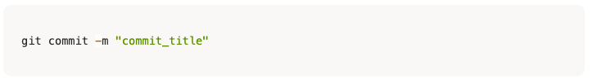
Get Started with Git
This command saves all the changes you've previously added to the staging area as a new version.
The -m flag allows you to directly write a concise message, which acts as a brief, descriptive log for your commit.

Slide 5
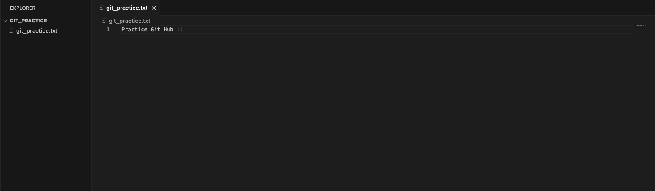
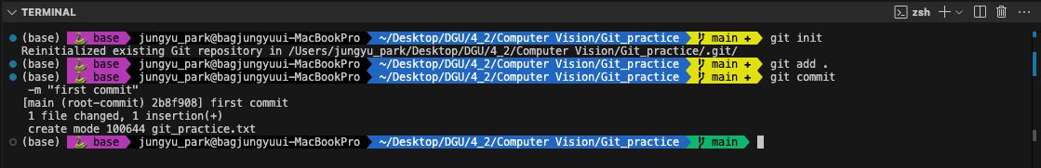
Get Started with Git

Slide 6
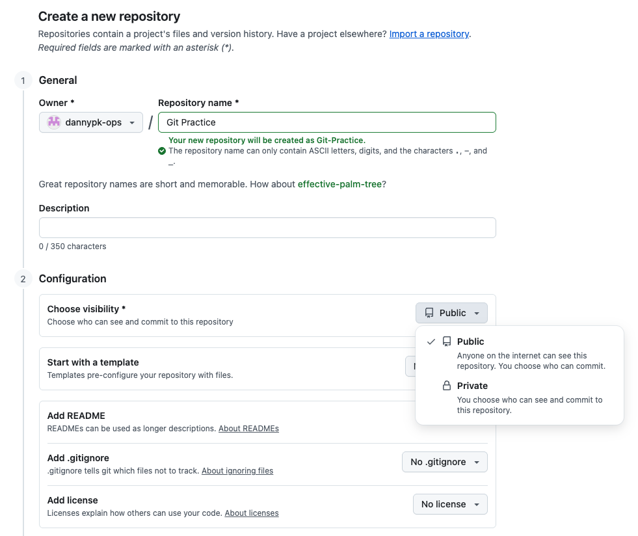
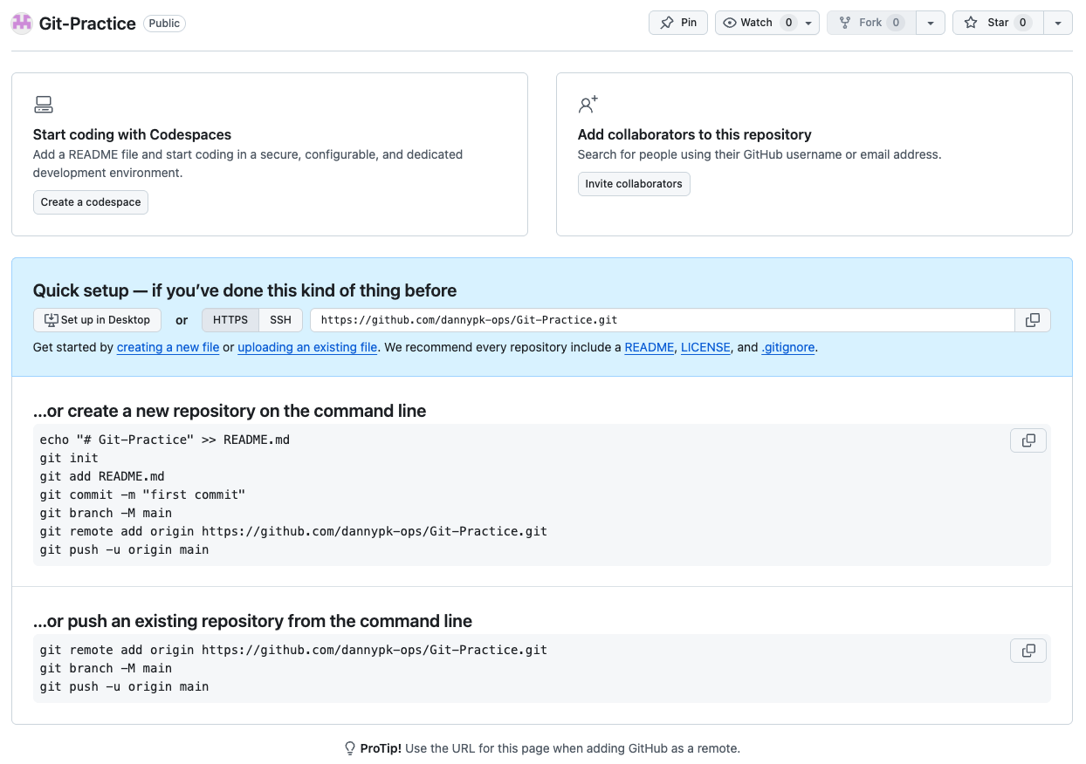
Connect to GitHub
Creating your own Repository.

Slide 7

Connect to GitHub
This step is crucial because it establishes the link between your computer and the online repository.
It allows you to push your local changes to the remote repository and pull down changes made by others.
It's essentially how you tell your local Git where its online counterpart is located.

Slide 8
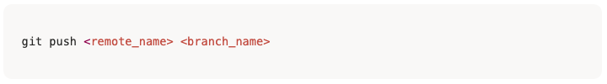
Connect to GitHub
This command is how you upload your local changes to a remote repository on GitHub.
It's essentially sending your commits from your computer to the cloud.
This step is crucial for sharing your work with a team and backing up your code.
It ensures that your local branch is synchronized with its online counterpart, making it visible to others and safe from local machine failures.

Slide 9
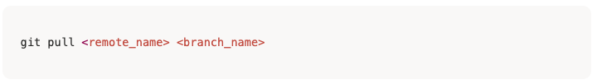
Connect to GitHub
This command is vital for collaboration because it's how you download and sync changes made by others.
When you run git pull, your local branch is updated to reflect the most recent state of the remote branch,
ensuring everyone on the team is working with the same version of the code.

Slide 10
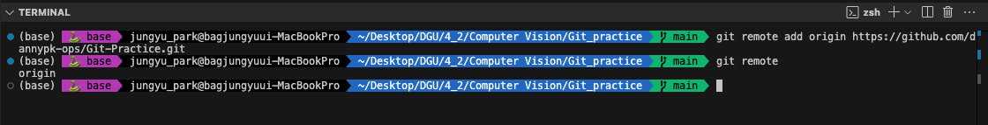
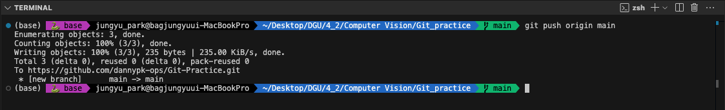
Connect to GitHub

Slide 11
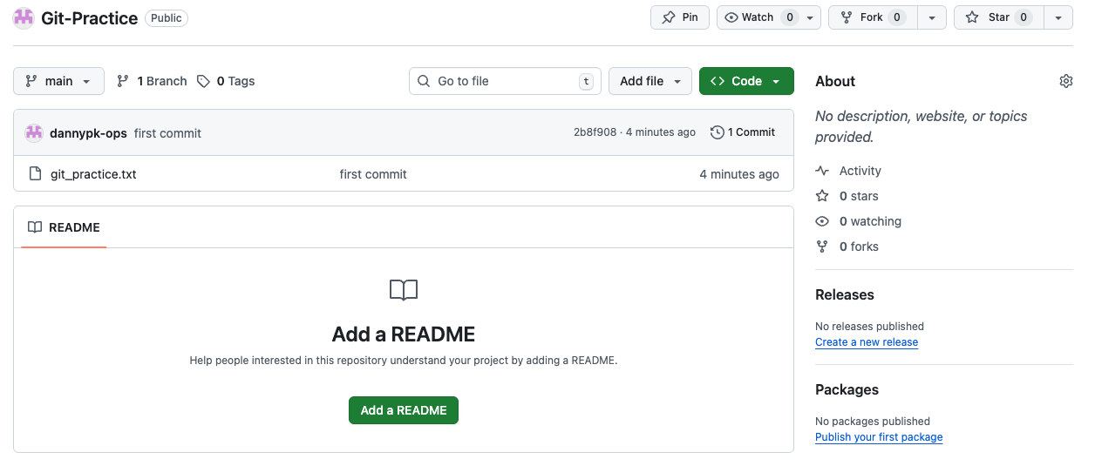
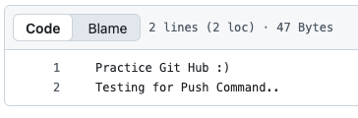
Connect to GitHub

Slide 12
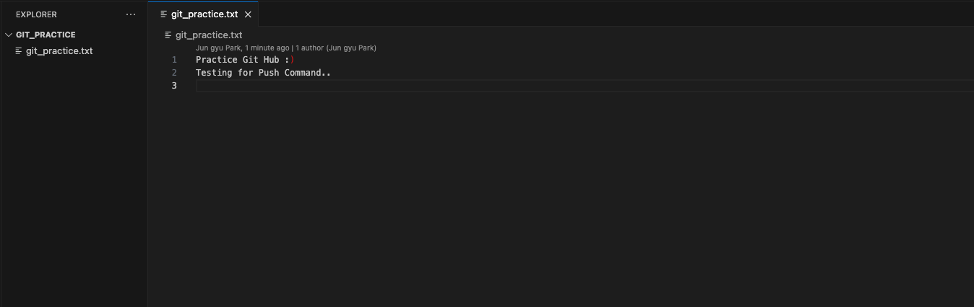
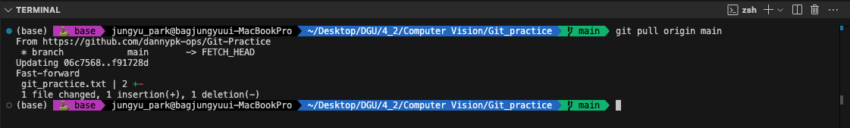
Connect to GitHub

Slide 13
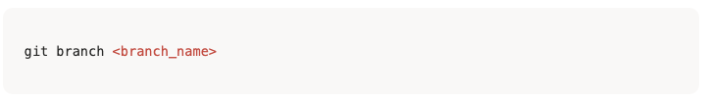
Collaborate with Branches
This command creates a new branch with the name you specify.
A branch is like a separate line of development that allows you to work on new features or bug fixes without affecting the main project.
This is a fundamental step in collaborative projects, as it lets you isolate your changes and keep the main branch clean and stable.

Slide 14
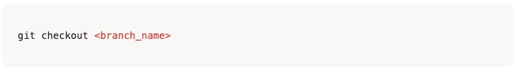
Collaborate with Branches
This command is used to switch from your current branch to another one.
It updates all the files in your working directory to match the version stored in the branch you are moving to.
This is a key step in a branching workflow, as it allows you to easily move between different lines of development.
You can quickly jump to a different feature branch to work on it, or go back to the main branch to see the project's stable version.

Slide 15
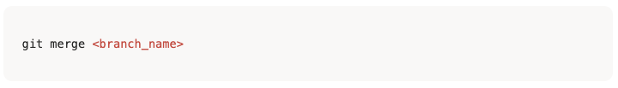
Collaborate with Branches
This command is used to integrate changes from a different branch into your current branch.
It combines the separate lines of development back together into a single, unified branch.
This is a critical step in a typical workflow.
After you've finished work on a feature branch, you use this command to merge those changes back into the main project. Git automatically handles combining the changes, though you may need to resolve any conflicts that arise.

Slide 16
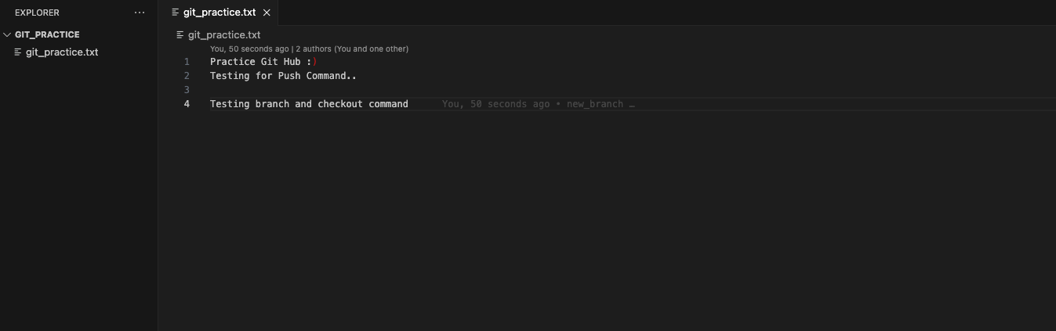
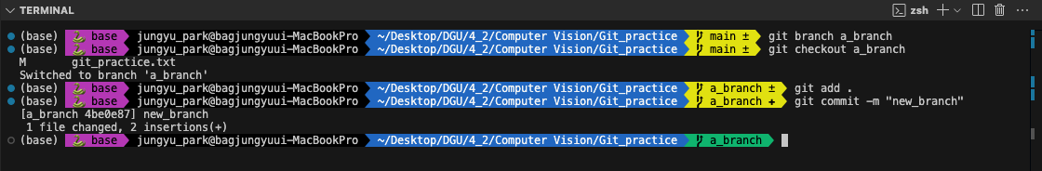
Collaborate with Branches

Slide 17
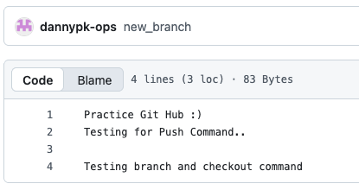
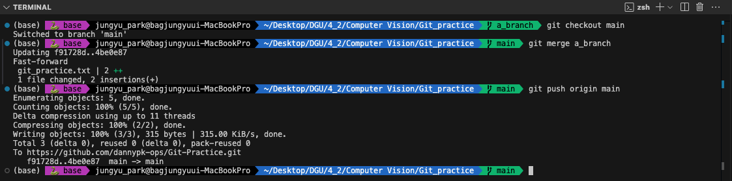
Collaborate with Branches

