Slide 1

CSC6023 - Advanced Algorithms
Course Introduction and Asymptotic Notations - Weefi 1
Patrick Neff

Slide 2
You¹rg Wglcomg! Wggfi 1
This is a very fast paced course, so this is the course introduction AND the revision of the asymptotic notation for algorithms efﬁciency

Slide 3

Agenda Week 1 Presentation
Course Introduction
Course format
Evaluation
Timeline
Asymptotic Notation
Basics
Number of operations
Big-O, Big-Omega, and Big-Theta
MCSS - a problem to exercise
The polynomial - cubic - solution
The polynomial - quadratic - solution
The linear solution

Slide 4
Course Format
Course Introduction
Instructor
Patrick Neff
neffp@merrimack.edu
People
Tutors Available
Check the Canvas announcements for the current tutor availability
Read the Syllabus!!

Slide 5
Course Format
Course Introduction
8-week long course
Each week typically has:
A live weekly class session Monday 6:30-8:30
PM EST via Zoom
Worksheet assignment during live class with deadline for Friday
Project assignment during live class with deadline for next Monday
Discussions due Friday, with 2 comments due the following Monday
Offfice hours Thursday 6:00-7:00 PM via Zoom
Quiz available Friday
Due next Monday
Live sessions
Read the Syllabus!!

Slide 6
Course Format Evaluation
Course Introduction
You will be evaluated based on
Assignment Type | Points | Percentage
Coding Projects | 100 each | 35%
Worksheets | 100 each | 21%
Quizzes | 100 each | 21%
Discussions | 100 each | 8%
Final Exam | 100 | 20%
Read the Syllabus!
Late Penalties: All weekly evaluated tasks are due by their stated deadline; the late penalties are a reduction of 10% of the evaluation, plus 2% for each full day of delay.
There is a cut-off ﬁnal deadline at the last day of class (last Friday of the 8th week) - a hard deadline.
The hard deadline for the ﬁnal exam is last week's Sat.

Slide 7
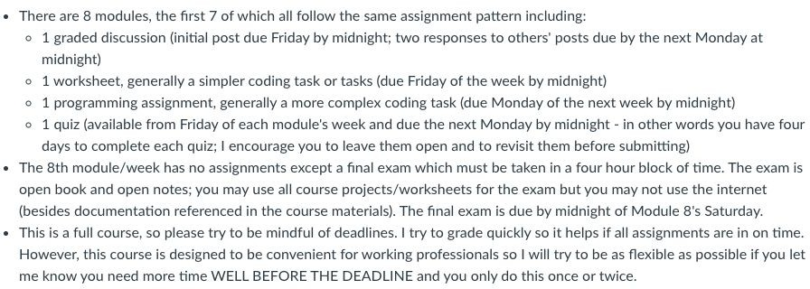

Slide 8


Slide 9
Read the Syllabus!!
Course Introduction
Course Format
You ffinal letter grade will follows this scale
A | A- | B+ | B | B- | C+ | C | C- | F
95 and up | 90 to 94.9 | 87 to 89.9 | 83 to 86.9 | 80 to 82.9 | 77 to 79.9 | 73 to 76.9 | 70 to 72.9 | 69.9 and low
Evaluation
There are no grade D+, D, or D- in graduate courses.
An average grade B is required to the Masters of Science in Computer Science.

Slide 10
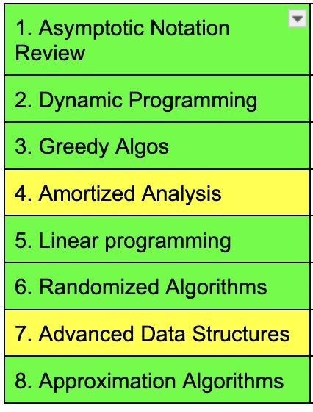
Course Format
Course Introduction
8-week course
Timeline
Read the Syllabus!!

Slide 11
“Algorithm” etymology
What is an “algorithm”?
“The word ‘algorithm’ itself is quite interesting; at first glance it may look as though someone intended to write ‘logarithm’ but jumbled up the first four letters. The word did not appear in Webster’s New World Dictionary as late as 1957; we find only the older form ‘algorism’ with its ancient meaning, i.e., the process of doing arithmetic using Arabic numerals. In the middle ages, abacists computed on the abacus and algorists computed by algorithm. Following the middle ages, the origin of this word was in doubt, and early linguists attempted to guess at its derivation by making combinations like algiros [painful] + arithmos [number]; others said no, the word comes from ‘King Algor of Castile.’ Finally, historians of mathematics found the true origin of the word algorithm: it comes from the name of a famous Persian textbook author, Abu Ja‘far Mohammed ibn Musa al-Khowarizmi (c. 825) - literally, ‘Father of Ja‘far, Mohammed, son of Moses, native of Khowarizm.’ Khowarizm is today the small Soviet city of Khiva. Al-Khowarizmi wrote the celebrated book Kitam al jabr w’al-muqabala (‘Rules of restoration and reduction’); another word, ‘algebra,’ stems from the title of his book, although the book wasn’t really very algebraic.”
(Page 1)
-The Art of Computer Programming: Volume 1/Fundamental Algorithms Donald E. Knuth, 1968
https://en.wikipedia.org/wiki/Muhammad_ibn_Musa_al-Khwarizmi
By the 1950s the word “algorithm” with the modern meaning of a precise method for a mathematical task was in use, most prominently with “Euclid’s algorithm,” a process for finding the greatest common divisor of two numbers.

Slide 12
Why algorithms?
Why study algorithms?
Traditionally an essential part of a computer science curriculum
Important for understanding what exactly we are asking the computer to do
Important for understanding scalability
Job interviews

Slide 13

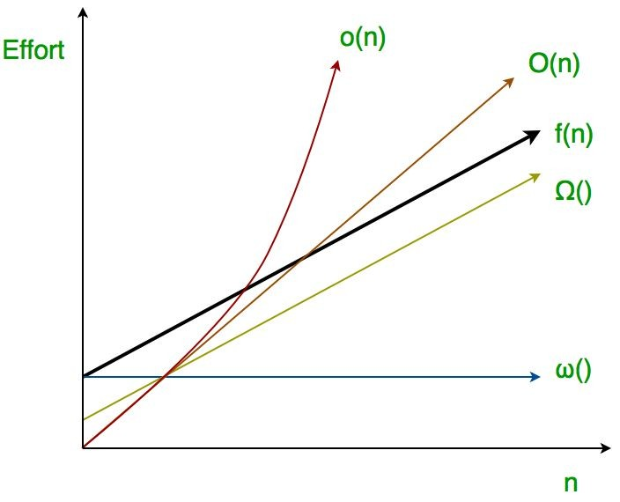
Week 1 Asymptotic notations review
How to know what to expect for your algorithm?
When you code your algorithm there is an amount of time that the code is expected to take considering the "size" of your problem. This amount of time is commonly referred as time complexity of the algorithm and it is frequently expressed by an asymptotic notation.

Slide 14
Asymptotic?
Etymology
From the Greek:
a = non
symptein = to meet
Meaning: not meeting
We call asymptotic notation because it involves bounding functions. The actual function of our algorithm does not meet the asymptote as they approach infinity.

Slide 15
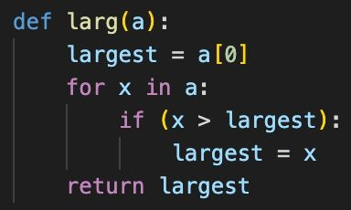
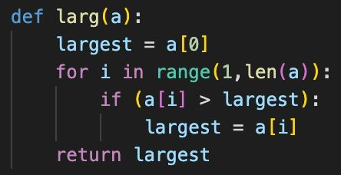
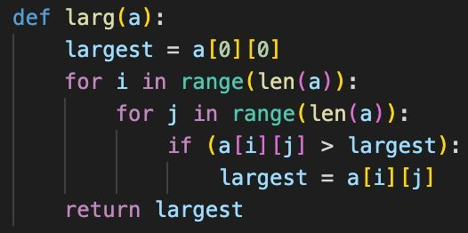
Asymptotic Notation
Giving an algorithm
What to expect in terms of relevant operations
For example, to ﬁnd the largest element in an array
Basics: Number of Operations
Counting the loops works usually well, but it is a simplification
Do you remember recursion?
A n sized array needs about n comparisons
Another example, ﬁnd the largest element in a square matrix
A square matrix of order n needs about n² comparisons

Slide 16
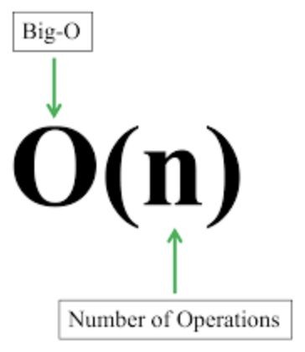


Asymptotic Notation
Giving an algorithm
What to expect in terms of relevant operations
For example, to ﬁnd the largest element in an array
Basics: Number of Operations
For iterative code, you can count the nested loops
For recursive code you should estimate the number of calls
A n sized array needs about n comparisons
Another example, ﬁnd the largest element in a square matrix
A square matrix of order n needs about n² comparisons

Slide 17
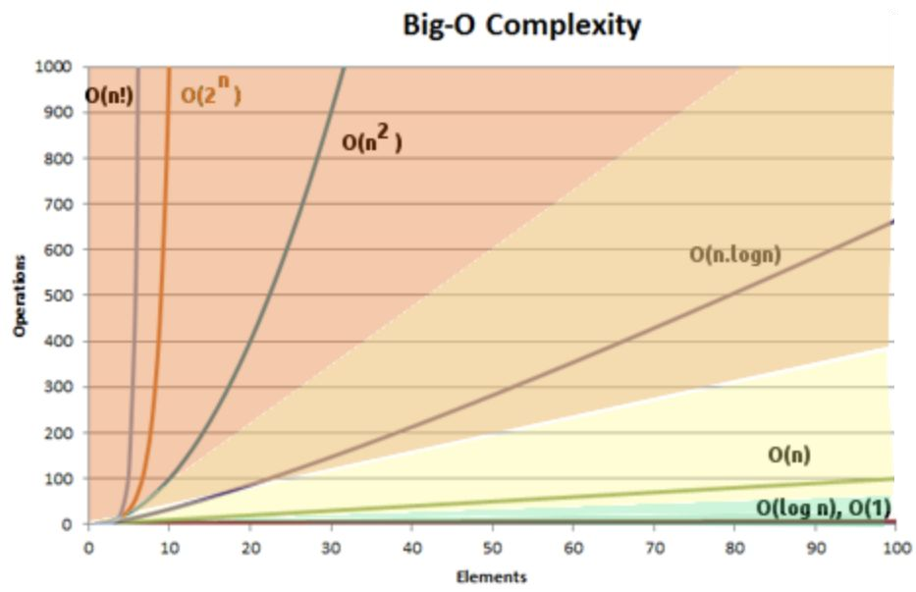
Asymptotic Notation
The classes of complexity
Basics Number of Operations
Big-O | complexity | examples
O(c) | constant | First element of an array
O(log n) | logarithmic | Binary search
O(n) | linear | Find the largest in an array
O(n log n) | log-linear | Merge sort
O(n^{c}) | polynomial | Selection sort (n² - quadratic)
O(c^{n}) | exponential | Find all subsets of a set (2^{n})
O(n!) | factorial | Find all permutations of a set
Big O is an upper bound… pessimistic (safe)

Slide 18
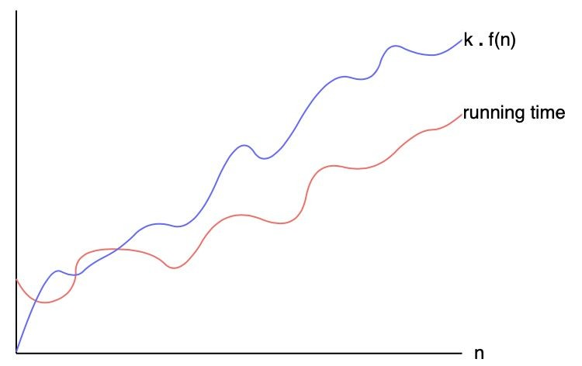
Asymptotic Notation
The functions of complexity
The Big-O is a function that is an upper bound of the algorithm
It safely states the longest the algorithm will take
Formally, if a function t(n) denotes the number of operations taken by a given algorithm, this function is said to be in O(g(n)) if t(n) is bounded above by some constant multiple of g(n) for all large n
For example, that an algorithm is in O(log n) means that this algorithm will require at most t(n) operations and t(n) <= c log n for all values of n above a certain (small) value
Basics Big-O,
Big-Omega, and Big-Theta

Slide 19
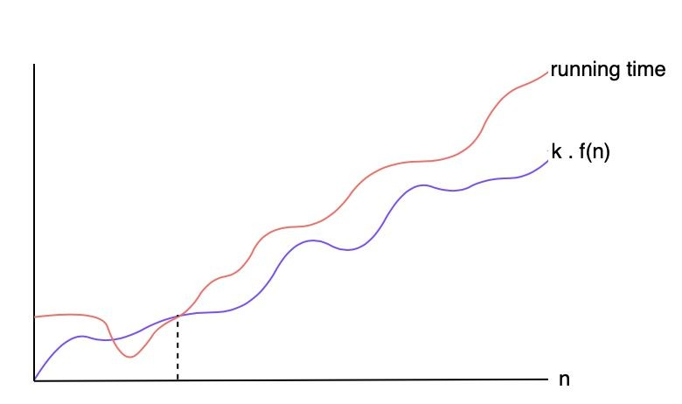
Asymptotic Notation
The functions of complexity
The Big-Omega is a function that is a lower bound of the algorithm
It safely states the shortest the algorithm will take
Formally, if a function t(n) denotes the number of operations made by a given algorithm, this function is said to be in 𝛺(g(n)) if t(n) is bounded below by some constant multiple of g(n) for all large n
For example, that an algorithm is in 𝛺(log n) means that this algorithm will require at least t(n) operations and t(n) >= c log n for all values of n above a certain (small) value
Basics Big-O,
Big-Omega, and Big-Theta

Slide 20
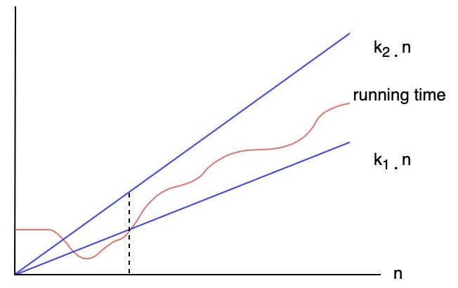
Asymptotic Notation
The functions of complexity
Basics Big-O,
Big-Omega, and Big-Theta
The Big-Theta is a function that express both a lower and an upper bound of the algorithm
It states at the same time the information stated by Big-O and Big-Omega
Formally, if a function t(n) denotes the number of operations taken by a given algorithm, this function is said to be in 𝚯(g(n)) if t(n) is bounded above by some constant multiple of g(n) and bounded below by some constant multiple of g(n) for all large n
For example, that an algorithm is in 𝚯(log n) means that this algorithm will require at least t(n) operations and t(n) >= c₁ log n and at most t(n) operations and t(n) <= c₂ log n for all values of n above a certain (small) value

Slide 21
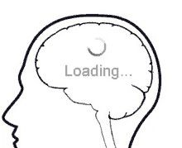
Asymptotic Notation
Maximum Contiguous Subsequence Sum
MCSS
A problem to exercise
Given an array of n integers (positives and negatives), what is the subsequence of contiguous elements that delivers the highest sum of its elements?
For example, for the array a = [ -2 , 11, -4, 13, -5, 2 ]
the answer is the sum 20 obtained by a[1:4] i.e. [ -2 , 11, -4, 13, -5, 2 ]
If the array was [ 5, -1, 56, -3, -18, 22, -9 ] what would be the answer?
Seriously, try it now!

Slide 22
Asymptotic Notation
Maximum Contiguous Subsequence Sum
a = [ 5, -1, 56, -3, -18, 22, -9 ]
MCSS
A problem to exercise
5
-1
56
-3
-18
22
-9
5 -1
-1 56
56 -3
-3 -18
-18 22
22 -9
5 -1 56
-1 56 -3
56 -3 -18
-3 -18 22
-18 22 -9
5 -1 56 -3
-1 56 -3 -18
56 -3 -18 22
-3 -18 22 -9
5 -1 56 -3 -18
-1 56 -3 -18 56
56 -3 -18 22 -9
61
5 -1 56 -3 -18 22
5 -1 56 -3 -18 56 -9
-1 56 -3 -18 22 -9
This is a difﬁcult problem to solve without a systematic approach … how much does this one cost?

Slide 23
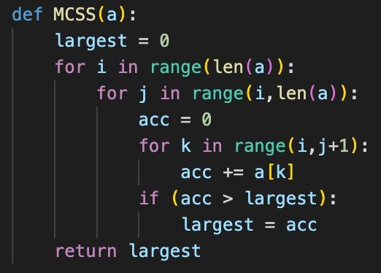

MCSS
A problem to exercise
Asymptotic Notation
Maximum Contiguous Subsequence Sum
The naive solution: test all possible subsequences
For all elements i of the array
For all elements j from i to the end
1
Compute the sum from i to j
… and keep the largest sum
First loop to choose the start of the subsequence
The second loop to choose the end of the subsequence
The third loop to add it up

Slide 24
MCSS
A problem to exercise
Asymptotic Notation
Maximum Contiguous Subsequence Sum
The naive solution: test all possible subsequences
For all elements i of the array
For all elements j from i to the end
1
Compute the sum from i to j
… and keep the largest sum
What is the complexity of this algorithm?
Polynomial - n^{c}
Cubic - n³
Can you do better?

Slide 25
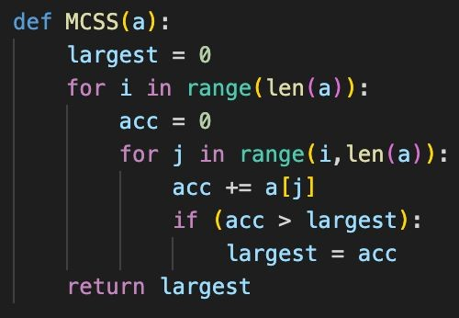
MCSS
A problem to exercise
Asymptotic Notation
Maximum Contiguous Subsequence Sum
A small improvement: test all possible subsequences, but sum as you go
For all elements i of the array
For all elements j from i to the end
Keep on computing the sum from i to j
… and keep the largest sum
First loop to choose the start of the subsequence
The second loop to choose the end of the subsequence and compute the sum as you go
2

Slide 26
MCSS
A problem to exercise
Asymptotic Notation
Maximum Contiguous Subsequence Sum
A small improvement: test all possible subsequences, but sum as you go
For all elements i of the array
For all elements j from i to the end
Keep on computing the sum from i to j
… and keep the largest sum
2
What is the complexity of this algorithm?
Polynomial - n^{c}
Quadratic - n²
Better, but can you still do better?

Slide 27
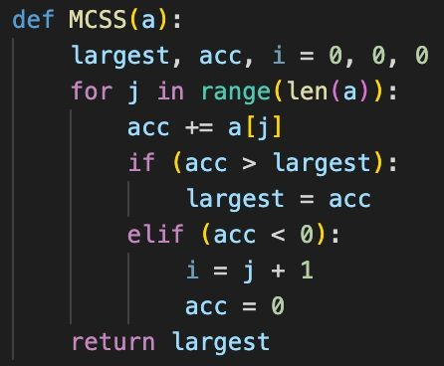
MCSS
A problem to exercise
Asymptotic Notation
Maximum Contiguous Subsequence Sum
What if you discard subsequences that start with negative values
Start with i as the ﬁrst element
For all elements j of the array
Keep on computing the sum from i to j
… and keep the largest sum
If the current sum is negative discard it
3
The ﬁrst, and only, loop advances the subsequence window computing as you go, and changing the beginning when the current window has a negative sum

Slide 28
MCSS
A problem to exercise
Asymptotic Notation
Maximum Contiguous Subsequence Sum
What if you discard subsequences that start with negative values
Start with i as the ﬁrst element
For all elements j of the array
Keep on computing the sum from i to j
… and keep the largest sum
If the current sum is negative discard it
3
What is the complexity of this algorithm?
Linear - n
That is as good as it gets since at least all elements have to be added once

Slide 29

Asymptotic Notation
Task 1 for this week's worksheet
MCSS
Hands-on
Create a program that randomizes a vector of 1000 positive and negative integers, then it ﬁnds the maximum contiguous subsequence sum value
Prints out the maximum value
Go to IDLE and try to program it
Save your program in a .py file and submit it in the appropriate delivery room
Deadline: This Friday 11:59 PM EST

Slide 30

Asymptotic Notation
Task 2 for this week's worksheet
Extends the program of Task 1 to output not only the maximum value, but also the initial and ﬁnal
MCSS
Hands-on
index of the elements to compute the maximum value
Go to IDLE and try to program it
Save your program in a .py file and submit it in the appropriate delivery room
Deadline: This Friday 11:59 PM EST

Slide 31
Asymptotic Notation
Project 1 - this week's Assignment
First Assignment
Create a program that implements a sort algorithm of your choice and applies it to a random vector of 1,000 elements
Repeat the process applying it to random vectors of 2,000, 3,000, … up to 10,000 elements
Compute the time complexity of your algorithm and verify if the time it takes to your 1,000 to 10,000 corresponds to the time complexity prediction.
Besides the implementation of your program, write a short report describing your experiences and conclusion.
You can use cProfile to measure the time of your code execution
cProfile documentation page: https://docs.python.org/3/library/profile.html

Slide 32
Asymptotic Notation
1 - this week's Assignment
This program must be your own, do not use someone else’s code
Any speciﬁc questions about it, please bring to the Ofﬁce hours meeting this Friday or contact me by email
This is a challenging program to make sure you are mastering your Python programming skills, as well as your asymptotic analysis understanding
Don’t be shy with your questions
Project
First Assignment
Go to IDLE and try to program it
Save your program in a .py file and submit it in the appropriate delivery room
Deadline: Next Monday 11:59 PM EST

Slide 33
Worksheet and Project Format
Format Guidelines:
Please submit both worksheets and projects in one zipped folder named according to the following example:
SmithJaneMod1Worksheet.zip SmithJaneMod1PA.zip
(pa = Programming Assignment)
Please follow this format even if your work only requires one simple Python ﬁle.

Slide 34

That’s all for today folks!
This wggfi¹s tnsfis
Ngxt wggfi
Transform-and- conquer algorithms
Discussion
Deadline: this Friday 11:59 PM EST
Tasks 1 and 2 for the worksheet
Deadline: this Friday 11:59 PM EST
Quiz 1 to be available this Friday
Deadline: Next Monday 11:59 PM EST
Project 1 assignment
Deadline: Next Monday 11:59 PM EST
Don’t let work pile up!
Don’t be shy about your questions
Try all exercises seen in class and consult the reference sources, as the more you practice, the easier it gets
Hnvg n Grgnt Wggfi!

