Slide 1
Live LLM Casting
Danny Son
LLM powered live CS2 gameplay commentary
Year 2026
Semester 2

Slide 2
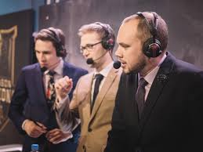
What is casting for games?
Live commentary over a match Similar to sports broadcasting
Context
Pipeline
Demo
Post-Mortem

Slide 3
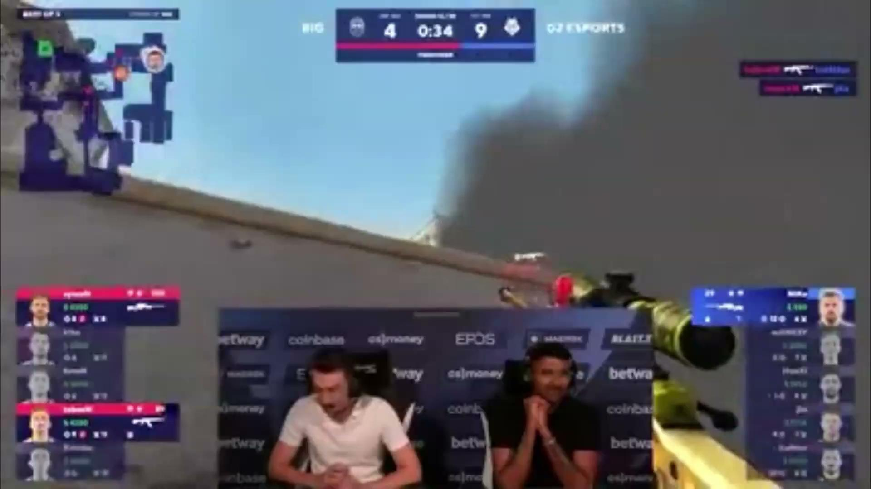
Context
Pipeline
Demo
Post-Mortem
30 sec in video

Slide 4

In-Game Casters
The Finals
Context
Pipeline
Demo
Post-Mortem
Event-Driven casting in real matches live

Slide 5
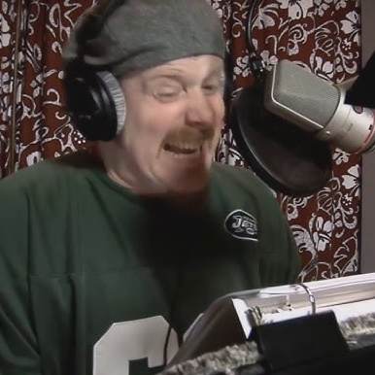
In-Game Casters
The Finals
Cloned Voices
Some Guy
Context
Pipeline
Demo
Post-Mortem
Event-Driven casting in real matches live
From VA samples to TTS

Slide 6

Context
Pipeline
Demo
Post-Mortem
30 sec in video

Slide 7
But its use is very restrained
Commentary is sparse
Round start/end
Time running out
Team wip
etc
Context
Pipeline
Demo
Post-Mortem

Slide 8
But its use is very restrained
Commentary is sparse
Repetitive
Lines/Audio curated beforehand
Nothing generated live
Commentary isn’t unique
Context
Pipeline
Demo
Post-Mortem

Slide 9
But its use is very restrained
Commentary is sparse
Mostly map-agnostic
Lacks locational awareness
Commentary isn’t unique
Commentary isn’t nuanced
Context
Pipeline
Demo
Post-Mortem

Slide 10
Lets tackle these problems
Commentary is sparse
Commentary isn’t unique
Commentary isn’t nuanced
Context
Pipeline
Demo
Post-Mortem

Slide 11

Context
Pipeline
Demo
Post-Mortem
What could this look like?
Running locally
Run output through local TTS LLM
Listen for live game events
Run context through local Text LLM

Slide 12
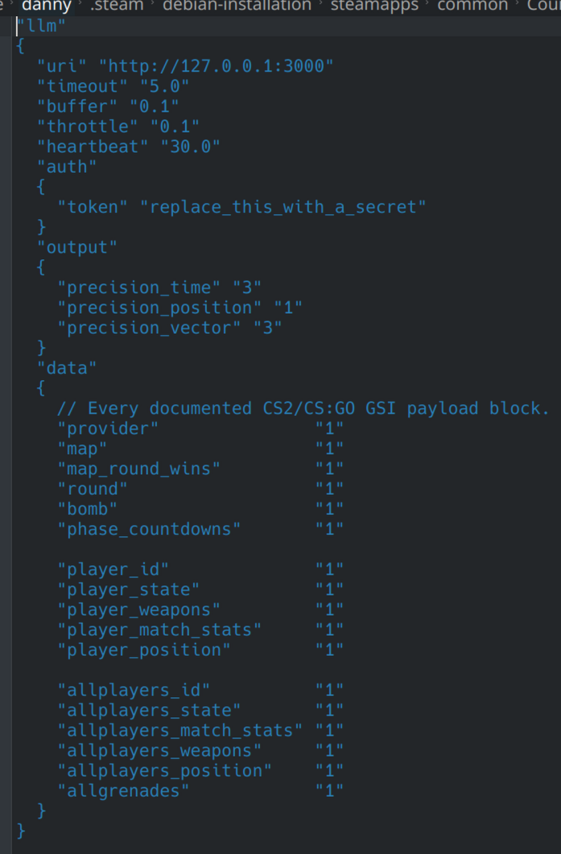
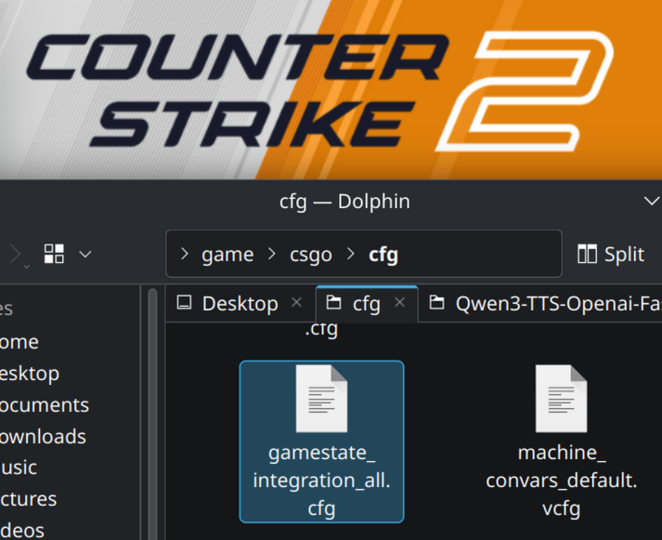
Context
Pipeline
Demo
Post-Mortem
My pipeline
Listen to events
Via GSI

Slide 13
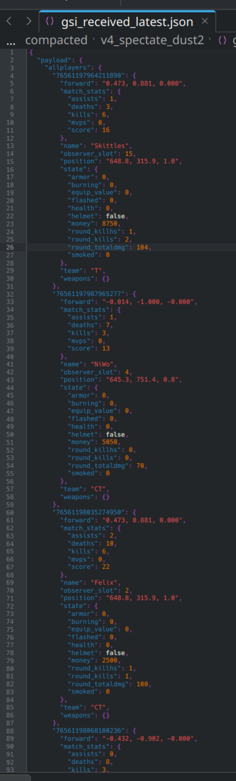
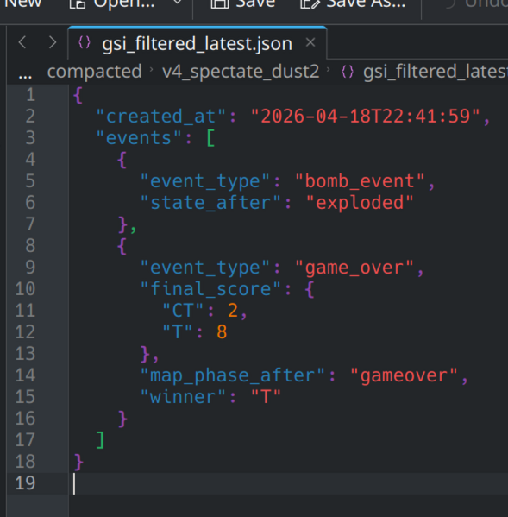
Context
Pipeline
Demo
Post-Mortem
My pipeline
Listen to events
Via GSI
Filter & Prompt

Slide 14
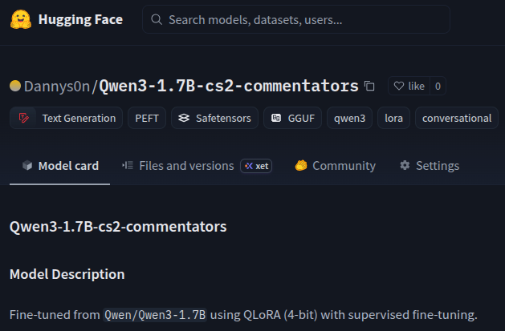
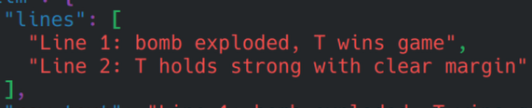
Context
Pipeline
Demo
Post-Mortem
My pipeline
Filter & Prompt
Output Json

Slide 15
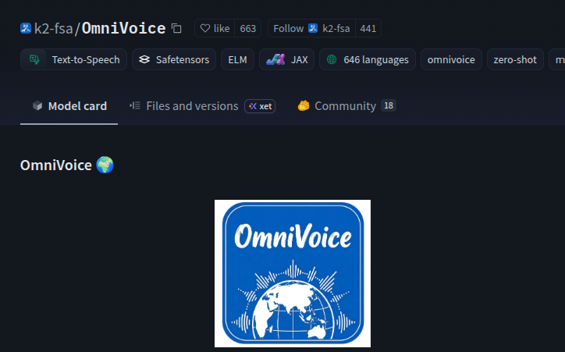
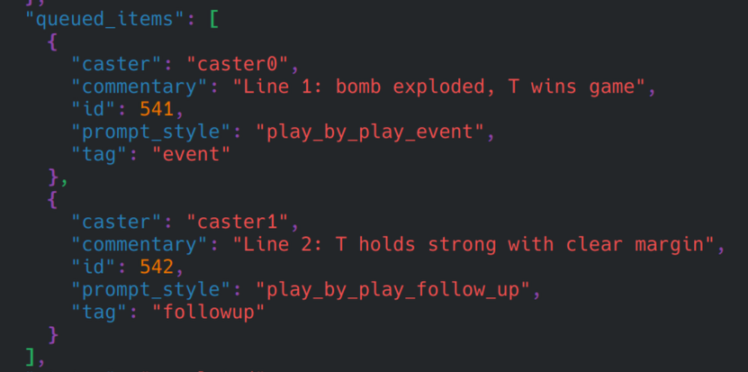
Context
Pipeline
Demo
Post-Mortem
My pipeline
Filter & Prompt
Output Json
Queue for TTS

Slide 16



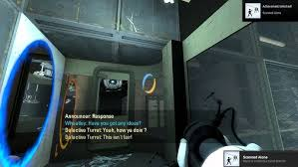
Context
Pipeline
Demo
Post-Mortem
Voices cloned
Turrets
Announcer

Slide 17
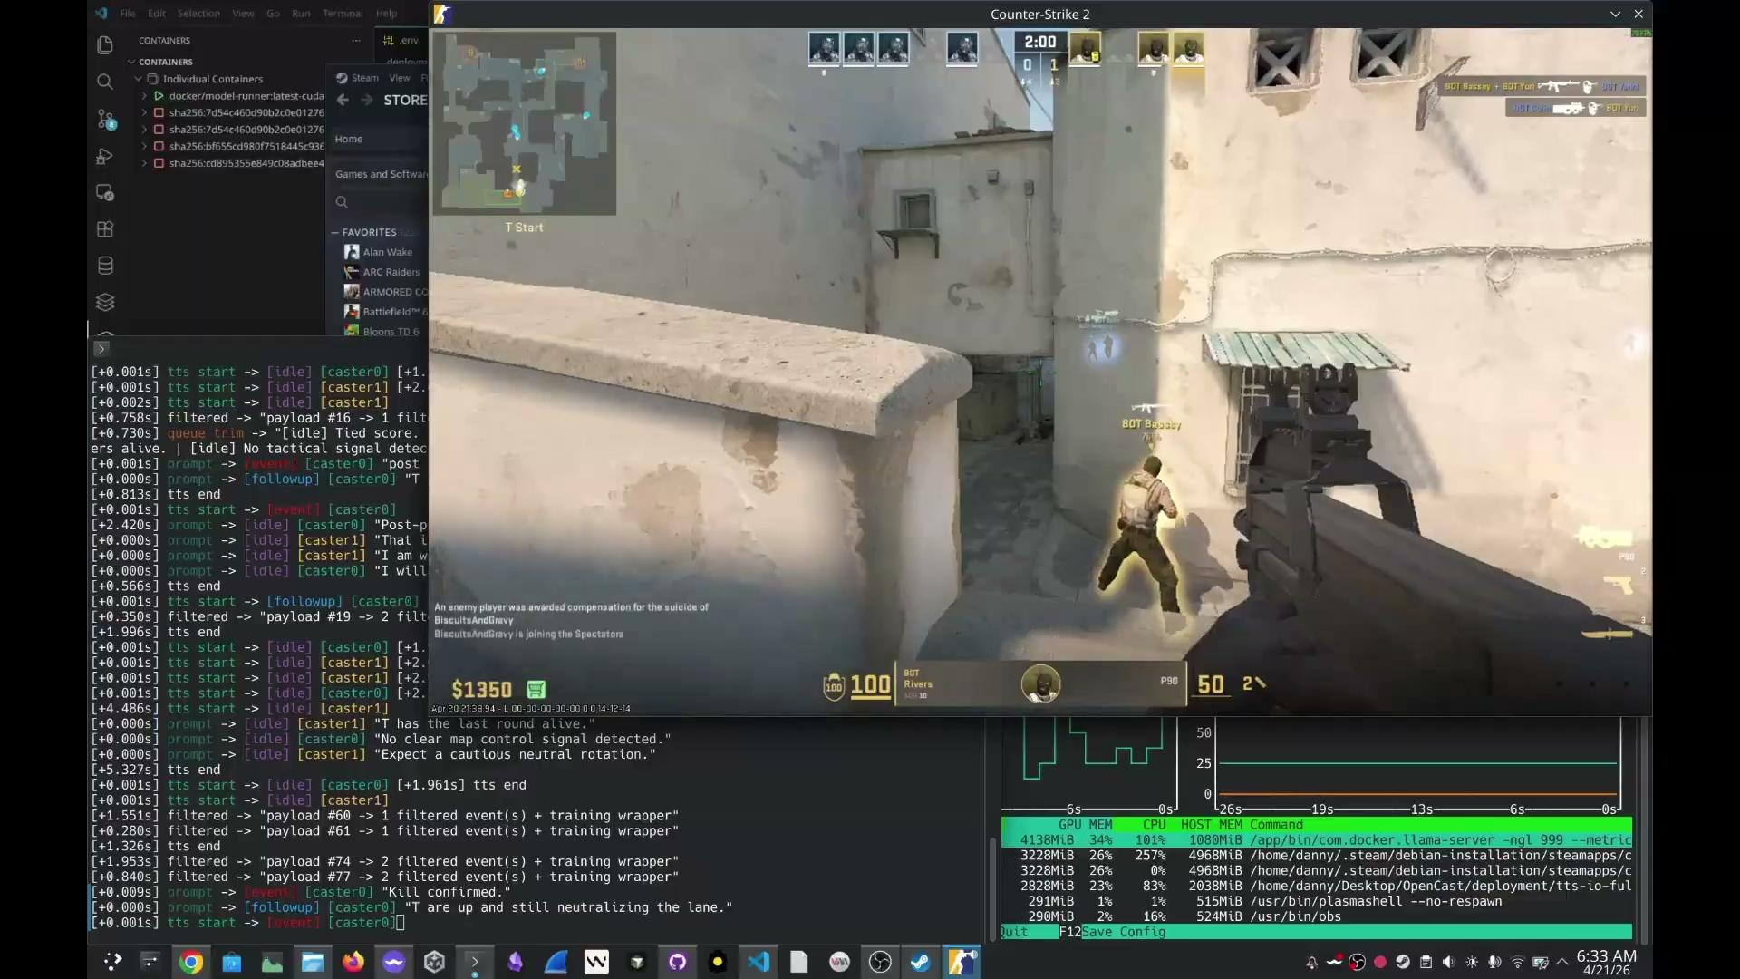
Pipeline
Events:
Context
Demo
Post-Mortem
kill, grenade, round completion
Insert vid here
$0M
$0M
$0M
00%
00%
$00
00%
00%
$0M
$00
$0M
$00
Metric
Metric
Metric
Metric
Metric
Metric
Metric
Metric
Metric
Notes:
3 kinds of lines prompting:
Events (what happened)
Follow Ups (light analysis given event + context)
Idle (heavier analysis + fill in dead air)
Location awareness i had to explicity map from position to gameplay
Wanted to add clones of different emotions:
Calm, excited, shouting
But found it inconsistent
tried adding comedic back and forth between casters: Decided to focus mostly on just analysis lines

Slide 18
Post-Mortem
What I learned
Context
Pipeline
Demo
A lot can be done on very small models,
But latency is still very gpu dependent

Slide 19
Post-Mortem
What I learned
Context
Pipeline
Demo
A lot can be done on very small models,
But latency is still very gpu dependent
Voice cloning and streaming TTS wasn’t too much trouble,
But fine tuning for analysis often varied in subjective quality

Slide 20
Post-Mortem
What I learned
Context
Pipeline
Demo
A lot can be done on very small models,
But latency is still very gpu dependent
Voice cloning and streaming TTS wasn’t too much trouble,
But fine tuning for live analysis was much more involved
More meaningful analysis requires custom implementation per game
TTS voices needs to be crafted around the pace of a game

Slide 21
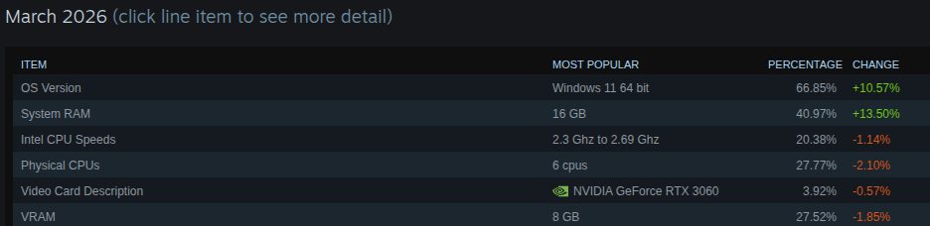
Post-Mortem
Goals met?
Context
Pipeline
Demo
Steam Hardware Survey as our target hardware:
RTX 3060 8GB vram
Quarter, Year
Milestone 3
Outline how you will achieve the strategic plan, step by step.
Quarter, Year
Milestone 4
Outline how you will achieve the strategic plan, step by step.
Outline how you will achieve the strategic plan, step by step.

Slide 22
Post-Mortem
Goals met?
Context
Pipeline
Demo
My Hardware: RTX 4080 12GB vram Laptop
X86_64 Linux Desktop

Slide 23
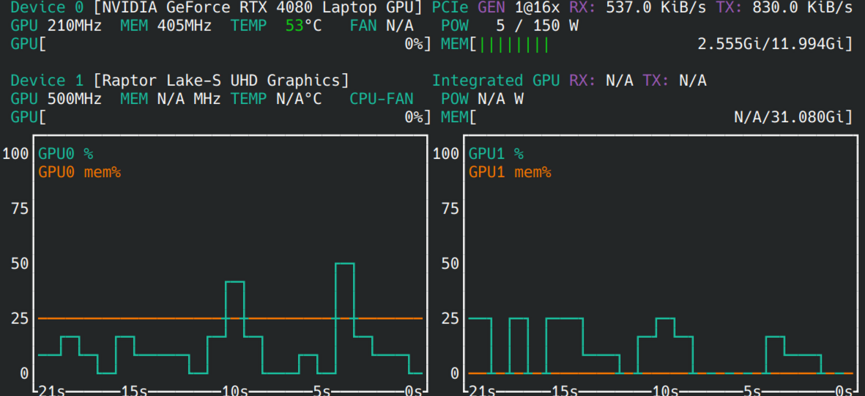
Post-Mortem
Goals met?
Context
Pipeline
Demo
My Hardware: RTX 4080 12GB Laptop
Text model vram usage:
About 2.6GB

Slide 24
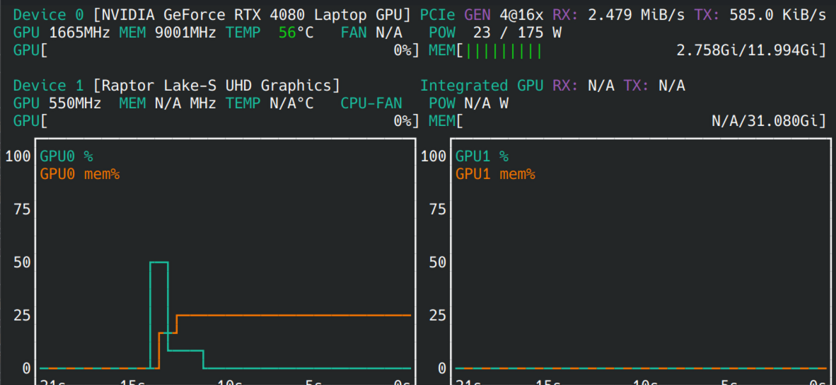
Post-Mortem
Goals met?
Context
Pipeline
Demo
My Hardware: RTX 4080 12GB Laptop
TTS model vram usage:
About 2.8GB

Slide 25
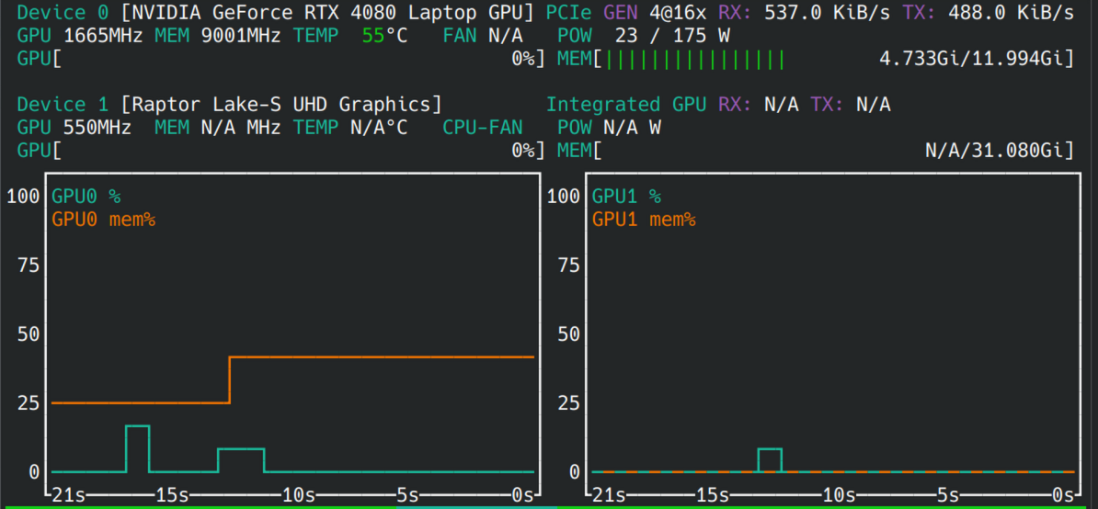
Post-Mortem
Goal met
Success-
And both running only uses 4.8 instead of 5.3 GB??
Context
Pipeline
Demo

Slide 26
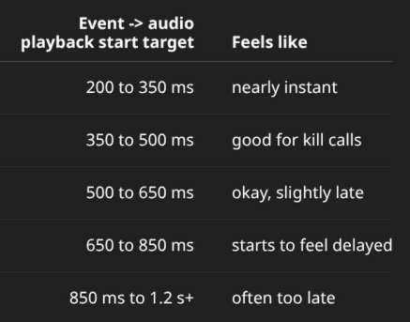
Post-Mortem
Goals met?
Context
Pipeline
Demo
Latency target for time to hear a sentence start:

Slide 27
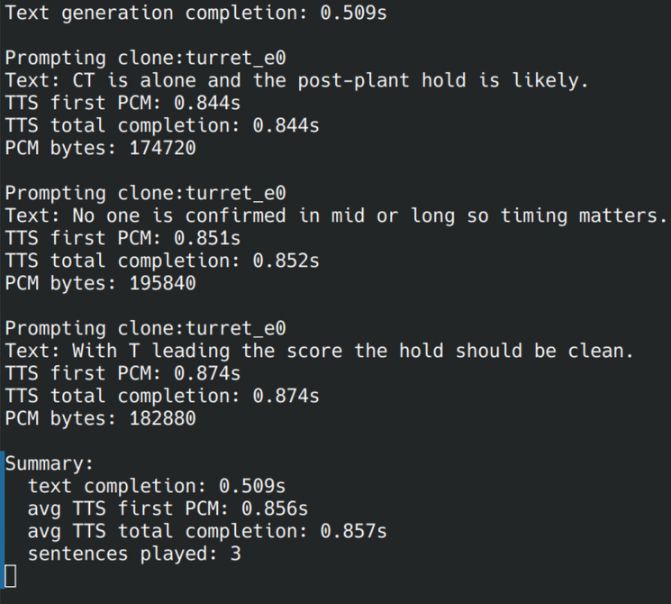
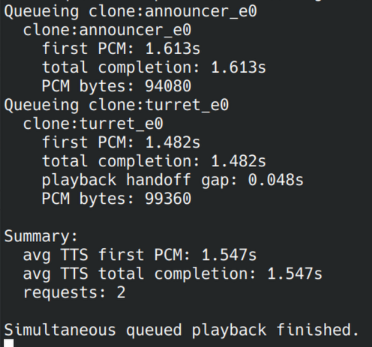
Post-Mortem
Goals met?
Context
Pipeline
Demo
Time to start TTS streaming +
Time between TTS streams:
0.9s individually
1.6s batching 2 at a time
>0.05s sequencing

Slide 28
Post-Mortem
Goals met?
Context
Pipeline
Demo
Slow on start. Sequenced is good
Overall.
Not ideal.

Slide 29
Post-Mortem
Goals met?
Commentary is sparse
Commentary isn’t unique
Commentary isn’t nuanced
Context
Pipeline
Demo

Slide 30
Post-Mortem
Goals met?
Yes
Kind of
Kind of
Context
Pipeline
Demo
Personally, I think it leaves a lot to be desired right now

Slide 31
Post-Mortem
If I had more time
Context
Pipeline
Demo
Try a server-side approach

Slide 32
Post-Mortem
If I had more time
Context
Pipeline
Demo
Try a server-side approach
Simulate ping for tts streaming

Slide 33
Post-Mortem
If I had more time
Context
Pipeline
Demo
Try a server-side approach
Simulate ping for tts streaming
Higher quality training data and support for more maps

Slide 34
Post-Mortem
If I had more time
Context
Pipeline
Demo
Try a server-side approach
Simulate ping for tts streaming
Higher quality training data and support for more maps
Fine tune bigger models for better generalizing analysis

Slide 35
Post-Mortem
If I had more time
Context
Pipeline
Demo
Try a server-side approach
Simulate ping for tts streaming
Higher quality training data and support for more maps
Fine tune bigger models for better generalizing analysis
Look at fine tuning the TTS model itself

Slide 36
Post-Mortem
The Ethics
Context
Pipeline
Demo
Voice cloning sits in a sensitive social spot. Examples like Deepfakes

Slide 37
Post-Mortem
The Ethics
Context
Pipeline
Demo
Voice cloning sits in a sensitive social spot. Examples like Deepfakes
Biggest risks for pipelines like these are impersonation or unauthorized voice use

Slide 38
Post-Mortem
The Ethics
Context
Pipeline
Demo
Voice cloning sits in a sensitive social spot. Examples like Deepfakes
Biggest risks for pipelines like these are impersonation or unauthorized voice use
Present confidently wrong live commentary as trustworthy analysis.

Slide 39
Post-Mortem
The Ethics
Context
Pipeline
Demo
Voice cloning sits in a sensitive social spot. Examples like Deepfakes
Biggest risks for pipelines like these are impersonation or unauthorized voice use
Present confidently wrong live commentary as trustworthy analysis.
Notes:
What this project explores raises meaningful ethical issues because it combines live AI analysis, synthetic speech, and voice cloning in a way that can easily blur authorship, authority, and consent;
the biggest risks for pipelines like these are impersonation or unauthorized voice use, and confidently wrong live commentary presented as trustworthy analysis.
This project is strictly for academic purposes and not hiding the fact that it’s all AI from end-to-end

Slide 40
Post-Mortem
The Ethics
Context
Pipeline
Demo
What this project explores raises meaningful ethical issues because it combines live AI analysis, synthetic speech, and voice cloning in a way that can easily blur authorship, authority, and consent;
the biggest risks for pipelines like these are impersonation or unauthorized voice use, and confidently wrong live commentary presented as trustworthy analysis.
This project is strictly for academic purposes and not hiding the fact that it’s all AI from end-to-end

Slide 41


Thank You
Danny Son
Project Repo:
https://github.com/dannys0n/OpenCast
LinkedIn:
Contact 2002dannyson@gmail.com

Slide 42
Pipeline detailed
GSI sends live CS2 state into the system.
Raw state is filtered into a compact wrapper.
The text model generates short caster lines.
Lines are split into interruptible sentences.
A queue prioritizes live events over idle chatter.
TTS turns sentences into low-latency audio.
Prompting and voices keep the two casters distinct.
Q&A

Slide 43
GSI & Filtering
Raw GSI is noisy and mode-dependent.
Filtering normalizes score, bomb, players, and events.
Spectator mode gives fuller round context.
Player POV uses local features like health, armor, and weapons.
The pipeline avoids inventing missing round state.
Tactical summaries compress pressure and risk signals.
Low-value prompts are filtered out early.
Q&A

Slide 44
TTS
OmniVoice replaced the earlier TTS backend.
Two cloned voices represent the casters.
The system optimizes for low first-audio latency.
Playback is sentence-level and interruptible.
v5 prefetches the next sentence.
Stale prefetched audio can be cancelled.
Timing logs track text and TTS latency.
Q&A

Slide 45
Fine tuning
Training inputs come from real structured match data.
Gold rows are hand-tuned for quality.
Separate styles cover events, color, and conversation.
Synthetic data uses real inputs plus gold few-shots.
Outputs stay in a simple structured lines format.
Validation checks JSON shape and line counts.
Fine-tuning improves grounding, not just style.
Q&A

