Slide 1
Star Hotels - Holidays begin here
Data based prediction model : Predict if a booking will be cancelled ?

Slide 2

Background
A significant number of hotel bookings are called-off due to cancellations or no-shows. The typical reasons for cancellations include change of plans, scheduling conflicts, etc.
Cancellations are less desirable and possibly revenue-diminishing factor for hotels to deal with. Such losses are particularly high on last-minute cancellations.
The new technologies involving online booking channels have dramatically changed customers’ booking possibilities and behavior.

Slide 3
Business Problem Overview and Solution Approach
Financial implications: Loss of resources (revenue) when the hotel cannot resell the room.
The cancellation of bookings impact a hotel on various fronts:
Additional costs of distribution channels by increasing commissions or paying for publicity to help sell these rooms.
Lowering prices last minute, so the hotel can resell a room, resulting in reducing the profit margin.
Human resources to make arrangements for the guests.
Objective
The increasing number of cancellations calls for a Machine Learning based solution that can help in predicting which booking is likely to be canceled.
Find which factors have a high influence on booking cancellations, build a predictive model that can predict which booking is going to be canceled in advance, and help in formulating profitable policies for cancellations and refunds.

Slide 4
Data Overview
Variable | Description
no_of_adults | Number of adults
no_of_children | Number of Children
no_of_weekend_nights | Number of weekend nights (Saturday or Sunday) the guest stayed
no_of_week_nights | Number of week nights (Monday to Friday) the guest stayed or booked
type_of_meal_plan | Type of meal plan booked by the customer:
required_car_parking_space | Does the customer require a car parking space
room_type_reserved | Type of room reserved by the customer
lead_time | Number of days between the date of booking and the arrival date
arrival_year | Year of arrival date
arrival_month | Month of arrival date
arrival_date | Date of the month
market_segment_type | Market segment designation.
repeated_guest | Is the customer a repeated guest?
Variable | Description
no_of_previous_cancellations | Previous bookings that were canceled by the customer prior to the current booking
no_of_previous_bookings_not_canceled | Previous bookings not canceled by the customer prior to the current booking
avg_price_per_room | Average price per day of the reservation
no_of_special_requests | Number of special requests
booking_status | Flag indicating if the booking was canceled or not.
Observations | Variables
56926 | 18

Slide 5
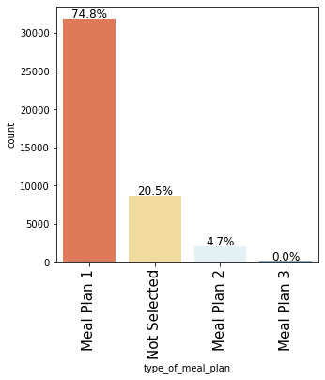
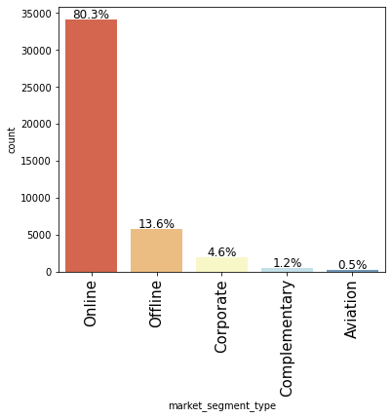
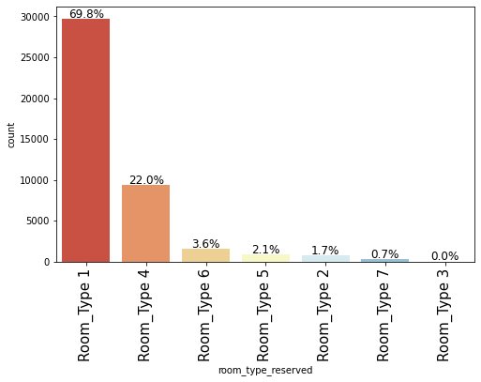
Exploratory Data Analysis
Meal Plan 1 ( Breakfast) accounts for almost 75% of the bookings
Online market segment is the largest. Offline is the second most booked segment
Room Type 1 , accounts for almost 70% of the bookings
Room Type 1 and Room Type 4 together make up over 90% of the bookings

Slide 6
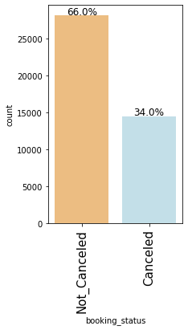
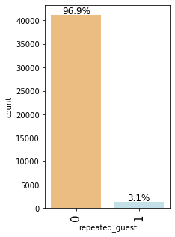
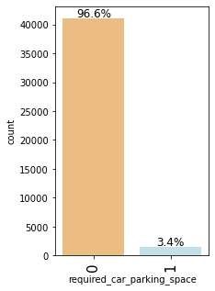
EDA
66% of the bookings are not canceled
About 3% of the booking are from repeated guests
Most bookings did not need a car parking space

Slide 7
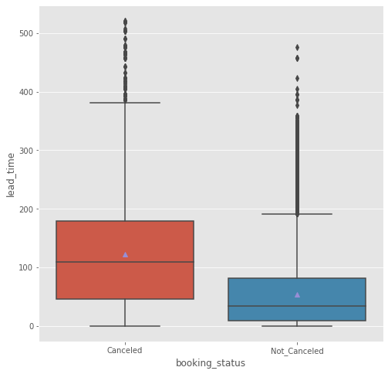
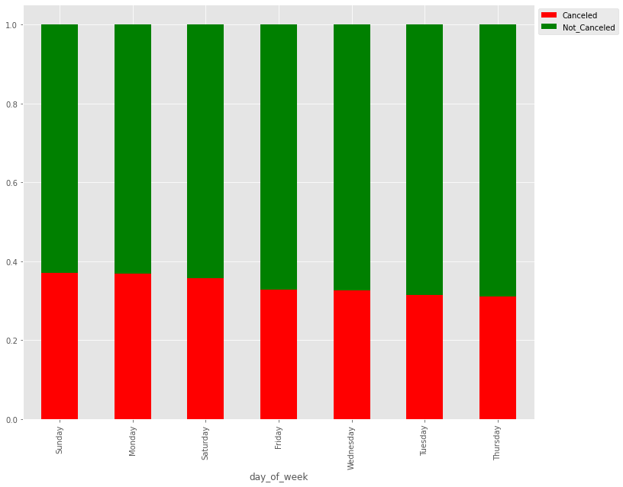
EDA
Almost all days of the week have similar possibility of cancellation
Higher lead_time bookings have risk of cancellation

Slide 8
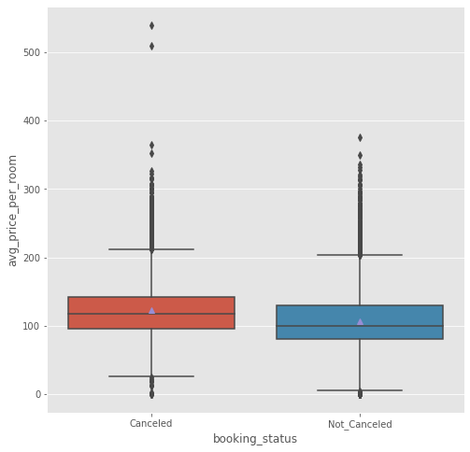
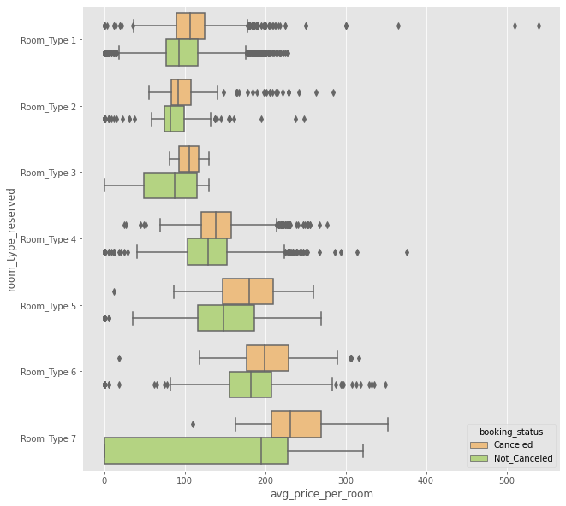
EDA
No particualr distinction on avg_booking_price wrt to booking_status
room_type 7, with avg_price_per_room greater than 200 Euros is more likely to be canceled.

Slide 9
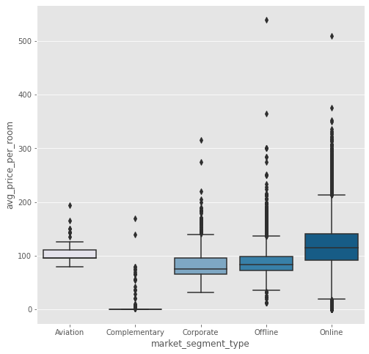
EDA – Contd.
Aviation segment: Although the price range is less, the avg price is higher then most segments
Corporate and Offline segments have almost similar average price ranges
Online has the largest range on prices
Data Overview
Observations
As the no of week nights increases, the cancellation probability increases.
The more the number of weekend nights , more likely to be cancelled.
Repeated_guest are least likely to cancel.
Higher lead_time bookings have risk of cancellation.

Slide 10
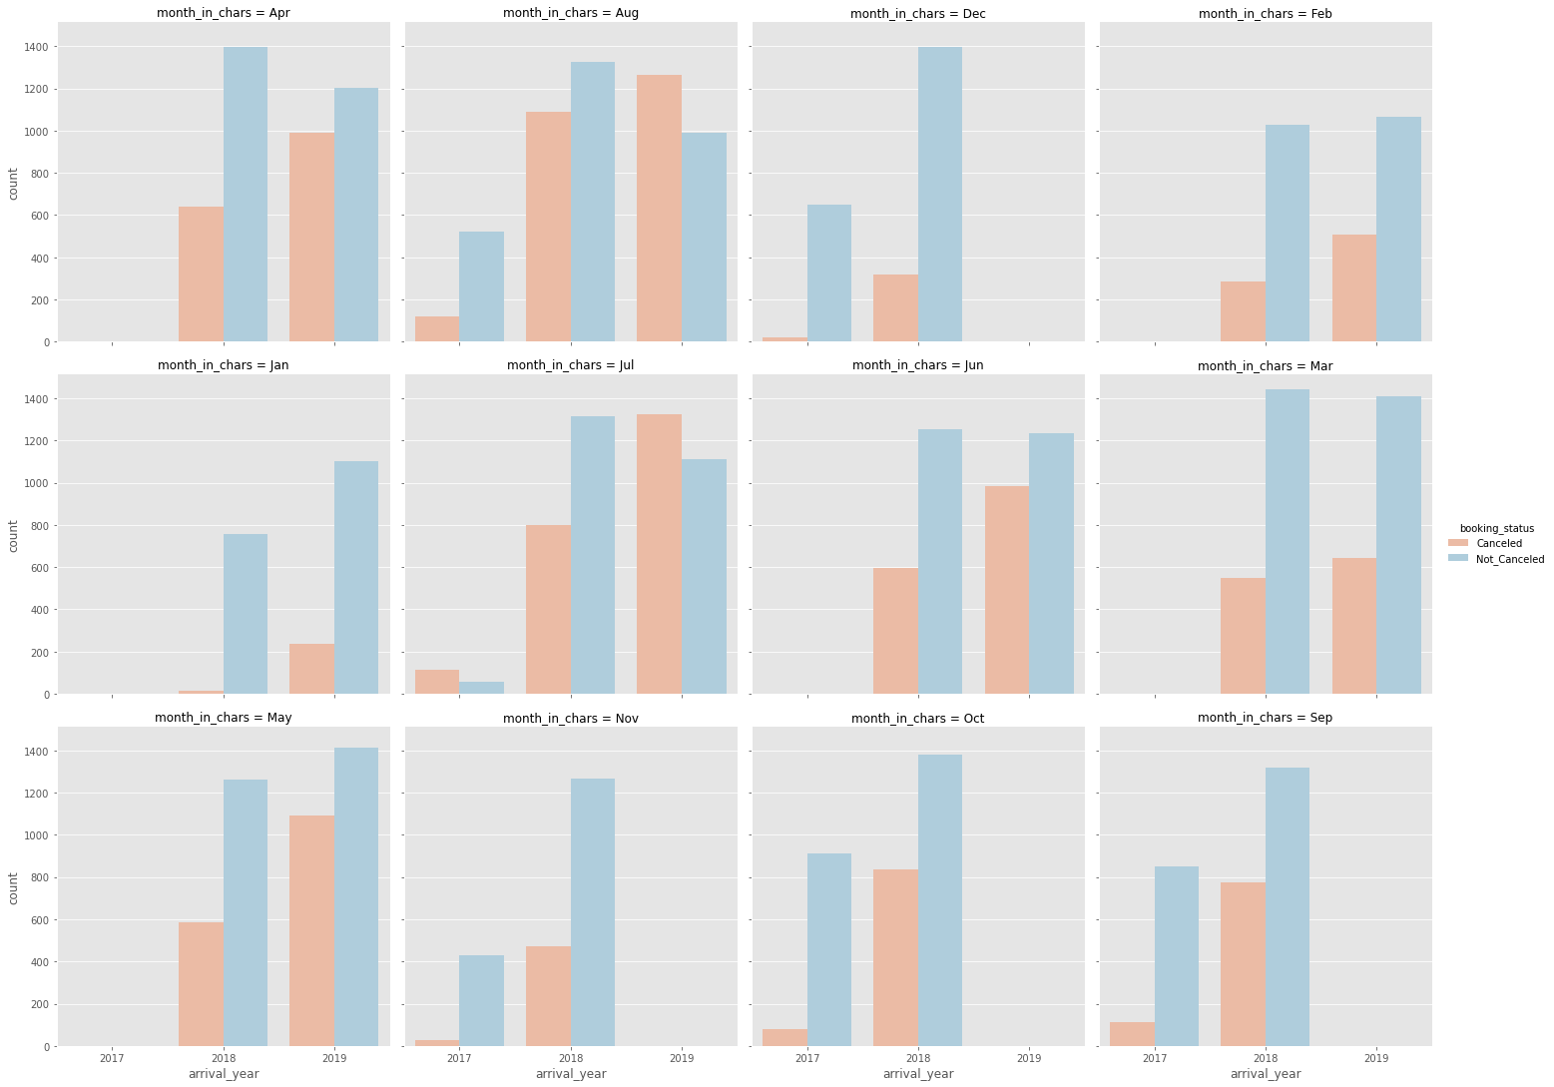
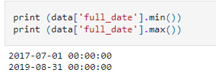
EDA – Contd.
Data is available for Jul 2017 to Aug 2019
So it will not be relevant to include arrival_year, arrival_month and arrival_date in the model

Slide 11
Key Questions:
What are the busiest months in the hotel?
March ,it has the highest non cancellations. Aug, May and Apr as well.
Which market segment do most of the guests come from?
Online
Hotel rates are dynamic and change according to demand and customer demographics. What are the differences in room prices in different market segments?
Aviation : Mostly between 90 and 110.
Corporate : 70 to 100
Offline : 80 to 100, with many outliers and max reaching above 500
Online : 90 to 130, with many outliers and max reaching above 500
What percentage of bookings are canceled?
At about 34% of booking are canceled.
Repeating guests are the guests who stay in the hotel often and are important to brand equity. What percentage of repeating guests cancel?
Less than 1% of repeated_guest cancel the booking
Many guests have special requirements when booking a hotel room. Do these requirements affect booking cancellation?
The more special requirements, the less likely they are to cancel

Slide 12
Model evaluation criterion
Model can make wrong predictions as:
Predicting a booking is not going to be Canceled but in reality is Canceled - Loss of resources
Predicting a booking is going to Cancel but in reality will not Canceled -Wrong flagging
Which Loss is greater ?
The cancellation of bookings impact a hotel on various fronts.
Loss of resources will be the greater loss as the hotel will lose out on revenue and other additional expenditure the cancel of bookings will cause.
How to reduce this loss i.e need to reduce False Negatives ?
Model should reduce false negatives, this can be done by maximizing the Recall. Greater the recall lesser the chances of false negatives.
Positive event and Negative Event
Positive event is cancellation
Negative event is Non cancellation

Slide 13
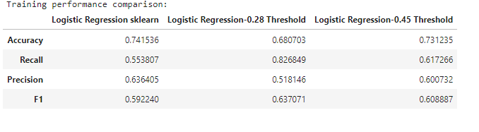
Logistic Regression
Model performance evaluation
All the models are giving a generalized performance on training and test set.
The highest recall is 82% on the training set.
Using the model with 0.28 threshold the model will give a high recall. This model will help the hotel identify potential bookings that will be cancelled
Final Model Summary
From our logistic regression model we identified that lead_time is a significant predictor of a booking being canceled.
Bookings that have no children are more likely to be cancelled
Online bookings are more likely to be cancelled
repeated_guest are least likely to cancel
The more special requirements, the less likely they are to cancel

Slide 14
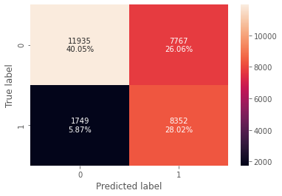
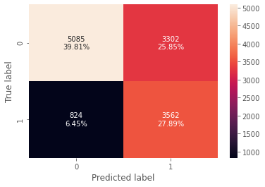
Logistic Regression
Training :optimal_threshold_auc_roc
Test :optimal_threshold_auc_roc

Slide 15
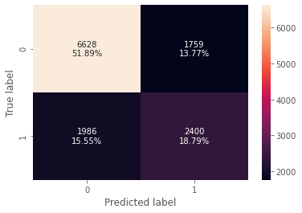
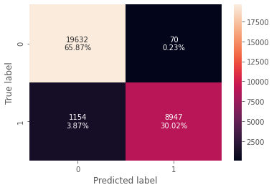
Decision Tree model
Training :
Recall Score: 0.8857538857538858
Test:
Recall Score: 0.5471956224350205
There is a huge disparity in performance of model on training set and test set, which suggests that the model is over fiiting.

Slide 16
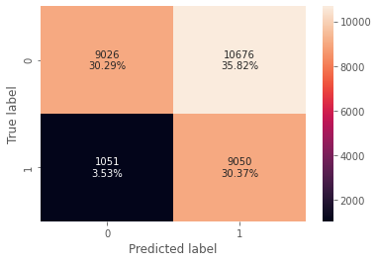
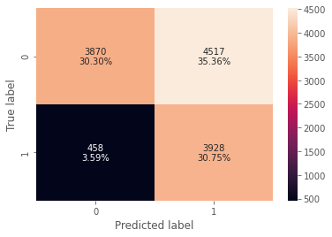
Decision Tree model - Reducing over fitting with Grid Search
Pre-Pruning
DecisionTreeClassifier(random_state=1,class_weight={0: 0.34, 1: 0.66})
# Grid of parameters to choose from
parameters = {'max_depth': np.arange(1,10),
'min_samples_leaf': [1, 2, 5, 7, 10,15,20],
'max_leaf_nodes' : [2, 3, 5, 10],
'min_impurity_decrease': [0.001,0.01,0.1]
}
Training
Test
Training :
Recall Score: 0.8959508959508959
Test :
Recall Score: 0.895576835385317
The model is giving a generalized result now.

Slide 17
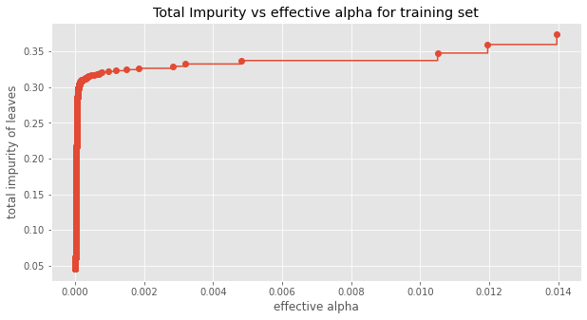
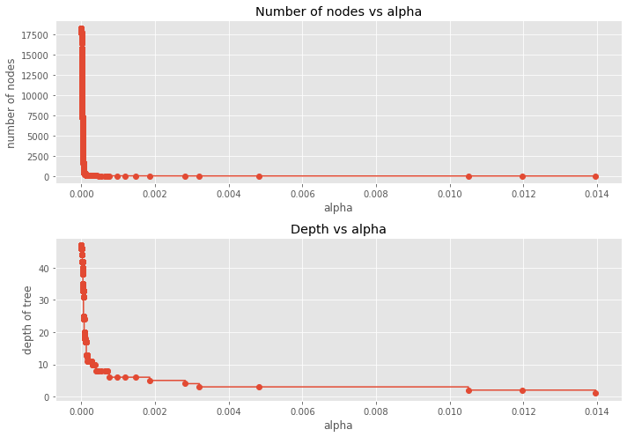
Decision Tree model - Cost Complexity Pruning (post-Pruning)
Next, we trained a decision tree using the effective alphas. The last value in ccp_alphas is the alpha value that prunes the whole tree, leaving the tree, clfs[-1], with one node.
Number of nodes in the last tree is: 1 with ccp_alpha: 0.07447795787334116
For the remainder, we remove the last element in clfs and ccp_alphas, because it is the trivial tree with only one node.

Slide 18
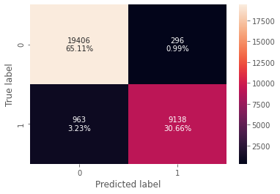
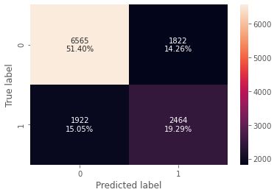
Decision Tree model – CCP – post-pruning
Training :
Recall Score: 0.8857538857538858
Test:
Recall Score: 0.5617875056999544
There is a huge disparity in performance of model on training set and test set. The pre-pruned model gives a better performance.

Slide 19
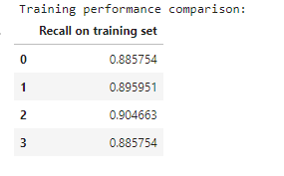
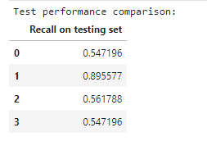
Decision Tree – Model Performance Comparison and Conclusions
0. Default Decision Tree
Pre-pruned ( with hyper parameters set )
Post-pruned( CCP with best fit)
Post-pruned ( CCP with 0.000000001 ccp_alpha)

Slide 20
Decision Tree – Conclusion
Decision tree model with pre-pruning has given the best recall score on training data and test data.
The pre-pruned and the post-pruned models have reduced overfitting and the model is giving a generalized performance.
The Decision tree with these parametes gives the best model
DecisionTreeClassifier(class_weight={0: 0.34, 1: 0.66}, max_depth=3, max_leaf_nodes=5, min_impurity_decrease=0.001, random_state=1)
Conclusions
With the logistic regression model the best performance of recall metric was 0.826849 on training and 0.81213 on test.
The logistic regression model had a optimal_threshold_auc_roc of 0.28767.
With Decision tree and pre-pruning the best performance was 0.89595 on training and 0.89557 on the test.
The Decision tree model had the pre-pruning parameters of class_weight={0: 0.34, 1: 0.66}, max_depth=3, max_leaf_nodes=5, min_impurity_decrease=0.001, random_state=1)
As with Decision tree model the important variable for determining the booking_status is lead_time and total_no_of_days the booking is done for.
For the logistic regression model repeated_guest and avg_price_per_room form the important variables.

Slide 21
Business Insights and Recommendations
What profitable policies for cancellations and refunds can the hotel adopt?
Higher lead_time bookings have risk of cancellation, a maximum of 90 days thershold can be set.
Higher cancellation charges can be applied if the customer booked with a lead time of more thatn 60 days.
When the booking is done for longer no of nights, the possibility of canellation is high.
Repeat guest are less likely to cancel. Hotel can consider to offer loyalty programs.
Hotel can apply additional surcharge when the booking exceeds total_no_of_day as 7.
Bookings with Sunday as the day of arrival, have a slightly higher changes of being cancelled, so hotel can charge a premium for sundays as arrival_day
Booking that are for only weekdays have higher change of being cancelled. If the booking is only for weekday cancellations policy can be adjusted to make it less attractive for cancellation.

Slide 22
Business Insights and Recommendations. Contd..
What profitable policies for cancellations and refunds can the hotel adopt?
Booking with children ( young family) are likely to be cancelled more often.
Online booking form the bulk of booking and also have the higher cancellation.
Bookings that have Meal Plan 3 as their choice are less likey to cancel.
Booking that have special_requests are less likely to cancel.
Bookings with room_type_reserved as 1 and 3 are less likey to cancel.

Slide 23
Business Insights and Recommendations
What other recommendations would you suggest to the hotel?
Repeat guest are less likely to cancel. Hotel can consider to offer loyalty programs.
Hotel can adopt dynamic pricing as the date draws closer as customer booking close to the arrival date are less likely to cancel.
Hotel can offer special rewards to coporate and aviation as the cancellations are lesser.
Bookings with room_type_reserved as 1 and 3 are less likely to cancel. Hotel can charge additional cancellation fee for other room types
For online segment, hotel can enforce a holding amount which can be refunded based on the cancellation date and arrival date.

