Slide 1
Cardio Good Fitness - Customer profile and Recommendations

Slide 2
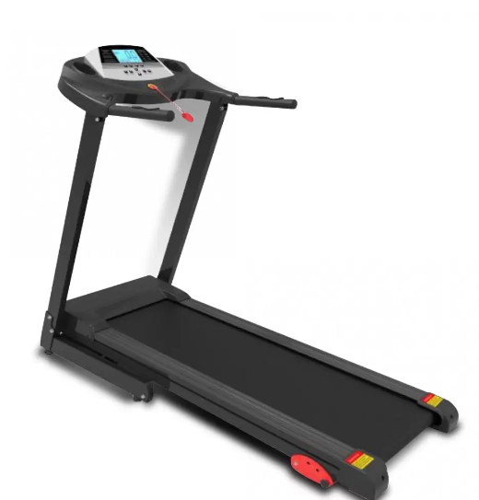
Background
A set of observation of stores existing customers is available.
With the available data, build a customer profile for different products
Generate insights and recommendations that will help the company to get new customers

Slide 3
Objective
To extract actionable insights from the data and recommendations that will help to grow the sales.
Focal points would be-
Variables than influence the usage of the product
Identify the core customer group
Core business idea
Increase sales
Problem to tackle
Identify new customers

Slide 4
Data Overview
Variable | Description
Product | Model no. of the treadmill
Age | No of years, of the customer
Gender | Gender of the customer
Education | Education in no. of years, of the customer
Marital Status | Marital Status of the customer
Usage | Avg. # times the customer wants to use the treadmill every week
Fitness | Self rated fitness score of the customer (5 - very fit, 1 - very unfit)
Income | Income of the customer in Dollars
Miles | Miles expected to run
Observations | Variables
180 | 9

Slide 5
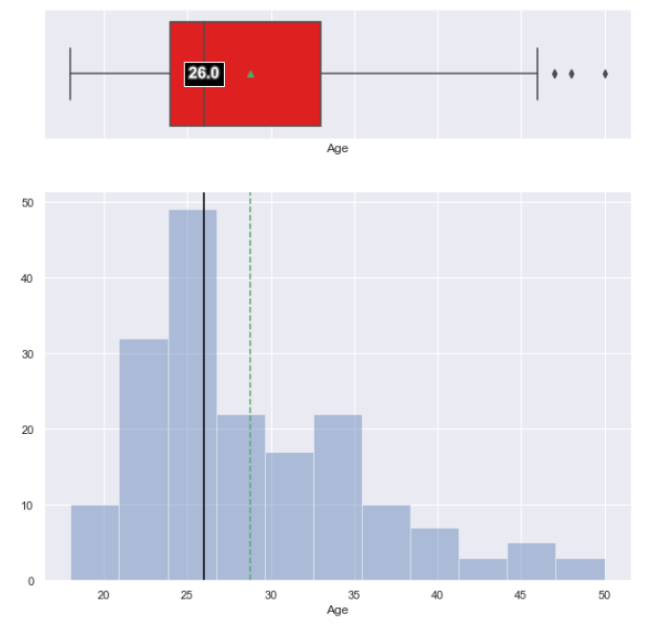
Exploratory Data Analysis - Age
Observations:
Average age of the customer is 29 and median value is 26.
Age group of 24 -33 form the core group of customers.

Slide 6
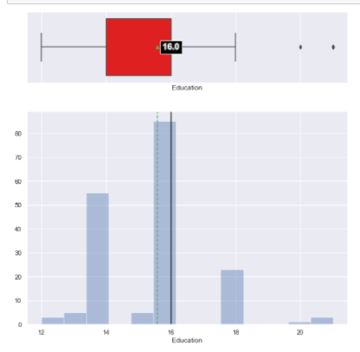
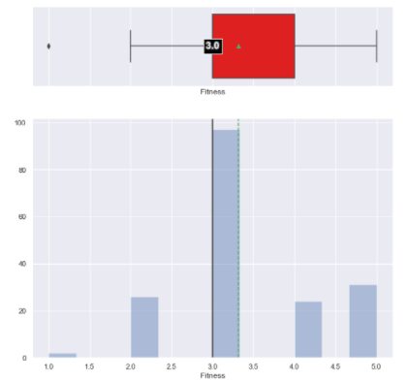
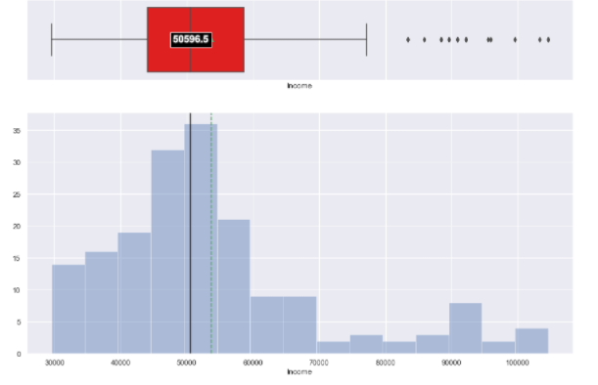
Exploratory Data Analysis – Education, Fitness and Income
Most customers have at least 15 year of education
Most customers rate themselves with a fitness level of 3
Most customers fall in the income range of 45,000 to 60,000 .

Slide 7
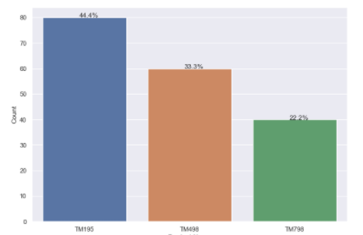
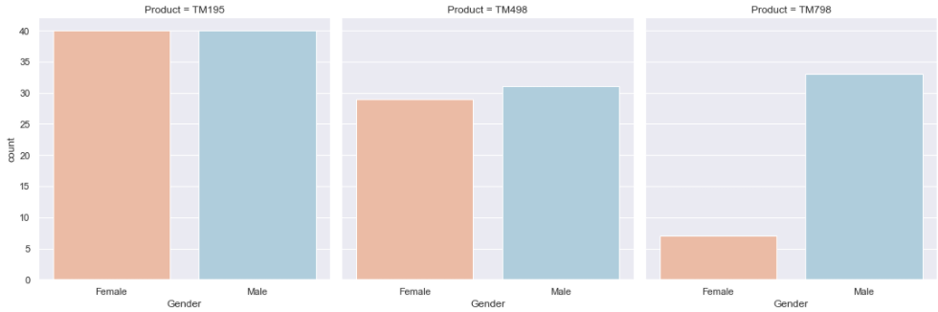
Analysis per product
Observation data distribution across product
Most customers have TM195 product.
TM798 is the product which has lesser customers.
Gender distribution across different product
Most customers have TM195 product. On Product,TM195 Equal distribution between male and female customers.
TM498 has almost equal distribution between male and female customers.
TM798 is the product which has lesser customers, and this product has more male customers.

Slide 8
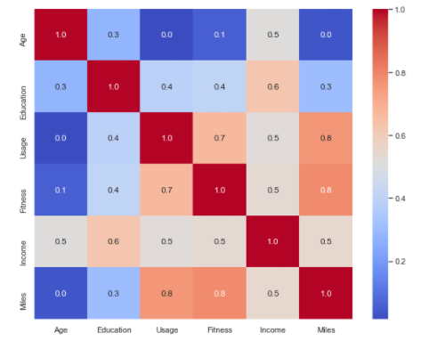
Correlation between variables from observation
Usage and Miles, Miles and Fitness are corelated.
The more the usage the more Miles are run.
As more miles are run , the user is at a higher Fitness level.
Understandably, Fitness and Usage have a correlation.
There does not seem to be a strong relationship between Usage and Age.

Slide 9
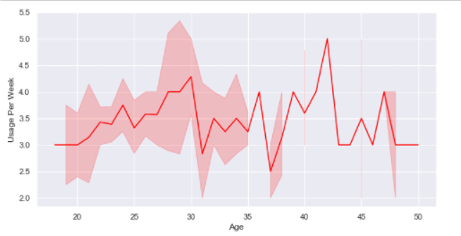
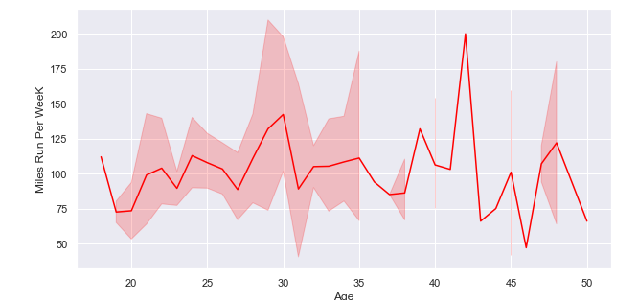
Age and Usage per week
Age group 28-30, have the most miles run per week.
The data is distributed between Age 20-35.
Miles and Usage per week
Age group 28-30 ,have the most miles run per week.
There is a good amount of dispersion in Usage for Age 20-35.

Slide 10
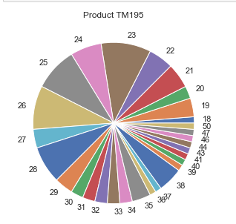
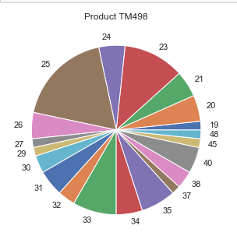
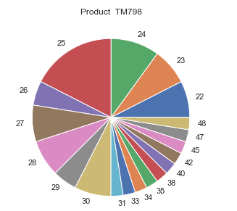
Age distribution per product
TM798 - Widely used by customers in Age 22-30.
TM195 - Widely used by customers in Age 22-29.
TM498 - Widely used by customer in Age 23-25.
Age group of 24 -33 form the core group of customers.

Slide 11
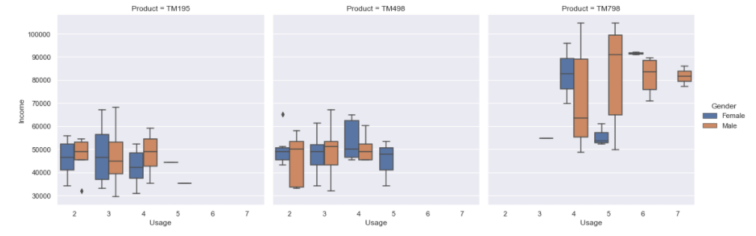
Usage per week vs Income per product
TM195 - Customer with annual income between 40000 and 55000 are likely to use this product
TM498 - Customer with annual income below 60000 are likely to use this product
TM798 - Customer with annual income more than 60000 are the core users for this product.

Slide 12
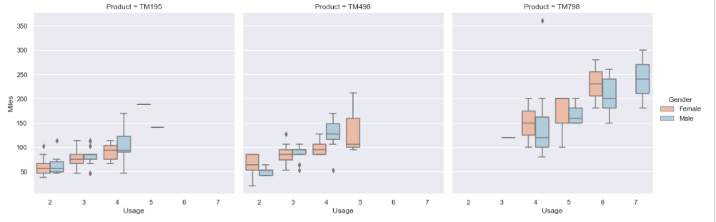
Usage vs Miles per week per Product
TM195 - Customer who like to run between 50 and 100 miles per week are likely to use this product.
TM498 - Customer likely to between 100 to 150 miles per week are likely to use this product.
TM798 - Customer who like to run more than 100 miles per week are more likely to use this product.

Slide 13
Business Insights and Recommendations
Conclusion based on interpretation of the model input variables
1. Most customers have TM195 product.
2. There are more male customer than female customers.
3. There are more customers who are with Marital Status of Partnered.
4. Customers between 24 to 33 are more likely to use the product
5. TM195 & TM498 , have a similar customer profile regarding usage level, Age, income and miles run per week
Usage per week : 3
Gender : Male
Fitness level: 3
Miles run per week : 50 -100
Annual Income: 40000 to 60000
Education : 14 to 16 years
Age: 23-28

Slide 14
Conclusion –contd.
6. TM798's customer profile:
Usage per week : 4
Gender : Males
Fitness level: 5
Miles run per week : 100
Annual Income: Above 60000
Education : More than 16 years
Age: 22-30

Slide 15
Further Analysis needed
TM798 has a different customer profile from the other two , more data needs to be collected to analyze this.
Data collection should have more variable that influence the usage, like the reason the customer wishes to buy product
Data should also be collected to infer if price of the product impacts the decision of the model purchased.

Slide 16
Recommendation
Recommendation to business
1. Age group of 24 -33 form the core group of customers. Sales should focus on this group
2. TM798 is more popular among Male customers.
3. TM798 is more popular with customer desiring a higher fitness level and having higher income.
4. TM195 is the most popular product.

