Slide 1
Office of Foreign Labour Certification
Data based prediction model : Predict if a prospective applicant will be granted visa
- by EasyVisa

Slide 2

Background
In FY 2016, the Office of Foreign Labor Certification (OFLC) processed 775,979 employer applications for 1,699,957 positions for temporary and permanent labor certifications.
This was a nine percent increase in the overall number of processed applications from the previous year. The process of reviewing every case is becoming a tedious task as the number of applicants is increasing every year.
The increasing number of applicants every year calls for a Machine Learning based solution that can help in shortlisting the candidates having higher chances of VISA approval

Slide 3
Business Problem Overview and Solution Approach
Business communities in the United States are facing high demand for human resources, but one of the constant challenges is identifying and attracting the right talent, which is perhaps the most important element in remaining competitive
OFLC processes job certification applications for employers seeking to bring foreign workers into the United States and grants certifications in those cases where employers can demonstrate that there are not sufficient US workers available to perform the work at wages that meet or exceed the wage paid for the occupation in the area of intended employment.
Objective
The increasing number of applicants every year calls for a Machine Learning based solution that can help in shortlisting the candidates having higher chances of VISA approval.
OFLC is interested in a data driven solution to analyze the data provided and, with the help of a classification model:

Slide 4
Data Overview
Variable | Description
case_id | ID of each visa application
continent | Information of continent the employee
education_of_employee | Information of education of the employee
has_job_experience | Does the employee has any job experience? Y= Yes; N = No
requires_job_training | Does the employee require any job training? Y = Yes; N = No
no_of_employees | Number of employees in the employer's company
yr_of_estab | Year in which the employer's company was established
region_of_employment | Information of foreign worker's intended region of employment in the US.
prevailing_wage | Average wage paid to similarly employed workers in a specific occupation in the area of intended employment. The purpose of the prevailing wage is to ensure that the foreign worker is not underpaid compared to other workers offering the same or similar service in the same area of employment.
unit_of_wage | Unit of prevailing wage. Values include Hourly, Weekly, Monthly, and Yearly.
Variable | Description
full_time_position | Is the position of work full-time? Y = Full Time Position; N = Part Time Position
case_status | Flag indicating if the Visa was certified or denied
Observations | Variables
25480 | 12

Slide 5
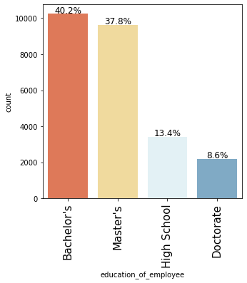
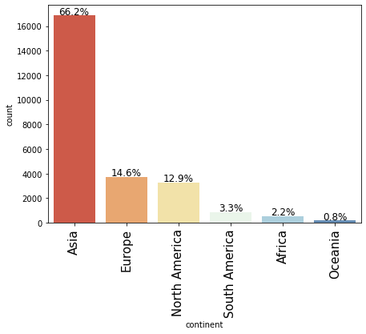
Exploratory Data Analysis
Asia has about 66 percent of total applications.
Europe and North America have about 14.6 and 13 percent of the total applications.
Nearly 40% of the applicants have Bachelor's and about 39% of them have Masters.

Slide 6
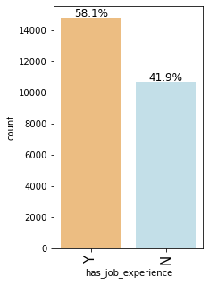
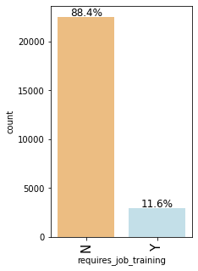
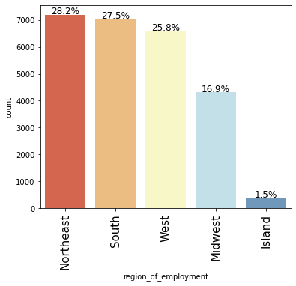
EDA
58% of the applicants for visa have job experience.
88% of then don't need job training.
The intended region of employment is almost equally distributed for Northeast, South, and West with 28%, 27.5% and 25.8%.

Slide 7
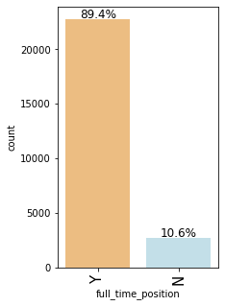
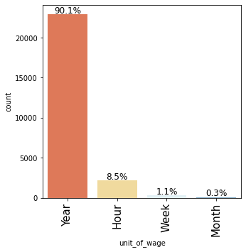
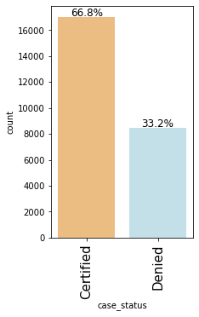
EDA
Almost 89% of the applicants, apply for full time positions.
Most of the job positions prevailing_wage are expressed in years.
66.8% of the applicants are successful in getting the Visa.

Slide 8
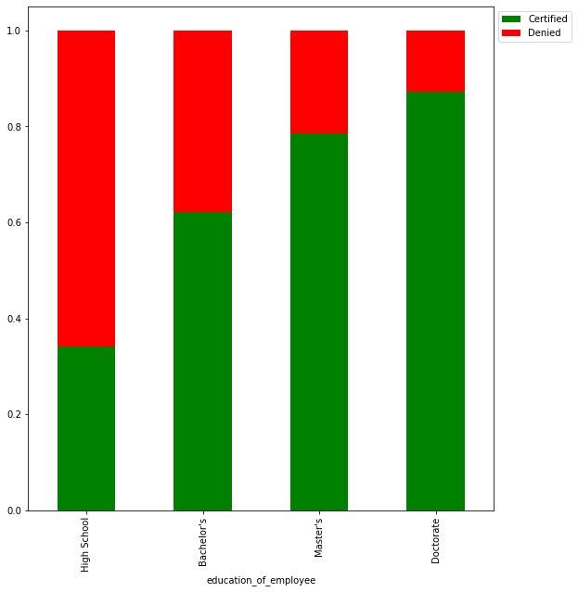
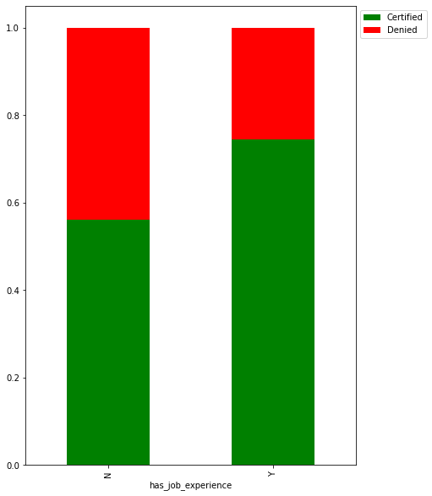
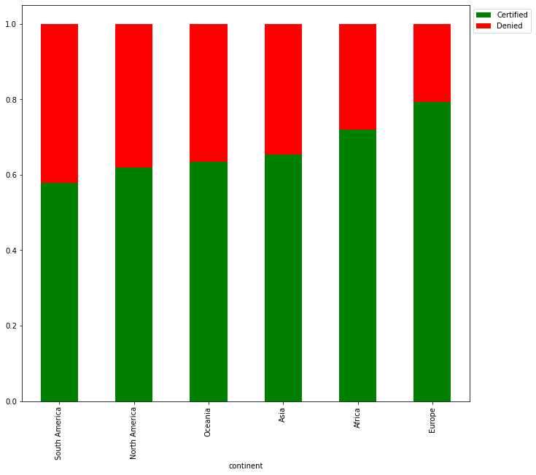
EDA
Employees having prior job experience have higher rate of approval.
Higher the education of the applicant the higher the chance of approval.
Doctorate's have almost 90% approval and Master's have roughly 80% approval rate.
Applicants from Europe have the highest rate of approval for Visa.
South America have the least rate of approval.

Slide 9
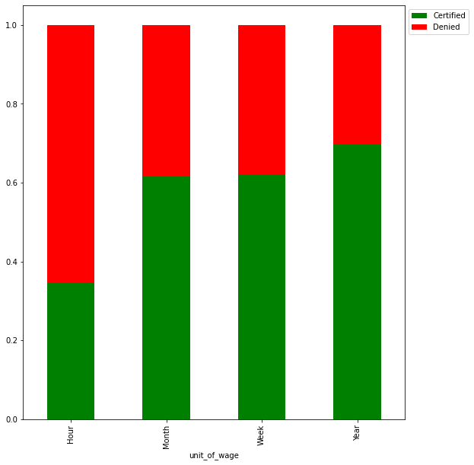
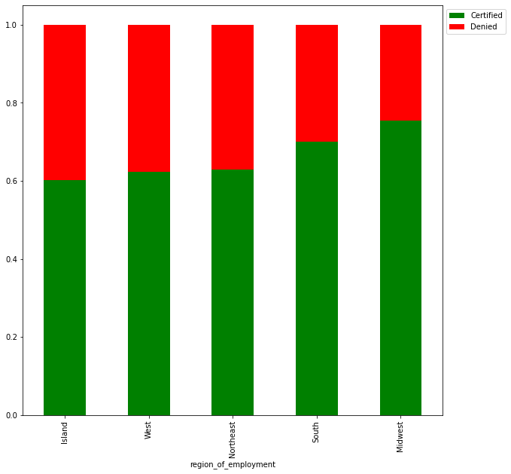
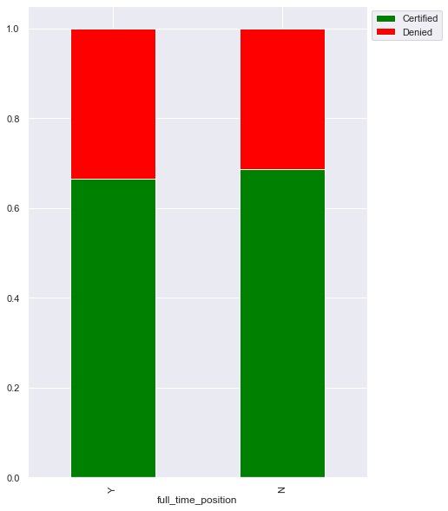
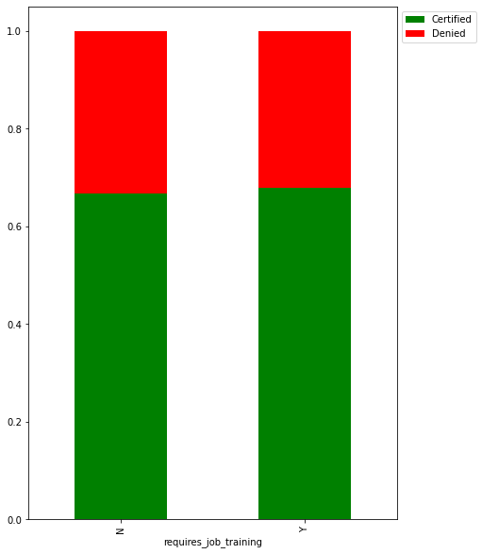
EDA – Contd.
Full time or part time nature of the work does not appear to impact the case status.
Applicants who have the unit_of_wage for prevailing_wage as year have the better chance of approval.
Midwest has the higher rate of Visa approval.
The region of intended employment does not seem to impact much, all regions have almost similar rate of approval.
Requirement for employee's Job training does not seem to be impacting the Visa application status.

Slide 10
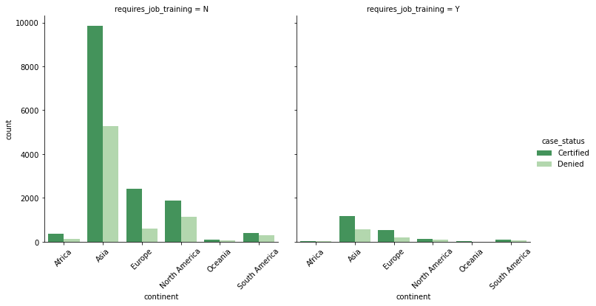
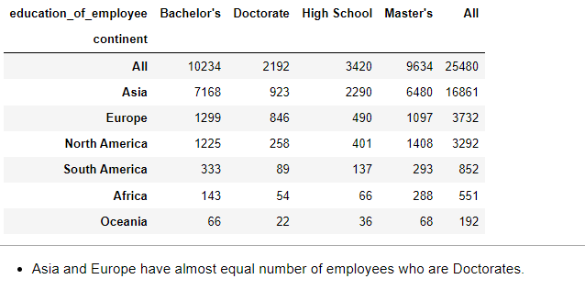
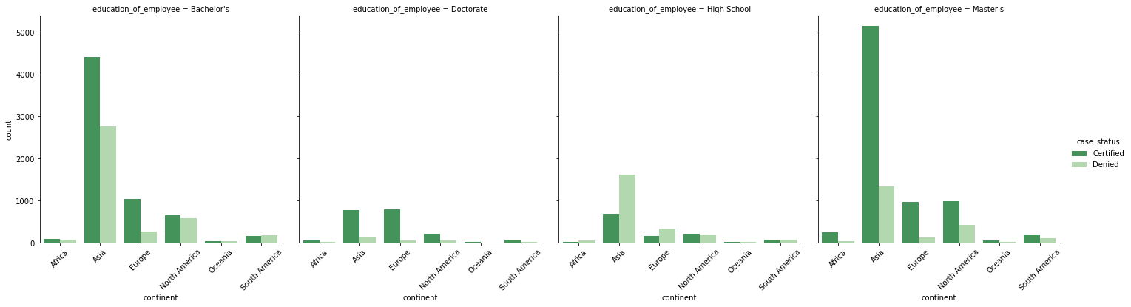
EDA – Contd.
Asia appears to widely approved Visa category, but there could be other factors like education
Applicants with High School have the lesser rate of approval

Slide 11
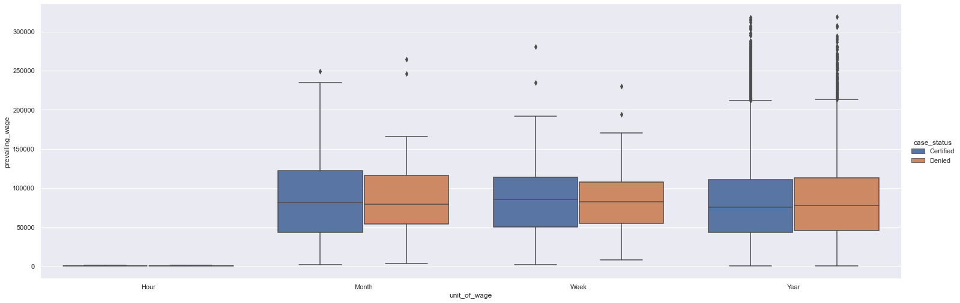
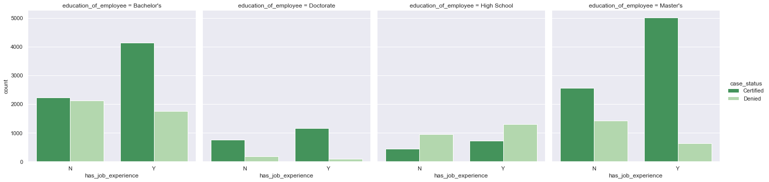
EDA – Contd.
Among the wage groups the wage does not seem to be deciding factor
Job experience seems to be a deciding factor for all education level except for Doctorate.

Slide 12
Key Questions:
Those with higher education may want to travel abroad for a well-paid job. Does education play a role in Visa certification?
Yes, employees with higher education have better rate of approval. Especially with Doctorate.
How does the visa status vary across different continents?
Yes, Europe seems to have higher level of approvals, this is also due to higher level of education among Europe applicants.
Experienced professionals might look abroad for opportunities to improve their lifestyles and career development. Does work experience influence visa status?
Yes, to some extent job experience influences visa status but not at a very high level as education.
In the United States, employees are paid at different intervals. Which pay unit is most likely to be certified for a visa?
Year to be the most approved, with hourly being least approved, but weekly and monthly too have good rates of approval.
The US government has established a prevailing wage to protect local talent and foreign workers. How does the visa status change with the prevailing wage?
Prevailing wage does not seem to appear impacting the visa status

Slide 13
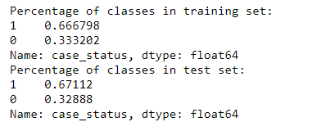
Model evaluation criterion
Model can make wrong predictions as:
Predicting an employee's Visa will not be Certified but in reality will be Certified- Loss of potential talent ( opportunity cost)
Predicting an employee's Visa will be Certified but in reality will not be Certified - Loss of resources
Which Loss is greater ?
Loss of potential talent ( opportunity cost) is nigher a skilled talent is hard to find.
Loss of resources is not a heavy burden as the application can be filtered in further processing.
How to reduce this loss i.e need to reduce False Negatives ?
Model should reduce false negatives, this can be done by maximizing the Recall. Greater the recall lesser the chances of false negatives.
Positive event and Negative Event
Positive event is Visa certified
Negative event is Visa is rejected
Total observations taken for model | 25,447
Training | 17,812
Test | 7635

Slide 14
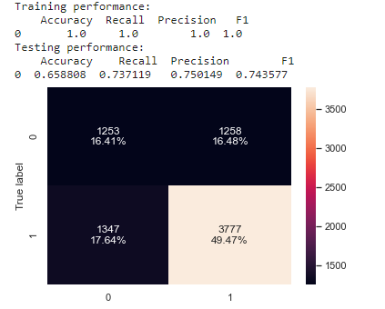
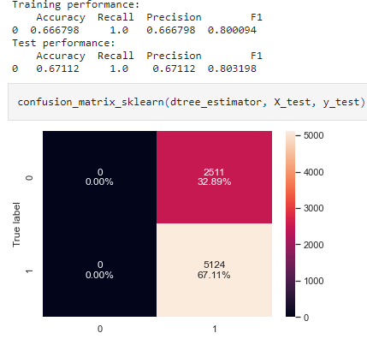
Model Building - Bagging
Decision Tree
The decision tree is overfitting the training data as there is a considerable difference between training and test scores for all the metrics.
The test recall is 73%. We can see if other models have better recall
DecisionTreeClassifier(max_depth=2, max_leaf_nodes=2, min_impurity_decrease=0.1,
min_samples_leaf=5, random_state=1)
Decision Tree - Tuned
- The decision tree is now more generalized model with consistent results for testing and training data
- The model has a very high recall score, but the precision is only about 66 to 67%.
- The model is biased and one side.

Slide 15
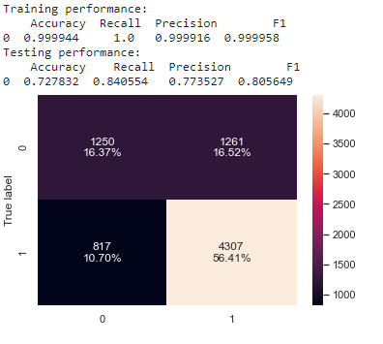
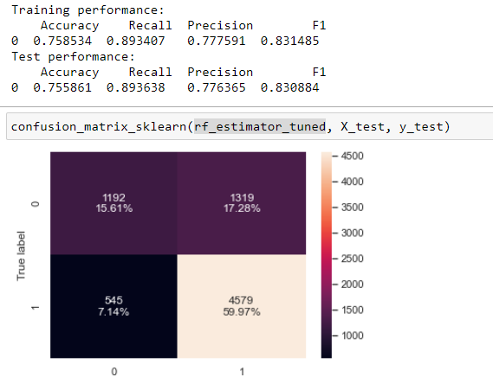
Bagging
Random Forest
The decision tree is overfitting the training data as there is a considerable difference between training and test scores for all the metrics.
The test recall is 84%. Its a good improvement from decision tree
Random Forest - Tuned
RandomForestClassifier(max_features=0.2, max_samples=0.3, min_samples_leaf=9,
n_estimators=150, random_state=1)
The Tuned Random Forest model is giving generalized results between training and test
The model has acceptable recall and precision scores

Slide 16
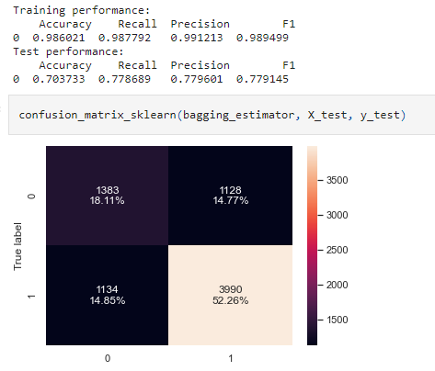
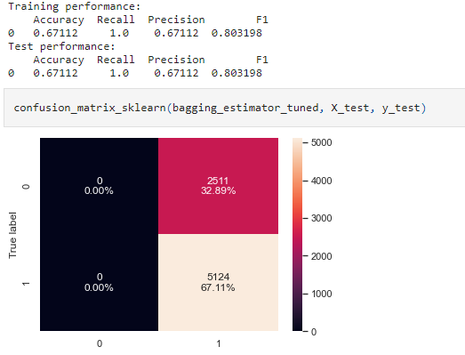
Bagging
BaggingClassifier(max_features=0.7, max_samples=1, random_state=1)
Bagging classifier
The Bagging classifier is overfitting the training data as there is a considerable difference between training and test scores for all the metrics.
The test recall is 77%. A slight improvement form the decision tree
Bagging classifier
- Tuned
RandomForestClassifier(max_features=0.2, max_samples=0.3, min_samples_leaf=9,
n_estimators=150, random_state=1)
The Bagging classifier is giving a generalized results now
The model appears to predict one sided, the default bagging classifier appears to be more robust.

Slide 17
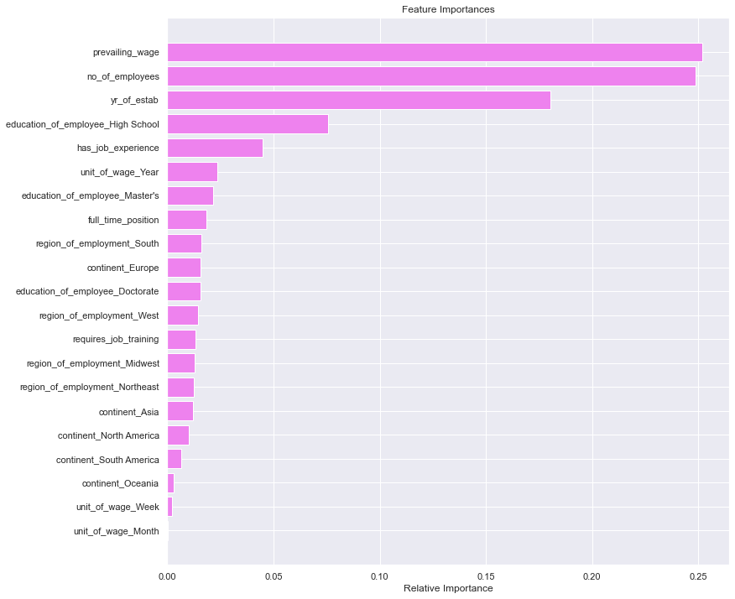
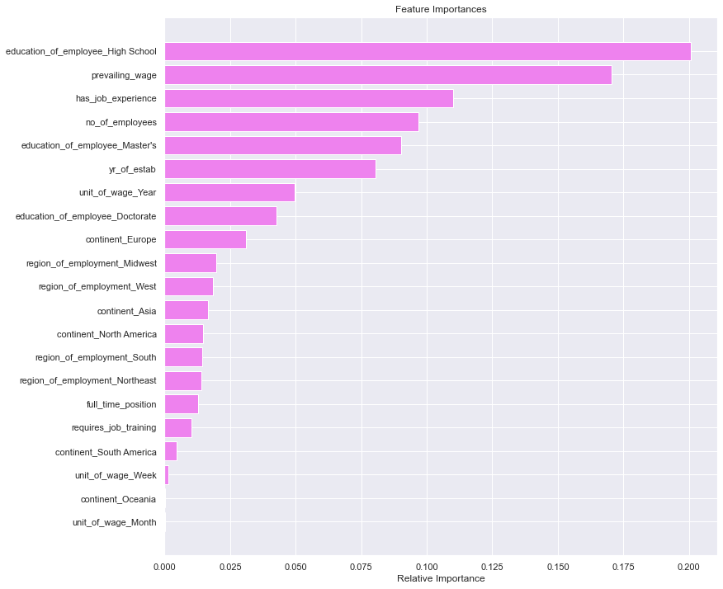
Bagging Model Decision Tree & Tuned Random Forest – Feature of Importance
Of the bagging models, the Tuned Random Forest without specific class weights assigned is the better model so far
The features of importance from best model so far is education_of_employee_High School prevailing_wage has_job_experience
<- Decision Tree
Random Forest – Tuned ->

Slide 18
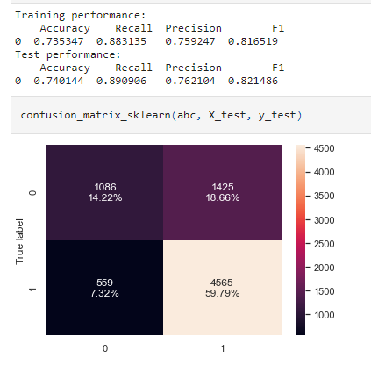
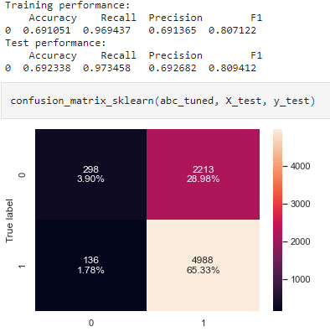
Model Building - Boosting
AdaBoost Classifier
Ada boost classifier is giving comparable results between training and test.
Model performance is comparable to Tuned Random Forest.
The importance feature for this model is prevailing_wage and no_of_employees.
AdaBoostClassifier(base_estimator=DecisionTreeClassifier(max_depth=1,
random_state=1),
learning_rate=0.2, n_estimators=10, random_state=1)
AdaBoost Classifier - Tuned
Tuned Ada boost classifier is giving comparable results between training and test.
Model performance is improved in terms of recall after tuning, but dropped for precision.
The importance feature for this model is education_of_employee_High Schoo' and has_job_experience.

Slide 19
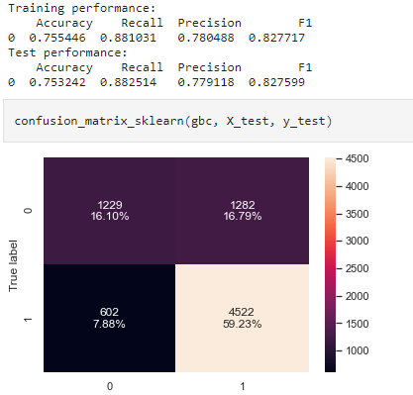
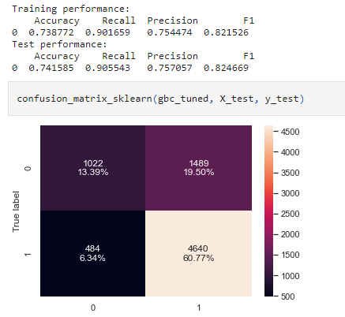
Model Building - Boosting
Gradient Boosting Classifier
Gradient boost classifier is giving comparable results between training and test.
Model performance is comparable to Tuned Random Forest.
The importance feature for this model is education_of_employee_High School and has_job_experience.
GradientBoostingClassifier(init=AdaBoostClassifier(random_state=1),
max_features=1, random_state=1, subsample=1)
Gradient Boosting Classifier - Tuned
Tuned Ada boost classifier is giving comparable results between training and test.
Model performance is improved in terms of recall after tuning, but dropped for precision.
The importance feature for this model is education_of_employee_High Schoo' and has_job_experience.

Slide 20
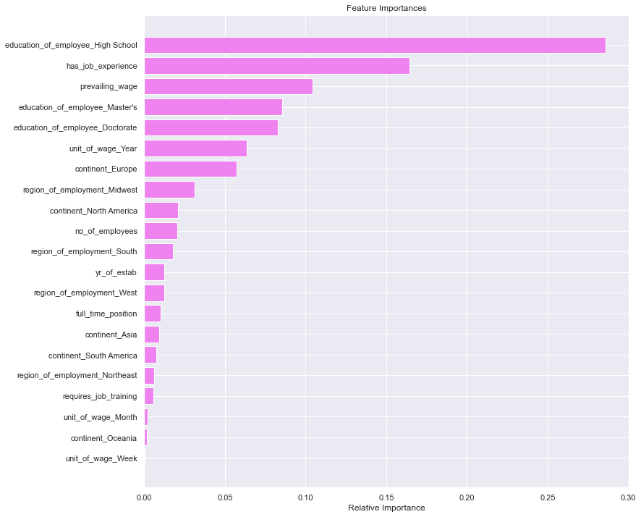
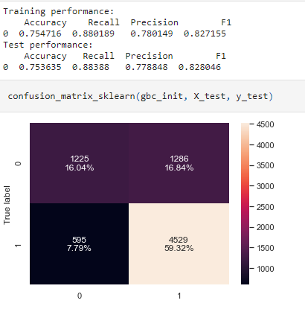
Model Building - Boosting
Gradient Boosting Classifier – With AdaBoost classifier as the estimator for initial predictions
Gradient boost classifier with Ada boost is giving comparable results between training and test.
Model performance is comparable to Gradient boost classifier with default.
The importance feature for this model is education_of_employee_High School and has_job_experience.

Slide 21
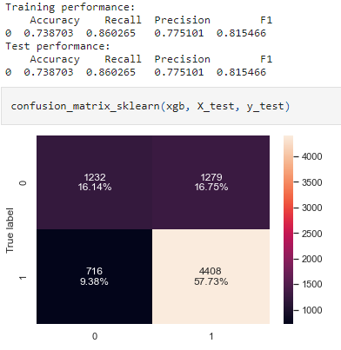
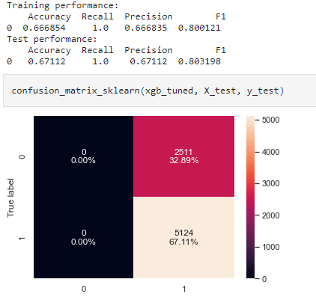
Model Building - Boosting
XGBoost Classifier
XG boost classifier is giving comparable results between training and test.
Model performance is comparable to Ada boost, Gradient boost and Tuned Random Forest.
The importance feature for this model is education_of_employee_High School and education_of_employee_Doctorate.
XGBClassifier(base_score=0.5, booster='gbtree', colsample_bylevel=0.5,
colsample_bynode=1, colsample_bytree=0.5, eval_metric='logloss',
gamma=0, gpu_id=-1, importance_type='gain',
interaction_constraints='', learning_rate=0.01, max_delta_step=0,
max_depth=6, min_child_weight=1, missing=nan,
monotone_constraints='()', n_estimators=30, n_jobs=8,
num_parallel_tree=1, random_state=1, reg_alpha=0, reg_lambda=1,
scale_pos_weight=5, subsample=0.5, tree_method='exact',
validate_parameters=1, verbosity=None)
XGBoost Classifier - Tuned
Tuned XG boost classifier is giving comparable results between training and test.
Model performance is has not improved on tuning and the model is biased.
The importance feature for this model is education_of_employee_High School and education_of_employee_Master's.

Slide 22
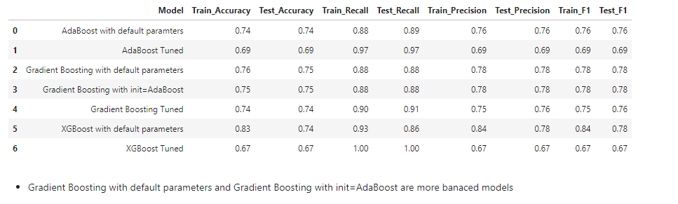
Boosting - Comparing all models

Slide 23
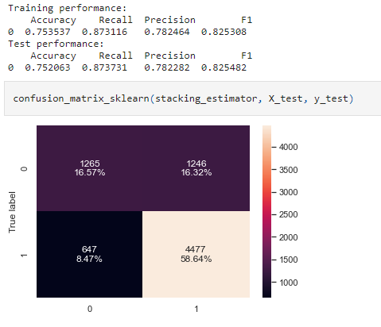
Stacking Model
StackingClassifier(cv=5,
estimators=[('Decision Tree',
DecisionTreeClassifier(class_weight={0: 0.665,
1: 0.335},
max_depth=2,
max_leaf_nodes=2,
min_impurity_decrease=0.1,
min_samples_leaf=5,
random_state=1)),
('Random Forest',
RandomForestClassifier(max_features=0.2,
max_samples=0.3,
min_samples_leaf=9,
n_estimators=150,
random_state=1)),
('Gradient Boosting',
Gradient...
importance_type='gain',
interaction_constraints=None,
learning_rate=None,
max_delta_step=None,
max_depth=None,
min_child_weight=None,
missing=nan,
monotone_constraints=None,
n_estimators=100, n_jobs=None,
num_parallel_tree=None,
random_state=1, reg_alpha=None,
reg_lambda=None,
scale_pos_weight=None,
subsample=None,
tree_method=None,
validate_parameters=None,
verbosity=None))
Stacking Classifier
Stacking model with decision tree and tuned random forest, and gradient boosting, then use XGBoost to get the final prediction.
The model appears to be generalized with comparable results in training and test.

Slide 24
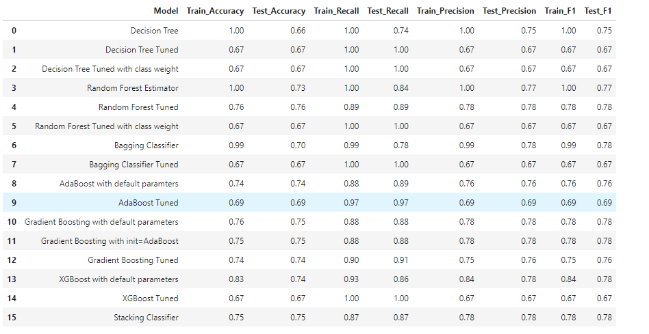
Bagging, Boosting & Stacking - Comparing all models

Slide 25
Model comparison:
Which model is best suited ?
The below models have comparable performance and balanced performance
Gradient Boosting with default parameters
Gradient Boosting with init=AdaBoost
Stacking Classifier
Random Forest Tuned
The Stacking Classifier might be the best model

Slide 26
Business Insights and Recommendations
Aim would be to balance the trade off between losing an opportunity (Deny Visa to skilled and qualified individual) in case of FN and losing the resources of office of foreign labour certification in case of False positive.
We emphasized that recall is the metric of interest here and we tuned our model on recall. But this does not mean that other metrics should be ignored completely.
Different model indicate that the main feature is education_of_employee and has_job_experience.
Employees with higher education have better rate of approval. Especially with Doctorate.
Europe seems to have higher level of approvals.
Pay unit of Yearly appears to be the most approved.

Slide 27
Observations:
The region of intended employment does not seem to impact much, all regions have almost similar rate of approval.
Full time or part time nature of the work does not appear to impact the case status.
Applicants who have the unit_of_wage for prevailing_wage as year have the better chance of approval.
Asia and Europe have almost equal number of employees who are Doctorates.
Job experience seems to be a deciding factor for all education level except for Doctorate.

