Slide 1
E-news Express - New landing page’s effectiveness.

Slide 2

Background
The design team of the company has created a new landing page.
Randomly selected 100 users are divided equally into two groups.
The old landing page is served to the first group (control group) and the new landing page is served to the second group (treatment group).
Various data about the customers in both groups have been collected.

Slide 3
Objective
To extract actionable insights from the data and recommendations that will help to grow the subscriber numbers.
Questions to answer:
Do the users spend more time on the new landing page than the old landing page?
Is the conversion rate for the new page greater than the conversion rate for the old page?
Does the converted status depend on the preferred language?
Is the mean time spent on the new page same for the different language users?

Slide 4
Data Overview
Variable | Description
User id | The user ID of the person visiting the website.
group | Group user belongs to the first group (control) or the second group (treatment).
Landing page | Represents whether the landing page is new or old.
Time spent on the page | Represents the time (in minutes) spent by the user on the landing page.
converted | Represents whether the user gets converted to a subscriber of the news portal or not.
Language preferred | Represents the language chosen by the user to view the landing page.
Observations | Variables
100 | 6
Null values
0

Slide 5
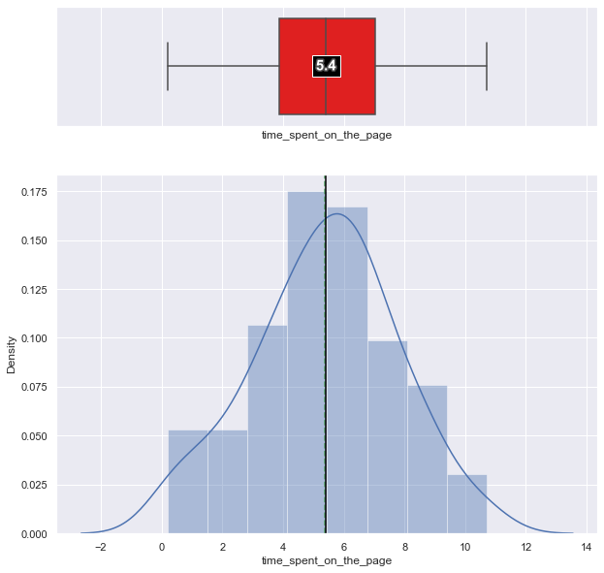
Exploratory Data Analysis - time_spent_on_the_page
Observations:
The mean time users spend on the web page is 5.38
The data follows almost normal distribution

Slide 6
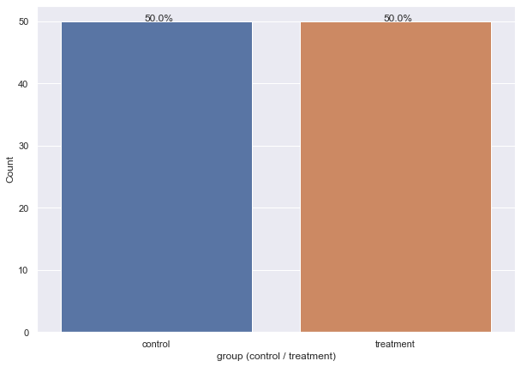
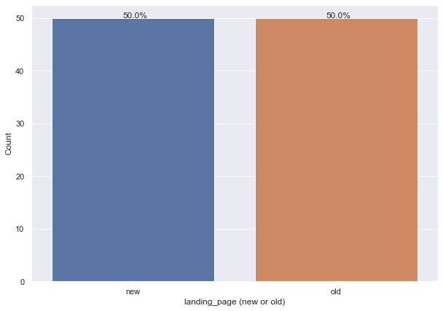
Exploratory Data Analysis – group, landing_page
100 users are divided equally into two groups
Control and treatment
100 users are divided equally and served old and new landing page
The old landing page is served to the first group (control group) and the new landing page is served to the second group (treatment group).

Slide 7
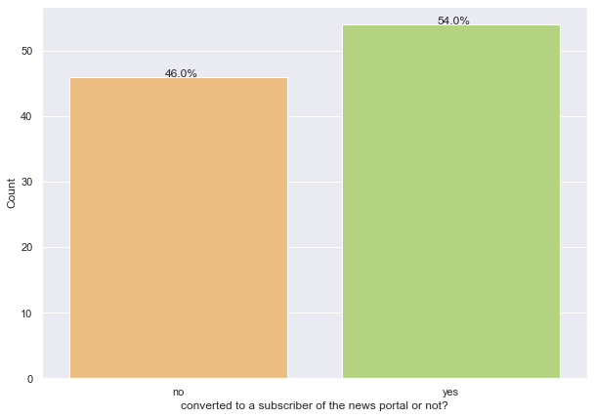
Exploratory Data Analysis – converted
Of the 100 users, users who got converted to subscribers form a larger percentage of about 54%

Slide 8
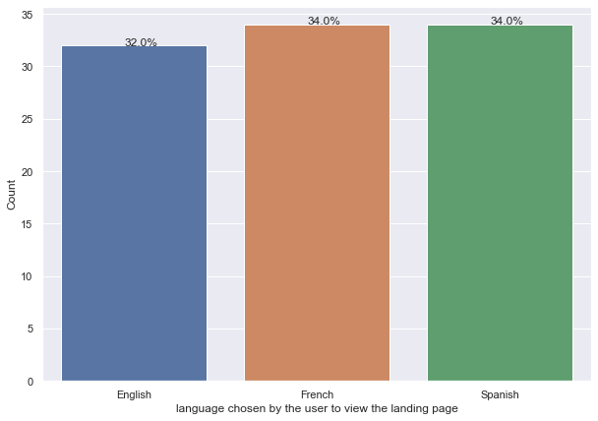
Observations on language_preferred
The data distribution between preferred languages of English, French and Spanish is almost uniform.

Slide 9
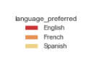
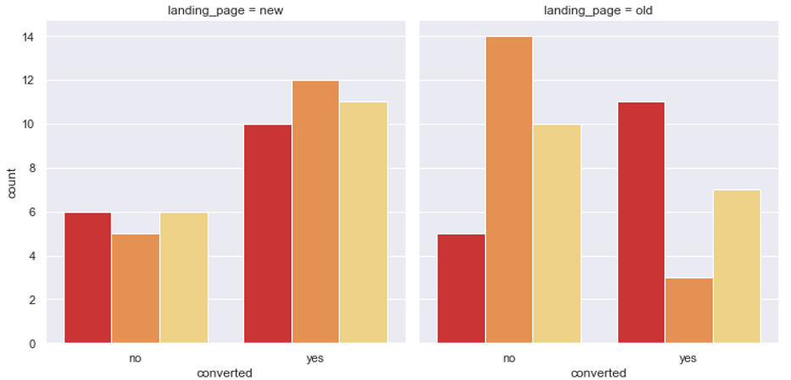
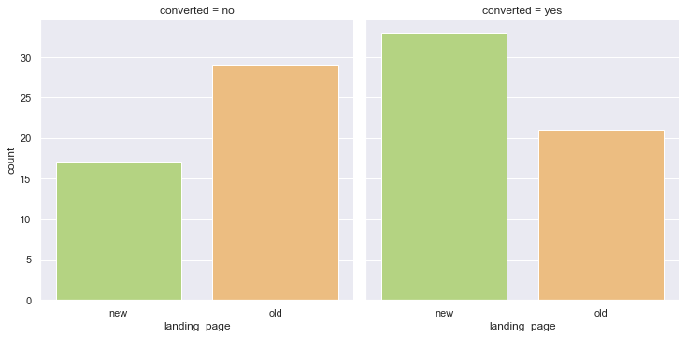
Bivariate Analysis
The new landing page has more a uniform distribution compared to old landing page.
The new landing page has more users who have been converted to subscribers.

Slide 10
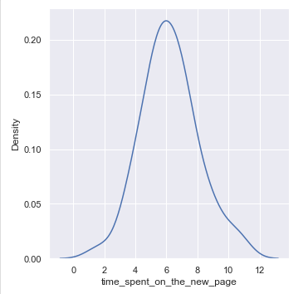
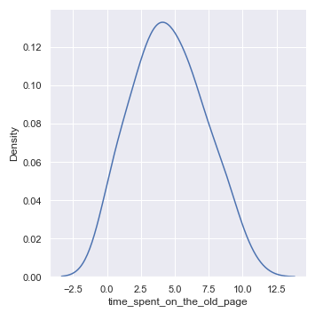
Do users spend more time on the new landing page than the old landing page?
Time spent on the new landing page follows a near normal distribution with a mean of 6.22 and standard distribution of 1.82
Time spent on the old landing page follows a near normal distribution with a mean of 4.53 and standard distribution of 2.58

Slide 11
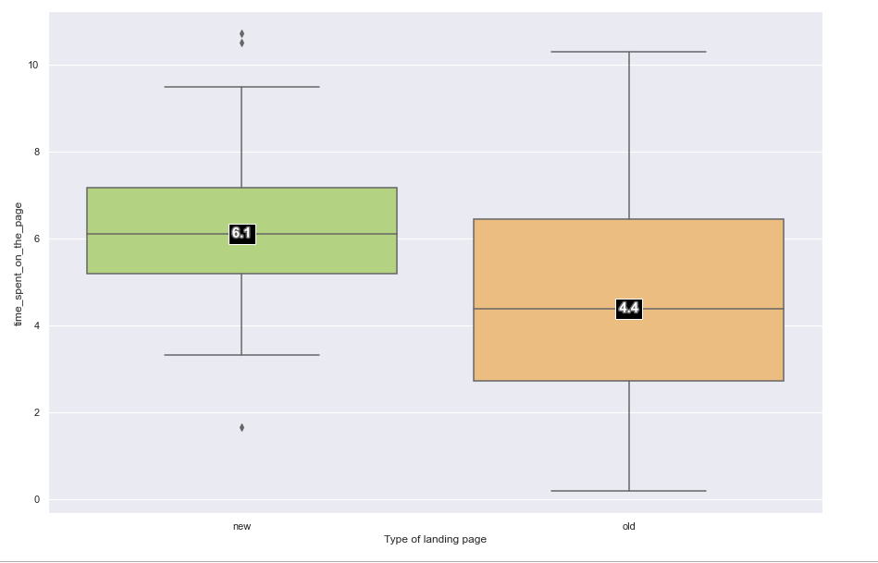
Do users spend more time on the new landing page than the old landing page? – Contd.
Applying a statistical test (Two Independent Sample T-test for Equality of Means - Unequal Std Dev) for the mean usage time for new landing page and old landing page reveals that
Conclusion:
- Uses spend more time on the new landing page.

Slide 12
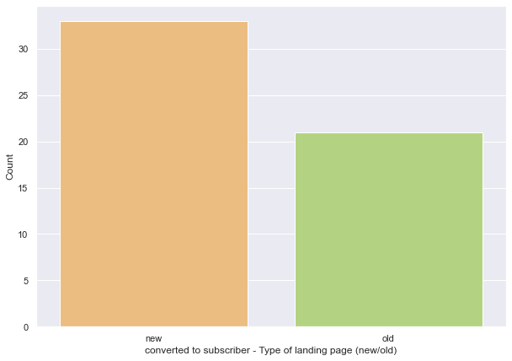
Is the conversion rate for the new page greater than the conversion rate for the old page?
Executing a statistical test (Proportions Z test ) for the conversion rate
The proportions of new page user converted, and old page user converted are 0.66, 0.42 respectively
Conclusion:
- The conversion rate for the new page is greater than the conversion rate for the old page

Slide 13
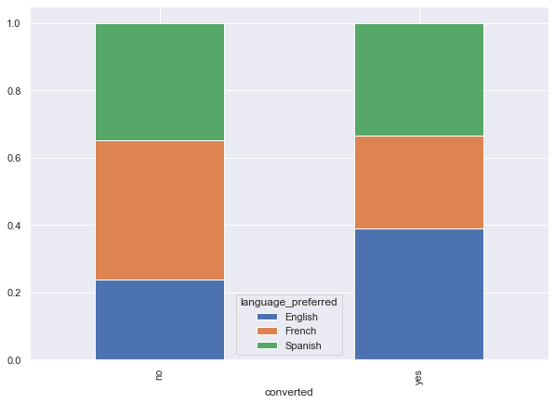
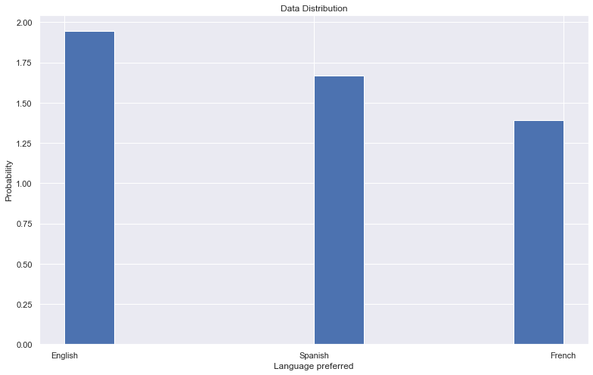
Does the converted status depend on the preferred language?
There is a uniform distribution for conversion status w.r.t to preferred language.

Slide 14
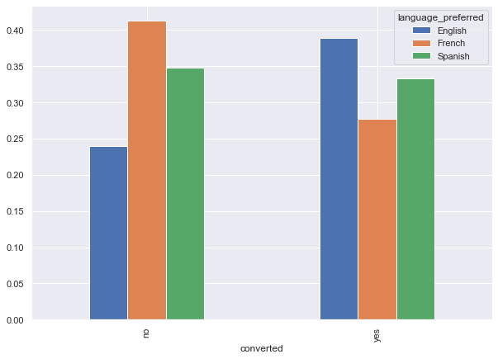
Does the converted status depend on the preferred language?
Applying a statistical test (Chi-square test of independence of attributes) to verify if conversion status depends on a preferred language.
We will test the null hypothesis
H_0: Converted status is independent of preferred language.
against the alternate hypothesis
H_a: Converted status is dependent on preferred language.
The p-value 0.21 is much larger than the significance level of 0.05 and we cannot reject the null hypothesis (H_0)
Conclusion:
The conversion rate for the new page is independent of preferred language

Slide 15
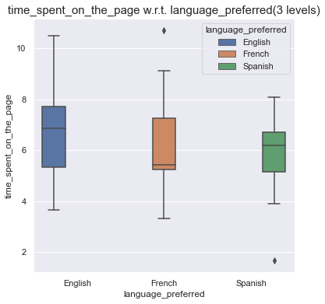
Is the mean time spent on the new page same for the different language users?
Executing a statistical test (One-way ANOVA ) for the conversion rate
Shapiro-Wilk’s test reveals Normal distribution.
Levene’s test results show All the variances are equal.
Conclusion:
- The mean time spent on the new page is same for the different language.

Slide 16
Business Insights and Recommendations
No | Key Questions: | Result of Statistical Analysis:
1 | Do the users spend more time on the new landing page than the old landing page? | Yes , users spend more time on the new landing page than the old landing page.
2 | Is the conversion rate for the new page greater than the conversion rate for the old page? | Yes, The conversion rate for the new page is greater than the conversion rate for the old page.
3 | Does the converted status depend on the preferred language? | The conversion rate for the new page is independent of preferred language.
4 | Is the mean time spent on the new page same for the different language users? | Yes, the mean time spent on the new page is same for the different language.

Slide 17
Conclusion
Dataset of 100 observation was analyzed. This data contained the usage characteristics of two groups. The old landing page is served to the first group (control group) and the new landing page is served to the second group (treatment group).
The key feature will be landing page type and time spent on the page . Also related is preferred language.
We can summarize that:
Users spend more time on the new landing page than the old landing page.
The conversion rate for the new page is greater than the conversion rate for the old page.
The conversion rate for the new page is independent of preferred language.
The mean time spent on the new page is same for the different language.

Slide 18
Recommendation to business
The new landing page is more successful in converting users to subscribers.
Users spend more time on the new landing page, irrespective of the preferred language.

