Slide 1
Trade&Ahead
Data based classification : Stay Ahead

Slide 2

Background
The stock market has consistently proven to be a good place to invest in and save for the future. There are a lot of compelling reasons to invest in stocks. It can help in fighting inflation, create wealth, and also provides some tax benefits.
It is important to maintain a diversified portfolio when investing in stocks in order to maximize earnings under any market condition. It is often easy to get lost in a sea of financial metrics to analyze while determining the worth of a stock.
By doing a cluster analysis, one can identify stocks that exhibit similar characteristics and ones that exhibit minimum correlation. This will help investors better analyze stocks across different market segments and help protect against risks that could make the portfolio vulnerable to losses.

Slide 3
Business Problem Overview and Solution Approach
Trade&Ahead is a financial consultancy firm who provide their customers with personalized investment strategies.
Objective
The objective is to analyze the data, grouping the stocks based on the attributes provided, and sharing insights about the characteristics of each group.
Data comprising stock price and some financial indicators for a few companies listed under the New York Stock Exchange is available to make the analysis.

Slide 4
Data Overview
Variable | Description
Ticker Symbol | An abbreviation used to uniquely identify publicly traded shares of a particular stock on a particular stock market
Company | Name of the company
GICS Sector | The specific economic sector assigned to a company by the Global Industry Classification Standard (GICS) that best defines its business operations
GICS Sub Industry | The specific sub-industry group assigned to a company by the Global Industry Classification Standard (GICS) that best defines its business operations
Current Price | Current stock price in dollars
Price Change | Percentage change in the stock price in 13 weeks
Volatility | Standard deviation of the stock price over the past 13 weeks
ROE | A measure of financial performance calculated by dividing net income by shareholders' equity (shareholders' equity is equal to a company's assets minus its debt)
Cash Ratio | The ratio of a company's total reserves of cash and cash equivalents to its total current liabilities
Net Cash Flow | The difference between a company's cash inflows and outflows (in dollars)
Net Income | Revenues minus expenses, interest, and taxes (in dollars)
Earnings Per Share | Company's net profit divided by the number of common shares it has outstanding (in dollars)
Estimated Shares Outstanding | Company's stock currently held by all its shareholders
P/E Ratio | Ratio of the company's current stock price to the earnings per share
P/B Ratio | Ratio of the company's stock price per share by its book value per share (book value of a company is the net difference between that company's total assets and total liabilities)
Observations | Variables
340 | 15
No Missing Data
No Duplicates

Slide 5
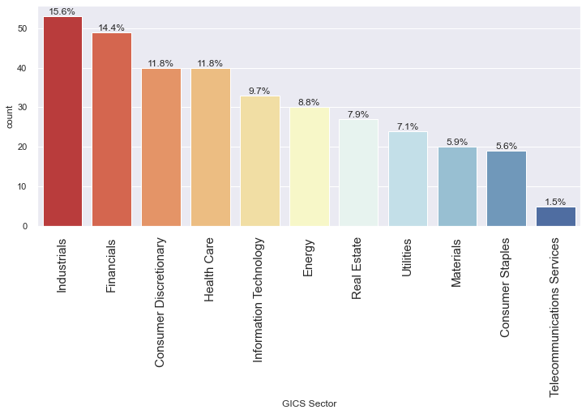
Exploratory Data Analysis
GICS Sector
Industrials and Financials are the top GISC Sector, each having 15.6 and 14.4 % respectively

Slide 6
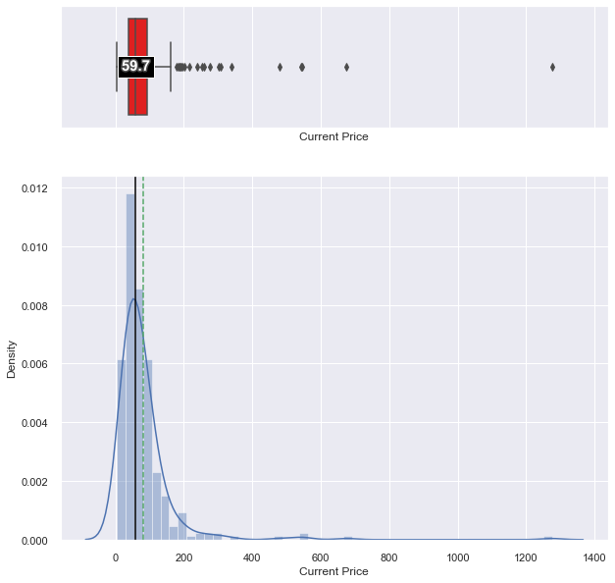
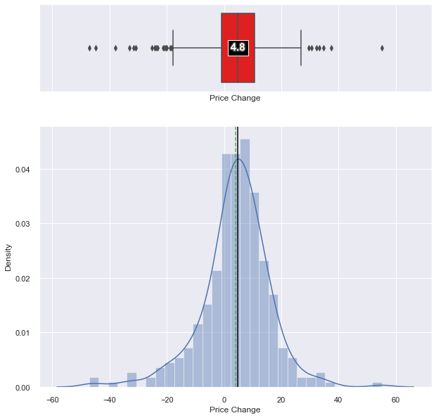
Exploratory Data Analysis
Current Price: Current Price is right skewed as expected, and there are outliers as well as expected
Price Change: Percentage change in the stock price in 13 weeks is almost normally distributed

Slide 7
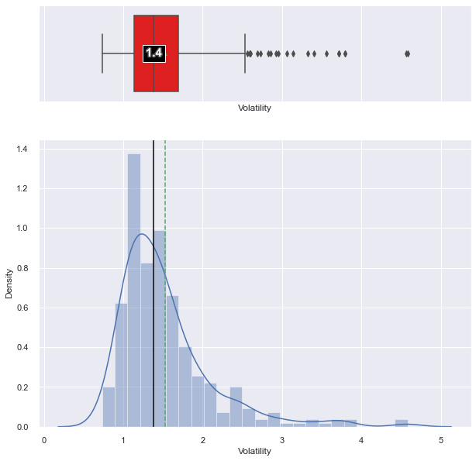
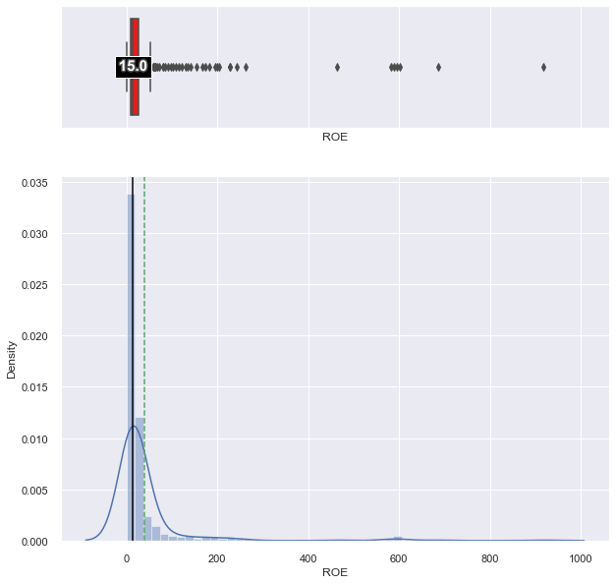
Exploratory Data Analysis
Volatility: Volatility is right tailed; some stock have had large price movements in the last 13 weeks.
ROE: ROE is right skewed

Slide 8
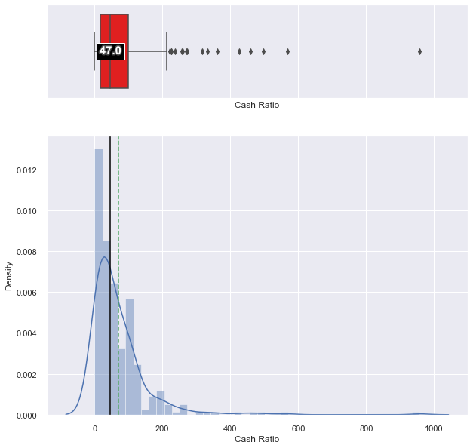
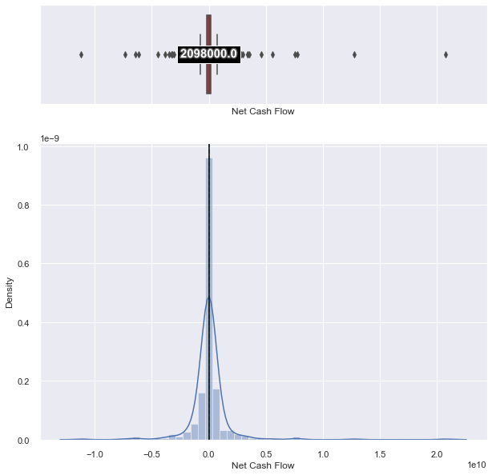
Exploratory Data Analysis
Cash Ratio: Cash Ratio is also right skewed
Net Cash Flow: Net Cash Flow is close to Normal distribution with a slight right skewed.

Slide 9
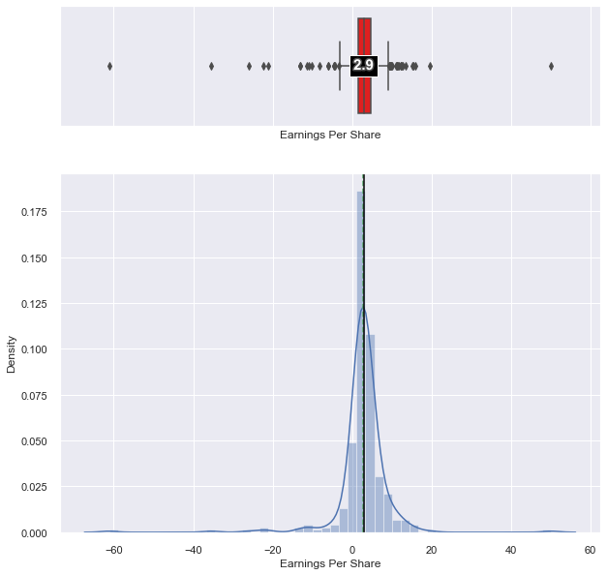
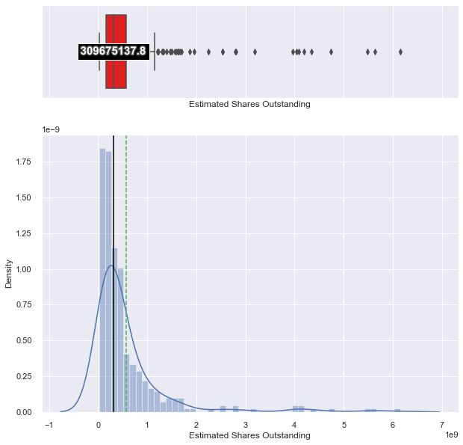
Exploratory Data Analysis
Earnings Per Share: Earnings Per Share
Estimated Shares Outstanding: Estimated Shares Outstanding is right skewed

Slide 10
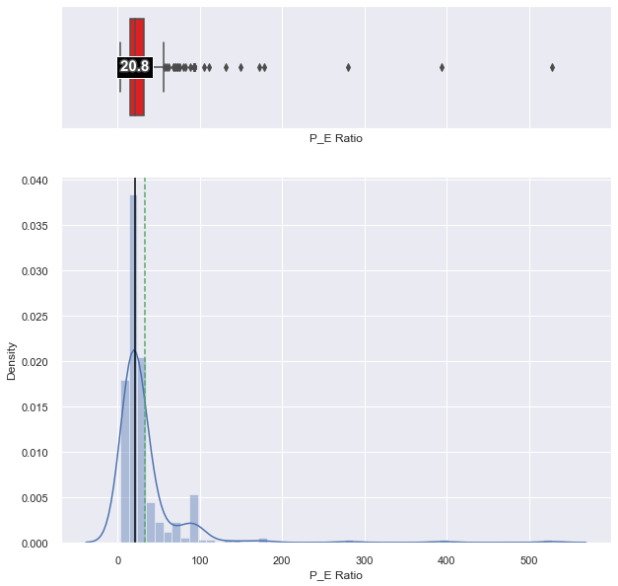
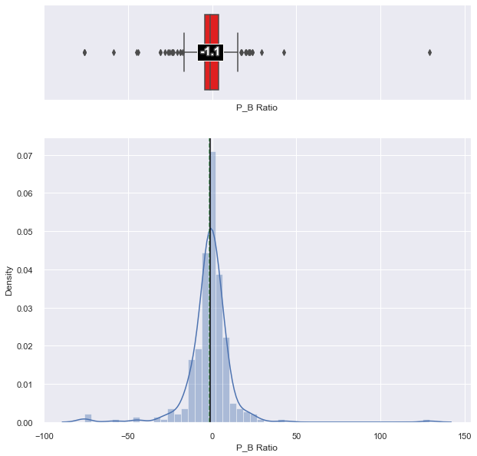
Exploratory Data Analysis
P/E Ratio : P/E ratio is right skewed
P/B Ratio : P/B ratio is close to normal distribution

Slide 11
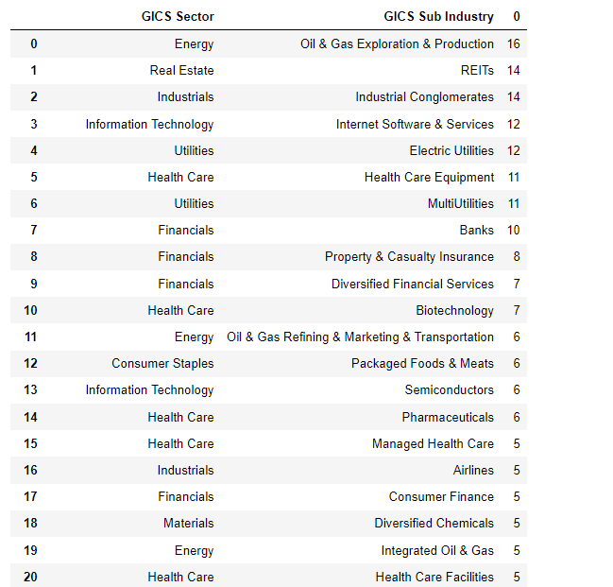
Exploratory Data Analysis
GICS Sub Industry
Top 20 GISC Sub Industry by no of stocks

Slide 12
Insights from EDA..
1. What does the distribution of stock prices look like?
- The distribution of the stock prices almost look like a normal distribution

Slide 13
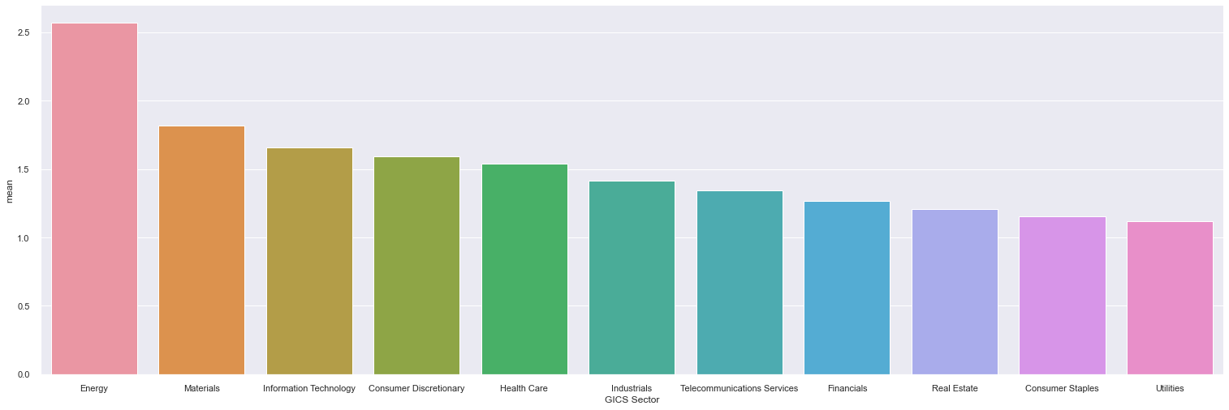
Insights from EDA..
2. The stocks of which economic sector have seen the maximum price increase on average?
The stocks of "Energy" economic sector have seen the maximum price increase on average.

Slide 14
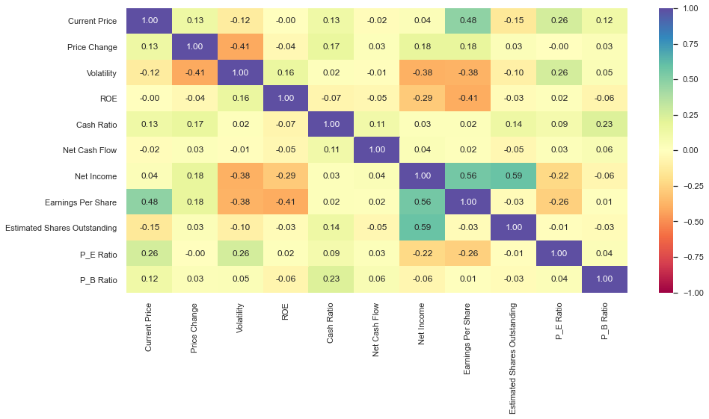
Insights from EDA..
3. How are the different variables correlated with each other?
Net Income and Estimated Shares Outstanding have good positive correlation, similarly Net Income and Earnings Per Share.
Current Price and Earnings Per Share have strong positive correlation.
ROE and Earnings Per Share have strong negative correlation.
Price Change and Volatility have strong negative correlation, this is as expected.
Earnings Per Share and Volatility, Net Income and Volatility exhibit negative correlation.

Slide 15
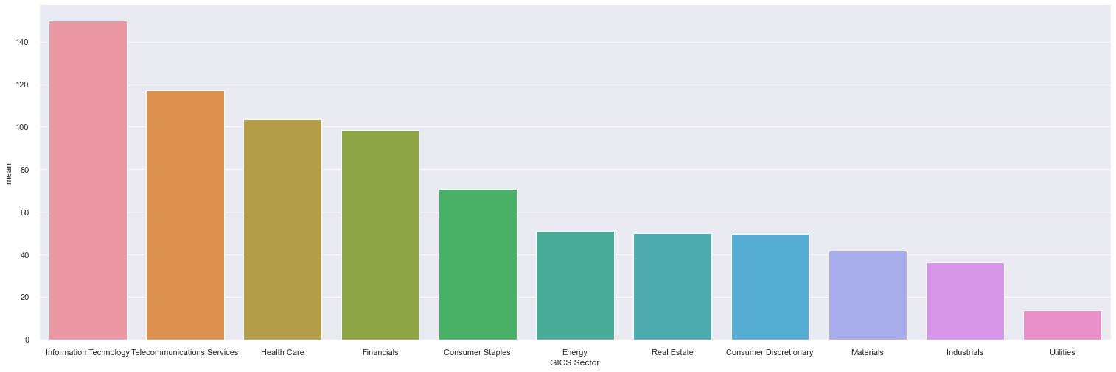
Insights from EDA..
4. Cash ratio provides a measure of a company's ability to cover its short-term obligations using only cash and cash equivalents. How does the average cash ratio vary across economic sectors?
Information Technology, Telecommunications Services and Health Care have very good cash ratio.
Materials, Industrials and Utilities have less cash ratio.

Slide 16
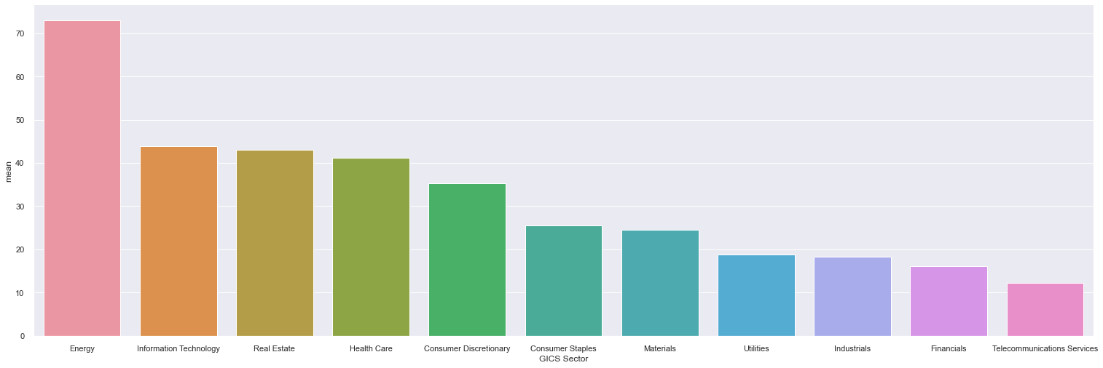
Insights from EDA..
5. P/E ratios can help determine the relative value of a company's shares as they signify the amount of money an investor is willing to invest in a single share of a company per dollar of its earnings. How does the P/E ratio vary, on average, across economic sectors?
Energy sector has a high P/E ratio
Information Technology, Real Estate, Health Care all have High P/E ratio, which may not be good for investors.
Utilities, Industrials, Financials have good P/E ratio for investors.
Telecommunications Services sector has a very good P/E ratio.

Slide 17
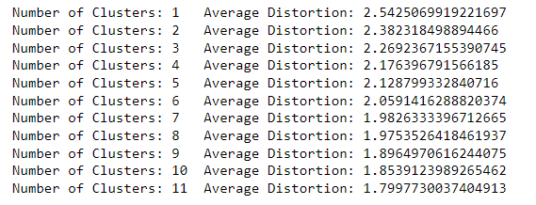
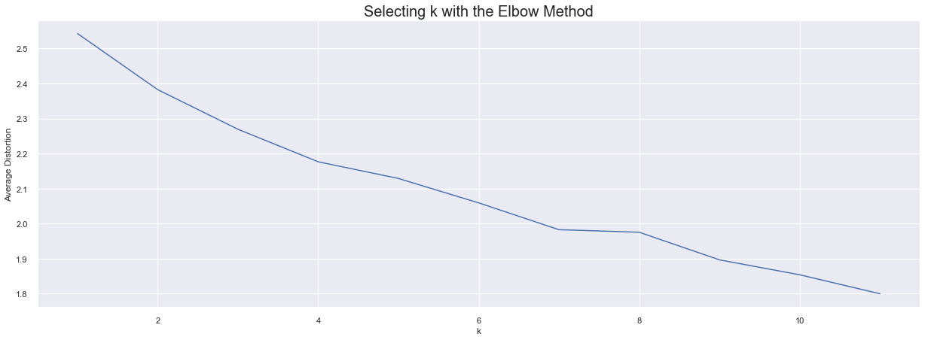
Model Building – K-means Clustering
Appropriate value for k seems to be 8 or 10.

Slide 18
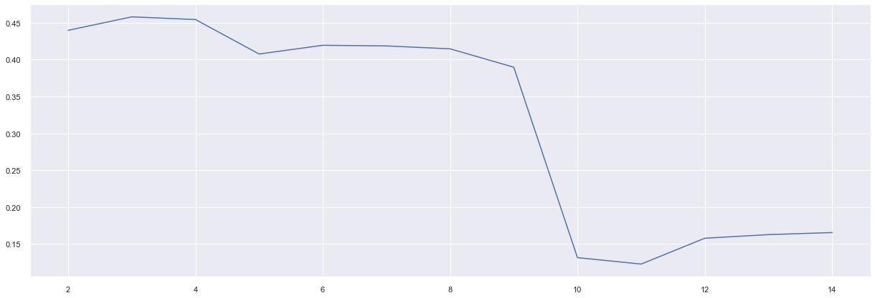
Model Building – K-means Clustering, contd..
Appropriate value for k seems to be 8 or 10.
Silhouette score for 6, 7 and 8 clusters is higher. So, let us explore different values of k.

Slide 19
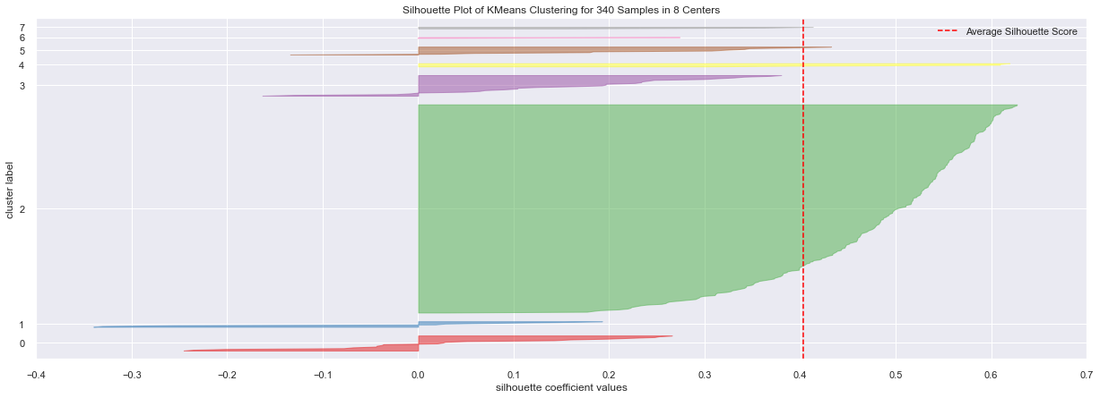
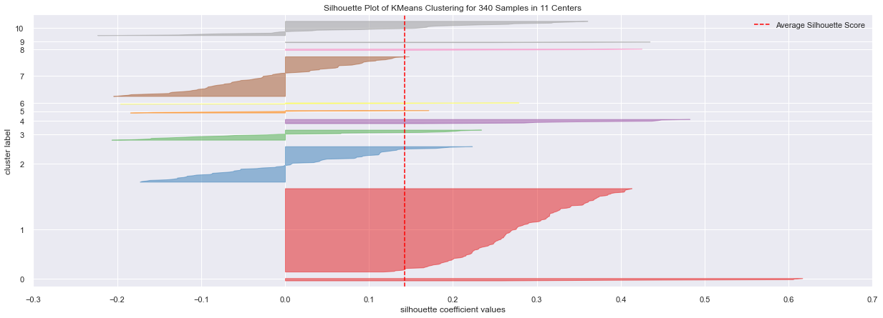
finding optimal no. of clusters with silhouette coefficients
Let us take 8 as the appropriate no. of clusters as the silhouette score is high and visual representation of the clusters at 8 gives an even distribution.

Slide 20
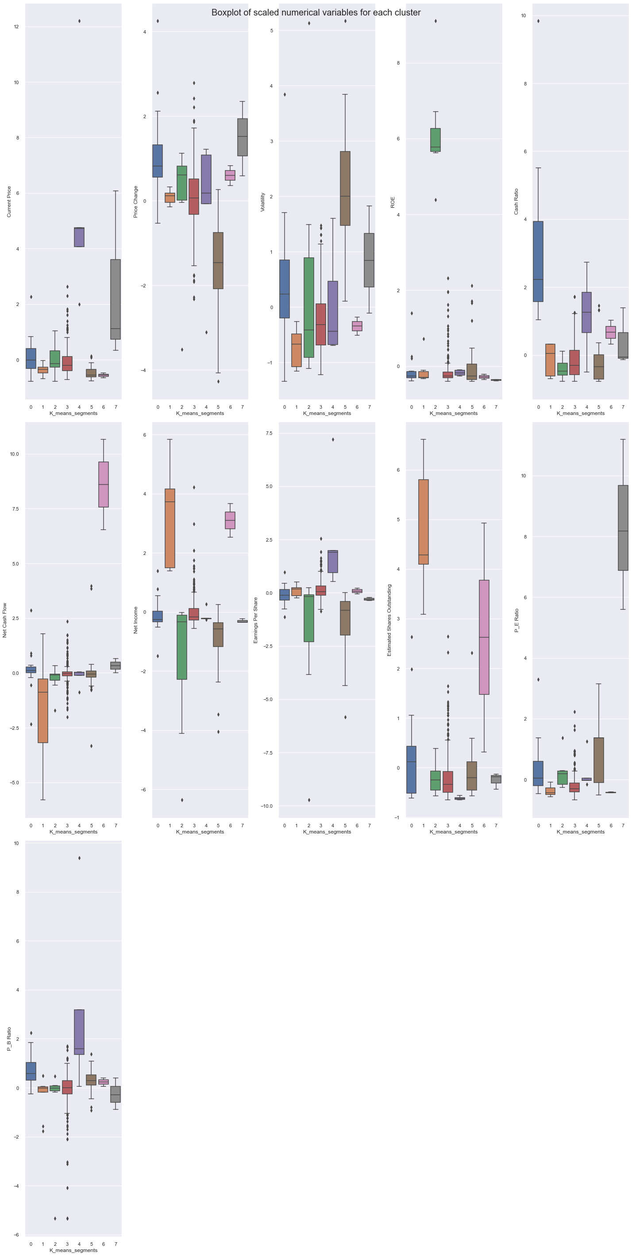
Cluster Profiling:

Slide 21
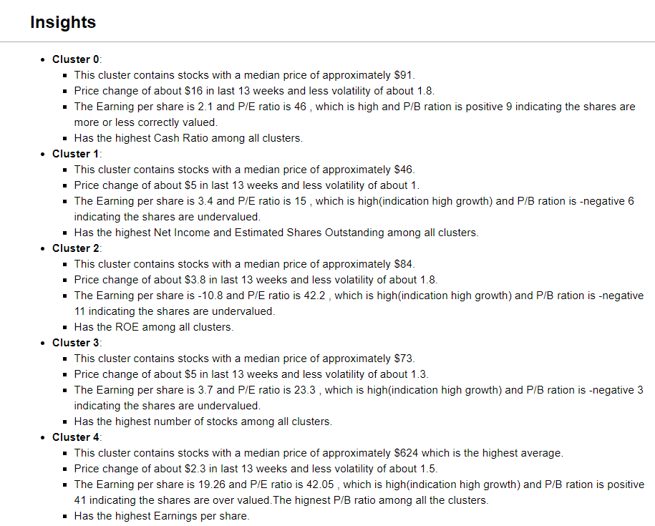
Insights – Clusters from K-Means

Slide 22
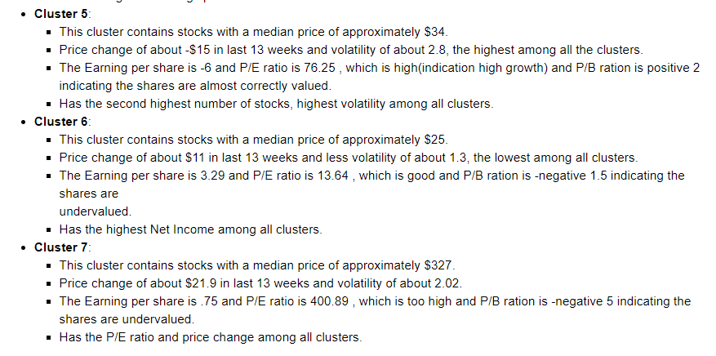
Insights – Clusters from K-Means, contd..

Slide 23
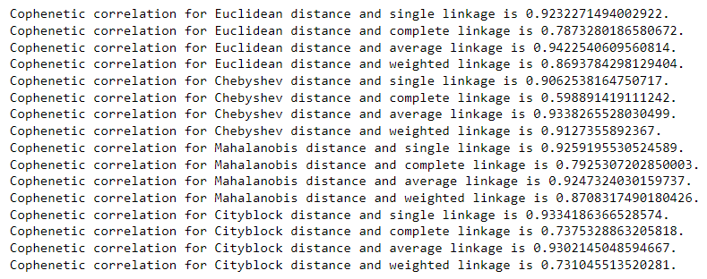
Model Building – Hierarchical Clustering
Highest cophenetic correlation is 0.9422540609560814, which is obtained with Euclidean distance and average linkage.

Slide 24
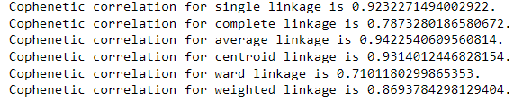
Model Building – Hierarchical Clustering, contd..
Let's explore different linkage methods with Euclidean distance only.
Highest cophenetic correlation is 0.9422540609560814, which is obtained with average linkage.
We see that the cophenetic correlation is maximum with Euclidean distance and average linkage.

Slide 25
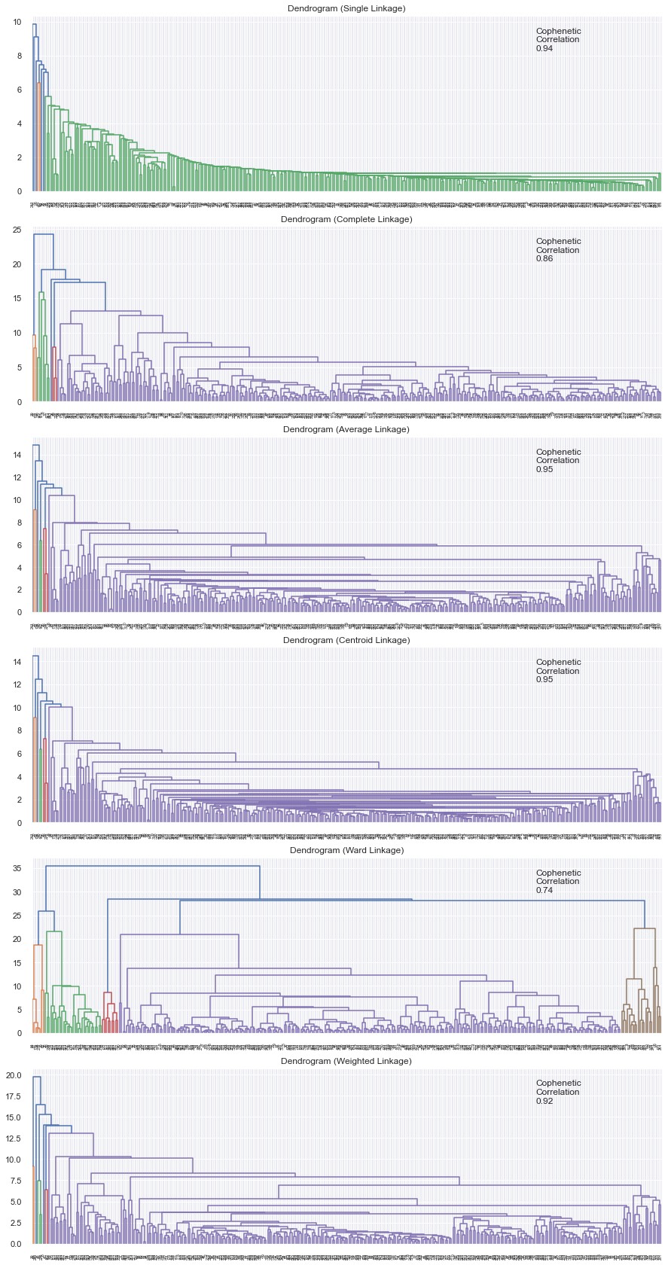
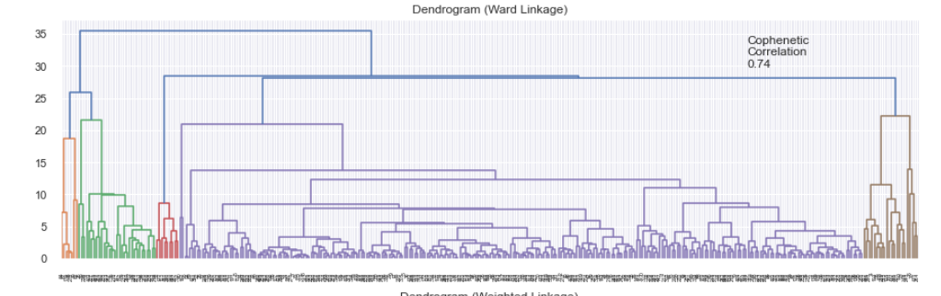
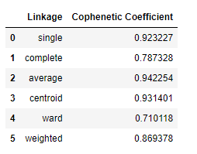
Hierarchical Clustering - Dendrogram
Dendrogram for Ward linkage shows distinct and separate clusters.

Slide 26
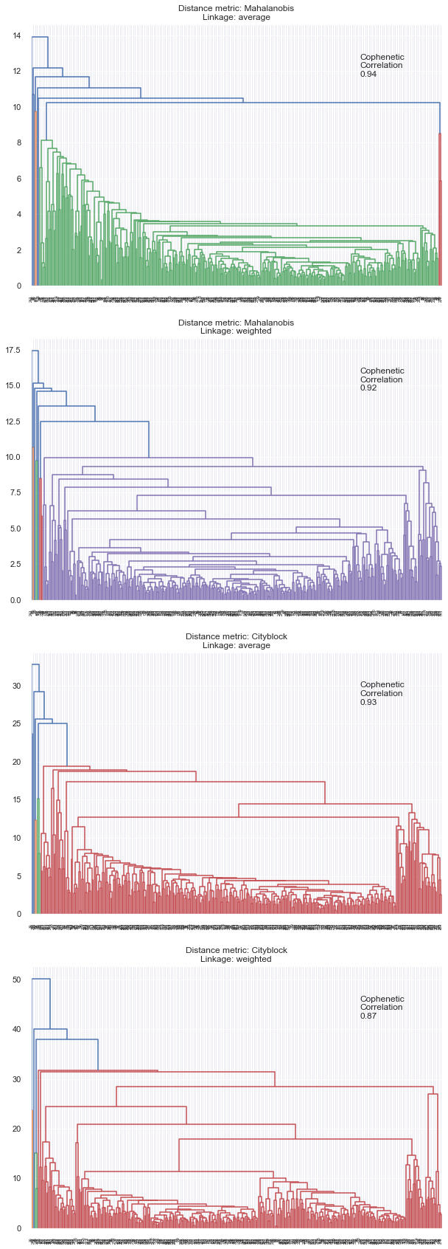
Hierarchical Clustering - Mahalanobis and Manhattan distances with average and weighted linkage methods
Out of all the dendrograms we saw, the dendrogram with Ward linkage gave us separate and distinct clusters.
Let us create 7 clusters.

Slide 27
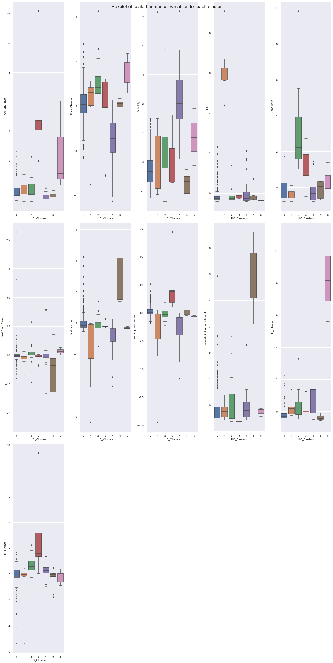
Cluster Profiling:

Slide 28
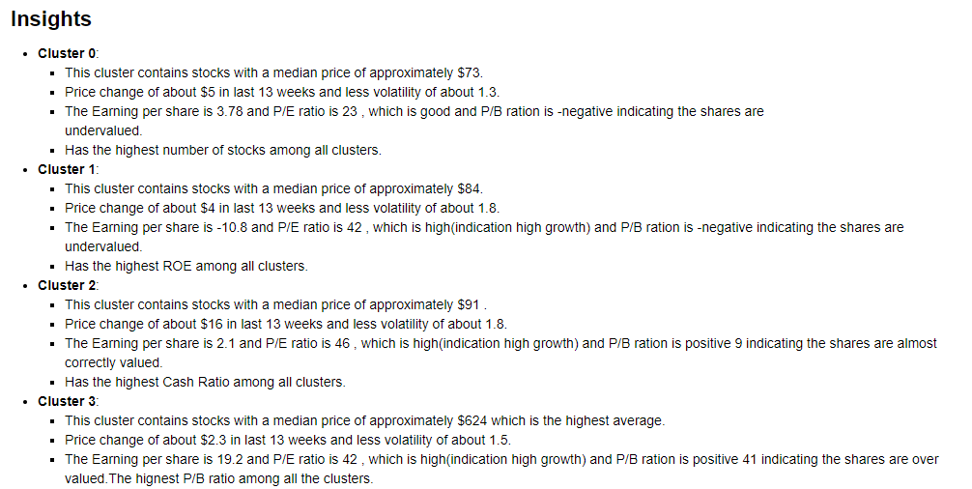
Insights – Clusters from Hierarchical clustering

Slide 29
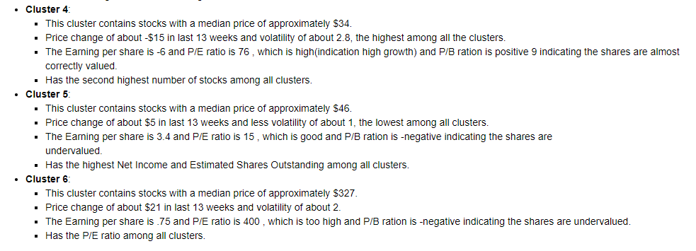
Insights – Clusters from Hierarchical clustering, contd..

Slide 30
K-means vs Hierarchical Clustering
K-means we took 8 clusters and Hierarchical clustering we took 7 clusters.
Looking at the clusters both the models reveal similar cluster information like P/E ratio matches between the K-means and Hierarchical clusters

Slide 31
Business Insights and Recommendations
Cluster 6 from K-means is promising. Has less volatility and good P/E and P/B ratio.
Cluster 5 from Hierarchical cluster is also promising. Has less volatility and good P/E and P/B ratio.
Cluster 3 from K-means is stable cluster. Has less volatility and good P/E and P/B ratio.
Cluster 0 from Hierarchical cluster is also stable cluster. Has less volatility and good P/E and P/B ratio.
Cluster 0 from K-means has less volatility and high price change, indication the prices moves often
Cluster 2 from Hierarchical cluster has less volatility and high price change, indication the prices moves often.
Cluster 5 from K-means has negative price change.
Cluster 4 from Hierarchical cluster has negative price change.
Cluster 6 from Hierarchical clusters has high P/E and high price change may not be a good investment vehicle.
Likewise, Cluster 7 from K-means has high P/E and high price change may not be a good investment vehicle.

