Slide 1
ReCell - Trusetd Reseller
Data based prediction model of prices for used/refurbished smartphones phones

Slide 2
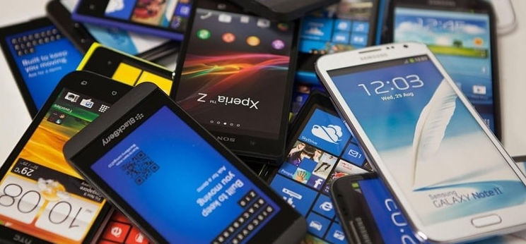
Background
1. ReCell, a startup dealing with refurbished and used mobile devices is aiming to tap the potential in the used/refurbished market.
2. ReCell wants to analyze the data provided and build a linear regression model to predict the price of a used phone
3. Also identify factors that significantly influence it.

Slide 3
Business Problem Overview and Solution Approach
Financial implications
A new IDC (International Data Corporation) forecast predicts that the used phone market would be worth $52.7bn by 2023 with a compound annual growth rate (CAGR) of 13.6% from 2018 to 2023.
The rising potential of refurbished and used mobile devices market fuels the need for an ML-based solution.
The solution will provide ReCell the ability to develop a dynamic pricing strategy for used and refurbished smartphones.
ReCell has a good collection of data no the various attribute of the phone that might impact the price of the used and refurbished phones.

Slide 4
Data Overview
Variable | Description
brand_name | Name of manufacturing brand
os | OS on which the phone runs
screen_size | Size of the screen in cm
4g | Whether 4G is available or not
5g | Whether 5G is available or not
main_camera_mp | Resolution of the rear camera in megapixels
selfie_camera_mp | Resolution of the front camera in megapixels
int_memory | Amount of internal memory (ROM) in GB
ram | Amount of RAM in GB
battery | Energy capacity of the phone battery in mAh
weight | Weight of the phone in grams
Variable | Description
release_year | Year when the phone model was released
days_used | Number of days the used/refurbished phone has been used
new_price: | Price of a new phone of the same model in euros
used_price | Price of the used/refurbished phone in euros
Observations | Variables
3571 | 15

Slide 5
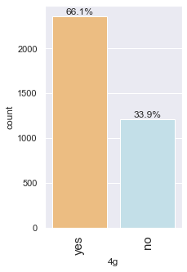
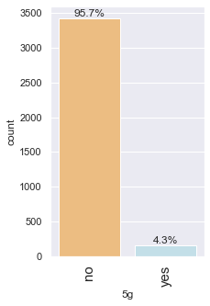
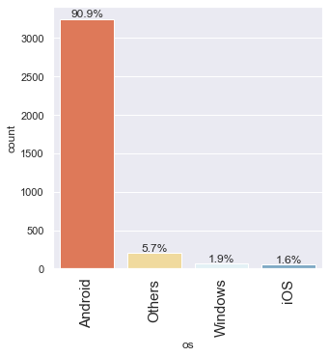
Exploratory Data Analysis
* Android has almost 91% share
* Most of the phones have 4G
* Most of the phones do not have 5G

Slide 6
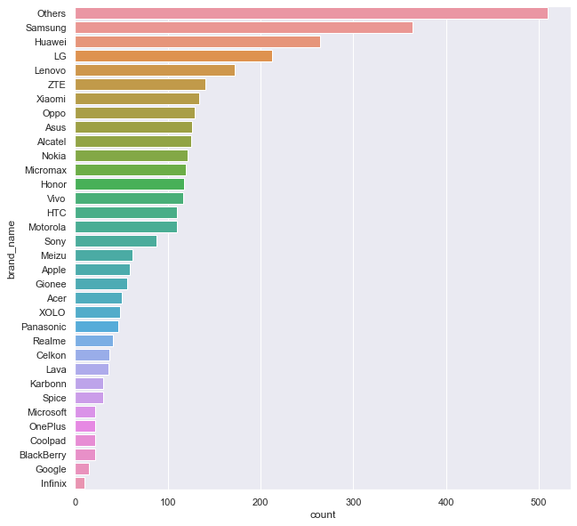
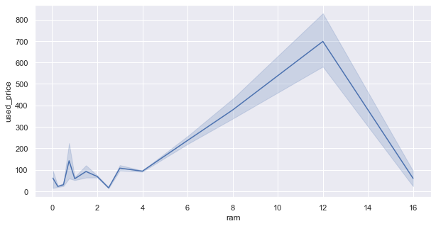
EDA
Increase in ram leads to higher used_price,
Interesting that price decreases after ram size reached 12 GB
Samsung, Huawei and LG are top 3 individual brands
There are 33 brands in total
Most of the phones are not from the 33 brands

Slide 7
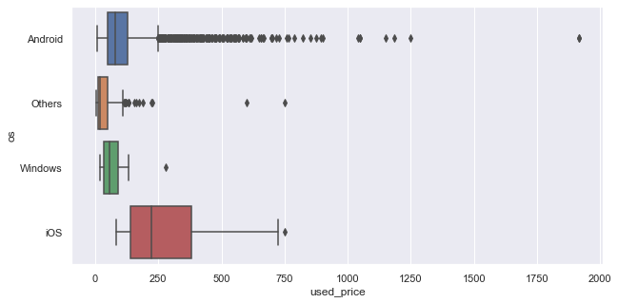
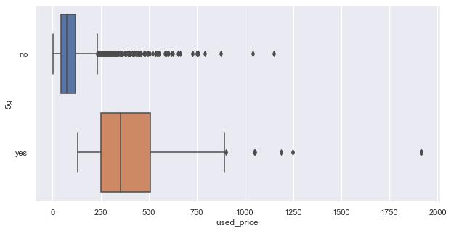
EDA
5G phones are in general higher priced
Among the brands 'iOS' has the highest priced phones
Android phones have large outliers , indication wide variety of phones

Slide 8
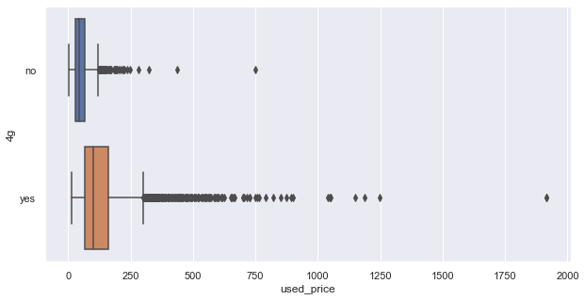
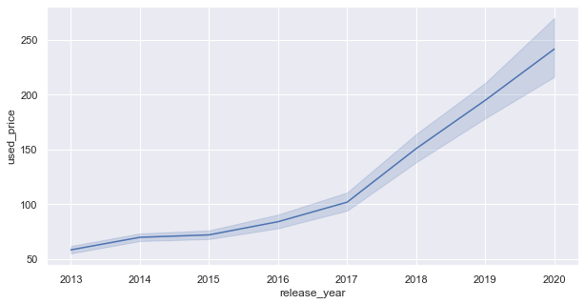
EDA
Unlike 5G, there is not considerable difference in price for phones with or with out 4G, also there are lot of outlier, indicating wide range of 4g phones
The latest the release_year the higher the price

Slide 9
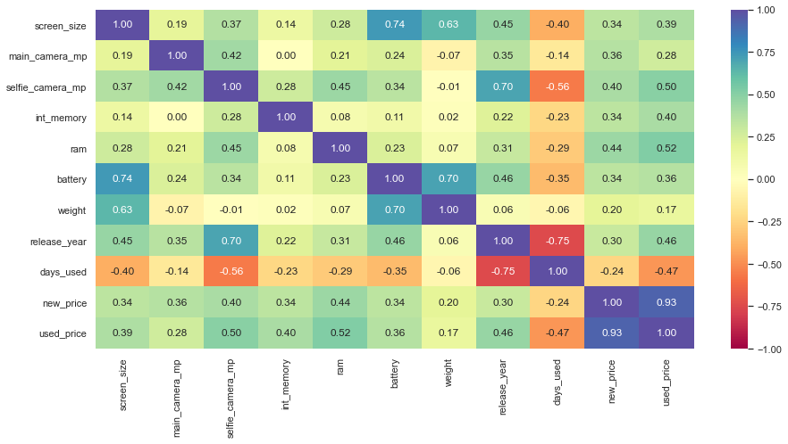
EDA – Contd.
Battery and weight are corelated , as expected.
Screen_size and battery are corelated , indicating large screen size needs large batteries.
selfie_camera_mp and release_year are corelated , indicating new models have better selfie cameras.
Days_used and used_price are negatively corelated.

Slide 10
Overview of ML model and its parameters
Dep. Variable: used_price R-squared: 0.956 Model: OLS Adj. R-squared: 0.955
Using the ordinary Least Square Model for regression model
Some of the variable used in the model
os, screen_size, 4g, 5g, main_camera_mp, selfie_camera_mp, int_memory, ram, battery, weight, release_year, days_used, new_price and few others
Total observations: 3571 . Observation taken after dropping nulls: 3368
There were null values , the treatment for null values was to drop the null rows.
The columns that were having null values did not have perfect normal distribution
Some of the missing values were key factor for the dependent variable

Slide 11
Model Performance Summary
Key model metrics with on the training data set ( 2357 observation), for the initial Model:
R-squared: 0.956
Adj. R-squared: 0.955
Some of the variables exhibited strong Multicollinearity
Multicollinearity was treated through Variance Inflation Factor (VIF)
VIF: VIF value of less than 10 was taken as the benchmark for Multicollinearity
The final list of variable taken into consideration for Final model:
['selfie_camera_mp', 'int_memory', 'new_price', 'Alcatel', 'Apple', 'Asus', 'Celkon', 'Coolpad', 'Gionee', 'Google', 'HTC', 'Honor', 'Lava', 'Lenovo', 'Meizu', 'Micromax', 'OnePlus', 'Oppo', 'Others', 'Panasonic', 'Samsung', 'Sony', 'Xiaomi', 'ZTE', 'Others', 'Windows', '5G_dum']

Slide 12
Model Performance Summary
Summary of key performance metrics for training from the OLS Model:
Model | R-squared | Adj. R-squared
Initial Model | 0.956 | 0.955
Pre-Final Model – Training Data | 0.966 | 0.965
Final Model – Training Data | 0.965 | 0.965

Slide 13
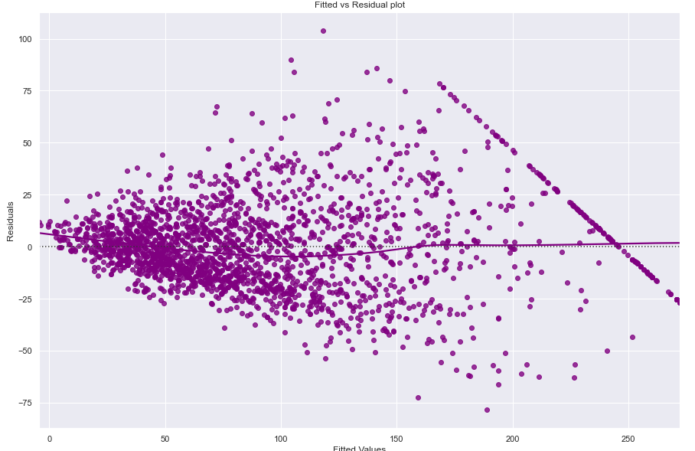
Linear Regression Assumptions
The variable in the final models was tested for Linear Regression Assumptions
No Multicollinearity : Variables with high VIF scores was removed recursively after checking its impact on the model. VIF score of less than 10 was taken as benchmark.
Linearity of variables:
The plot of Residuals (errors) Vs
fitted values (predicted values) did not show any pattern.
3. Independence of error terms:
The plot of Residuals (errors) Vs
fitted values (predicted values) did not show any pattern.

Slide 14
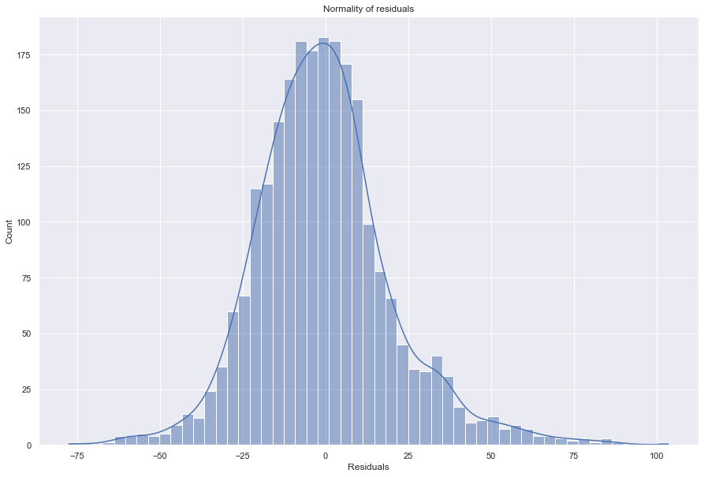
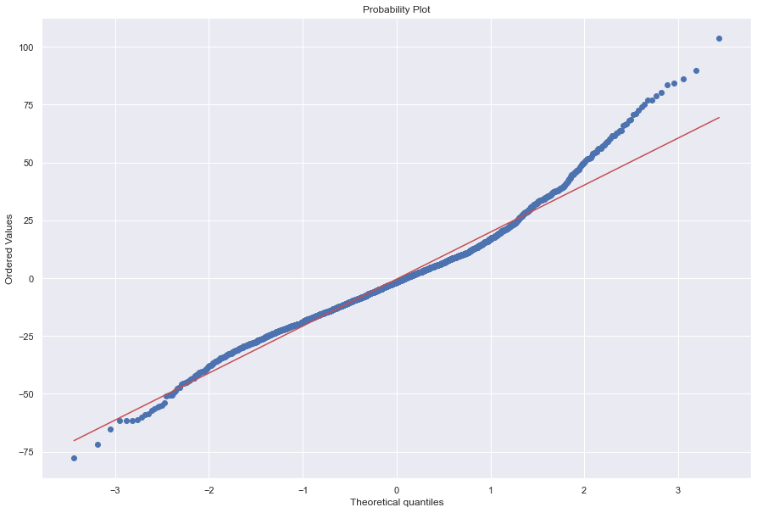
Linear Regression Assumptions – Contd.
Normality of error terms:
The histogram of residuals does have a bell shape.
The residuals more or less follow a straight line except for the tails.
Results of the Shapiro-Wilk test.
(statistic=0.9716421365737915, pvalue=3.3734527662670446e-21)
Since p-value < 0.05, the residuals are not normal as per the Shapiro-Wilk test.
Strictly speaking, the residuals are not normal.
However, as an approximation, we can accept this distribution as close to being normal.
So, the assumption is satisfied

Slide 15
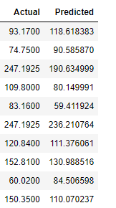
Linear Regression Assumptions – Contd.
No Heteroscedasticity
[('F statistic', 1.0654310933381863), ('p-value', 0.14112269394353816)]
Since p-value > 0.05, we can say that the residuals are homoscedastic.
So, this assumption is satisfied.
Sample Actual Vs Predicted:

Slide 16
Key Model Performance Metrics
 | RMSE | MAE | R-squared | Adj. R-squared | MAPE
Training Performance | 20.595608 | 15.388272 | 0.890274 | 0.888907 | 21.080383
Test Performance | 21.630428 | 16.175851 | 0.893233 | 0.890077 | 22.921057
The model is able to explain ~89% of the variation in the data, which is very good.
The train and test RMSE and MAE differences are low and comparable. So, our model is not suffering from overfitting.
The MAPE on the test set suggests we can predict within 23% of the used_price.
Hence, we can conclude the model is good for prediction as well as inference purposes.

Slide 17
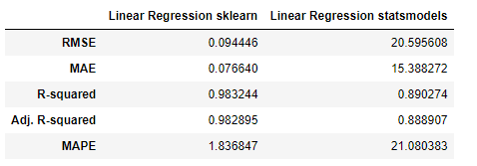
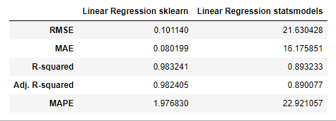
Key Model Performance Metrics - Comparison
Training Performance Comparison:
Test Performance Comparison:
The R-squared and Adj. R-squared are
comparable between the sklearn learn model
and Linear Regression statsmodels

Slide 18
Business Insights and Recommendations
Android phones dominate the used phone market. Nearly 81% of the market share.
'selfie_camera_mp', 'int_memory', 'new_price' and 5G have a positive coefficients. So, as they increase, used_price of the phone also increases.
Among the brands 'Apple', 'Google' and 'Honor' have a positive coefficients. So, as these brands have higher used_price.
new_price: Mean is around 185 Euors used_price: Mean is around 65 Euors.
OnePlus, Apple, Google have highest mean used_price
Among the brands 'iOS' has the highest priced phones
Android phones have large outliers , indication wide variety of phones

Slide 19
Business Insights and Recommendations
OnePlus, Oppo and Vivo offer the max RAM
Huawei, Samsung offer the most number of phones with screen size greater than 6 inches.
Xiaomi, Realme and Vivo offer many models with selfie camera with more than 8Mp on budget price ( less than 100 Euros) Sony, Samsung, Oppo, Honor and Huawei also good number of models with selfie camera more than 8Mp on budget.
The latest the release_year the higher the price.

Slide 20
Business Insights and Recommendations
Additional data sources for model improvement:
Geography and user attributes.
Model implementation in real world:
The model can be implemented in real world and feedback taken to improve the model.
Potential business benefits from model:
ReCell can offer dynamic pricing and offer competitive rates.

