Slide 1
Assertions in message-based systems
T1: command
T2: event
A
B
T3: store
??: assert
system under test

Slide 2
Conversations
T1: command
T2: event

Slide 3
auditing
Handler
B
A
C
D
A
D
C
B
Audit log

Slide 4
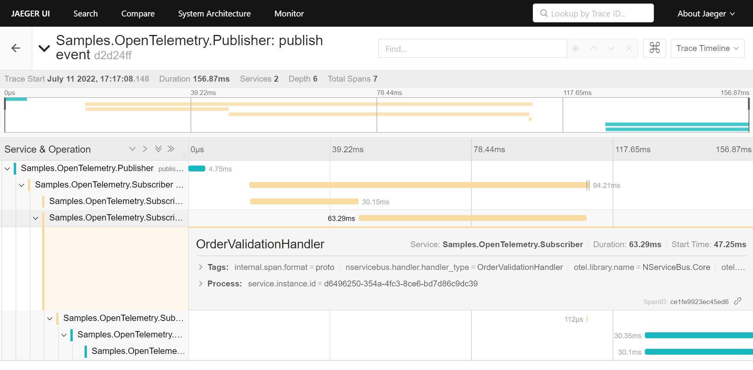
Open Telemetry

