Slide 1

Ortho eyes

Slide 2
Table of contents
Progress
Planning
Questions

Slide 3
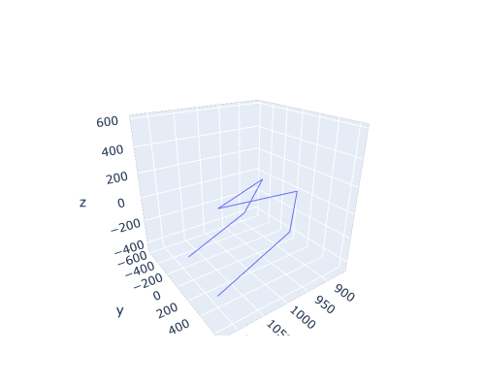
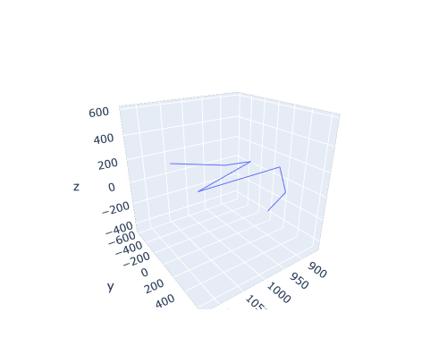
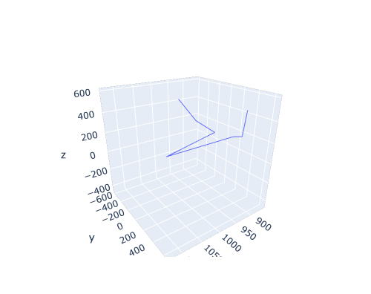

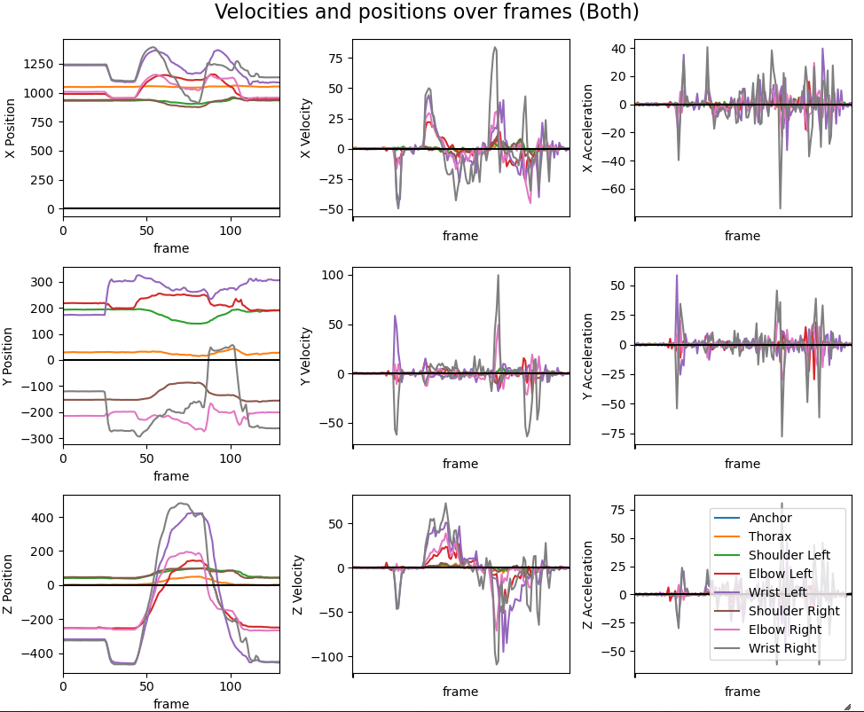
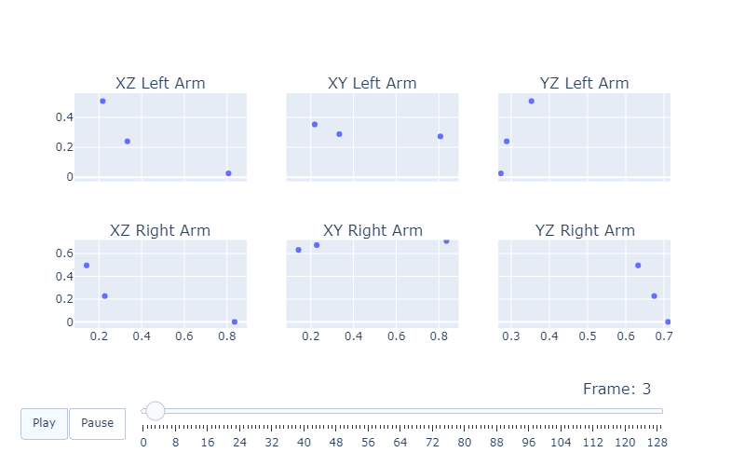
The progress
Experimented with plotting data
Side
Upper
Front
Notes:
Experimented with plotting the velocity and acceleration
Front- upper- and sideviews, to explore symmetry

Slide 4
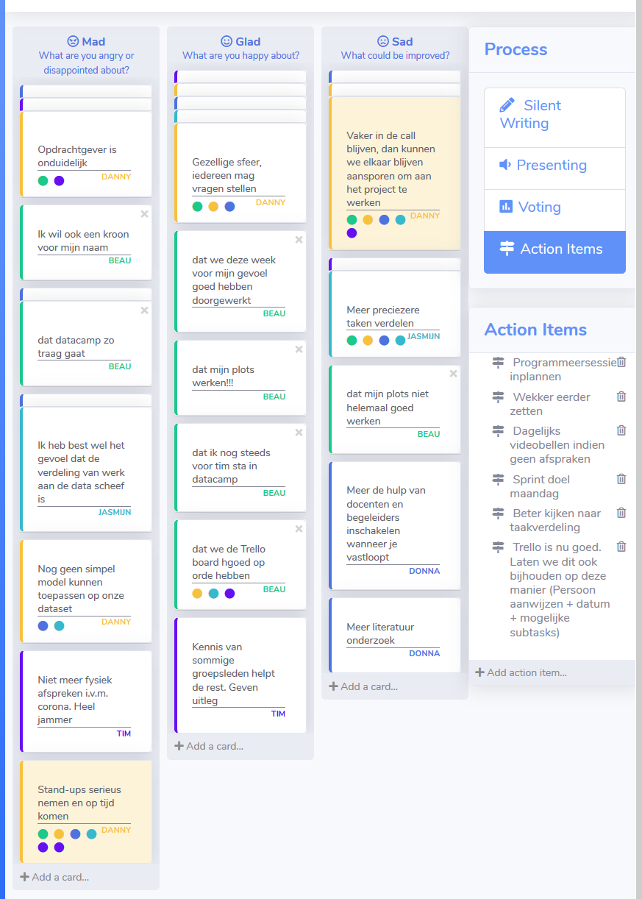
The progress
Retrospective

Slide 5
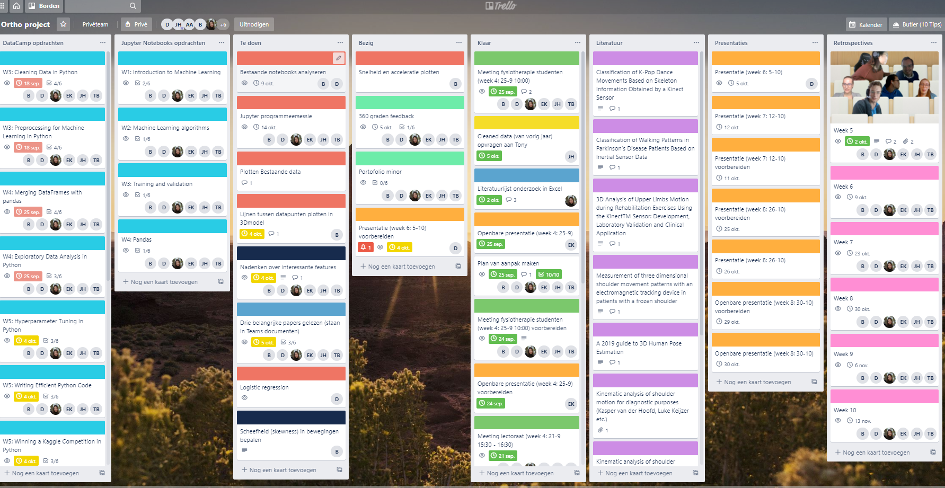
Planning
Notes:
Analyze code from last year
Programming session
Create a simple classification model
Explore interesting features

Slide 6
Questions

