Slide 1


Slide 2
Table of contents
Our project
Recap OR-ensemble
Progress since last week
Planning for this week
Questions

Slide 3

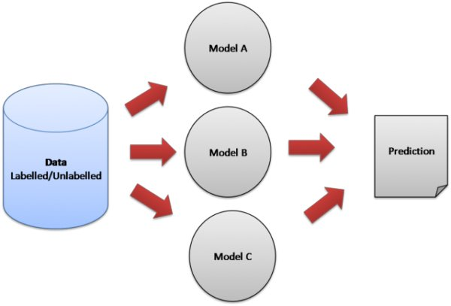


Recap OR-ensemble
Category 1 = no (0)
Category 3 = yes (1)
Boolean OR
Max height left wrist
Max height right elbow
Max angle right shoulder
Notes:
- Ensemble learning
- For every feature a logistic regression model
Models can be seen as doctors
Doctors look at 1 specific feature
If 1 doctor says

Slide 4
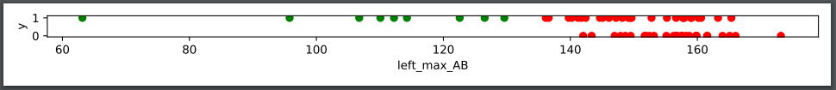
Hyperparameter f
Selects only patients which stand out
Higher f means less training data
Default f = 1.1

Slide 5
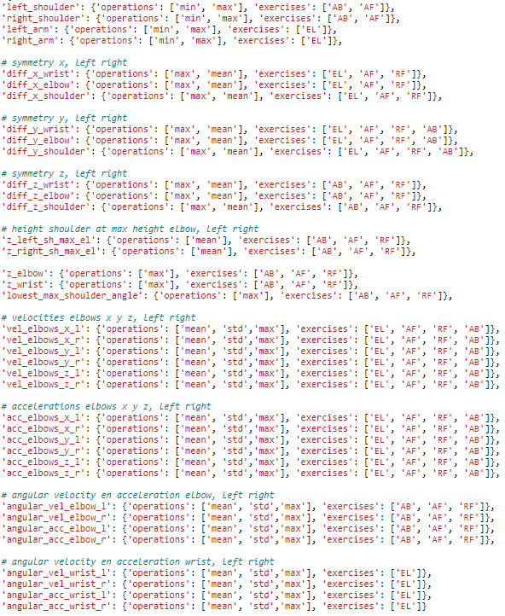
Progress
38 possible features
279 combinations

Slide 6
progress
Auto ensemble
Features with precision of 1
Classifying patients (categories 2, 3 & 4) from non-patients (category 1)
f = 1.1, recall 0.87, precision 1, accuracy 0.90
f = 1.5, recall 1, precision 1, accuracy 1
Hyperparameter tuning
Cleaning data

Slide 7
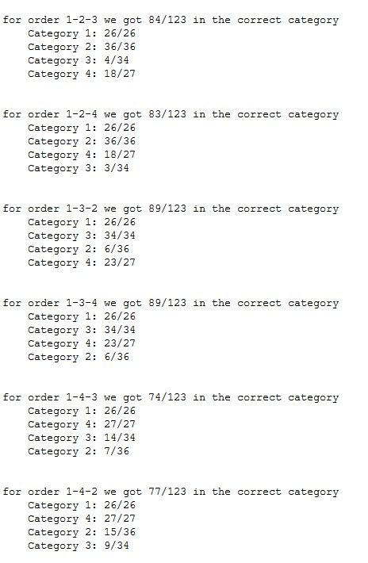
Progress
Classifying all categories
f = 1.8

Slide 8
Planning
Finish cleaning data
Filter features
Collinearity
Unnecessary features
Hyperparameter tuning
Classifying multiple categories
Classifying 1 & 2 from 3 & 4

Slide 9
Questions
Thanks for listening!
Are there any questions?

