Slide 1
OFFICIAL 2025/2026 B.SC. FINAL PROJECT DEFENSE
DESIGN AND IMPLEMENTATION OF A DISTRIBUTED STUDENT RESULT MANAGEMENT SYSTEM
For Staff, Students and Departments of a Tertiary Institution
ACADEMIC DEPARTMENT & SUPERVISION
Institution: University of Nigeria, Nsukka (UNN)
Faculty: Faculty of Physical Sciences
Department: Department of Computer Science
Supervisor: Mr. S.B. Ponsak
Coordinator: Dr. Anichebe G.E.
Session / Date: 2025/2026 Session | October 2026
PROJECT GROUP MEMBERS & INDIVIDUAL DEFENSE ROLES
1. UDE JUSTINE ONYEDIKA
Reg No: 2022/244096 | Member 1: Database Design & Form Population
2. UDEBUANI DANIEL UCHECHUKWU
Reg No: 2022/249081 | Member 2: Demonstration of Stated Objectives
3. UDEBUANI SOMTO SIXTUS
Reg No: 2022/246656 | Member 3: Unit & Integrated Code Modules

Slide 2
PART A.1: DEFENSE GUIDELINES ORDER
Abstract of the Study
Context & Problem: The traditional management of student examination results in Nigerian tertiary institutions is plagued by persistent operational bottlenecks. Manual record entry, physical broadsheet movement, and siloed departmental databases frequently cause computation errors, delayed result distribution, and lost grade records, particularly for inter-departmental service courses taken across multiple beneficiary departments.
Proposed Solution: This project presents the design and implementation of a modern, Distributed Student Result Management System specifically tailored for tertiary institutions conforming to the National Universities Commission (NUC) benchmark. The system eliminates manual distribution by providing an automated, role-based architecture serving Course Lecturers, offering Heads of Department, beneficiary receiving HODs, Departmental Examination Officers, and Students.
Technical Implementation: The system was engineered using a cloud-distributed PostgreSQL database hosted on Supabase comprising 12 normalized relational entities. The application tier is implemented using Next.js 14 and React with server-side validation, SheetJS client-side Excel batch parsing, dynamic weighted CGPA calculation, cryptographic session-scoped role access, and a transparent four-stage grade rectification workflow.
Results & Evaluation: Empirical verification on active 2025/2026 academic cohorts confirmed 100% computational fidelity against NUC 5-point benchmark standards, zero inter-departmental broadsheet transit delays, automated multi-department distribution acknowledgement, and instantaneous grade dispute resolution with an immutable audit trail. The system offers an institutional-grade solution that transforms result administration in universities.
Keywords: Distributed Results, Inter-Departmental Distribution, NUC 5.0 CGPA Computation, SheetJS Parser, Grade Rectification Pipeline, Supabase PostgreSQL, UNN.

Slide 3
PART A.2: DEFENSE GUIDELINES ORDER
Aim and Specific Objectives of the Study
RESEARCH AIM: To design, develop, and implement an automated, secure, and distributed student result management system that streamlines inter-departmental broadsheet distribution, automates NUC 5.0 CGPA computation, and provides transparent multi-tier grade dispute rectification.
OBJECTIVE 1 — Role-Based Access Control (RBAC)
To design and implement a secure, multi-tier authentication mechanism with cryptographic authorization for Course Lecturers, offering HODs, receiving HODs, Exam Officers, and Students.
OBJECTIVE 2 — Automated Excel Ingestion & Validation
To develop a client-side Excel batch upload and auto-validation engine using SheetJS to eliminate manual score transcription errors and enforce CA (0-30) and Exam (0-70) boundaries.
OBJECTIVE 3 — Inter-Departmental Broadsheet Distribution
To formulate and implement a distributed inter-departmental distribution workflow enabling offering departments to dispatch verified service course broadsheets to beneficiary HODs with digital acknowledgement receipts.
OBJECTIVE 4 — NUC 5.0 Standard CGPA Computation
To develop an automated mathematical computation engine strictly conforming to NUC 5.0 benchmarks, calculating Total Credit Units (TCU), Total Quality Points (TQP), and real-time degree classifications.
OBJECTIVE 5 — Transparent Grade Dispute Rectification
To establish a closed-loop grade dispute management system that enables students to lodge rectification tickets and routes them through Lecturer audit, HOD endorsement, and Exam Officer final synchronization.

Slide 4
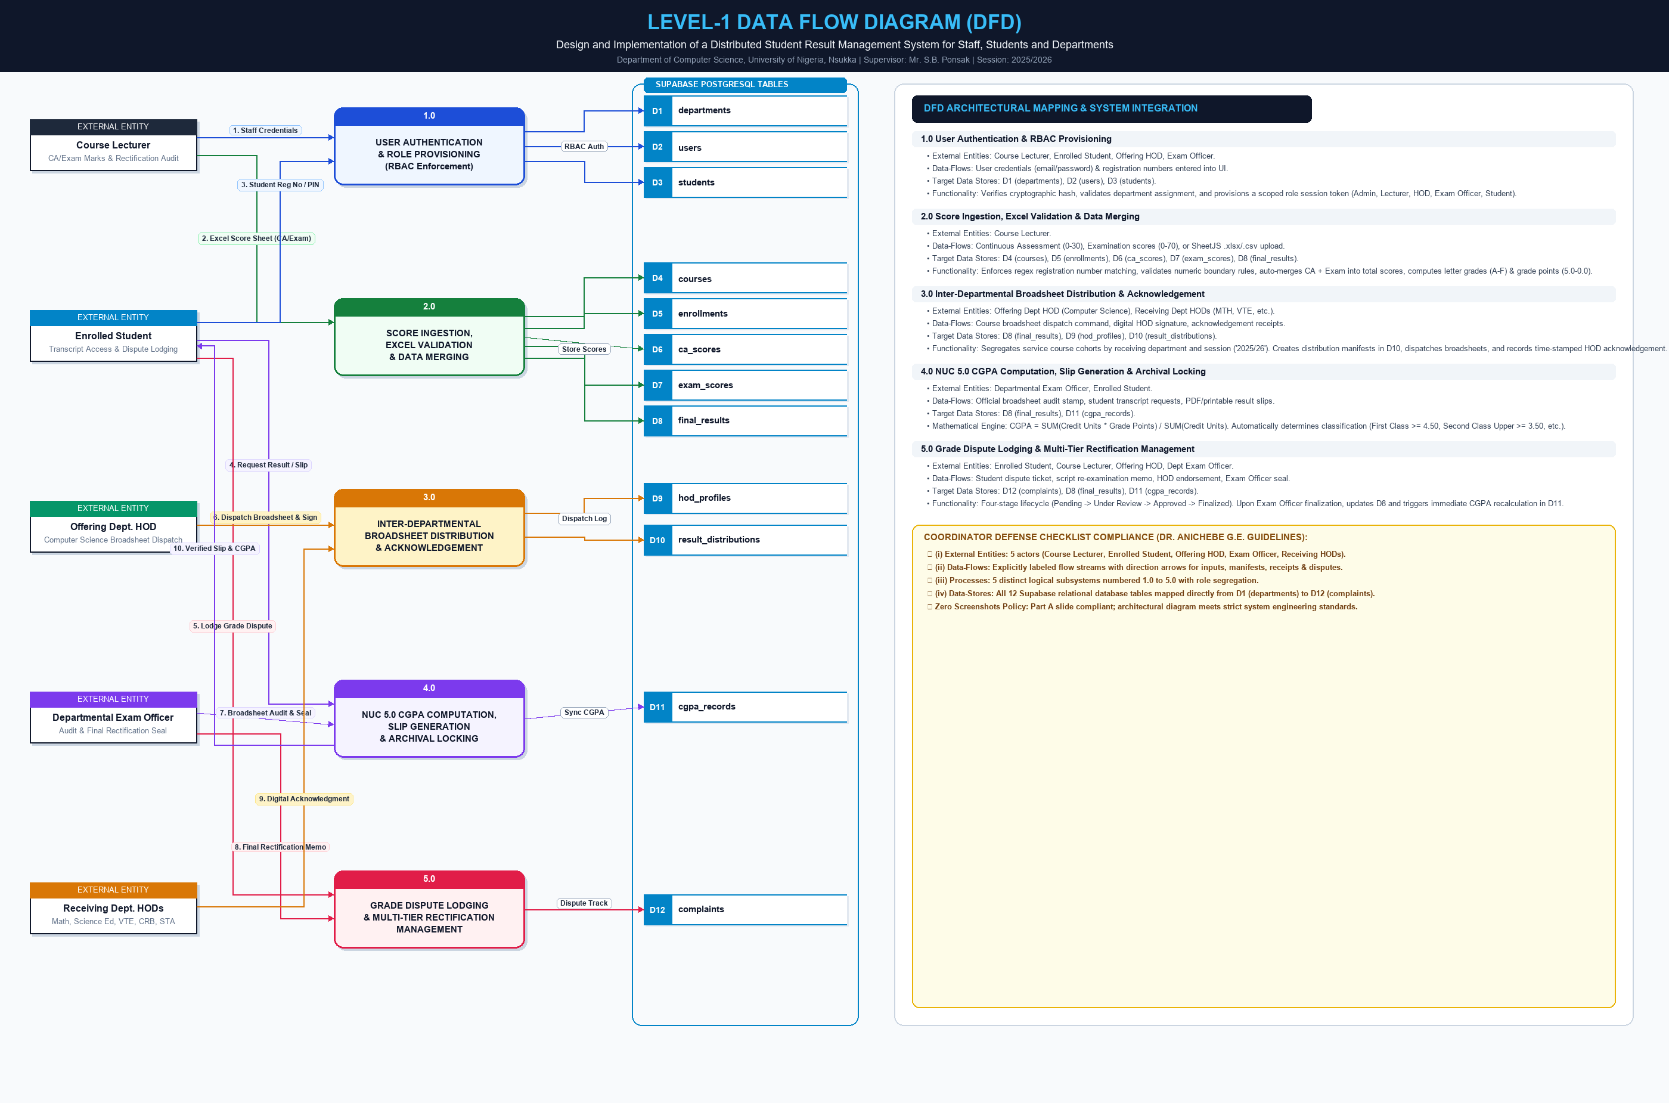
PART A.3: DEFENSE GUIDELINES ORDER
Level-1 Data Flow Diagram (DFD) of the System

Slide 5
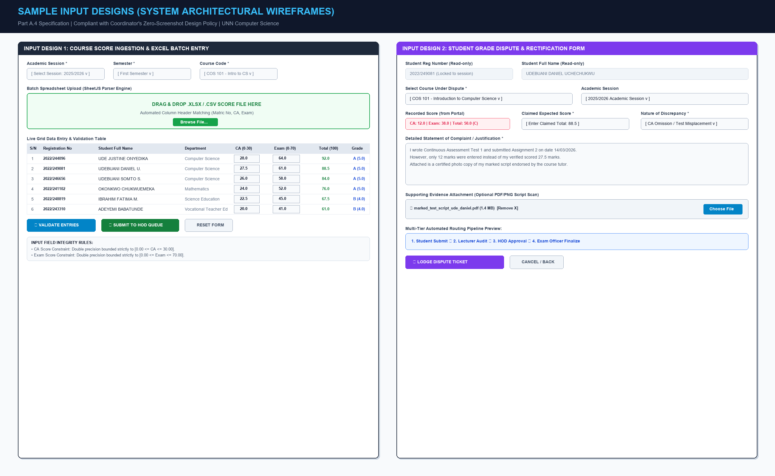
PART A.4: DEFENSE GUIDELINES ORDER (ZERO-SCREENSHOT COMPLIANT)
Sample of Input Designs (System Architectural Wireframes)

Slide 6
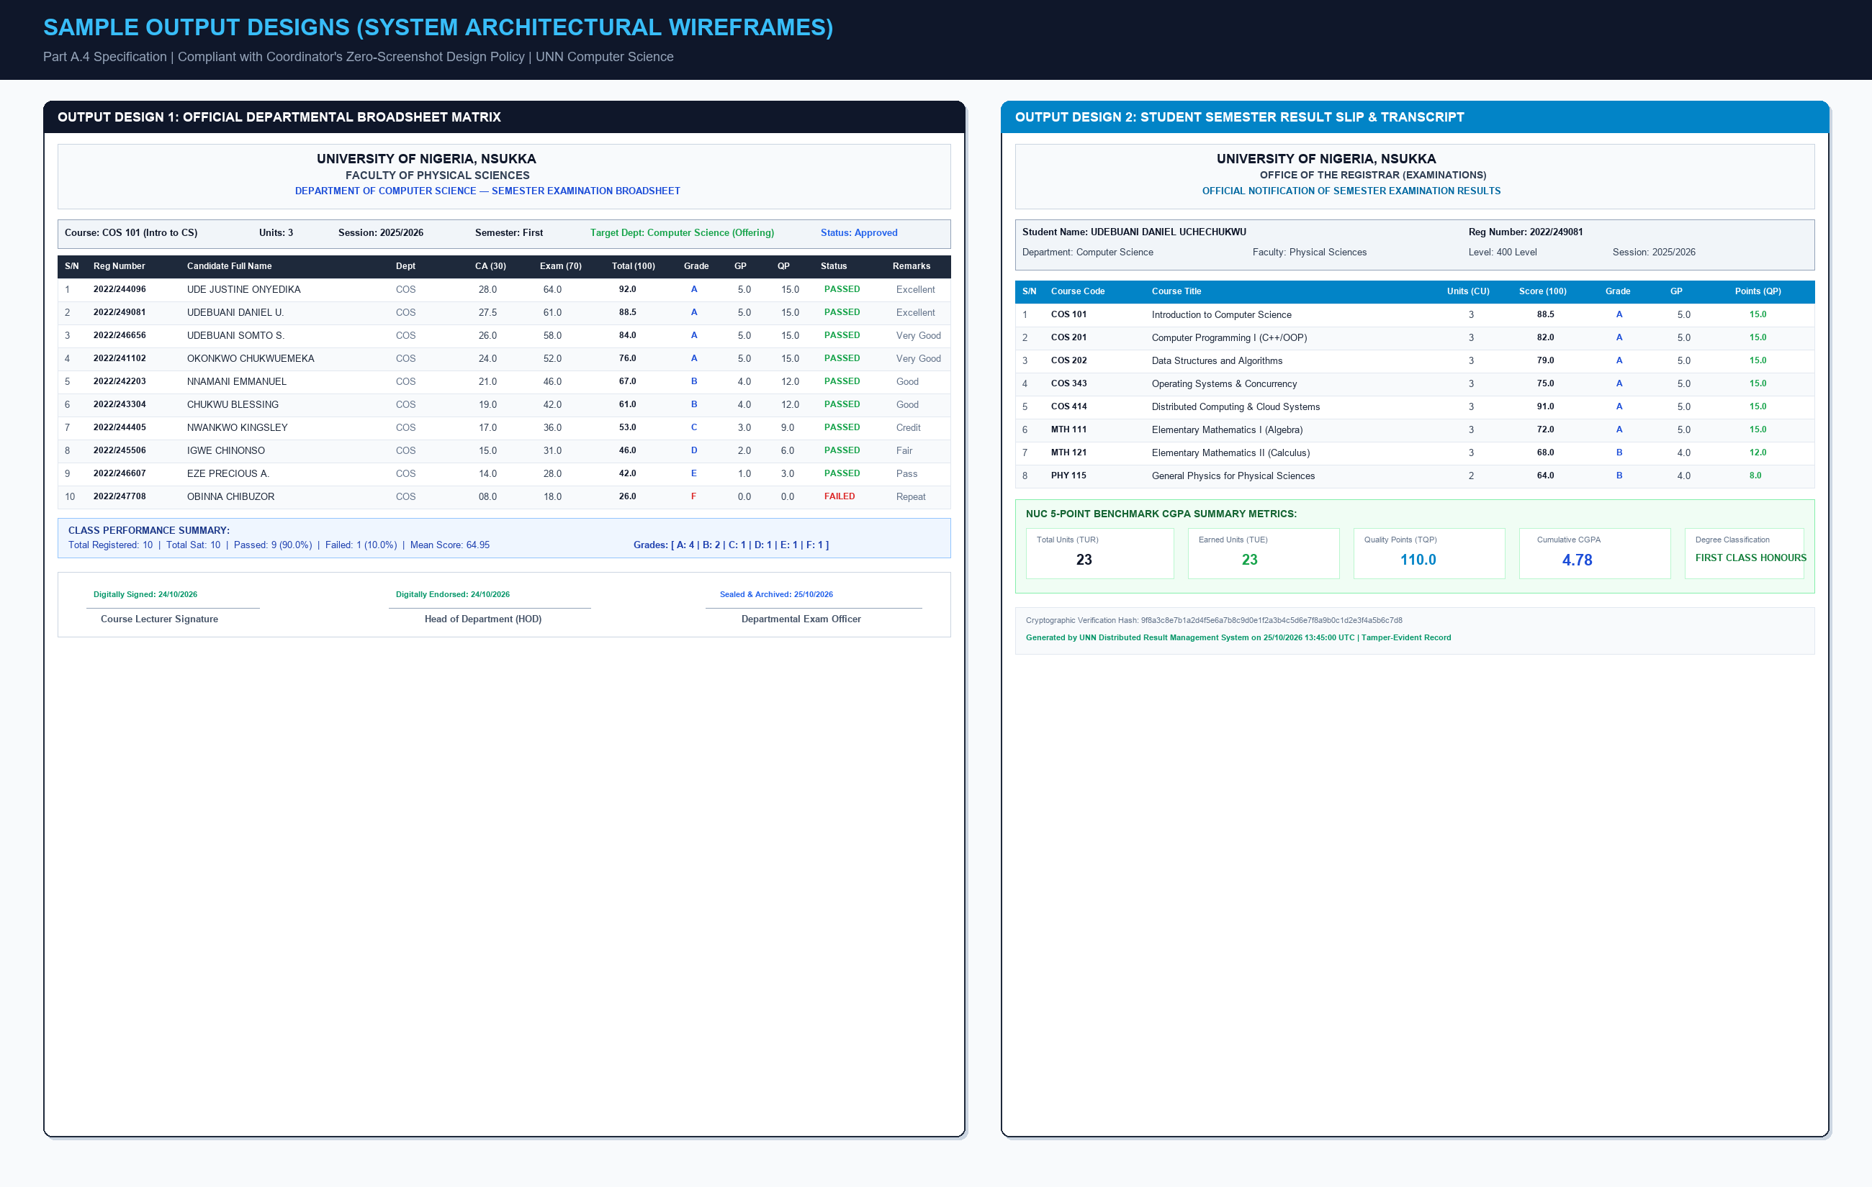
PART A.4: DEFENSE GUIDELINES ORDER (ZERO-SCREENSHOT COMPLIANT)
Sample of Output Designs (System Architectural Wireframes)

Slide 7
PART B: RUNNING OF SOURCE CODE & PRACTICAL DEMONSTRATION (10 MINUTES)
Individual Demonstration Schedule & Defense Roles
MEMBER 1
Ude Justine Onyedika
Reg No: 2022/244096
Task (i): Database Schema Agreement
Demonstrate how the 12 normalized PostgreSQL tables on Supabase match Table 3.5.1 database specifications in Chapter 3.
Task (ii): Form Data Population
Demonstrate how live input forms populate database tables (students, courses, ca_scores, exam_scores, enrollments).
MEMBER 2 (LEAD DEMO)
Udebuani Daniel U.
Reg No: 2022/249081
Demonstration of Stated Objectives
Live software tour showing how all 5 research objectives are achieved:
• Obj 1: RBAC Login
Course Lecturer vs HOD vs Exam Officer vs Student.
• Obj 2: Score Ingestion
Upload Excel sheet with auto-validation.
• Obj 3: Inter-Dept Distribution
COS 101 dispatched to 5 departments for 2025/2026.
• Obj 4: CGPA Computation
NUC 5.0 Result Slip & Transcript.
• Obj 5: Grade Dispute
Dispute lodging, approval, & auto-recalculation.
MEMBER 3
Udebuani Somto Sixtus
Reg No: 2022/246656
Unit Modules & Functions
Explain core unit algorithms:
• calculateGrade(score)
NUC 5.0 score-to-grade mapping logic.
• calculateCGPA(results)
Weighted quality points summation engine.
Integrated Modules
Explain system subsystems:
• createResultDistribution
Active session scoping ('2025/26').
• examOfficerFinalizeRectification
Cascade recalculation & tamper audit.

