Slide 1
Git & GitHub
جامعة البعث
الكلية التطبيقية
السنة الثالثة
برمجة ويب 2
المحاضرة الأولى + الثانية
إعداد المهندس بإشراف الدكتورة
داني وسوف فدوى صافية

Slide 2
Agenda
What is Git and Github
Repository
Branches
(Push,clone,pull,pullrequest)
Generate and test General Key

Slide 3
What is Git and Github
Git is Distributed Version Control System
Git is Free and Open Source
Github Is Source for Project
You can use Git Without Github
Github is website allow to use Git

Slide 4
Repository
Repository is store to save our Project
- Remote Repo (Github)
- Local Repo (Laptop)
Branch : It is part of repo use to solve tasks

Slide 5
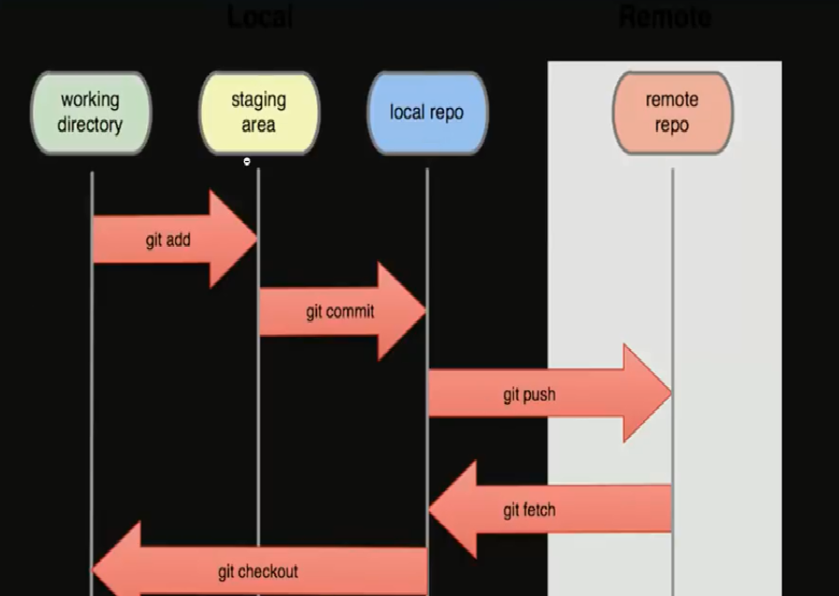
Git commands

Slide 6
Git commands
Git init
Git status
Git clone origin
Git add * (file name)
Git reset head filename
Git commit –m “message”

Slide 7
Git commands
Git pull origin
Git push origin master
Git branch
Git remote -v

Slide 8
Generate General Key
ssh -keygen -t rsa –b 4096
this command to generate public key
Cat ~/.ssh/id_rsa.pub
this command is to get public key

Slide 9
Test General Key
ssh –t git@github.com
this command use to test if our public kay working or not

Slide 10
Future work
Pull and pull request
Create multi branches
Fork
Alias
Release

Slide 11
Thank you

