Slide 1

Marketing Mix Modeling: Revenue Discrepancy Analysis
Marketing ROI Analysis
Examining discrepancies between reported and modeled revenue to uncover drivers of incremental impact, diminishing returns, and channel interactions.
Overview of data exploration, metric distributions, and channel comparisons between dev and prod environments.

Slide 2
Reported Revenue in Dev vs Prod
Dev Environment
Sampled or aggregated data → smoother trends
Cleaner, less noisy, good for testing
Prod Environment
Full-scale live data → more variability
Includes late attribution, budget shifts, seasonal spikes
Discrepancies
Prod more volatile than Dev, and reported revenue is extremely volatile in general
Marketing Channels probably inflating revenue numbers, vested interest

Slide 3
Modeled Revenue in Dev vs Prod
Dev Environment
Modeled revenue trends are stable and reproducible
Used to validate assumptions before scaling
Prod Environment
Modeled revenue aligns closely with Dev
Confirms model robustness under real-world conditions
Discrepancies
Bing Ads spike, Pinterest spike, and Adwords initial low prod revenue
Disc

Slide 4
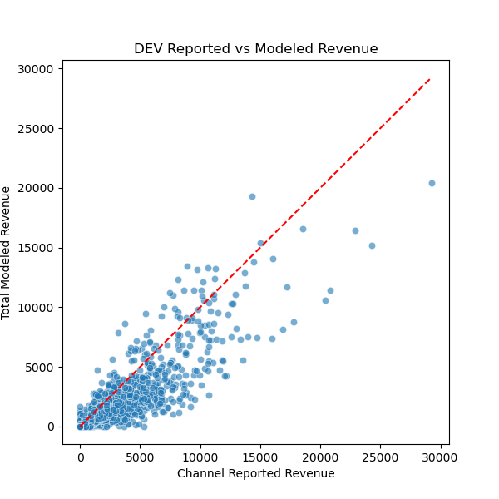
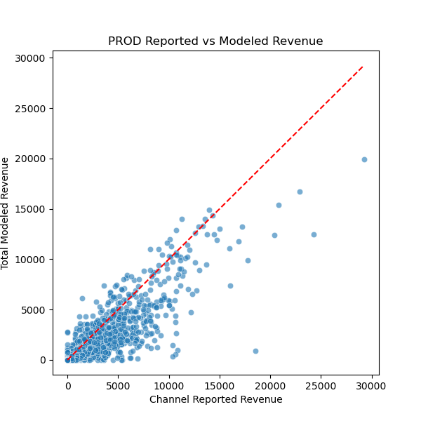
Reported vs Modeled Revenue
Reported vs. Modeled Revenue
- Observation: Modeled revenue is lower across nearly all channels.
- Reason: Platforms report total influenced revenue; MMM isolates incremental short-term lift.
- Implication: Reported numbers reflect broad influence, while modeled revenue reveals causal efficiency.
Modeled revenue is generally lower as the model focuses on incremental impact.
Compared reported revenue across channels over time
Visualized reported vs modeled revenue per channel
Observed that modeled revenue < reported revenue for almost all channels
Explained by model focusing on incremental short-term impact vs. reported totals

Slide 5
Understanding Incremental Revenue
Understanding Incremental Revenue
- Modeled revenue captures only the additional revenue directly generated by marketing spend.
- Platform reports often overstate impact by including all influenced revenue.
- Explains why modeled revenue < reported revenue.
Our model estimates the additional revenue generated per dollar spent, excluding long-term effects
Model measures incremental short-term impact
Does not fully capture long-term customer value (repeat purchases, referrals, cross-sell)
ROI reflects conservative, short-term estimate of marketing effectiveness

Slide 6
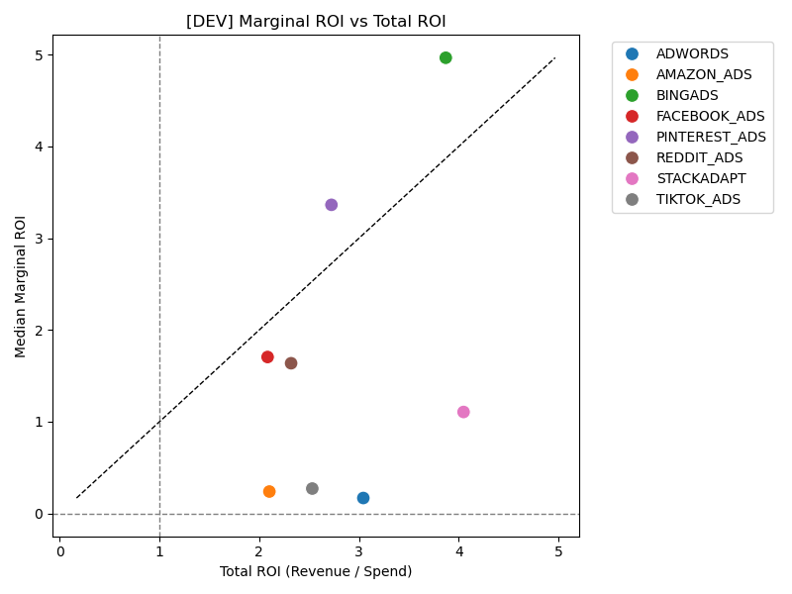
Total ROI vs Marginal ROI
Collinearity and Overlap (VIF Analysis)
- High VIF (>10) = Strong overlap across channel spend.
- Overlap reduces modeled contributions since multiple channels share credit.
- Optimizing requires balancing spend across overlapping channels.
Channels like StackAdapt, Amazon Ads, TikTok Ads, AdWords show high Total ROI but low Marginal ROI
Indicates diminishing returns as channels become saturated
Future spend in these channels yields weaker incremental gains
Bing Ads, which had the discrepancy between dev and prod, has highest marginal ROI

Slide 7
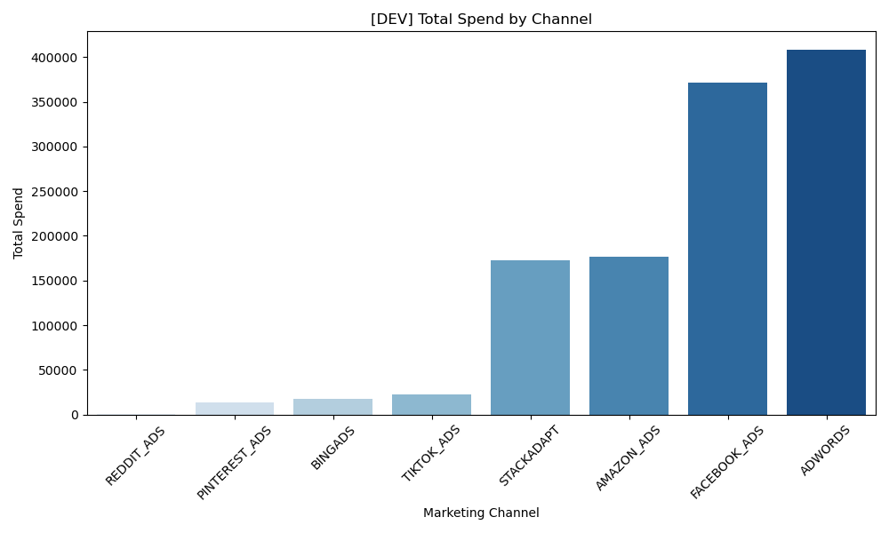
Diminishing Returns
Some channels have much higher total spend than others.
High spend levels often coincide with diminishing marginal returns—each additional dollar spent generates less incremental revenue.
Channels with large spend may still have high total ROI historically, but the model shows current incremental efficiency is lower.
This helps explain why modeled revenue < reported revenue for these channels.

Slide 8
Diminishing Returns on Marketing Spend
Diminishing Returns on Marketing Spend
- Insight: As spend increases, marginal gains decline.
- Findings:
• Channels like Amazon Ads, TikTok, AdWords, StackAdapt show high historical ROI but low incremental ROI.
• Indicates saturation—each additional dollar yields less incremental revenue.
- Conclusion: Modeled revenue highlights reduced efficiency even in historically strong channels.
High spend
Diminishing Returns
marginal ROI < total ROI
modeled revenue < reported revenue.

Slide 9
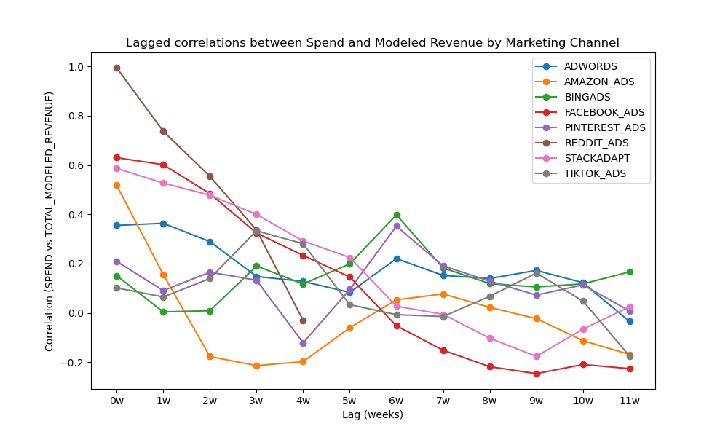
Lagged Correlations Between Spend and Modeled Revenue
Next Steps
1. Reallocate budget away from saturated channels toward higher incremental ROI opportunities.
2. Identify collinear channels and test optimal spend combinations.
3. Incorporate lag effects into planning—budget for both short-term impact and long-term brand lift.
Shows how spend in each channel impacts revenue over time
Positive lag → effect of spend shows up after a delay (e.g., awareness campaigns)
Negative lag → potential reverse causality (revenue movements precede spend adjustments)
Helps distinguish short-term vs. delayed channel impact

Slide 10
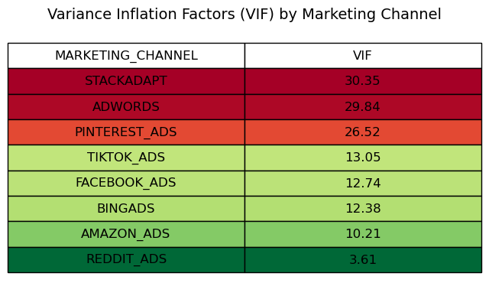
Collinearity: Variance Inflation Factor (VIF)
High VIF (>10) indicates strong overlap in channel spend, explaining why modeled contributions may appear lower than reported revenue.

Slide 11

Next Steps
Identify saturated channels and reallocate budget to maximize incremental impact.
Find collinear channels and see if there is an optimal allocation of spend to a combination of channels.

Slide 12

Key Takeaways
Reported revenue = influence (broad attribution claimed by platforms)
Modeled revenue = causality (isolates incremental lift directly caused by spend)
Sharpen budget decisions by focusing on incremental and marginal ROI
Business takeaway: modeled view guides where to invest next
Data science focus: refine the model (saturation, lag, overlap) for reliable recommendations

