Slide 1
Hospital Management System
Danny lam

Slide 2
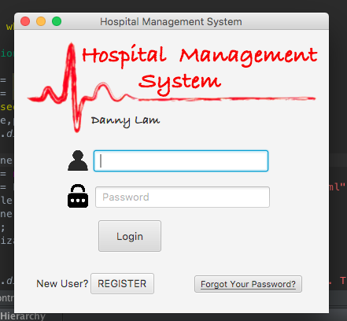
The login page of the Hospital Management System. Includes Login, Register, and ForgotPW (N/A) button.

Slide 3
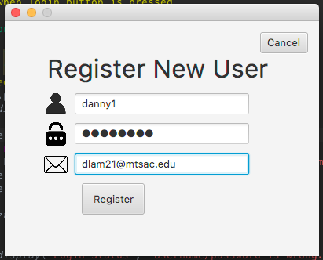
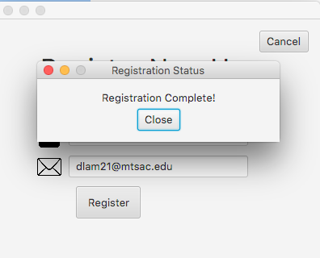
Create a new user by inputting your username, password, and email. Click “Register” and you are notified that it is complete.

Slide 4
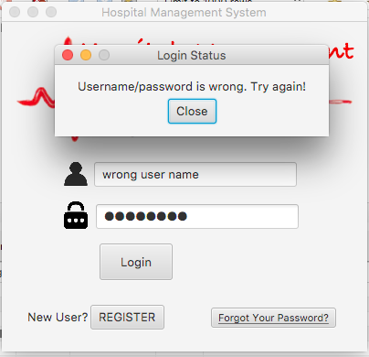
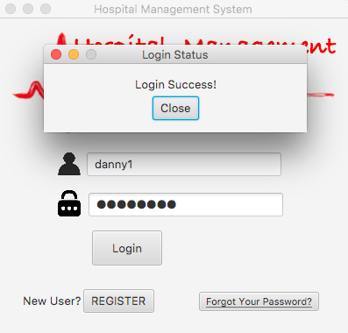
If the username and password you enter doesn’t match to one in the database, you will be asked to try again.
When you input a correct username and password, it will notify you that you are into the program.

Slide 5
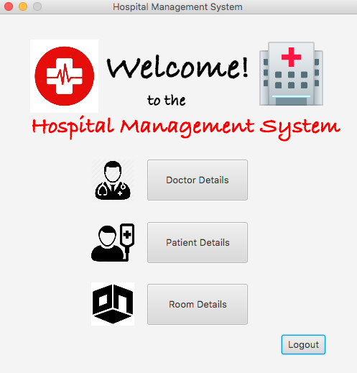
This is the main page of the Hospital Management System. User have access to 3 panels: Doctor, Patient, and Room. There is also a Logout button to log off the program.

Slide 6
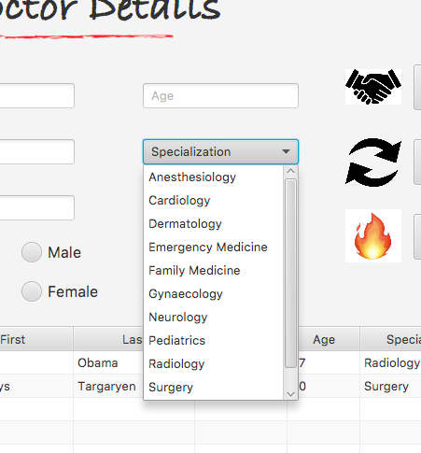
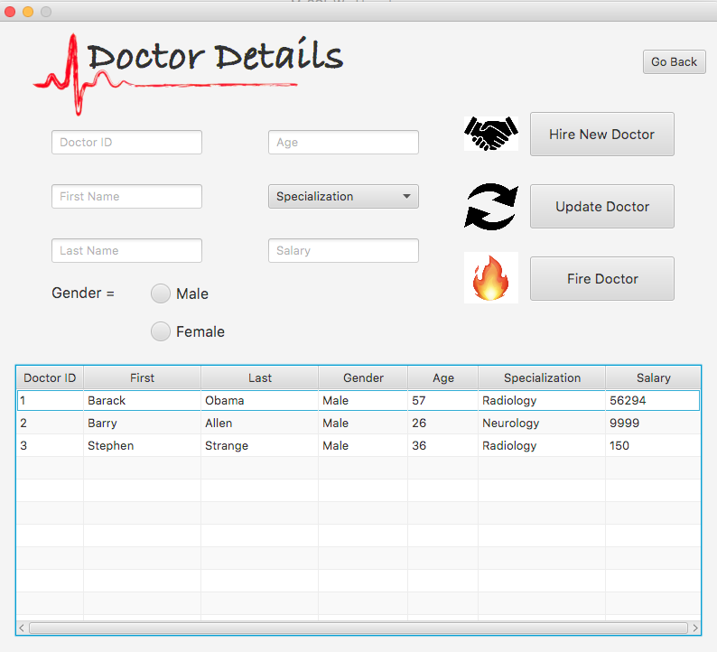
In the Doctor Details, you can hire new doctors, update their info, and fire them! You can choose their specialization from the combo box.

Slide 7
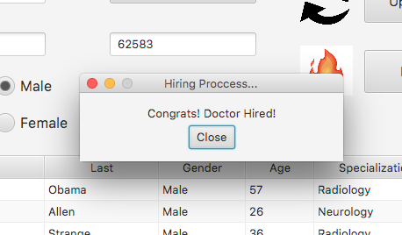
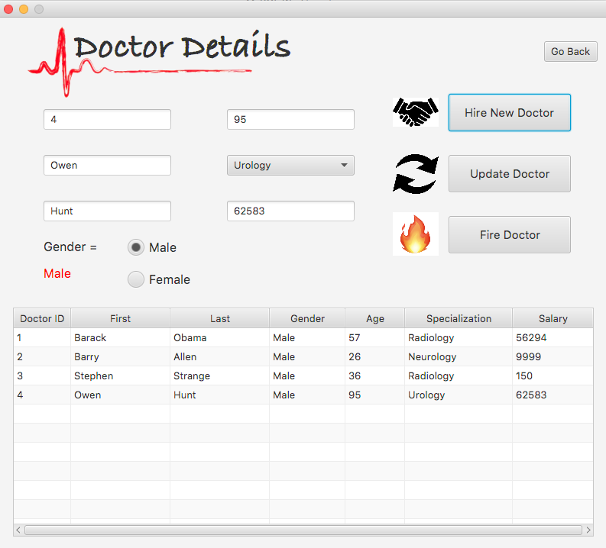
When you ”Hire” a new doctor, the system will congratulate them on their new job and their record will be loaded onto the table.

Slide 8
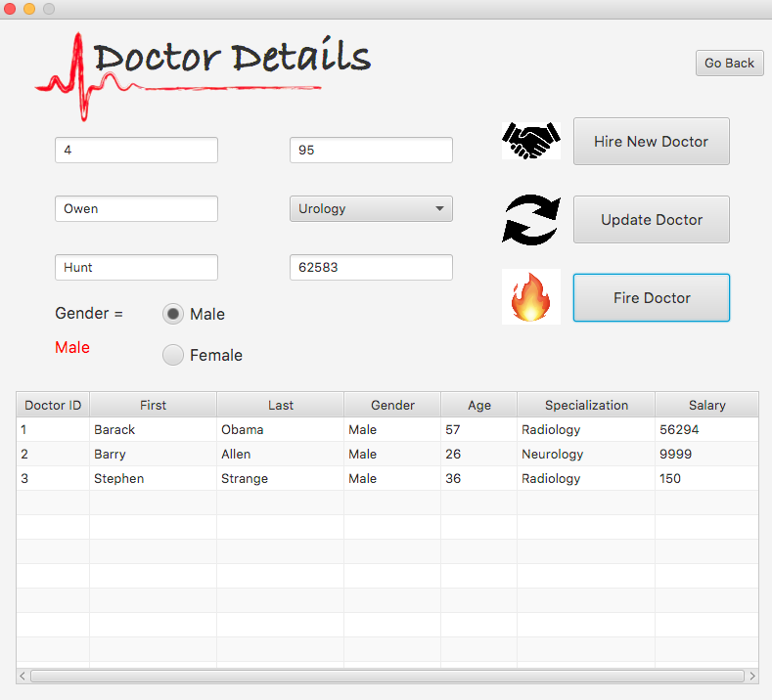
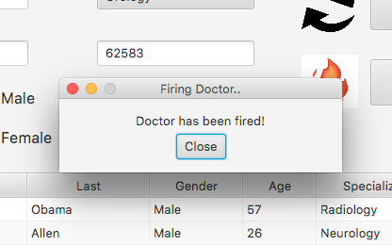
Use the doctor ID, to choose which doctor you would like to fire from the hospital. Time for a new job doc!

Slide 9
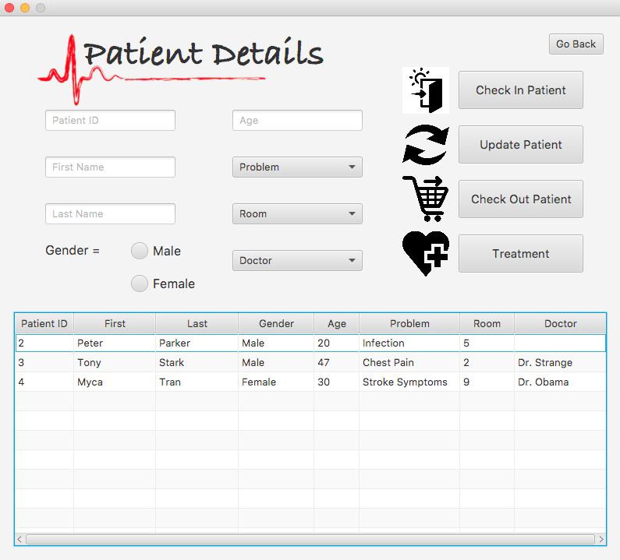
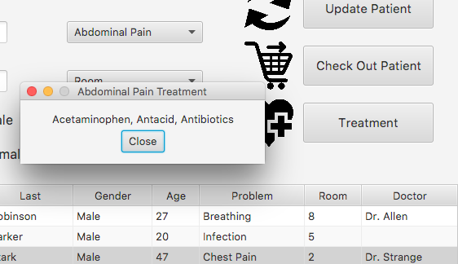

In the Patient Details, you can check in, update, and check out patients. You can also determine a treatment for them based on their problem.

Slide 10
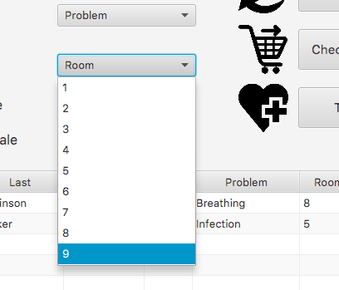
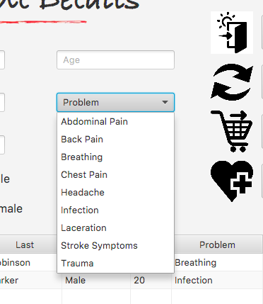
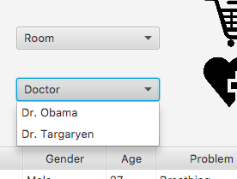
Choose the doctors that are available. When new doctors are added, they will appear.
You can choose a medical Problem that the patient has.
Choose which room # to admit them into.

Slide 11
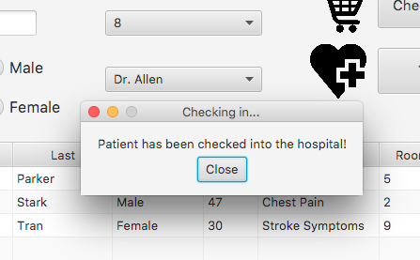
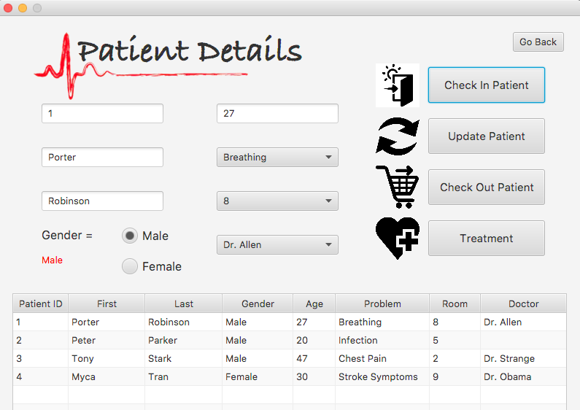
Now when you click the button, the new patient has successfully been checked in.

Slide 12
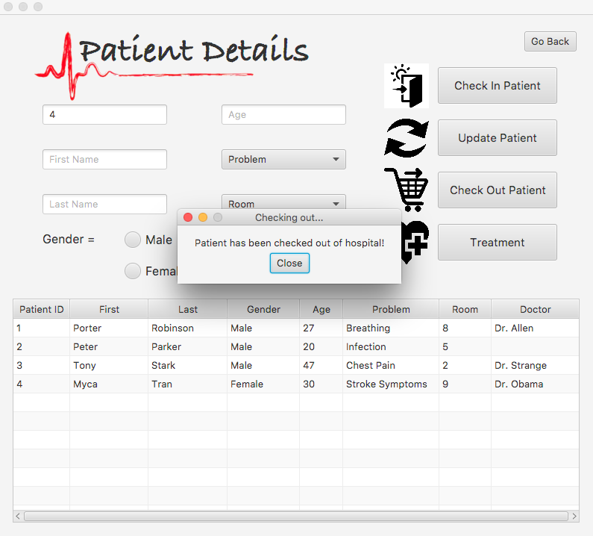
When the patient healing and ready to leave the hospital, the patient ID is used to check them out of the hospital.

Slide 13
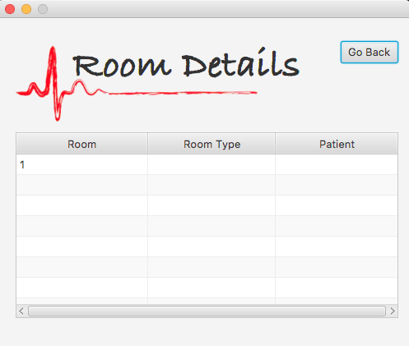
(In progress…)
The Room Details will display the room number, type of room, and which patient is staying in that room.

